Slide 1
MWA Status
L. Greenhill (Harvard/Smithsonian)
RTS/Survey – Proj. Sci.
Digital 6T first light
512T in simulation
Haystack, MIT, SAO, Harvard, Austr. Consort., RRI
MWA-ers also at the workshop:
D. Mitchell, Randall Wayth, Steve Ord (CfA)
Judd Bowman (CIT), Colin Lonsdale (Haystack)
Chris Williams (MIT), Stewart Gleadow (U.Mel)

Slide 2
Characteristics (thus far)
80-300 MHz
30 MHz BW (instant.)
8000 short dipoles •
1.2x10⁴ m² @ 100 MHz
1.0x10⁴ m² @ 200 MHz
2.9x10³ m² @ 300 MHz
512 [4x4] tiles
131k baselines
full polarization
15 - 45∘ FWHM
768 x 40 kHz channels
5500 total
+16 voltage beams
6m - 1.5 km bslns •
325m for 32T
16 outriggers (3 km)
sky noise limited •
T_{RX} = 30 K @ 200 MHz
T_{RX} =130 K @ 110 MHz
real-time pipeline dependent •
8^{s} resolution
40 Gb/s throughput
1000x1000 pxl native
3x oversampled
Drty map every 8^{s}
O(10) Tflop/s load •
GPU accelerated cluster
64 nodes
20 kW max
Wide-field large-N hierarchical beamforming array

Slide 4
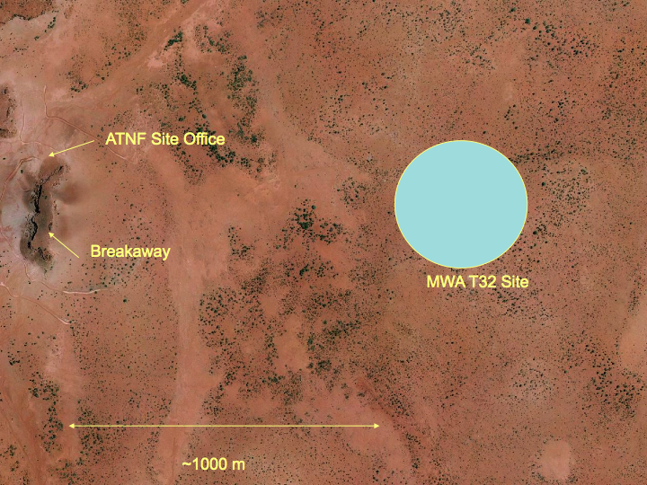

Slide 5
8T / 32T
Today

Slide 6
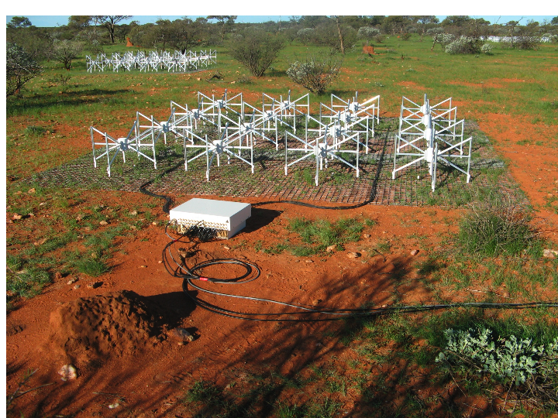
Happy
grass
Beamformer
New generation dipoles

Slide 7
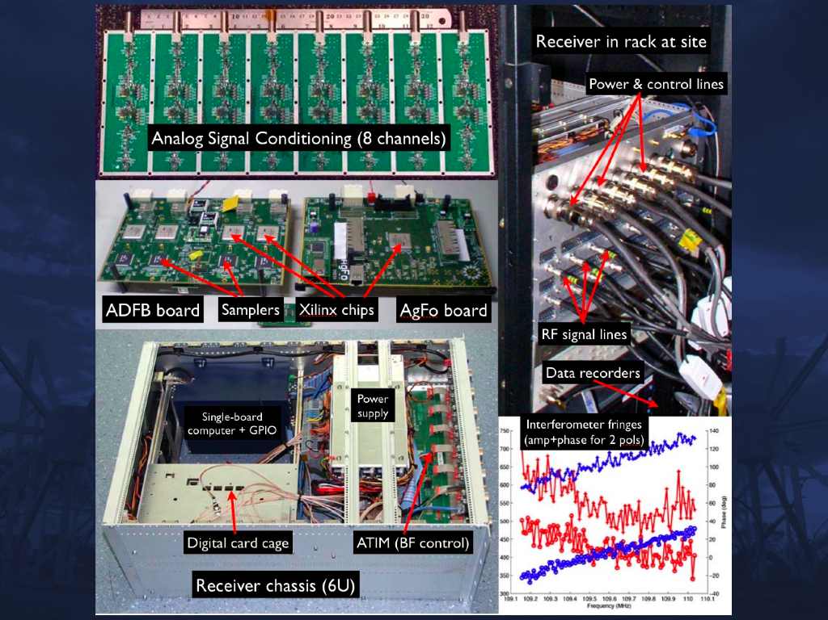
Prototype Rack mounted RX

Slide 8
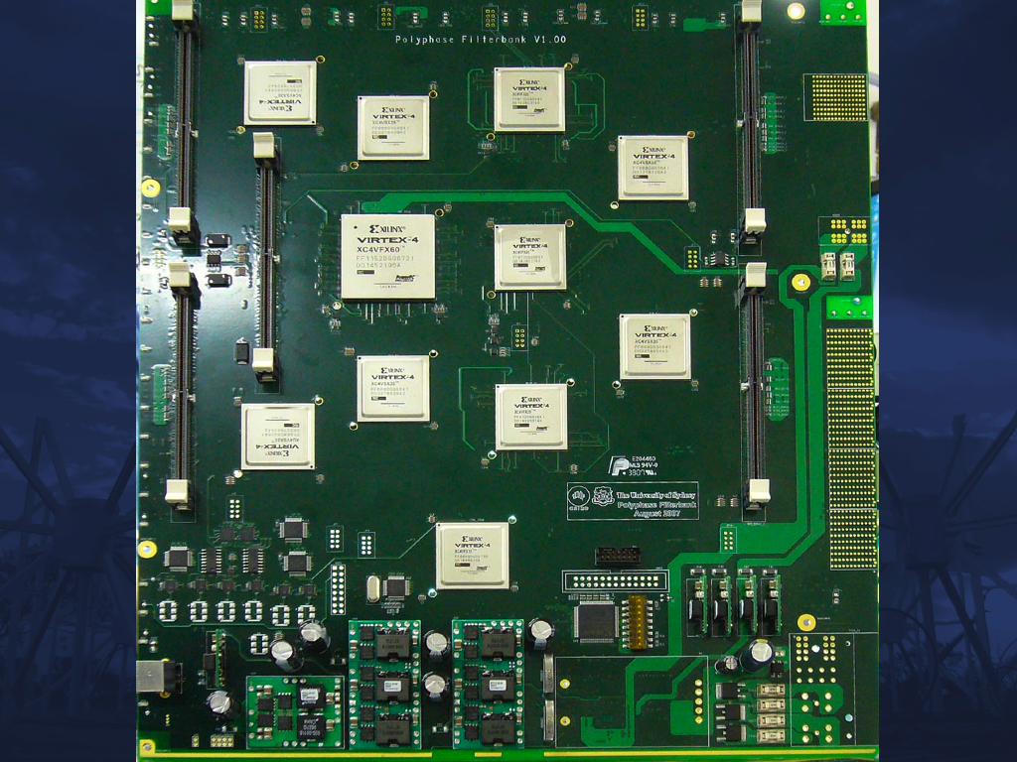
Correlator Board in Assmebly

Slide 9
First self-calibrated images via digital RX: 6T Apr/May
Hydra A

Slide 10
Schedule
512T
S/W
Correlation
8T
06/10
32 RX ch
fielded
01/10
256T
01/09
H/W
Correlation
[1 board]
06/09
Build out
32T
Demo
Site visits: monthly until summer;
eng. tests during summer;
32T integration thereafter

Slide 11
end

