Slide 1
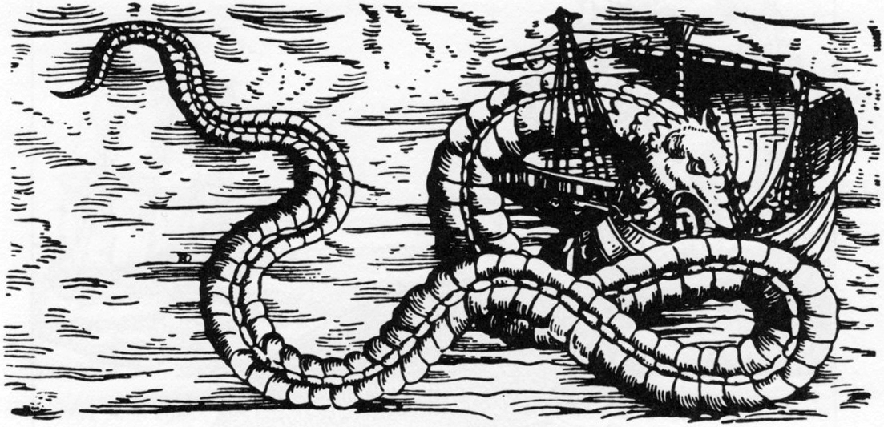
Here Be Dragons:
The Dynamic Radio Sky
Geoffrey C Bower
(UC Berkeley)

Slide 2

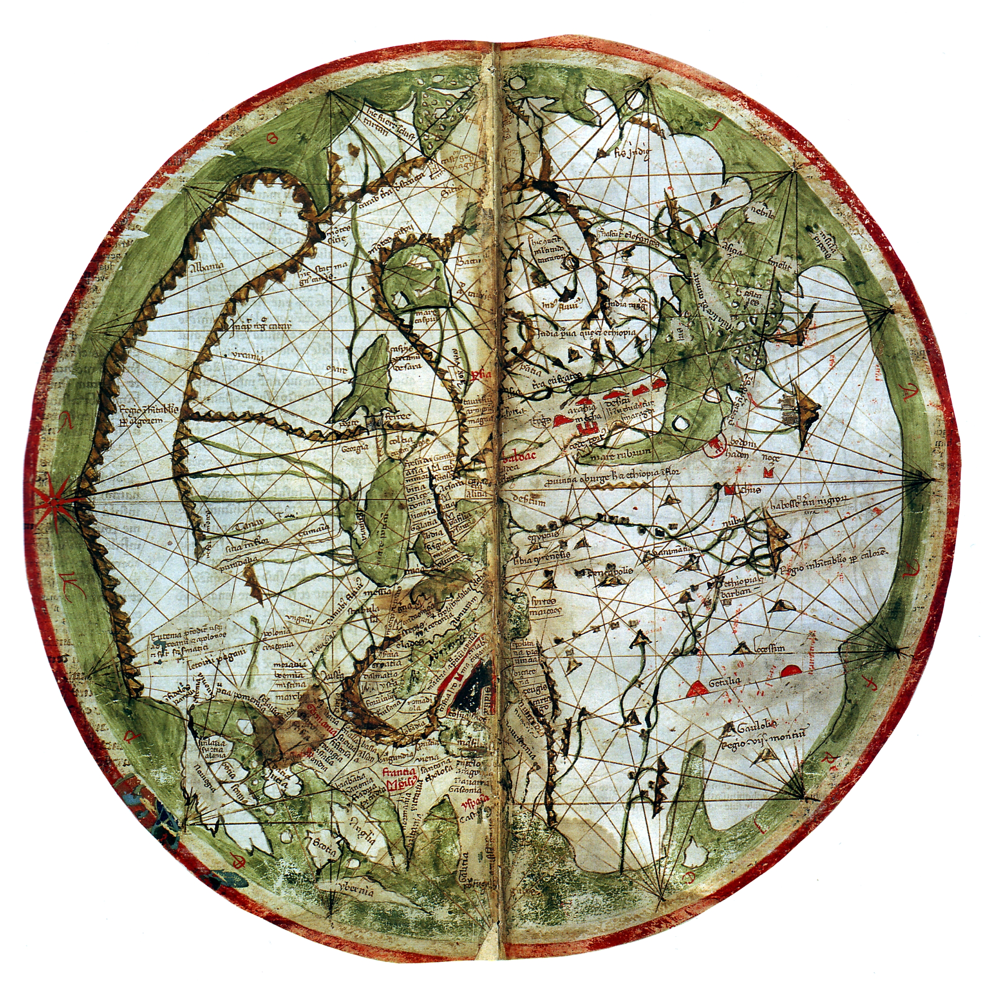

Slide 3
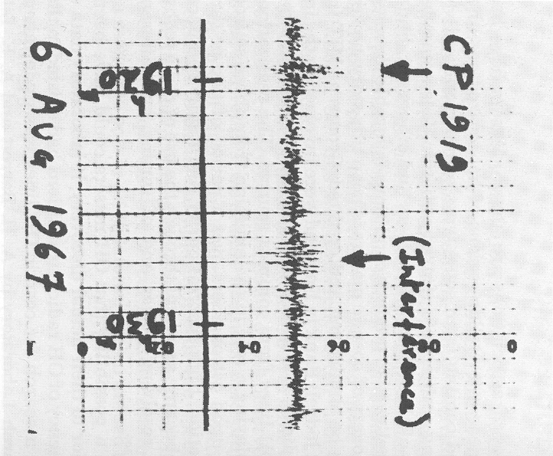
Pulsar Discovery
The Holy Grail
“a bit of
scruff”
-J Bell

Slide 4
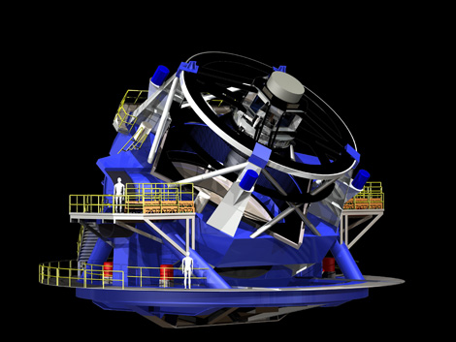
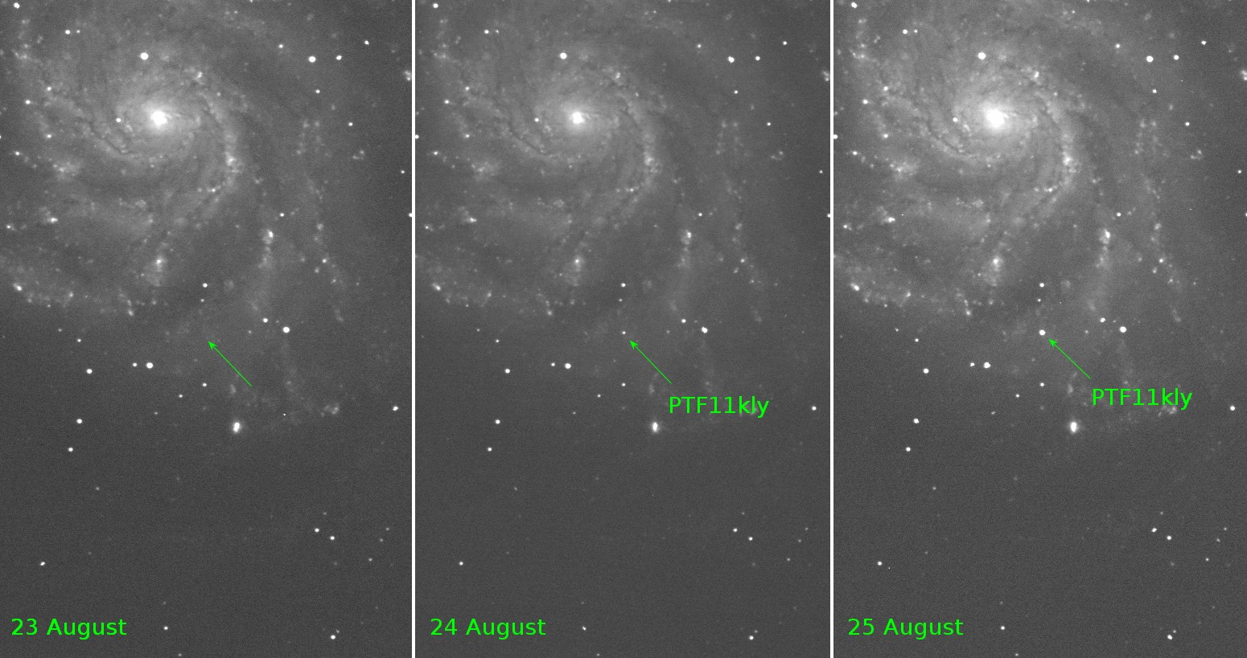
Optical Time Domain Science
LSST: The whole observable sky every 3 nights in multiple filters. The same data serves many projects
Enormous cameras and data volumes
Builds on SDSS, PTF, PanStarrs, etc
PTF images of M101: Nugent et al 2011

Slide 5
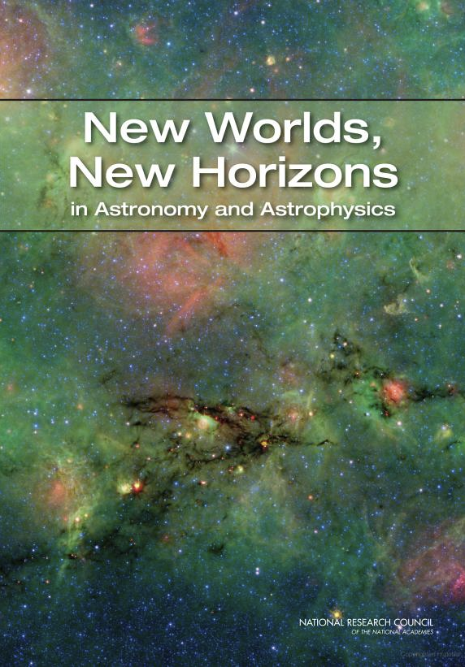
New Worlds New Horizons
Recognized Time Domain as a scientific frontier discovery area
KBOs to GRBs to Black Holes to Type Ia SNe
“only just begun to explore lively variations in the cosmos”
The unexpected is expected
LSST is number one ground-based priority

Slide 6
Why Radio Transient Surveys?
In some cases, more optimal search technique than optical or high energy (dust, spectrum, duration)
Study unbiased samples to discover new source classes
Determine the variability ``foreground’’ for rare events
Simultaneous radio/optical surveys for rejection of optical foregrounds

Slide 7
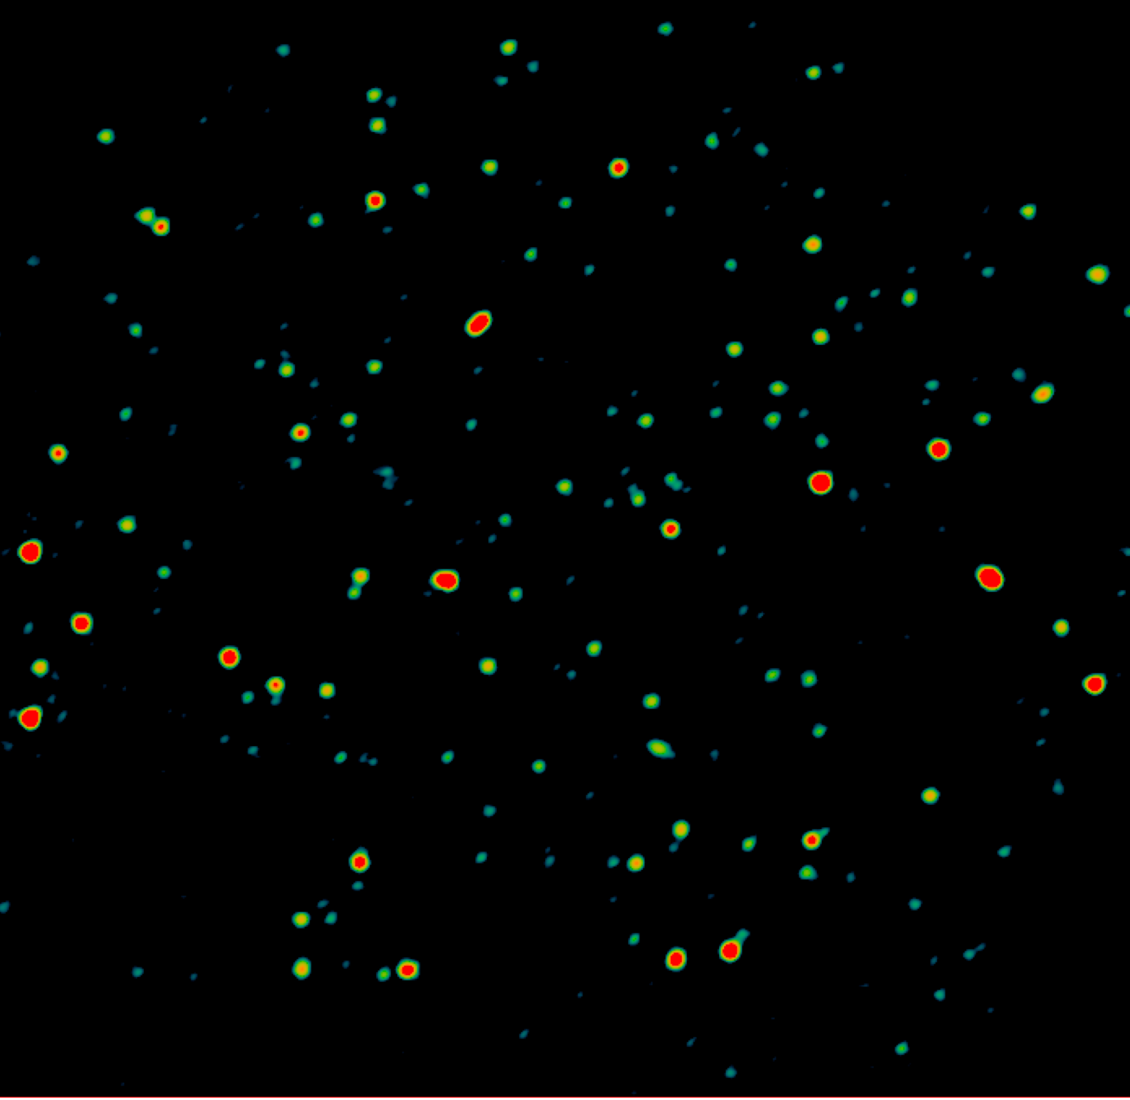
Different Physics, Different Technology
Fast Transients
Slow Transients
Coherent emission processes
Neutron stars, pulsars, evaporating black holes, cyclotron masers
Single dish, high bandwidth, de-dispersion hardware
Incoherent emission (synchrotron)
Jets, shocks → SNe, GRBs, AGN
Interferometric imaging

Slide 8
Commensal Transient Search in Cygnus & Galactic Center
>100 epoch
3.1 GHz
Sensitive to different populations than PiGSS
  E.g., Becker et al 2009
  Cyg X-3
  XRBs, Low-mass stars
Explore radio/gamma-ray connection
Williams, Bower, Tomsick et al

Slide 9
Slow Transient Parameter Space
AGILITE
Swept under the rug
Frequency
Time scale
Galactic/Xgal
PiGSS-All
Bower et al 2011
Frail et al 2012

Slide 10
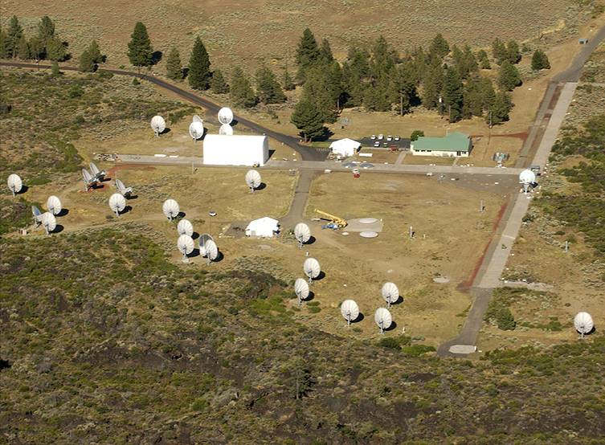
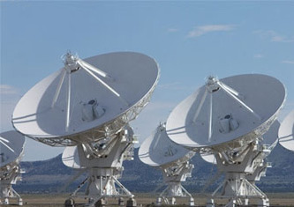
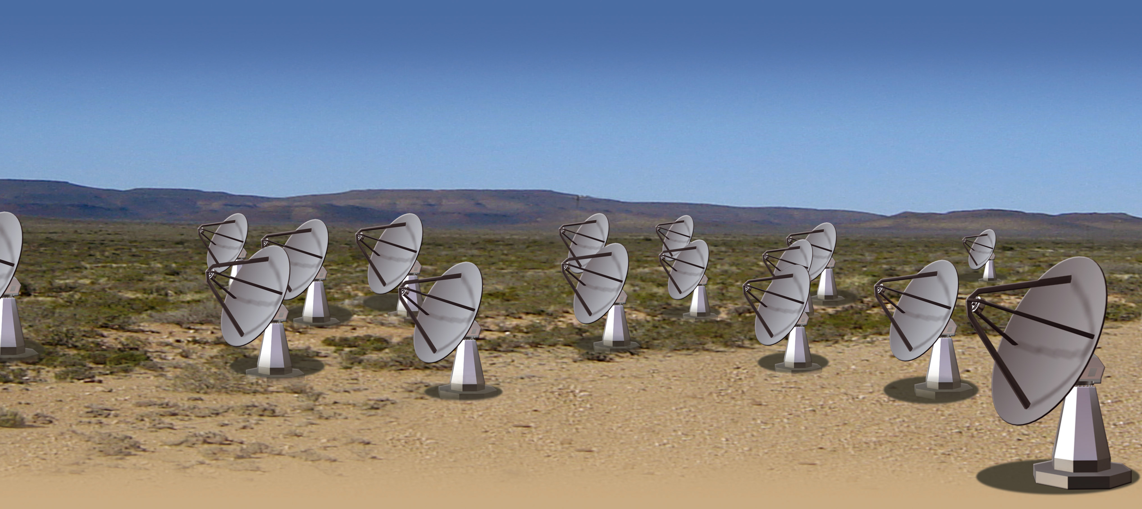
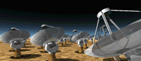
A New Era for Radio Astronomy
Design Principles
Trade steel for silicon
  →LNSD (Large-N-Small-Diameter)
  → Wide field of view → surveys
Exploit Flexible Digital hardware
  Upgrade backend processors frequently following Moore’s Law
Commensal observing
  Do multiple projects simultaneously in different instruments
Allen Telescope Array (ATA)
Expanded Very Large Array
(EVLA)
Karoo Array Telescope (meerKAT, ZA)
Australian SKA Pathfinder (ASKAP)

Slide 11
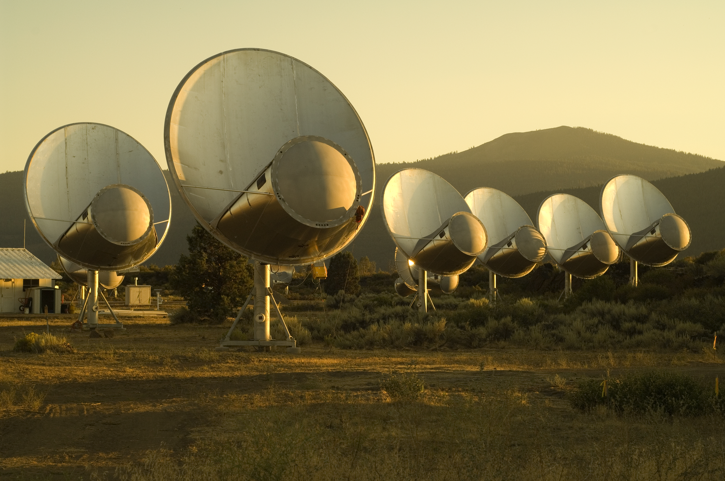

The Allen Telescope Array

Slide 12
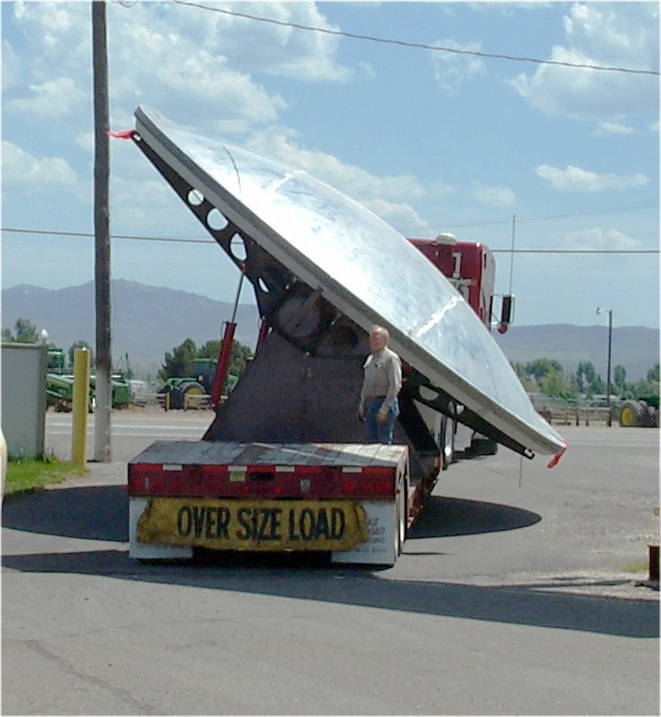
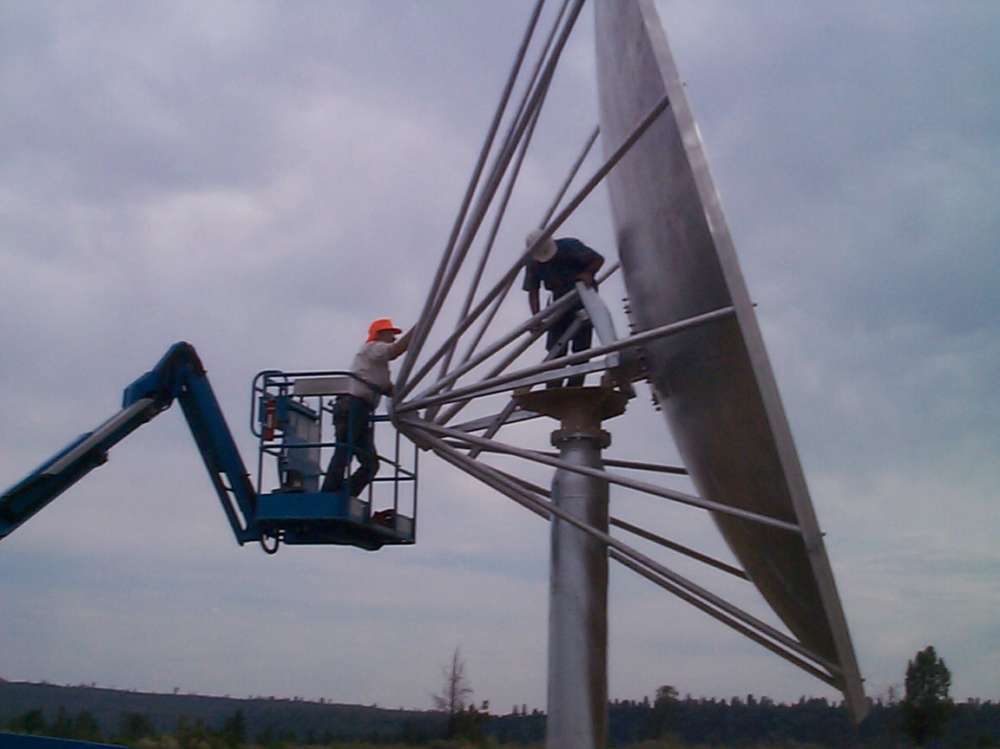
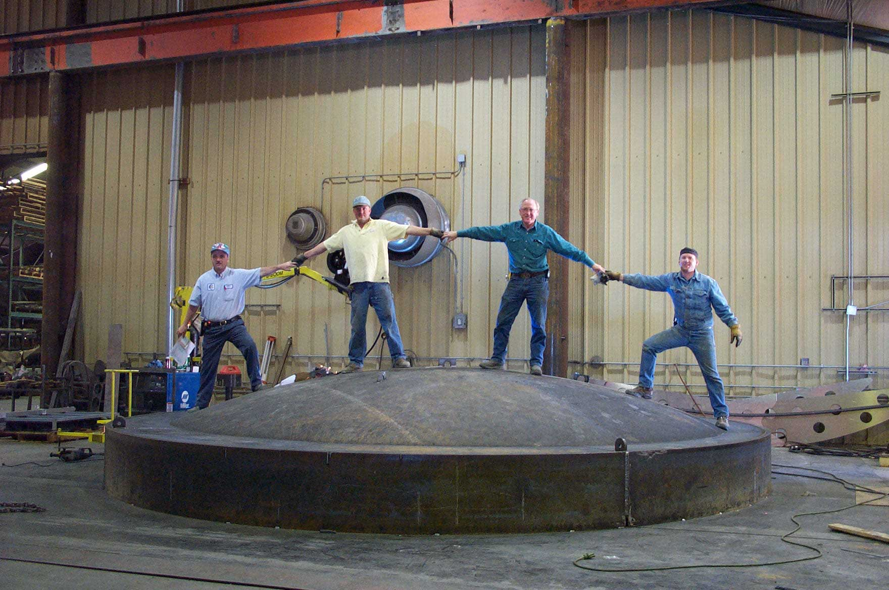
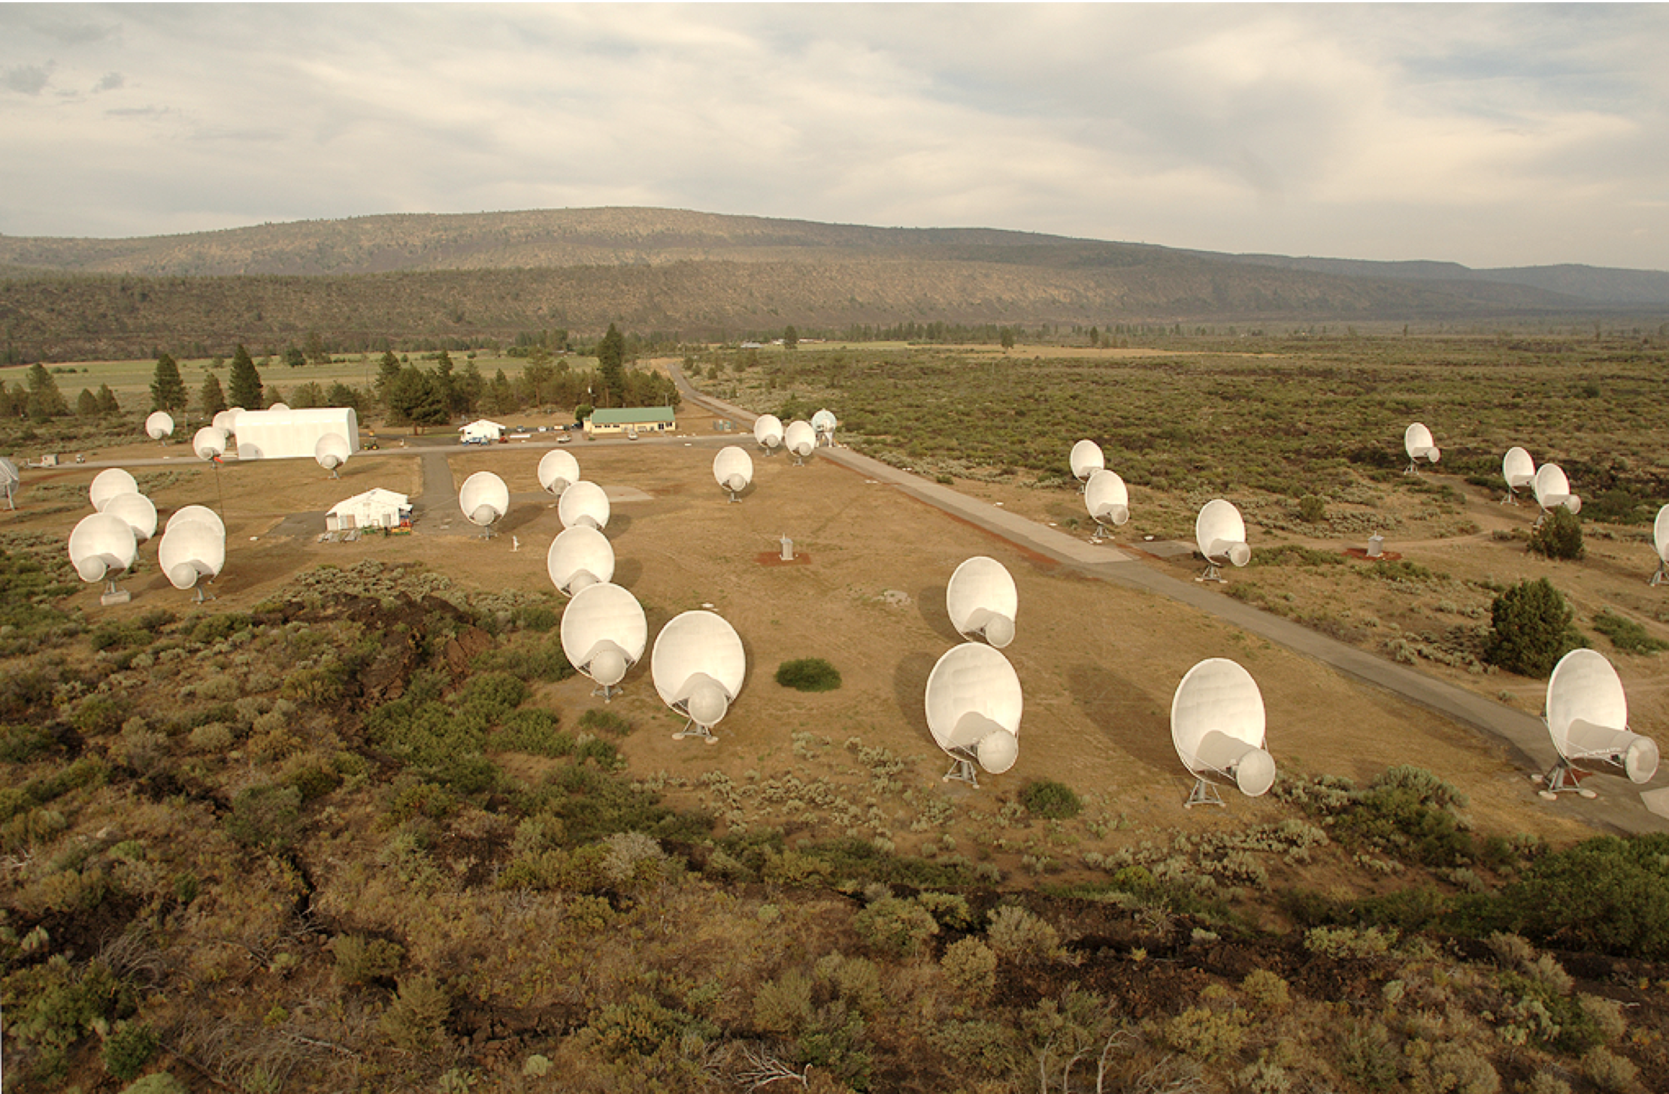
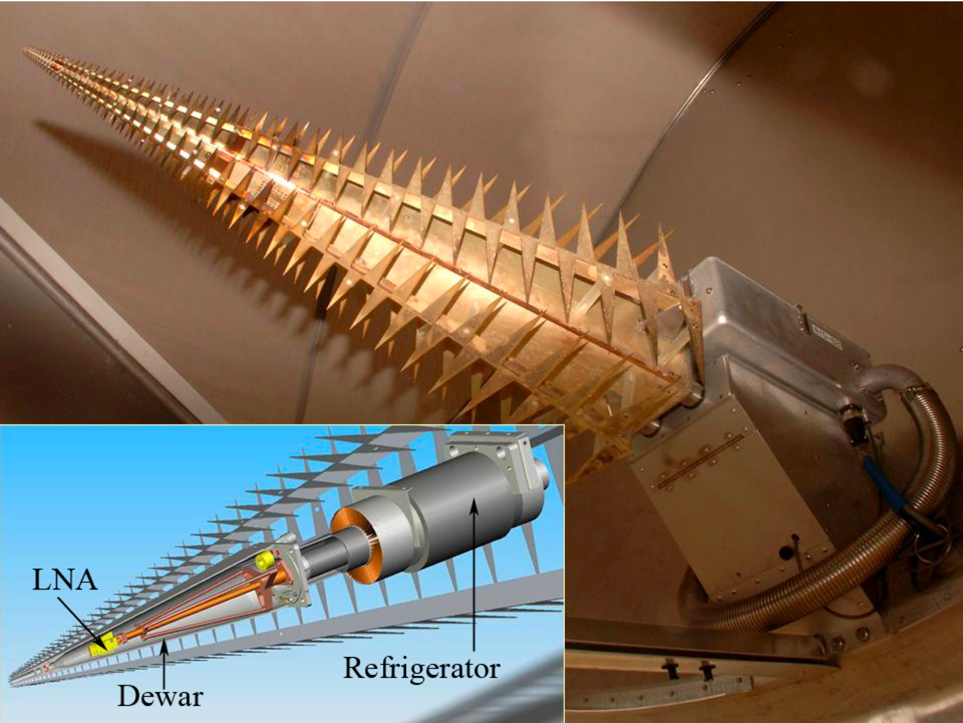
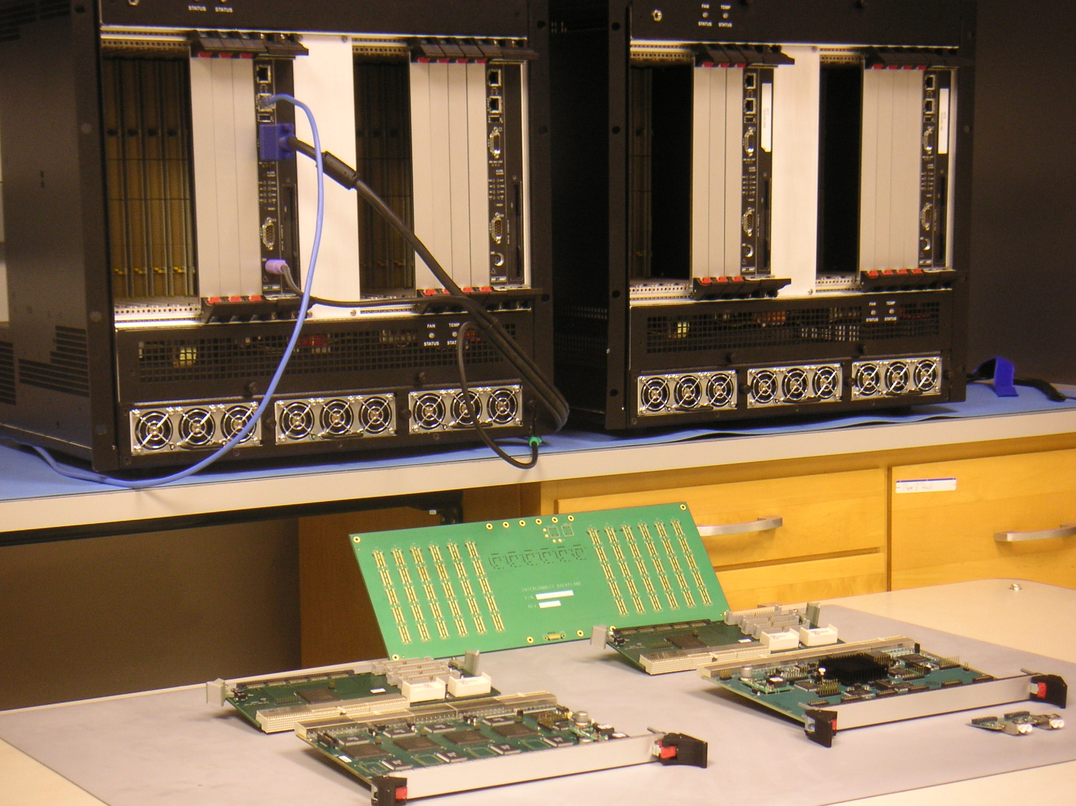
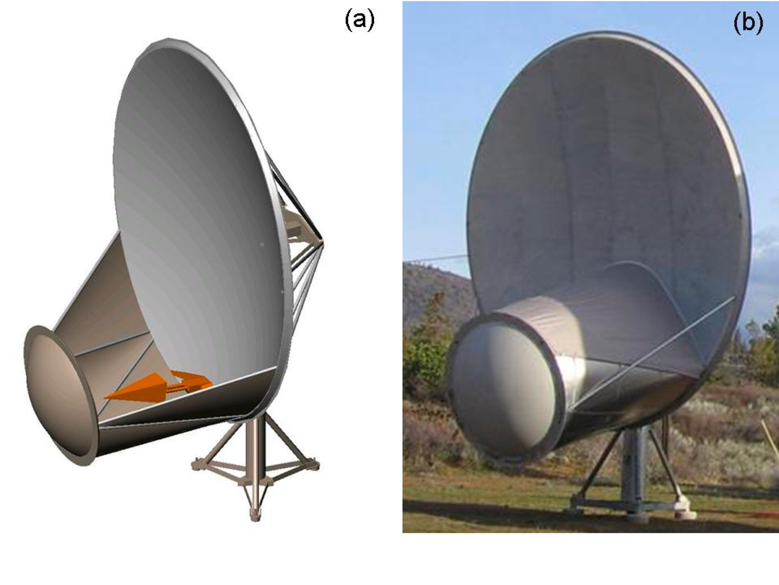
Novel ATA Technologies

Slide 13
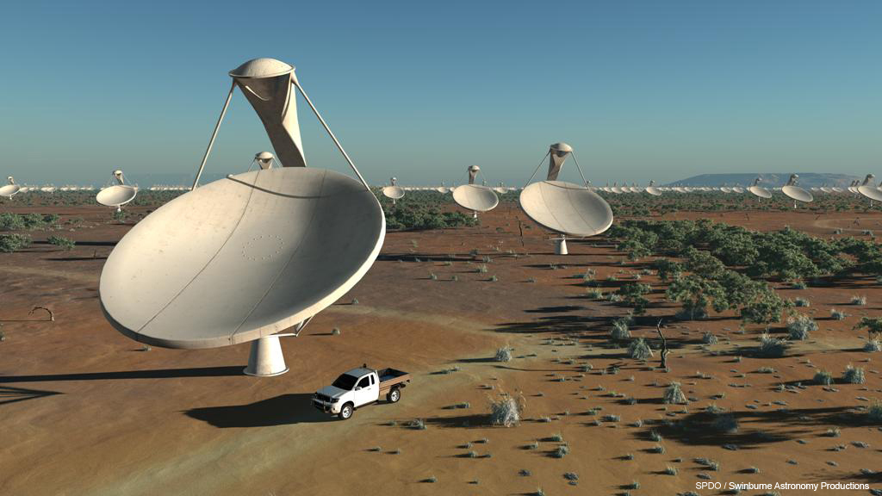
SKA Mid Visualization

Slide 14
Fast Transients
Giant pulses
Rotating radio transients (RRATs)
Lorimer bursts/Perytons
Gravitational Wave Counterparts
Evaporating black holes
Bursts from planetary atmospheres and extrasolar planets

Slide 15
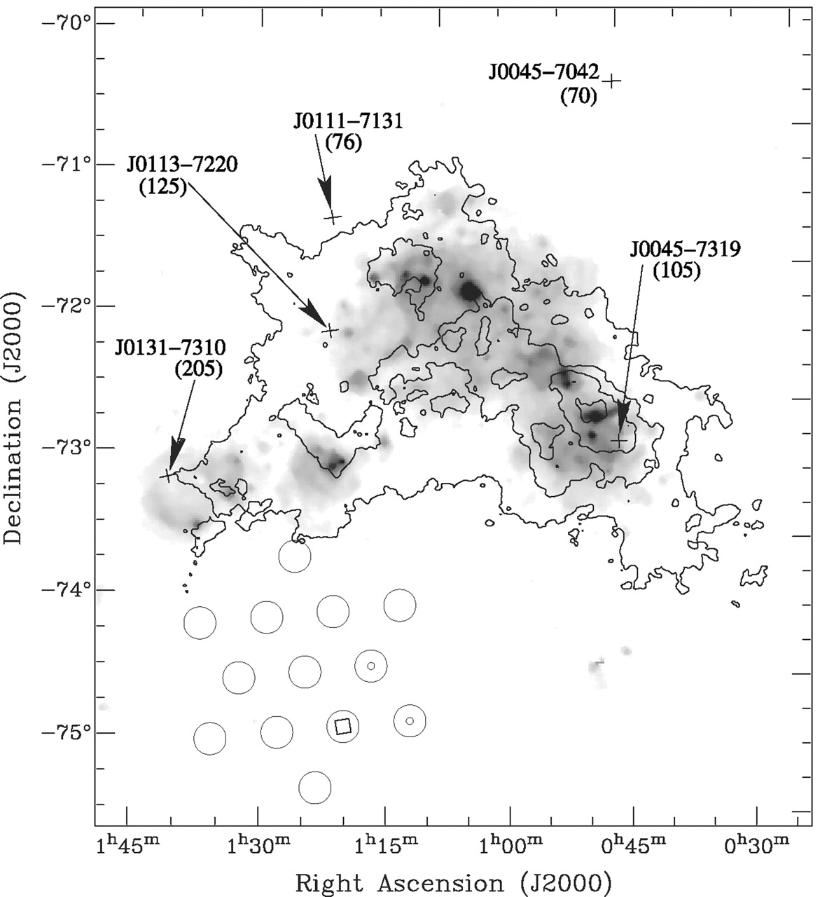
Lorimer Burst
Original Discovery
  30 Jy event @ Parkes
  DM = 375 pc cm^-3
    → D~1 Gpc !!!
    Enormous energy density
    Probe of the ionized IGM
Lorimer et al 2007

Slide 16
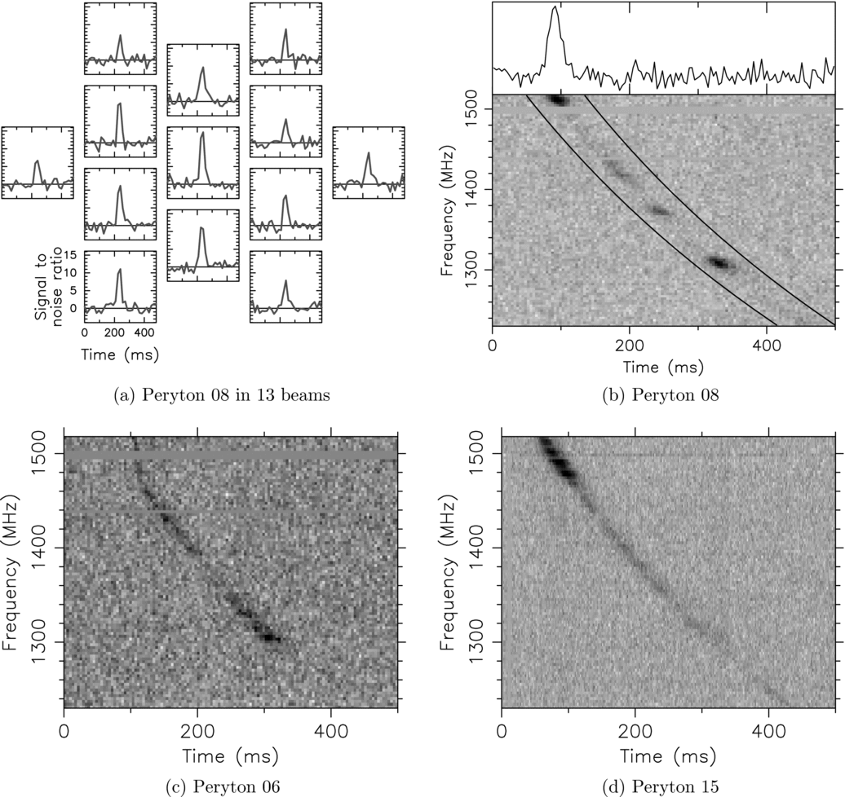
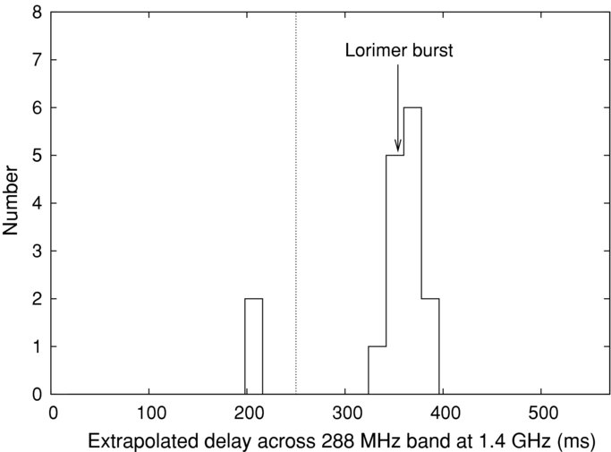
Lorimer Follow-Up: Terrestrial Origin?
Burke-Spolaor 2011
Terrestrial Origin?
  Non-dispersive shape
  Daylight, non-random distribution
  → Associated with lightning?
RFI?
  Also detected by Parkes
  Unusual timing signatures

Slide 17
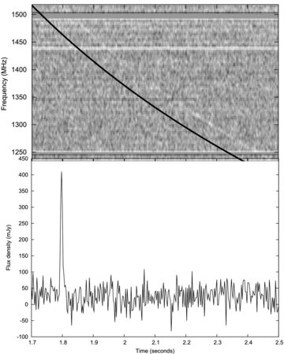
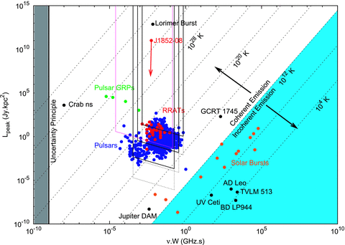
Lorimer Follow-Up: A New Event
J1852−08 burst with DM = 745 cm⁻³ pc
Also Discovered with Parkes
DM_{Galaxy} = 530 cm⁻³ pc
Keane, Stappers, Kramer et al 2011

Slide 18
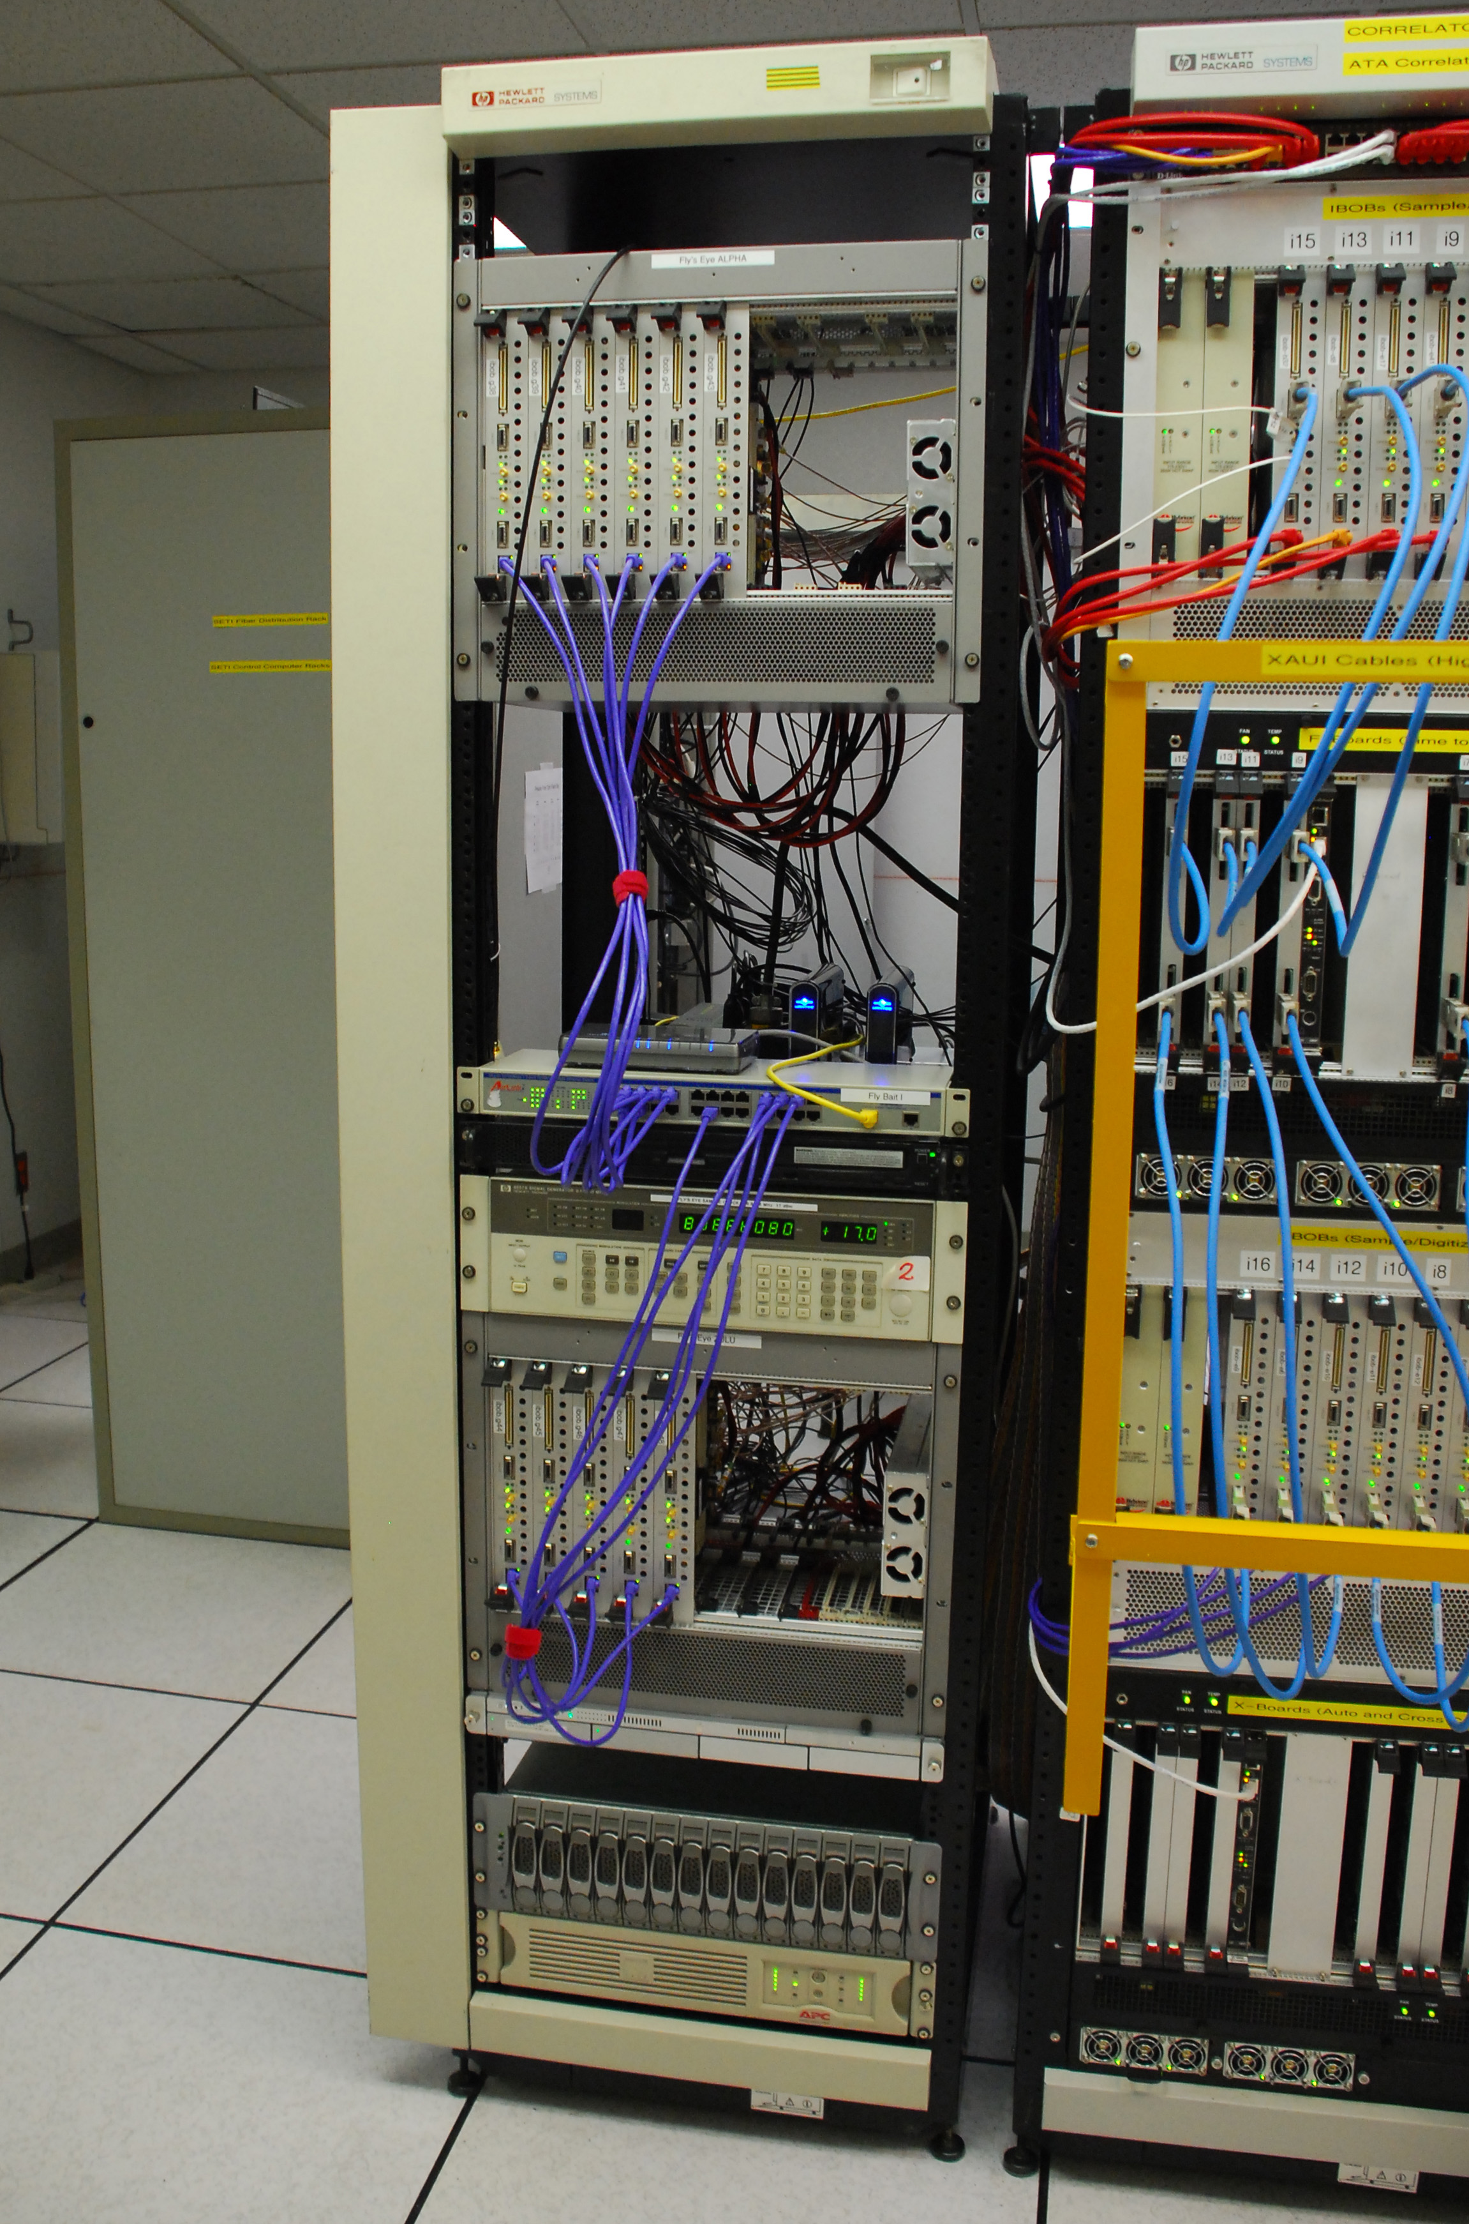
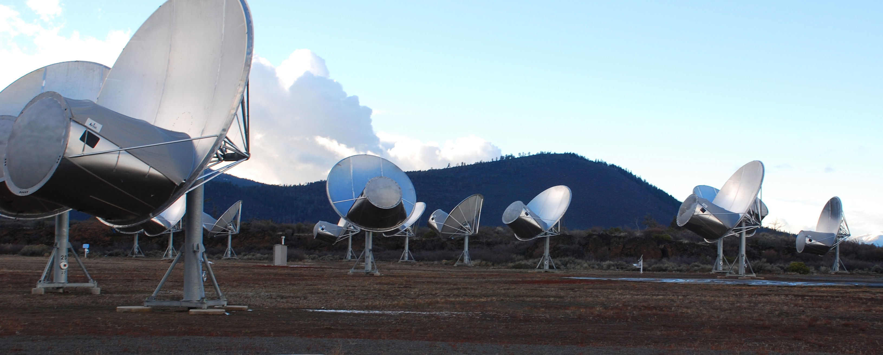
ATA Fly’s Eye Experiment
Search for very bright, very rare Lorimer bursts analogs
Ω_{FE} = 400 Ω_{parkes}
450 hours of observing
17 TB of data
10⁵ cpu-hours of processing
New modes of RFI rejection
Siemion, Bower, Foster, McMahon, Wagner, Werthimer, Backer, Cordes, van Leeuwen 2011
Hogden, vander Wiel, Bower, Michalak, Siemion, Werthimer 2011

Slide 19
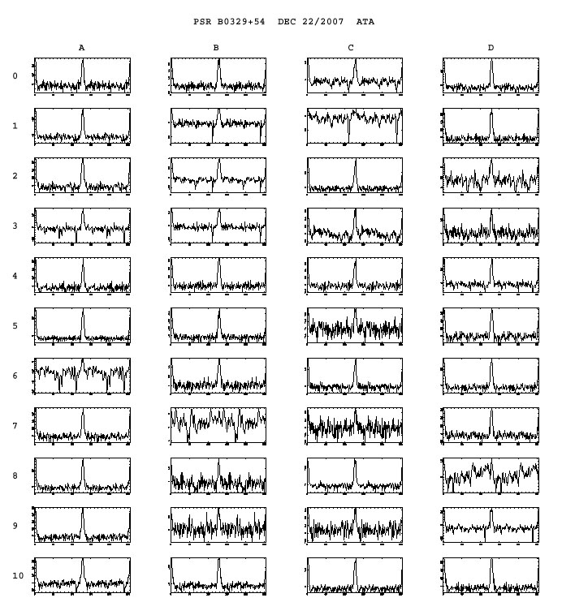
Fly’s Eye Results
Crab Giant Pulses
Multiple independent detections of a pulsar
Unusual RFI

Slide 21
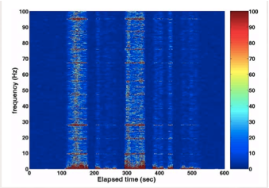
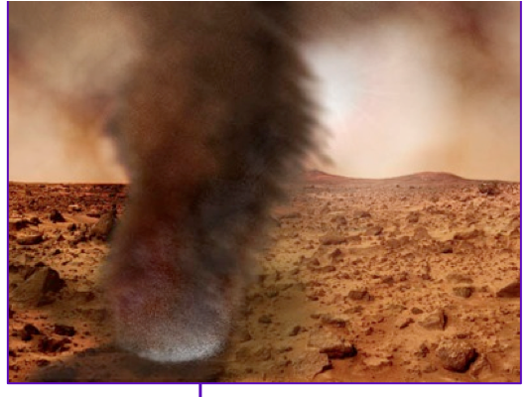
Search for Electrostatic Discharges from Martian Dust Storms
Ruf et al 2009
Anderson, Siemion, Barrott, Bower, de Pater, Delory, Werthimer 2011

Slide 22
Kurtosis as Indicator of Short-Timescale Variability
Pulsar B0329+54
Crab Giant Pulse
Power
Kurtosis
Power
Kurtosis

Slide 23
Martian Discharges are Likely RFI
ATA
Ruf et al 2009

Slide 24
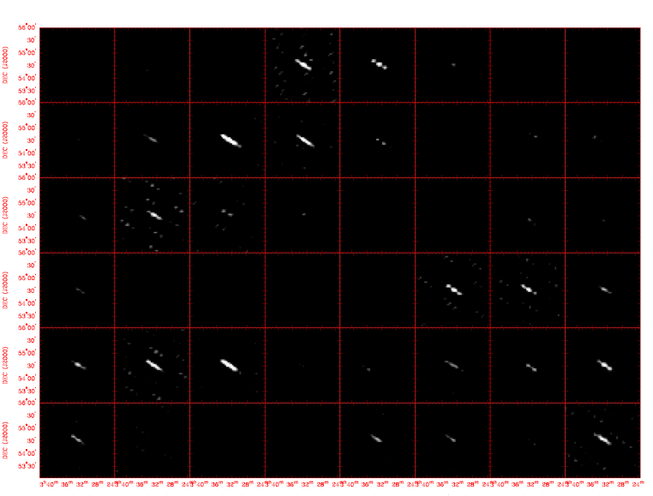
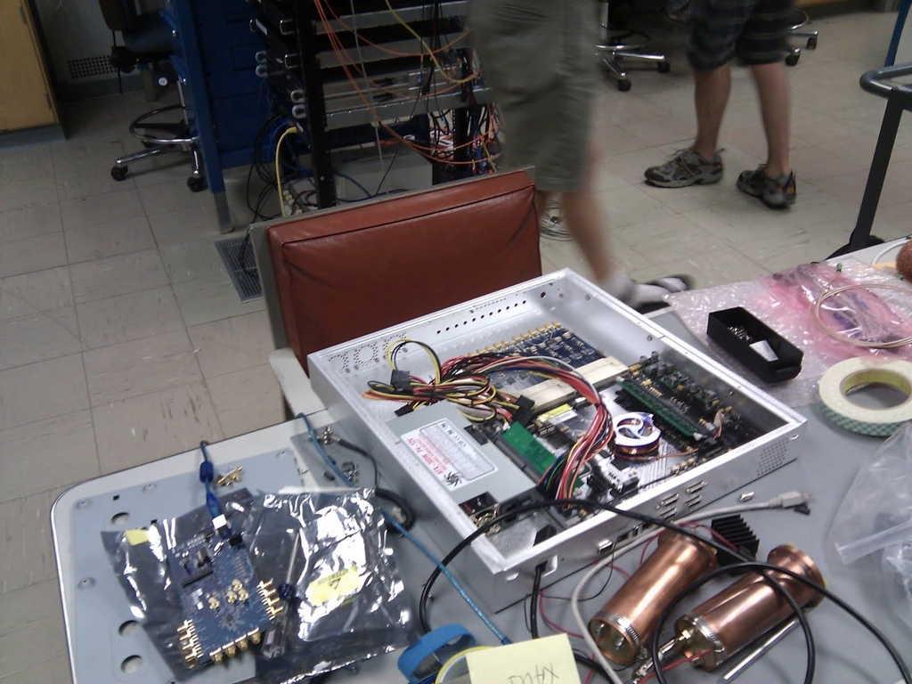
Individual Pulse Imaging
Defines a new mode of fast pulse searching & localization
  Hybrid of single dish & interferometer techniques
ATA demonstration
  Pulsar B0329+54
    0.7 sec period
  100 msec dump time
  6 antennas, 4 MHz
  Custom digital hardware
Law, Jones, Backer, Barrott, Bower, Kraybill, Williams, Werthimer 2011

Slide 25

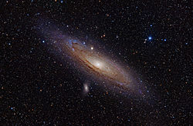
ATA Search for Pulses in M31
Image-based search:
complete to 190 Jy
Δt < ∼5 ms
rate < 4.3/hr
GBT
ATA
Optical image of Andromeda
Law, Jones, Backer, Barrott, Bower, Kraybill, Williams, Werthimer 2011
Casey Law :: NRAO Socorro :: July 2011

Slide 26
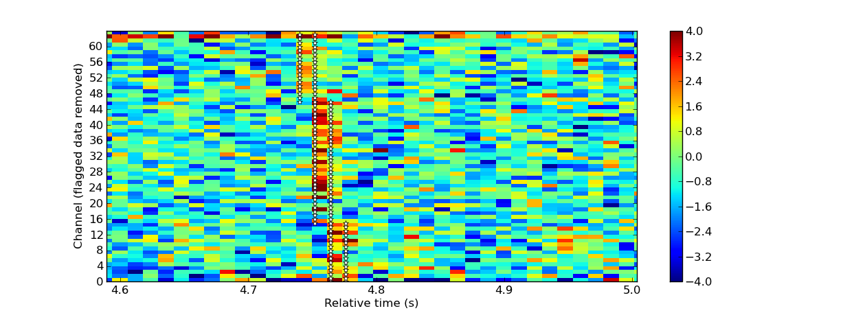
EVLA Results on Fast Imaging
Crab Giant Pulses
  27 EVLA Antennas
  12 msec integrations
  128 MHz Bandwidth
Law, Bower, Pokorny, Rupen, Sowinski

Slide 27
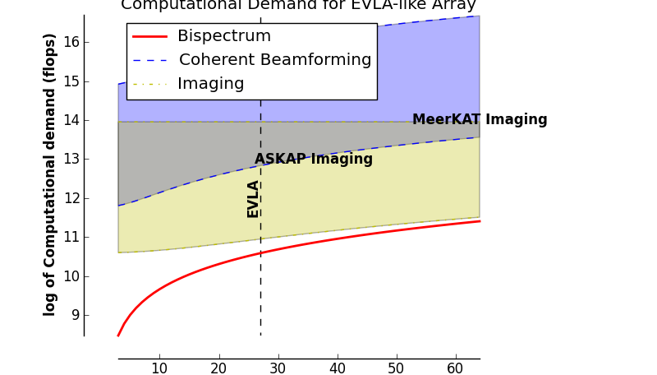
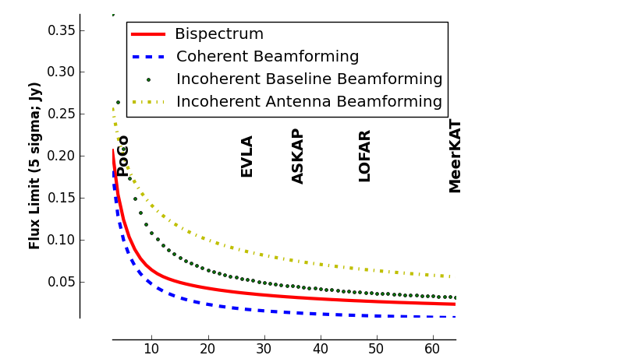
EVLA RRAT Trap
A computationally efficient algorithm
  Based on the bispectrum
  ~ 10³ x faster
  Use all antennas @ 10 msec
  → Lead to commensal, realtime search
Science Targets
  Localize RRATs
    Permits multi-lambda detection (X-ray)
  Search GC for giant pulses
    Characterize the GC neutron star population &scattering
    → Optimization for Sgr A* pulsar detection
  Magnetically active stars, brown dwarfs and planets
ATA FE
Law & Bower 2012

Slide 32
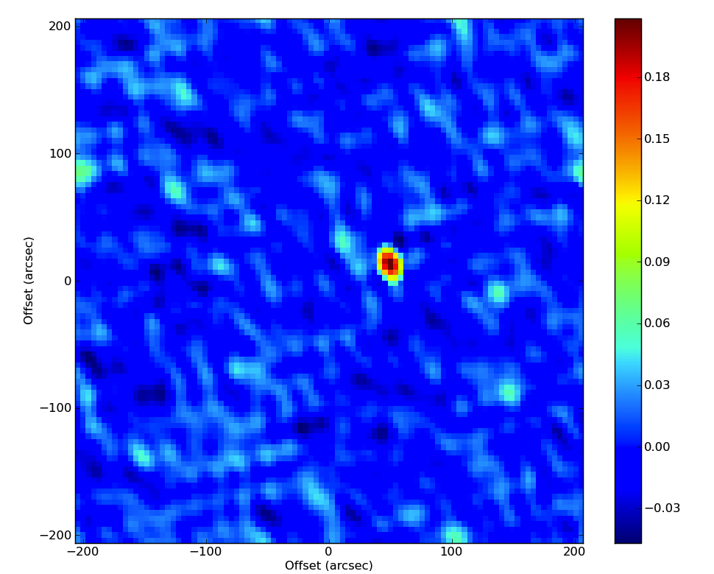
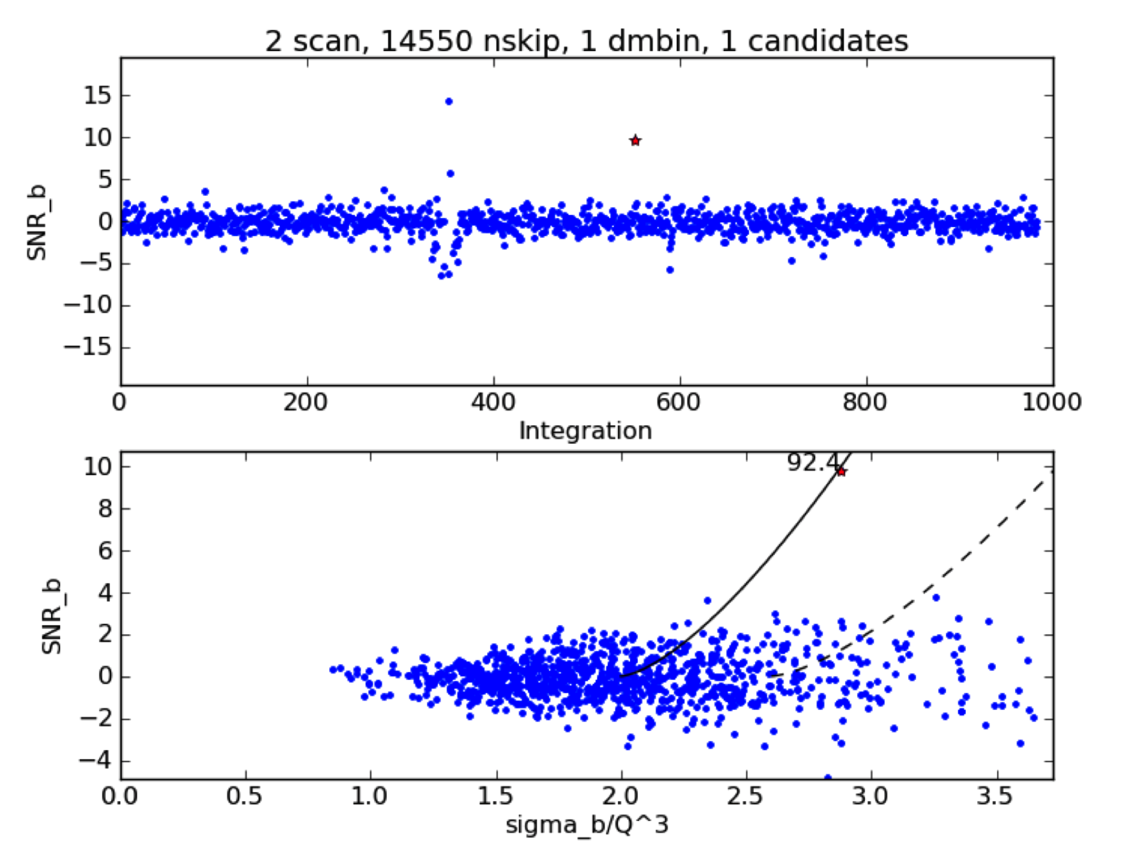
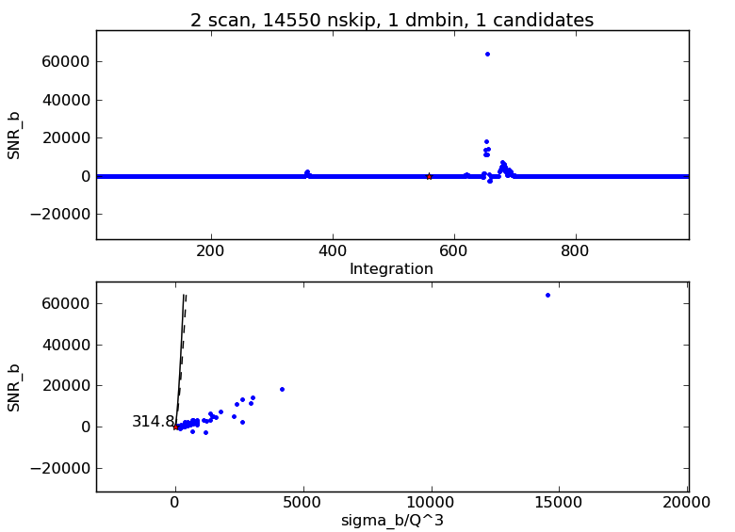
RRAT Trap First Results:
Arcsecond Localization of a RRAT
Law, Bower, Pokorny, Rupen, Sowinski

Slide 33
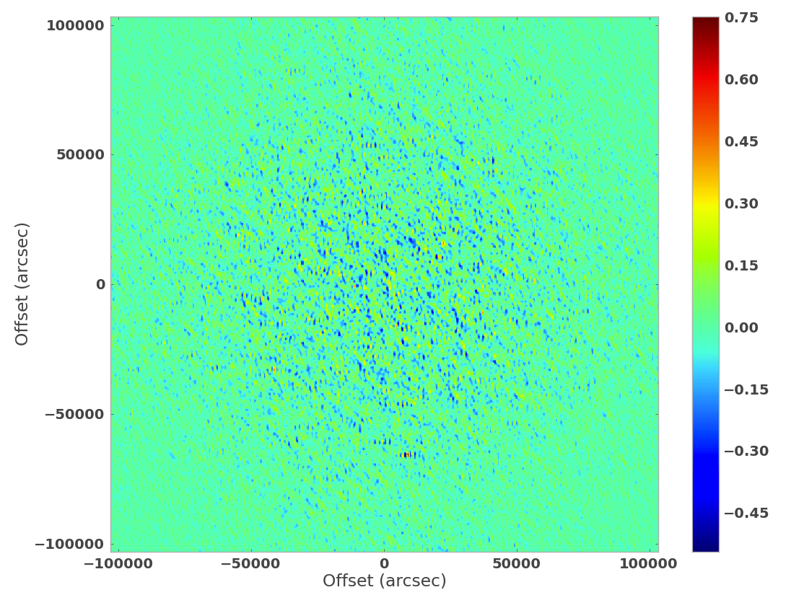
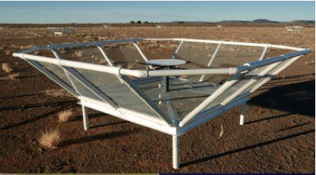
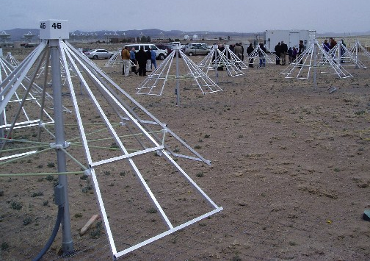
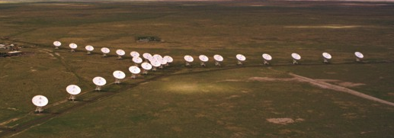

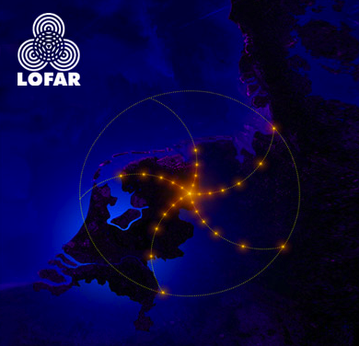
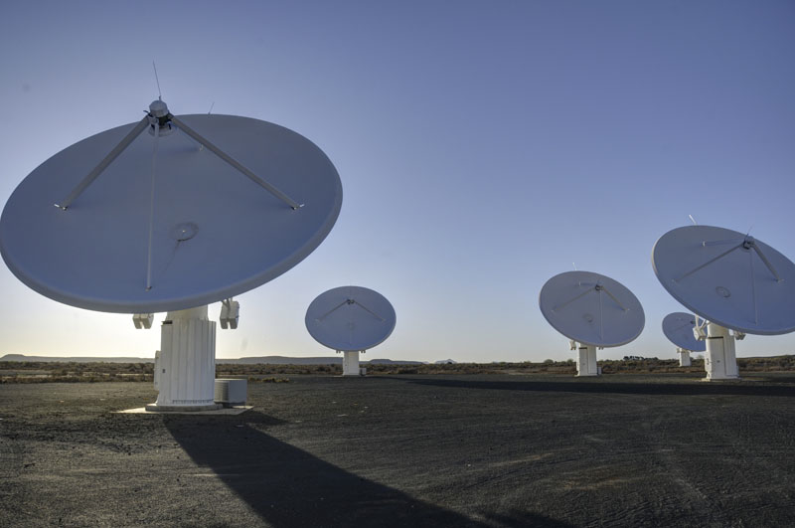
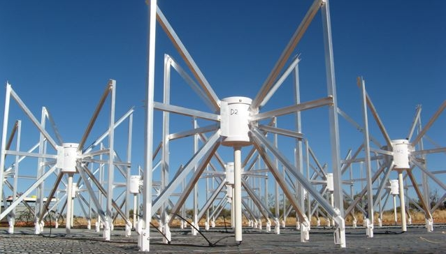
Future Work with Bispectrum

Slide 34
Some Lessons Learned & Questions
Archival searches have been very effective
Real time detection very powerful but very difficult to achieve
New algorithms can be very important as triage techniques
New algorithms require deeper understanding of statistical properties and observational limitations
Deep images are very useful tool for characterization of variable and transient population
Low angular resolution makes imaging and searching easy but makes multi-wavelength, multi-survey identification difficult
Finding sources in nearby galaxies very difficult --- requires high angular resolution to eliminate confusion
Commensal modes are effective way to get a lot of observing time
What is the right balance between shallow-and-wide, deep-and-narrow, and targeted?
What is the best frequency to search?
Source-, timescale-, frequency-dependent characterizations of transient parameter space are needed

Slide 35
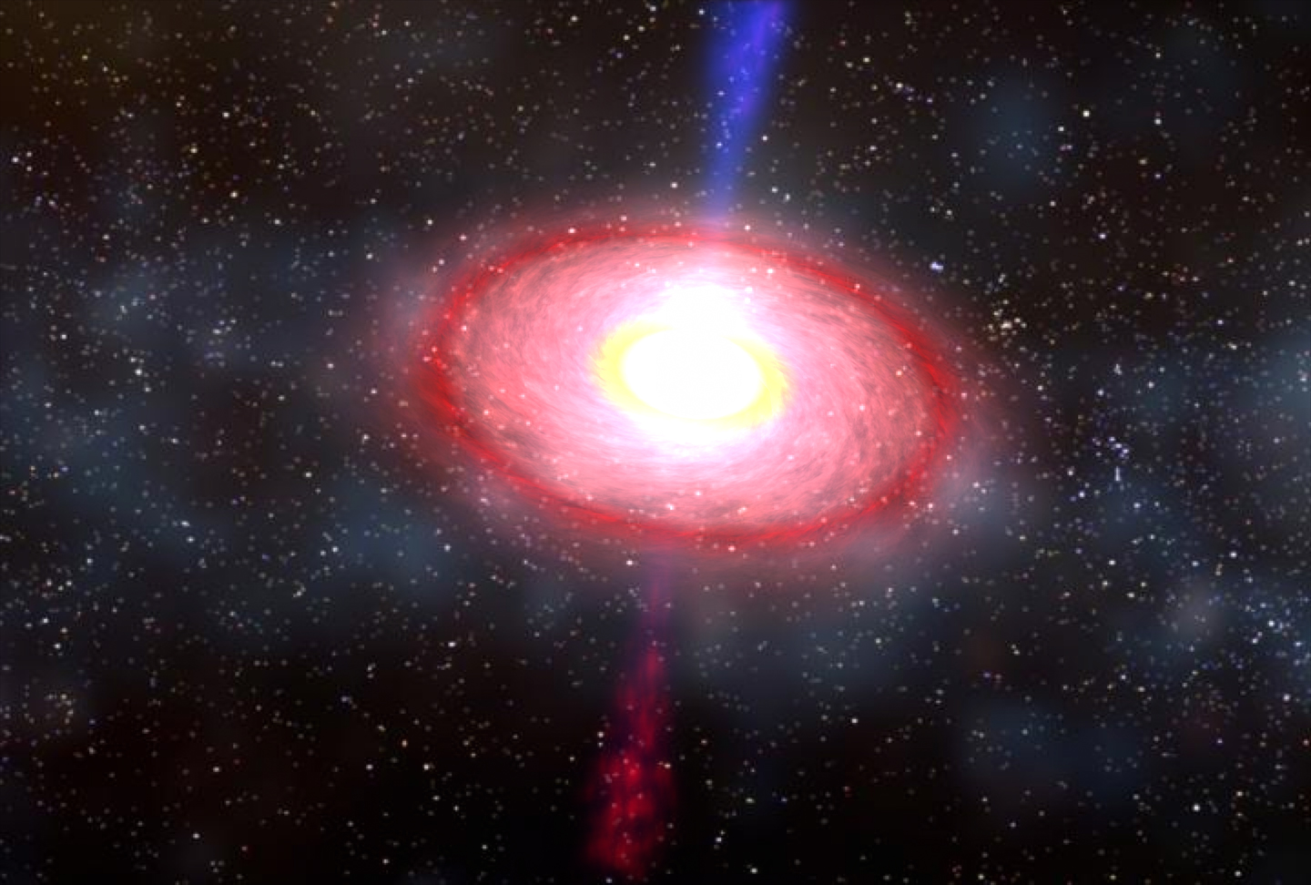
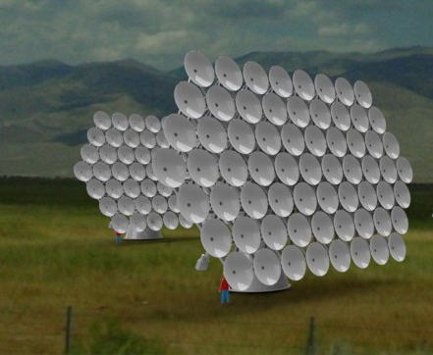
A New Era of Radio Transient Science
Transient parameter space is wide open on timescales of milliseconds to decades
New discoveries indicate rich phenomena
ATA & VLA surveys address a broad parameter space and have had significant impact on technology and design for future experiments
Next generation surveys & instruments will be powerful tools
  EVLA, ASKAP, MeerKAT, DACOTA

Slide 36
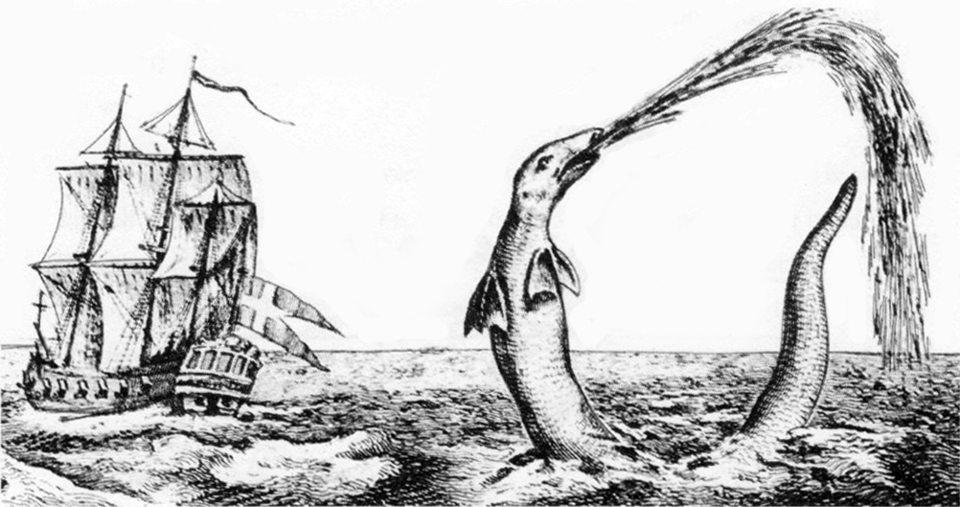
Collaborators
Fast Transients
  Anderson, Law, Siemion, de Pater, Werthimer, Cordes, van Leeuwen, Hogden, Michalak, vander Wiel, Macquart, Pokorny, Rupern, Sowinski, Egorov, Blanchard
Slow Transients
  Croft, Whysong, Williams, Keating, Law, Gaensler, Frail, Kulkarni, Bloom, Filippenko, Cenko, Saul, Kaplan, Chatterjee, Tomsick, Anderson, Frail
ATA
  DeBoer, Welch, Hull, Williams, Croft, Whysong, Keating, Wright, Kraybill, Blair, Heiles, Blitz, Backer, …
Undergraduates
Graduate students
Postdocs

