Slide 1
A Multi-Messenger Search for Radio Transients and Gravitational Waves
Michael Kavic & Leandro Quezada (Long Island University)
LWA Users Meeting July 26th, 2012
Collaborators: Peter Shawhan, Cregg Yancey (UMD),
John Simonetti, Steven Ellingson (VT), Sean Cutchin (NRL)
Jonah Kanner (NASA-Goddard)

Slide 2
The Plan….
Multi-messenger astronomy
Searching for radio transients & gravitational waves
Current status of coincident search

Slide 3
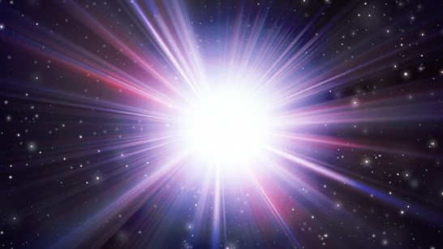
Multi-Messenger Astronomy

Slide 4
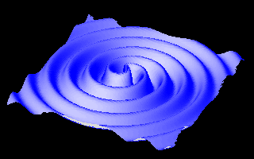
Gravitational waves
Gravitational waves are quadrupolar distortions of distances between freely falling masses. They are produced by time-varying mass quadrupoles.
Notes:
4
1AU x 1e-21 = 149 598 000 000 meters x 1e-21 = 1.5e11m x 1e-21 = 1.5 e-10 m = 3 Bohr radius
1 Bohr radius = 0.5 e-10 m

Slide 5
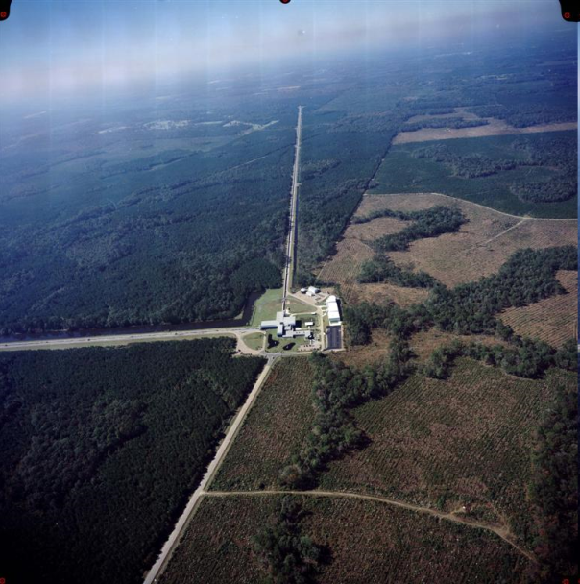
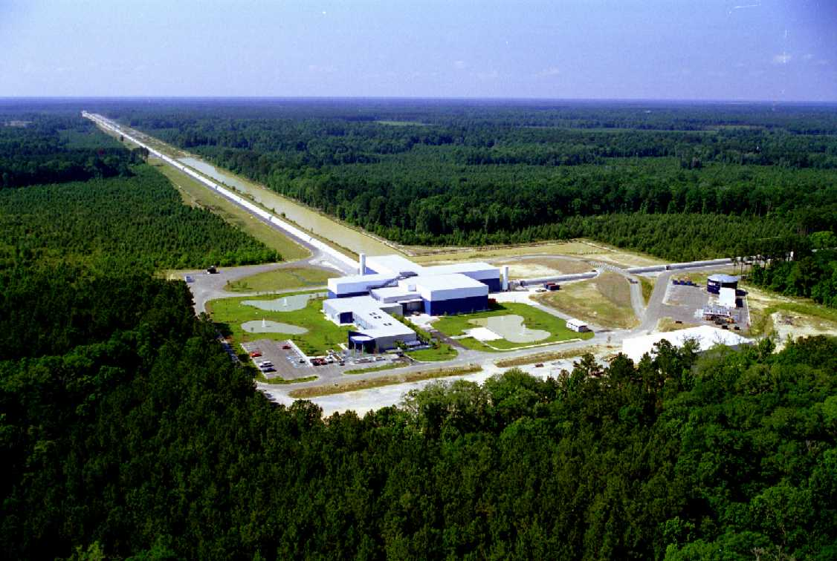
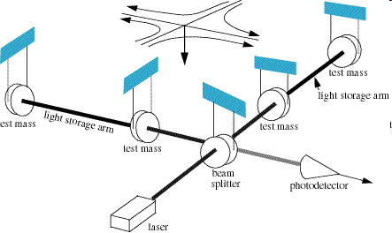
The Laser Interferometer Gravitational-Wave Observatory (LIGO)
2 large laser interferometers located in Washington State and Louisiana
Several science runs have been completed without a positive detection.
LIGO is a truly all-sky instrument, seeing both above and below the horizon.
LIGO data is logged and searched for positive detections much like LWA data.
Two other gravitational wave detectors are part of the LSC collaboration. Virgo and Geo located in Italy and Germany respectively.
Notes:
5

Slide 6
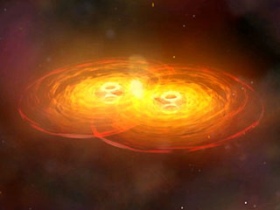
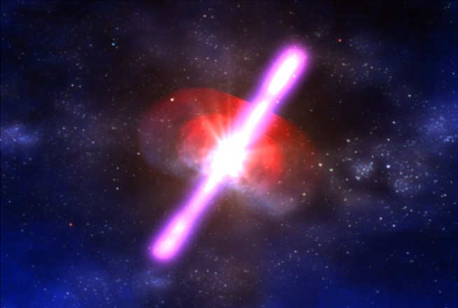
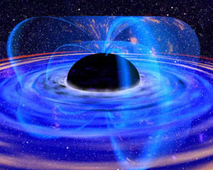
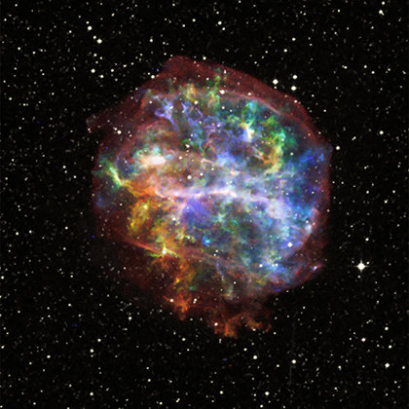
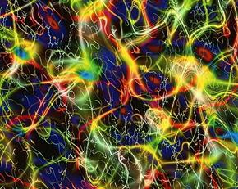
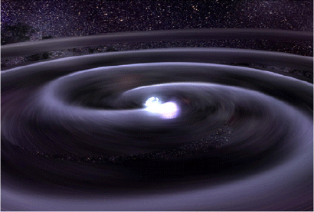
Astronomical Sources of Radio Transients & Gravitational Waves
Gamma-Ray Bursts
Primordial
Black Hole
Compact Object Mergers
Gravitational Waves
Cosmic Strings
Supernovae

Slide 7
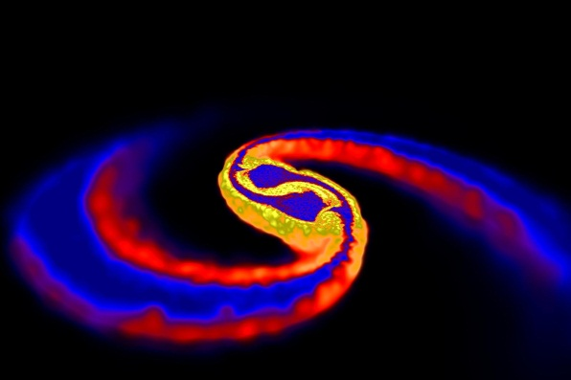
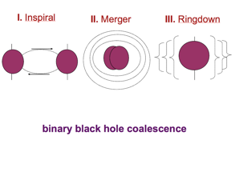
As 2 neutron stars merge, gravitational waves carry away the history of their motions.
A “chirp” signal is emitted with increasing frequency until merger at which point a coalescence wave-form is emitted.
Neutron Star Binaries: Initial LIGO ~15Mpc (~1/50 year), Advanced LIGO: ~200Mpc (40/year!).

Slide 8
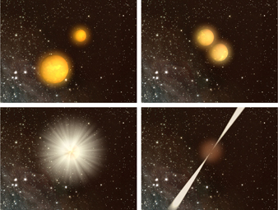
Rotational energy is converted to increase the magnetic field strength of the system by nearly an order of magnitude to B~10¹⁵ G.
This leads to a bright pulsar-like emission emitted as the binary pair mergers.
M.S. Pshirkov, K.A. Postnov Astrophys.Space Sci. 330 (2010)
LWA-1 can detect these events out to ~ 1 Gpc.
NSBP/NSHP 2011

Slide 9
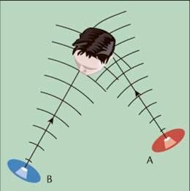
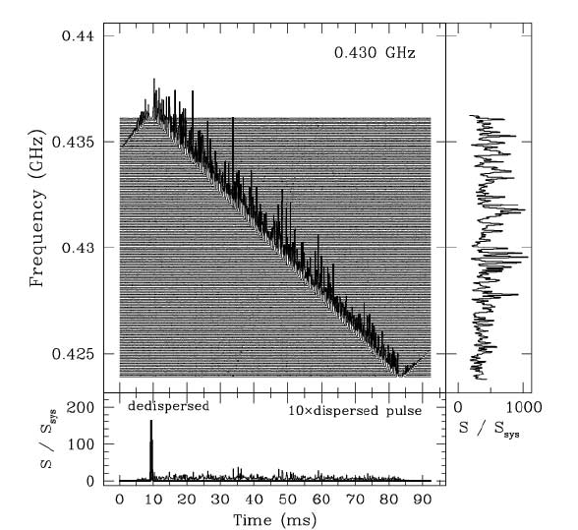
A Coincident Search Window
LWA events used an external trigger gravitational wave detection can be used to establish a spatio-temporal search window within LIGO/Virgo/GEO data.
The spatial window is determined by degree to which transient radio signals can be localized.
The LWA-1 station as a solitary instrument has 2 degree resolution at 80 MHz and 8 degree resolution at 20 MHz, at the zenith
Using the measured dispersion of a transient radio signal we can calculate the approximate time the GW which does not dispersion should have arrive in the corresponding detector.

Slide 10
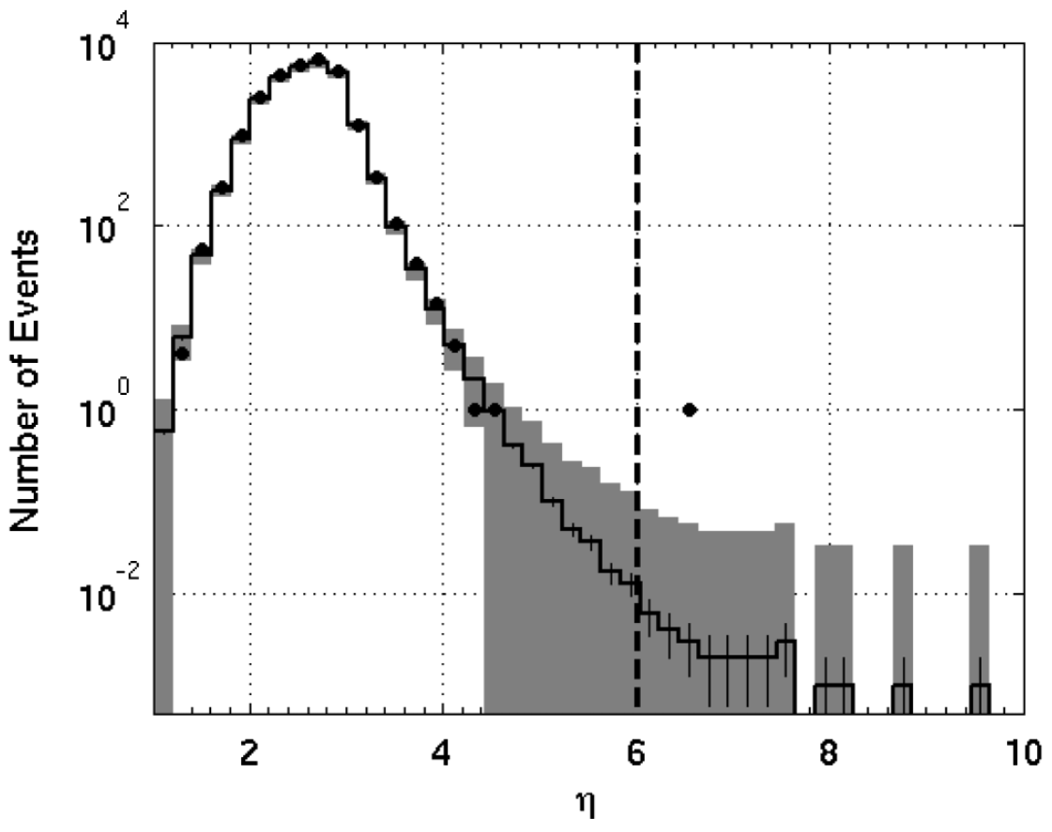
Background distribution from LIGO-Virgo GW burst search
Requiring coincidence of a GW candidate with a radio burst may allow the GW false alarm rate to be increased by a factor of 1000. That would allow the SNR threshold to be reduced by a factor of ~1.5, giving sensitivity to (1.5)³ ~ 3 times the volume of space.
Figure from Abadie et al., PRD 81, 102001 (2010)
Blind injection (simulated signal)
Over duration of science run

Slide 11
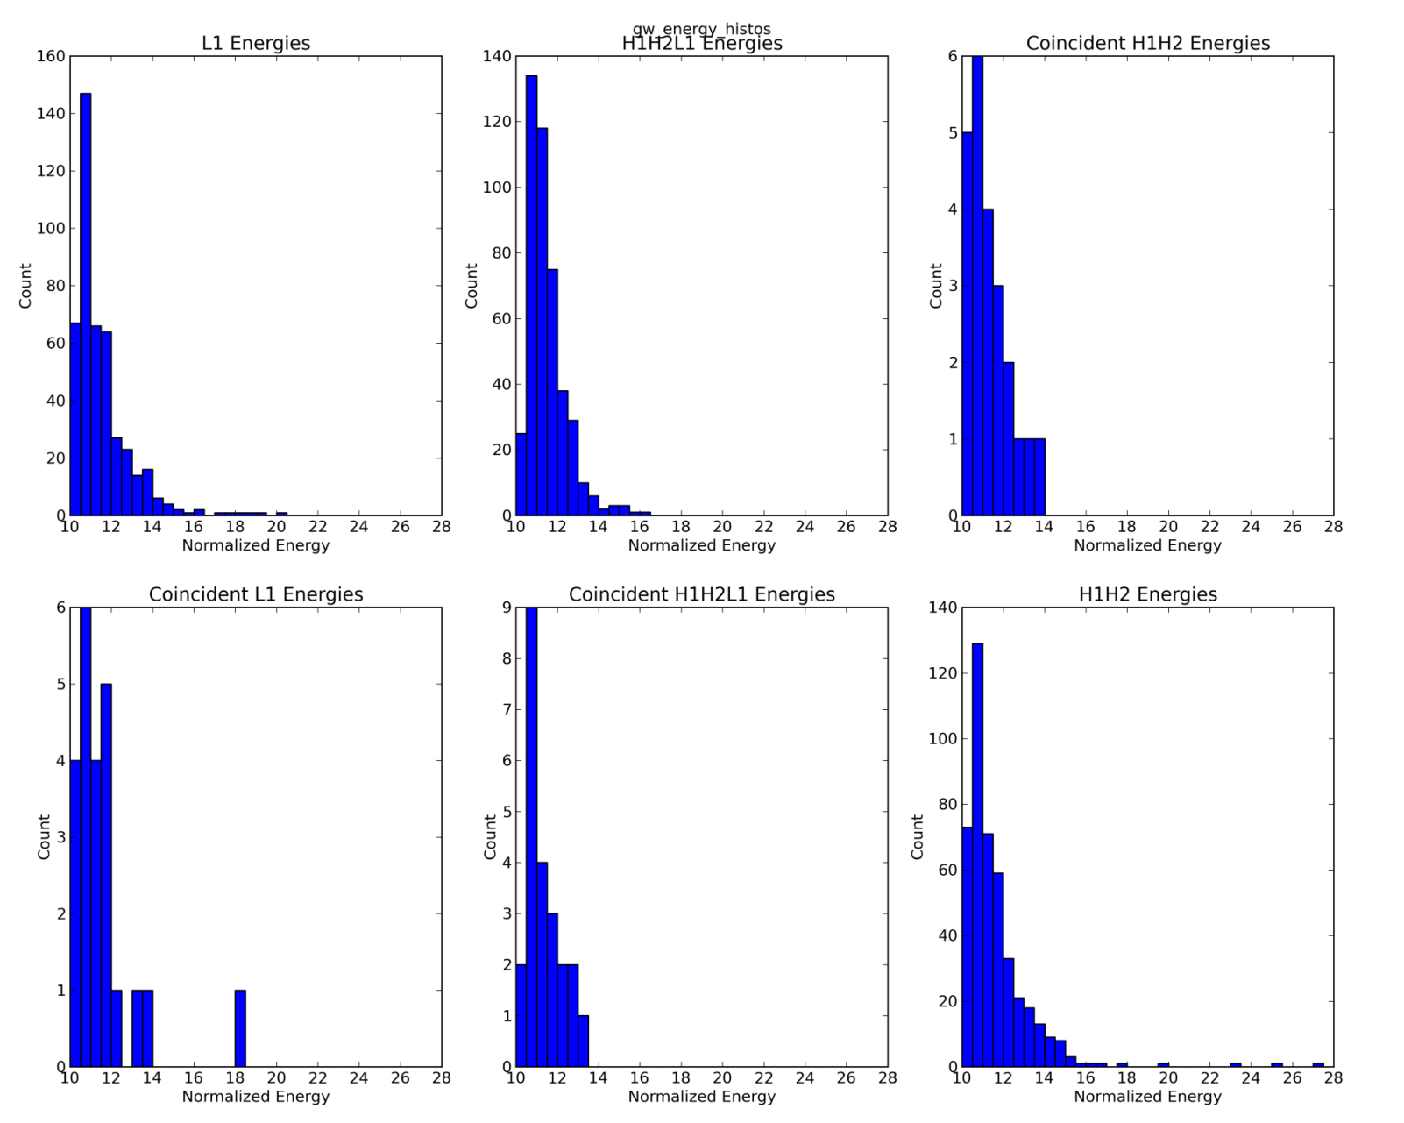
Coincident Events

Slide 12
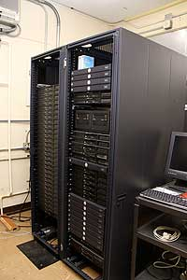
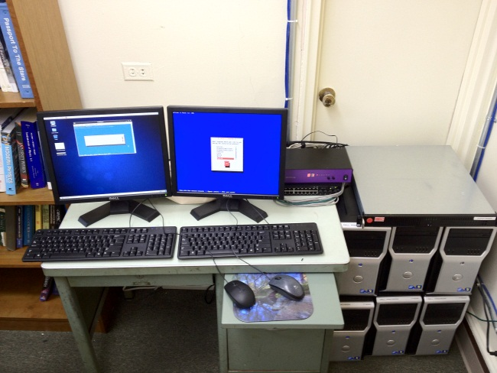
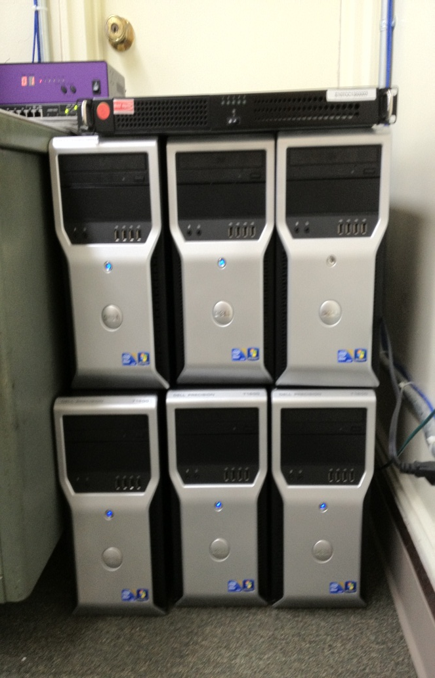
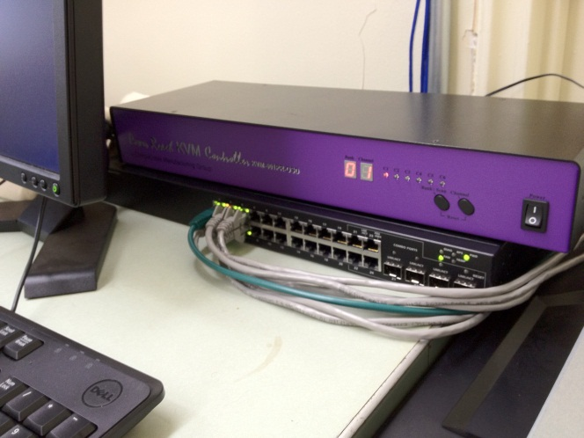
Data Infrastructure
5 DRSUs containing 10 Tb each
Data is being reduced at Virginia Tech (Tempest) and at LIU (Arcturus)
Arcturus is a dedicated cluster for LWA data reduction
Specs:
6 node Dell Precision T1600 Tower Workstation cluster
250 Gb hard drive
8 Gb RAM
Intel Pentium Dual Core Xeon Processors
Tempest
Arcturus

Slide 13
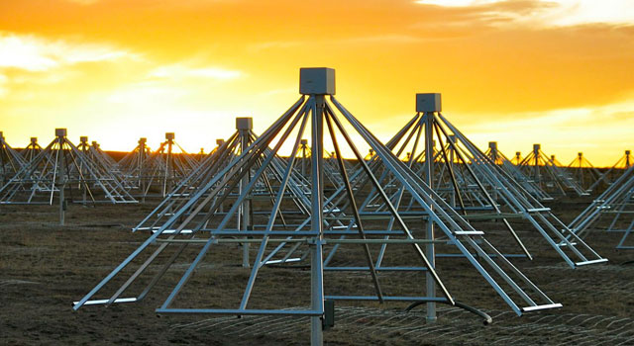
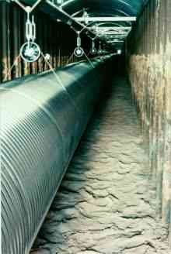
Current Status
Preliminary coincident observations with LIGO conducted during LWA-1 commissioning.
MOU for coincident search approved by LSC collaboration
First planned coincident observations conducted early 2012.
Observation made in DRX mode: ~30 hours (~120 beam hours) , 4 beams, 2 tunings per beam.
Beams (x2) pointed at Ursa Major Reference Field and Pulsar B0950+08
Data taken coincidently with GEO. (LIGO is currently undergoing an upgrade.)
Data pipeline established and coincident search code created.
Data reduction ongoing, comparative analysis with GEO to begin in the near future.

Slide 14
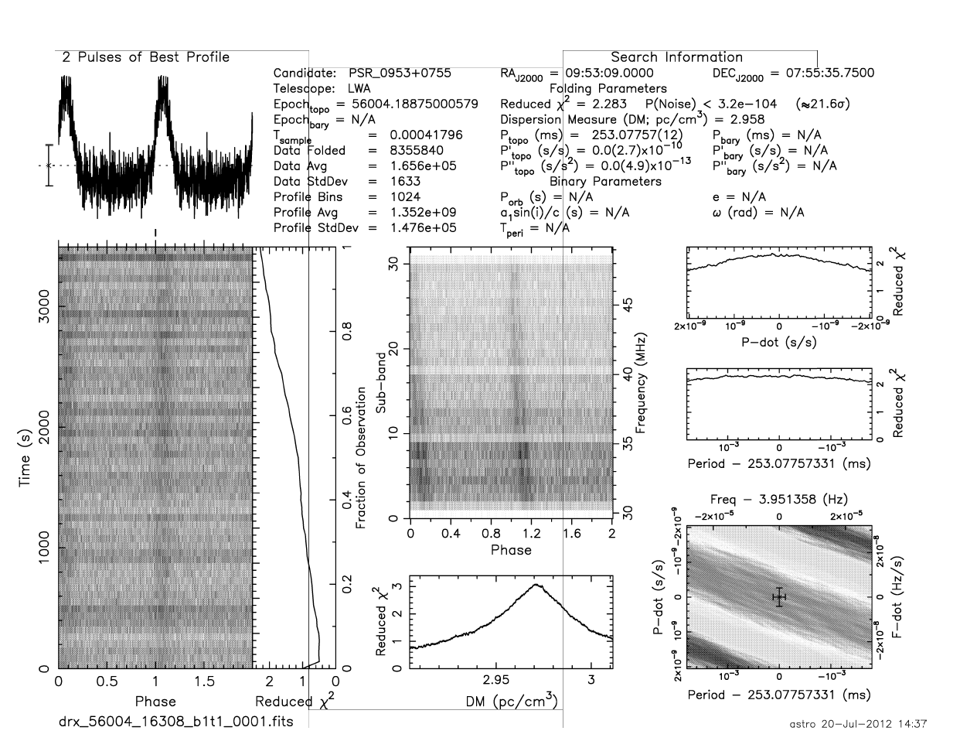
Pulsar (B0950+08) observed at 38 MHz

Slide 15
Outlook
Multi-messenger Astronomy can help give a clearer, more complete picture of the nature of an astronomical event as well as make searches for such events more sensitive.
The nature the properties of low-frequency EM and GW signals makes this approach particularly effective.
The LWA is searching the low-frequency radio band for transient radio events. The LSC is searching for the first direct detection of GWs.
These instruments have an overlapping list of primary sources and gather data in an analogous fashion making a coincident search a promising proposition.
Initial coincident observations have been performed. Data reduction and coincident comparison is underway.
Refined coincident observation are ongoing.

Slide 16
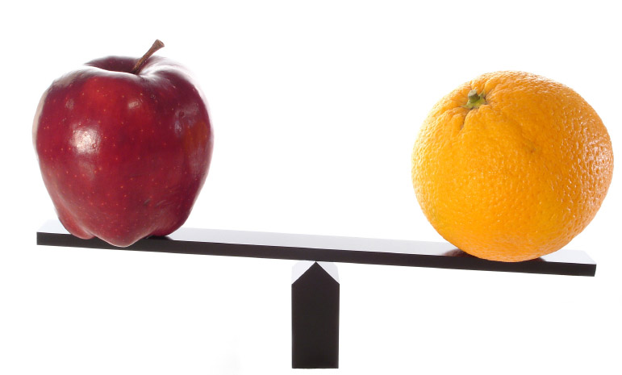
A coincident search
Coincident observations between 2 all-sky instruments
Data logged by both instrument for ex post facto comparison
Radio transients used as external trigger for GW search in LIGO
This has the potential to pick out true GW signals which would otherwise be lost in background noise.
Data has been taken coincidently during ETA’s first science run as well as during LWA preliminary observing period. Further coincident observations are planned both with Geo and Advanced LIGO.

Slide 17
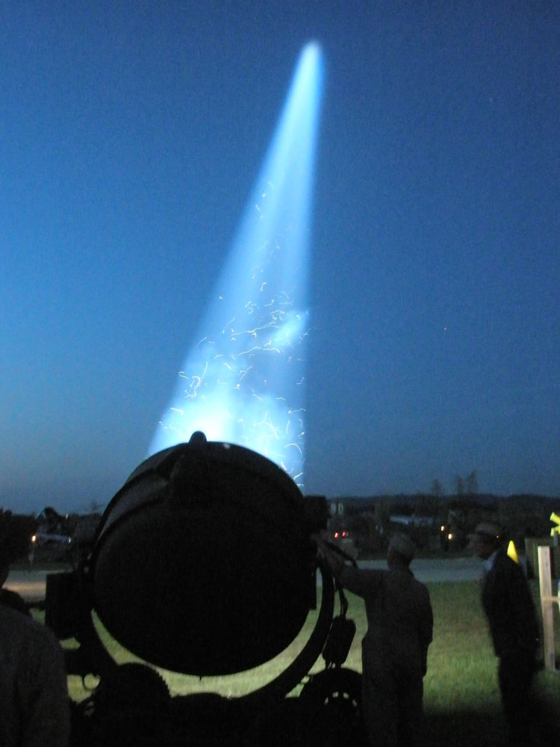
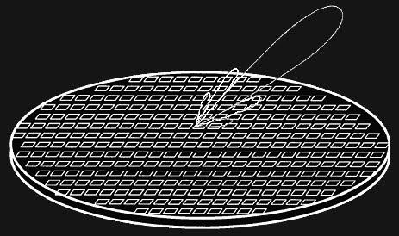
LWA beamforming
LWA-1 is configurable in a variety of different data collection modes including an all-sky and a DRX beam- forming configuration.
Beam-forming involves synchronizing the signal from multiple antennas for increased sensitivity to a particular portion of the sky.

Slide 18
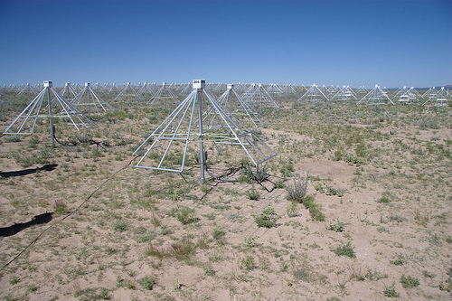
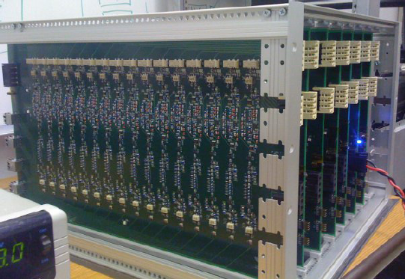
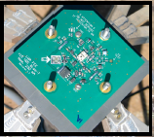
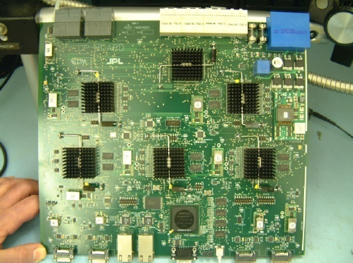
LWA-direct-sampling receiver
256+2 “outrigger” stands
528 Analog Receivers
Analog-to-Digital converters (196 million samples per second).
Data stored on “DRSU” hard drive arrays. (5Tb~10 hours of data)

Slide 19
Gravity vs. Electromagnetism
If observing new wavelengths of light lead to such revolutions in astronomy, what might we expect when we observe an entirely new spectrum?
Electromagnetism:
Gravity:
A strong force, but with
opposing charges ( + and − )
A weak force, but with
only one charge (mass)
Fields generated by
microscopic charge separations
Fields generated by
bulk accumulation of matter
Waves are easy to detect, but
easily blocked
Waves are hard to detect, but
pass undisturbed through anything
Show the surfaces of bodies
Reveal the bulk motion of matter
Used to construct images of
celestial objects
Can be though of as sounds emitted
by those objects
A fundamentally different way of observing the Cosmos!

Slide 20
Multi-messenger searches
Follow-ups & External Triggers
LSC/Virgo current agreements with:
γ-rays: SWIFT, Fermi GBM, LAT
X-rays: RXTE
Neutrinos: Antares, IceCube
Wide-field Optical: QUEST, ROTSE, TAROT, Pi of theSky, SkyMapper, PTF
Radio: LOFAR, LWA/ETA

Slide 21
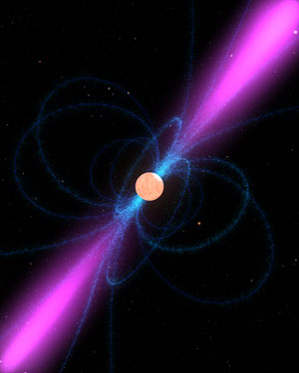

Slide 22
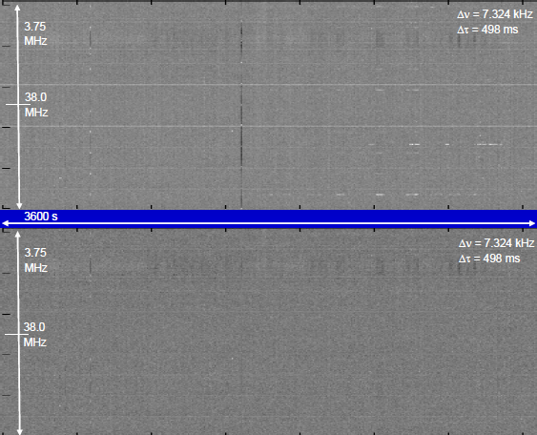
ETA-Spectrogram
Preliminary ETA data: Before (Upper Panel) and After (Lower Panel) RFI Mitigation
Notes:
22

Slide 23
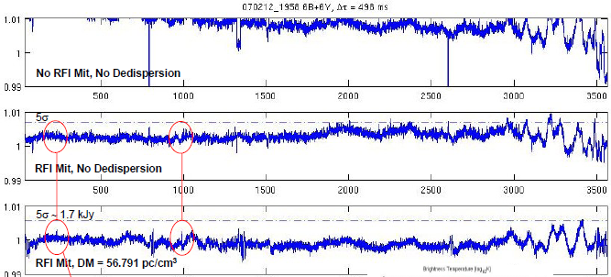
ETA-Candidate Pulses
Notes:
23

Slide 24
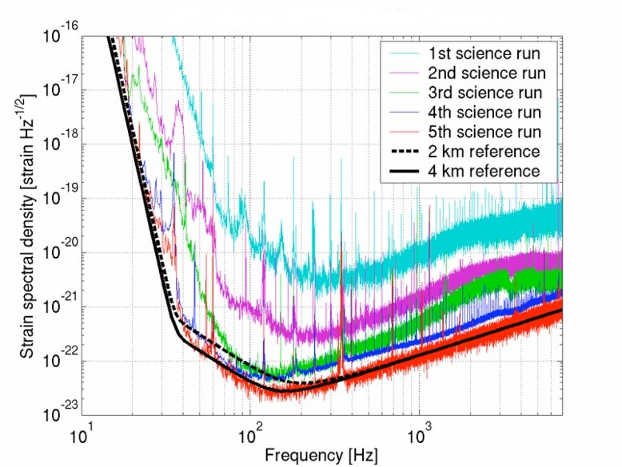
LIGO Sensitivity

Slide 25
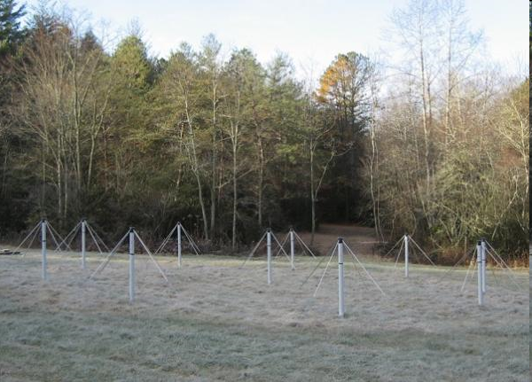
Eight-meter-wavelength Transient Array (ETA)
The ETA-1 was composed of 10 dual-polarization dipole antennas.
It is sensitive to a bandwidth of 27-49 MHz.
Operated at the Pisgah Astronomical Research Institute (PARI) for its first science run.
Currently being updated and reconstituted in western Virginia, ETA-2 will observe coincidently with LWA. (a baseline of ~2400 km)
~40 hours of data have been collected and are currently being analyzed.
Notes:
25

Slide 26
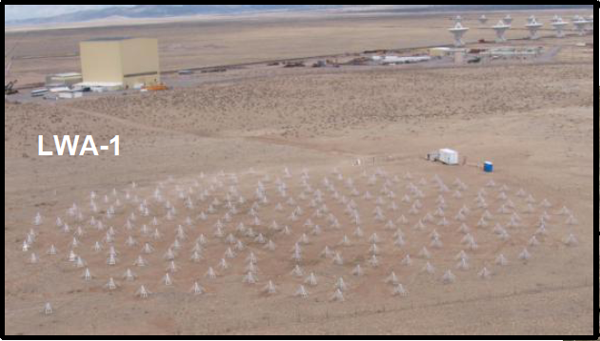
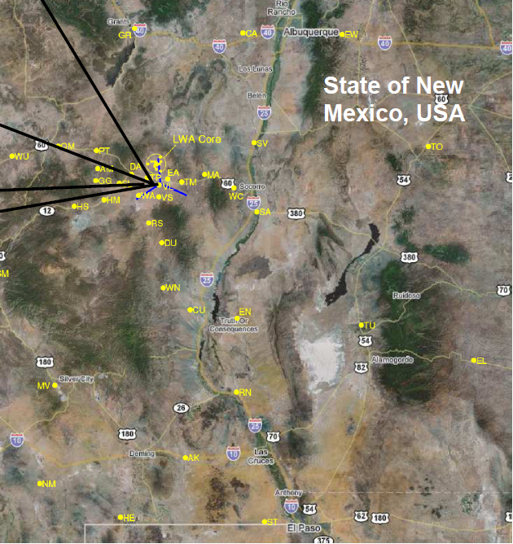
Long Wavelength Array (LWA)
The LWA is sensitive to a bandwidth of 10-88 MHz.
The first station of the LWA (LWA-1) is composed of an array of 256 dual-polarization dipole antennas laid out in a 100m diameter aperture.

Slide 27
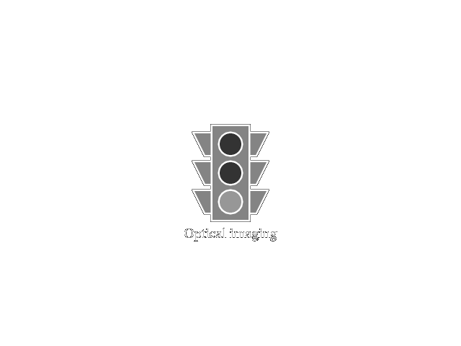
An analogy

Slide 28
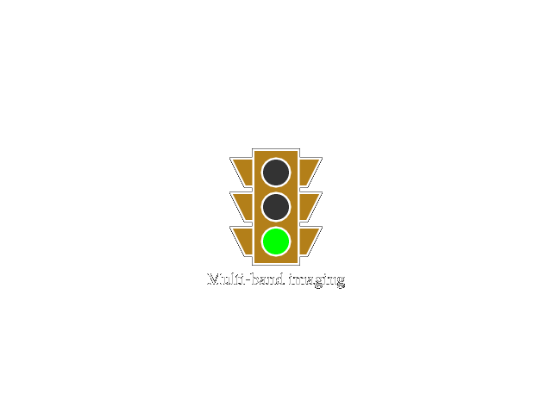
An analogy

Slide 29
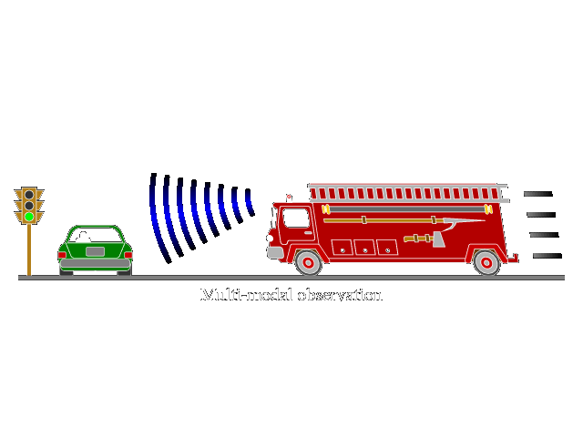
An analogy

Slide 30
Compact Object Mergers
Image Credit: Daniel Price (U/Exeter) and Stephan Rosswog (Int. U/Bremen).

Slide 31
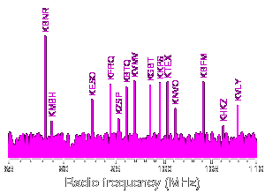
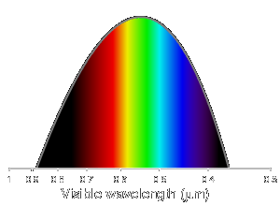
Electromagnetic waves
Some familiar spectral bands:

Slide 32
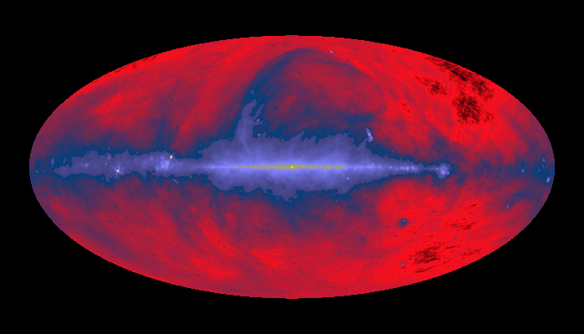
All-Sky
Dipole antennas at very low frequency can observe the entire sky above the horizon with a large collecting area.
Gravitational wave interferometers are sensitive to signals above and below the horizon
This is particularly useful for detecting transient events which can come from a seemingly random part of the sky.
A $∝$ λ²

Slide 33
The Plan….
Multi-messenger astronomy
Searching for radio transients & gravitational waves
Common sources
A coincident search

Slide 34
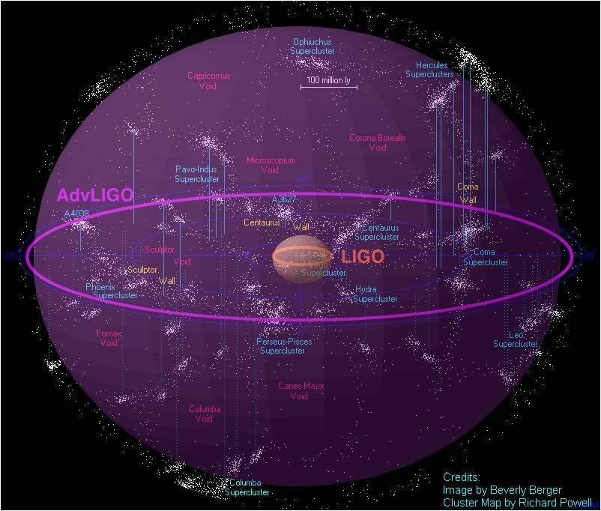
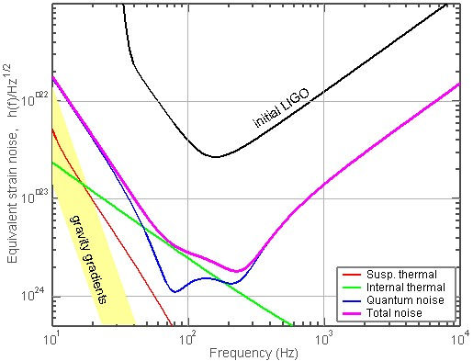
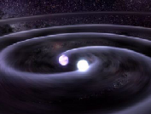
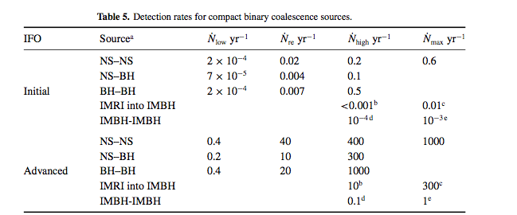
Advanced LIGO detectors
Neutron Star Binaries:
Initial LIGO: ~15 Mpc → rate ~1/50yrs
Advanced LIGO: ~ 200 Mpc
Realistic rate ~ 40/year !
Advanced LIGO
Class. Quant. Grav. 27, 173001 (2010)
Notes:
P0900125-v8

