Slide 1
Spectroscopy and Atoms
How do we know:
- Temperature, density of stars.
- Chemical make-up and ages of stars, galaxies
- Masses and orbits of stars, galaxies, extrasolar planets
expansion of universe, acceleration of universe.
All rely on taking and understanding spectra

Slide 2
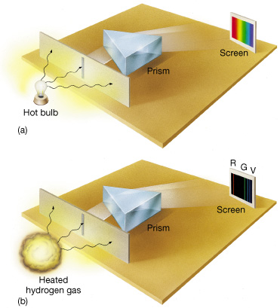

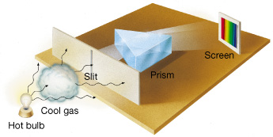

Types of Spectra and Kirchhoff's (1859) Laws
1. "Continuous" spectrum - radiation over a broad range of wavelengths (light: bright at every color). Produced by a hot opaque solid, liquid, or dense gas.
2. "Emission line" spectrum - bright at specific wavelengths only. Produced by a transparent hot gas.
3. Continuous spectrum with "absorption lines": bright over a broad range of wavelengths with some dark lines. Produced by a transparent gas absorbing light from a continuous spectrum source.

Slide 3
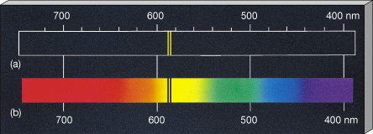
The pattern of lines is a fingerprint of the element (e.g. hydrogen, neon) in the gas.
For a given element, emission and absorption lines occur at same wavelengths.
Sodium

Slide 4
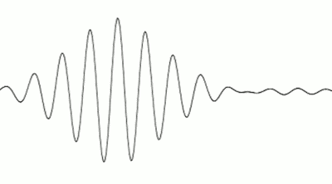
The Particle Nature of Light
On microscopic scales (scale of atoms), light travels as individual packets of energy, called photons. (Einstein 1905).
c
photon energy is proportional to radiation frequency:
E α ν (or E α )
example: ultraviolet photons are more harmful than visible photons.
1
λ

Slide 5
The Nature of Atoms
The Bohr model of the Hydrogen atom (1913):
electron
_
_
+
+
proton
"ground state"
an "excited state"
Ground state is the lowest energy state. Atom must gain energy to move to an excited state. It must absorb a photon or collide with another atom.

Slide 6
But, only certain energies (or orbits) are allowed:
_
_
_
a few energy levels of H
+
The atom can only absorb photons with exactly the right energy to boost the electron to one of its higher levels.
(photon energy α frequency)

Slide 7
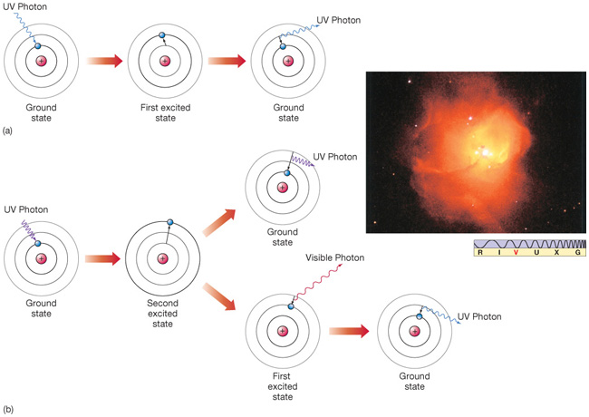
When an atom absorbs a photon, it moves to a higher energy state briefly
When it jumps back to lower energy state, it emits a photon - in a random direction

Slide 8
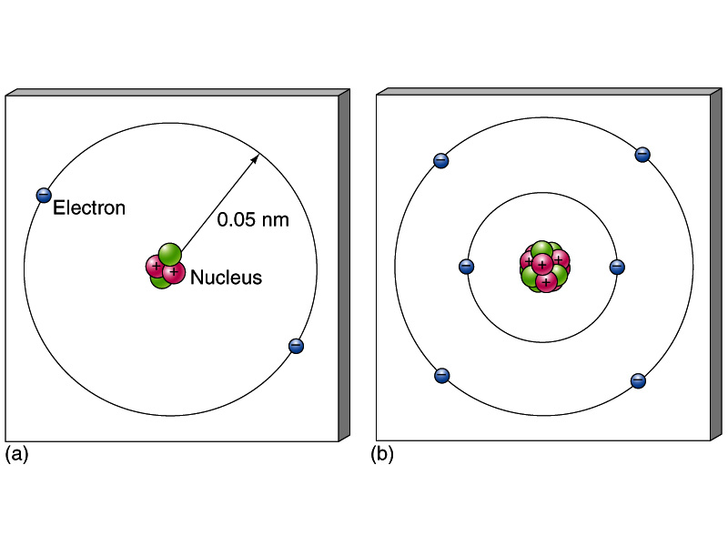
Other elements
Helium Carbon
neutron proton
Atoms have equal positive and negative charge. Each element has its own allowed energy levels and thus its own spectrum. Number of protons defines element. Isotopes of element have different number of neutrons.

Slide 9
Ionization
Hydrogen
_
+
Energetic UV Photon
_
Helium
+
+
Energetic UV Photon
_
Atom
"Ion"
Two atoms colliding can also lead to ionization. The hotter the gas, the more ionized it gets.

Slide 10
So why do stars have absorption line spectra?
Simple case: let’s say these atoms can only absorb green photons. Get dark absorption line at green part of spectrum.
.
.
.
.
.
.
.
.
.
.
.
“atmosphere” (thousands
of K) has atoms and ions
with bound electrons
hot (millions of K), dense interior
has blackbody spectrum,
gas fully ionized

Slide 11
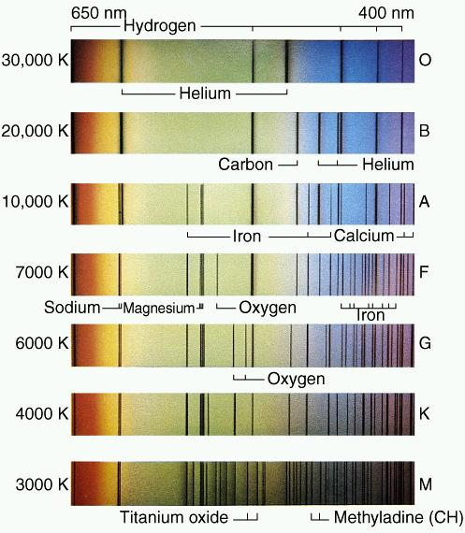
Stellar Spectra
Spectra of stars differ mainly due to atmospheric temperature (composition differences also important).
“hot” star
“cool” star

Slide 12
Why emission lines?
hot cloud of gas
.
.
.
.
.
.
- Collisions excite atoms: an electron moves to a higher energy level
- Then electron drops back to lower level
- Photons at specific frequencies emitted.

Slide 13
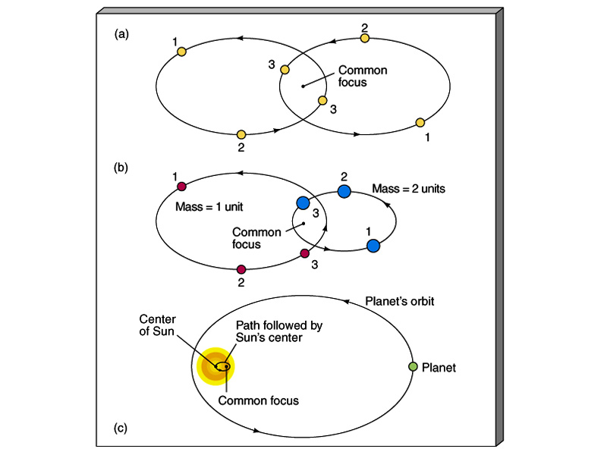
We've used spectra to find planets around other stars.
Animation

Slide 15
So why absorption lines?
.
.
.
.
.
cloud of gas
.
.
.
.
.
.
The green photons (say) get absorbed by the atoms. They are emitted again in random directions. Photons of other wavelengths go through. Get dark absorption line at green part of spectrum.

Slide 16
Molecules
Two or more atoms joined together.
They occur in atmospheres of cooler stars, cold clouds of gas, planets.
Examples
H₂ = H + H
CO = C + O
CO₂ = C + O + O
NH₃ = N + H + H + H (ammonia)
CH₄ = C + H + H + H + H (methane)
They have
- electron energy levels (like atoms)
- rotational energy levels
- vibrational energy levels

Slide 17
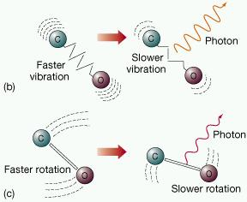
Molecule vibration and rotation

Slide 18
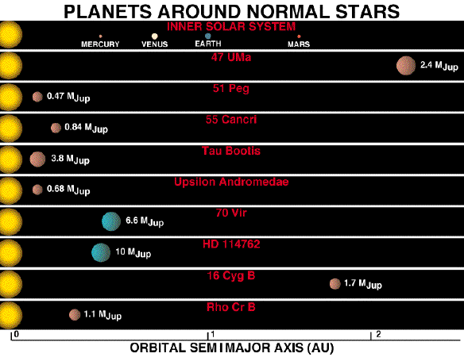
Now 1000’s of extrasolar planets known. Here are the first few discovered.

Slide 19
Types of Spectra
1. "Continuous" spectrum - radiation over a broad range of wavelengths
(light: bright at every color).
2. "Emission line" spectrum - bright at specific wavelengths only.
3. Continuous spectrum with "absorption lines": bright over a broad range of wavelengths with a few dark lines.

Slide 20
Kirchhoff's Laws (1859)
1. A hot, opaque solid, liquid or dense gas produces a continuous spectrum.
2. A transparent hot gas produces an emission line spectrum.
3. A transparent, cool gas absorbs wavelengths from a continuous spectrum, producing an absorption line spectrum.

Slide 21

Star wobbling due to gravity of planet causes small Doppler shift of its absorption lines.
Amount of shift depends on velocity of wobble. Also know period of wobble. This is enough to constrain the mass and orbit of the planet.

