Slide 1
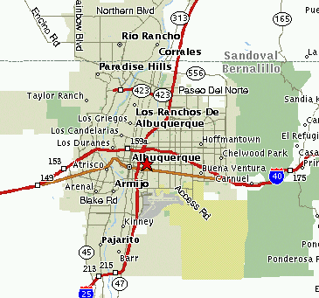

Neutron Stars
If star has mass 12-25 M_{Sun} , remnant of supernova expected to be a tightly packed ball of neutrons.
Diameter: 10 km only!
Mass: 1.4 - 3(?) M_{Sun}
Density: 10¹⁴ g / cm³ !
Rotation rate: few to many times per second!!!
Magnetic field: 10¹⁰ x typical bar magnet!
A neutron star over the Sandias?
Please read about observable neutron stars: pulsars.

Slide 2
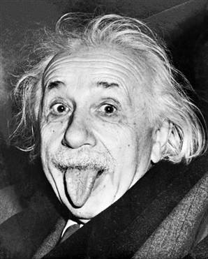
Black Holes and General Relativity
General Relativity: Einstein's (1915) description of gravity (extension of Newton's). It begins with:
The Equivalence Principle
Demonstrated by either of two thought experiments.
1) Freefall and weightlessness are equivalent
a) Imagine you are far from any source of gravity, in free space, weightless. If you shine a light or throw a ball, it will move in a straight line.

Slide 3
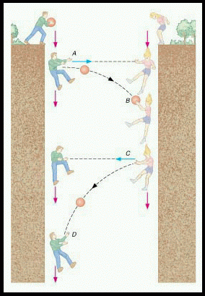
b) If you are in freefall (due to gravity), you are also weightless. Einstein says these are equivalent. So in freefall, light and ball also travel in straight lines.
c) Now imagine two people in freefall on Earth, passing a ball back and forth.
From their perspective, they pass it in a straight line. From a stationary perspective, it follows a curved path. So will a flashlight beam, but curvature of light path small because light is fast (but not infinitely so).
The different perspectives are called frames of reference.

Slide 4
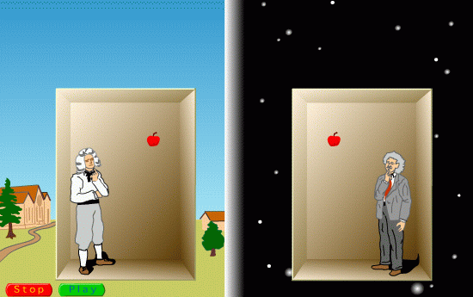
2) Gravity and acceleration are equivalent.
An apple falling in Earth's gravity is the same as one falling in an elevator accelerating upwards, in free space.
All effects you would observe by being in an accelerated frame of reference you would also observe when under the influence of gravity.

Slide 5
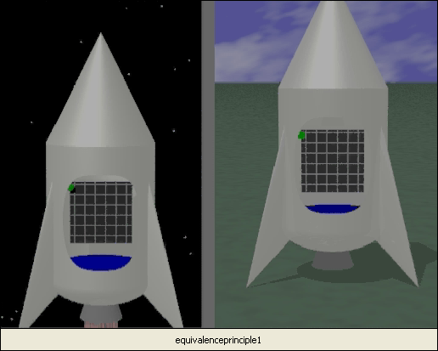
Bending of light in this case:
Accelerating elevator in free space: straight path of light appears curved
Therefore, same is true of stationary elevator in gravity
link

Slide 6
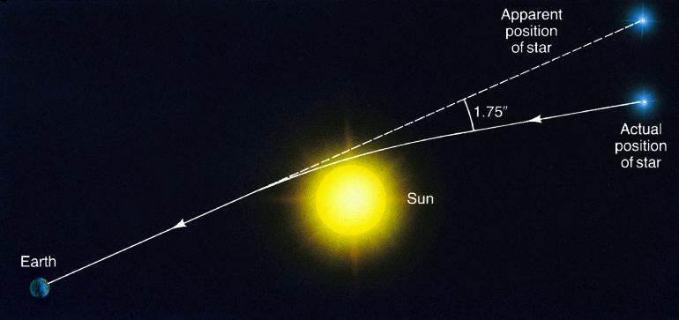
Testable Consequences of General Relativity:
1. Bending of light (just discussed)
Observed! In 1919 eclipse.

Slide 7
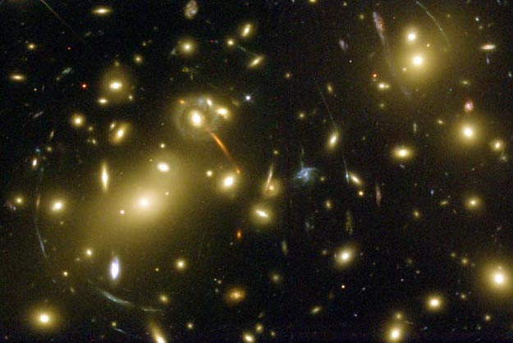
Gravitational lensing. The gravity of a foreground cluster of galaxies distorts the images of background galaxies into arc shapes.

Slide 8
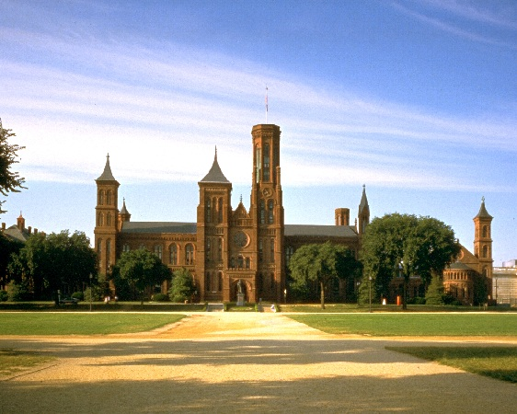
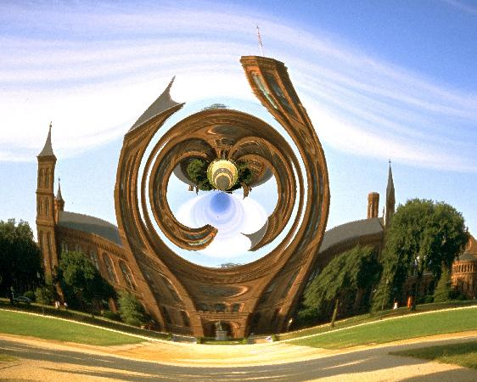
Saturn-mass
black hole

Slide 9
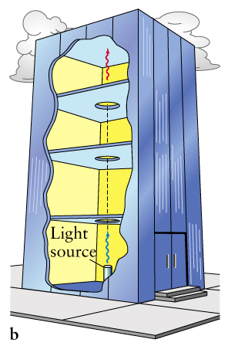
2. Gravitational Redshift
light received when elevator receding at some speed.
later, speed > 0
Consider accelerating elevator in free space (no gravity).
Received light has longer wavelength because of Doppler Shift ("redshift"). Gravity must have same effect! Verified in Pound-Rebka experiment.
time zero, speed=0
light emitted when elevator at rest.
3. Gravitational Time Dilation
Direct consequence of the redshift. Observers disagree on rate of time passage, depending on strength of gravity they’re in.

Slide 10
Escape Velocity
Velocity needed to escape an object’s gravitational pull.
v_{esc} =
2GM
R
Earth's surface: v_{esc} = 11 km/sec.
If Earth shrunk to R=1 cm, then v_{esc} = c, the speed of light! Then nothing, including light, could escape Earth.
This special radius, for a particular object, is called the Schwarzschild Radius, R_{S}. R_{S} α M.

Slide 11
Black Holes
If core with about 3 M_{Sun} or more collapses, not even neutron pressure can stop it (total mass of star about 25 M_{Sun} ?).
Core collapses to a point, a "singularity".
Gravity is so strong that not even light can escape.
R_{S} for a 3 M_{Sun} object is 9 km.
Event horizon: imaginary sphere around object, with radius R_{S} .
Event horizon
R_{S}
Anything crossing the event horizon, including light, is trapped

Slide 12
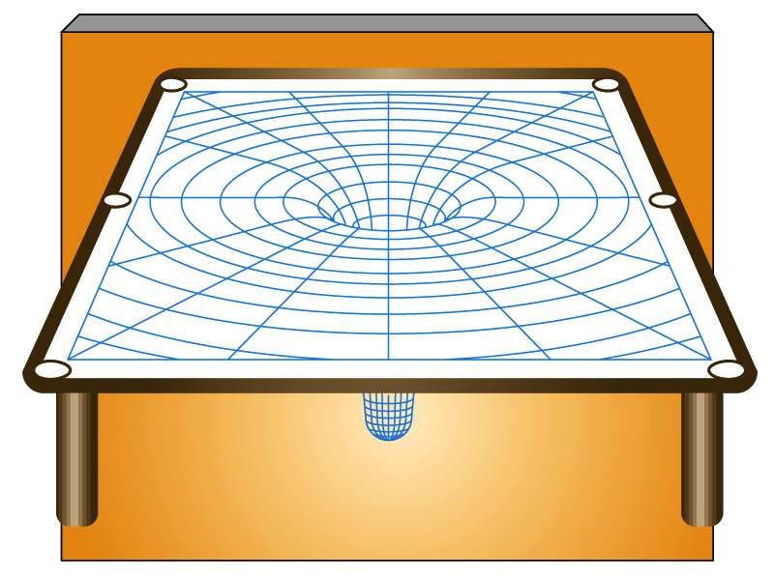
Black hole achieves this by severely curving space. According to General Relativity, all masses curve space. Gravity and space curvature are equivalent.
Like a rubber sheet, but in three dimensions, curvature dictates how all objects, including light, move when close to a mass.

Slide 13
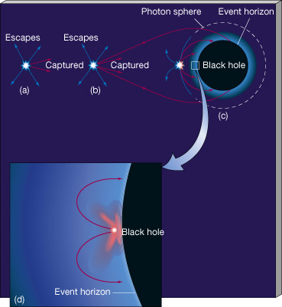
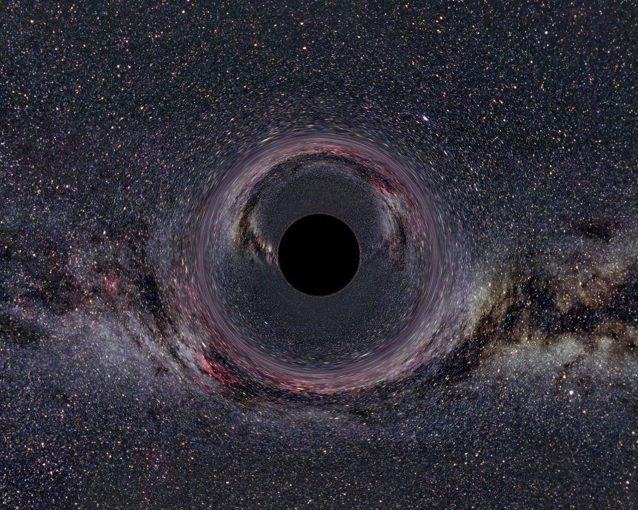
Curvature at event horizon is so great that space “folds in on itself”.

Slide 14
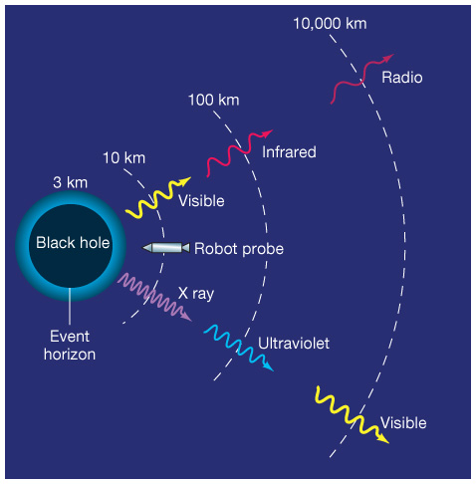
Effects around Black Holes
1) Enormous tidal forces.
2) Gravitational redshift. Example, blue light emitted just outside event horizon may appear red to distant observer.
3) Time dilation. Clock just outside event horizon appears to run slow to a distant observer. At event horizon, clock appears to stop.

Slide 15
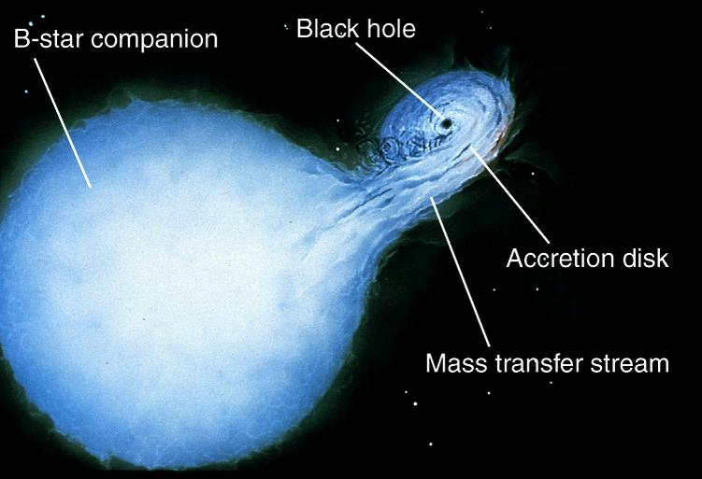
Do Black Holes Really Exist? Good Candidate: Cygnus X-1
- Binary system: 30 M_{Sun} star with unseen companion.
- Binary orbit => companion > 7 M_{Sun}.
- X-rays => million degree gas falling into black hole.

Slide 17
Final States of a Star
1. White Dwarf
If initial star mass < 8-12 M_{sun} .
2. Neutron Star
If initial mass > 12 M_{Sun} and < 25 ? M_{Sun} .
3. Black Hole
If initial mass > 25 ? M_{Sun} .

