Slide 1
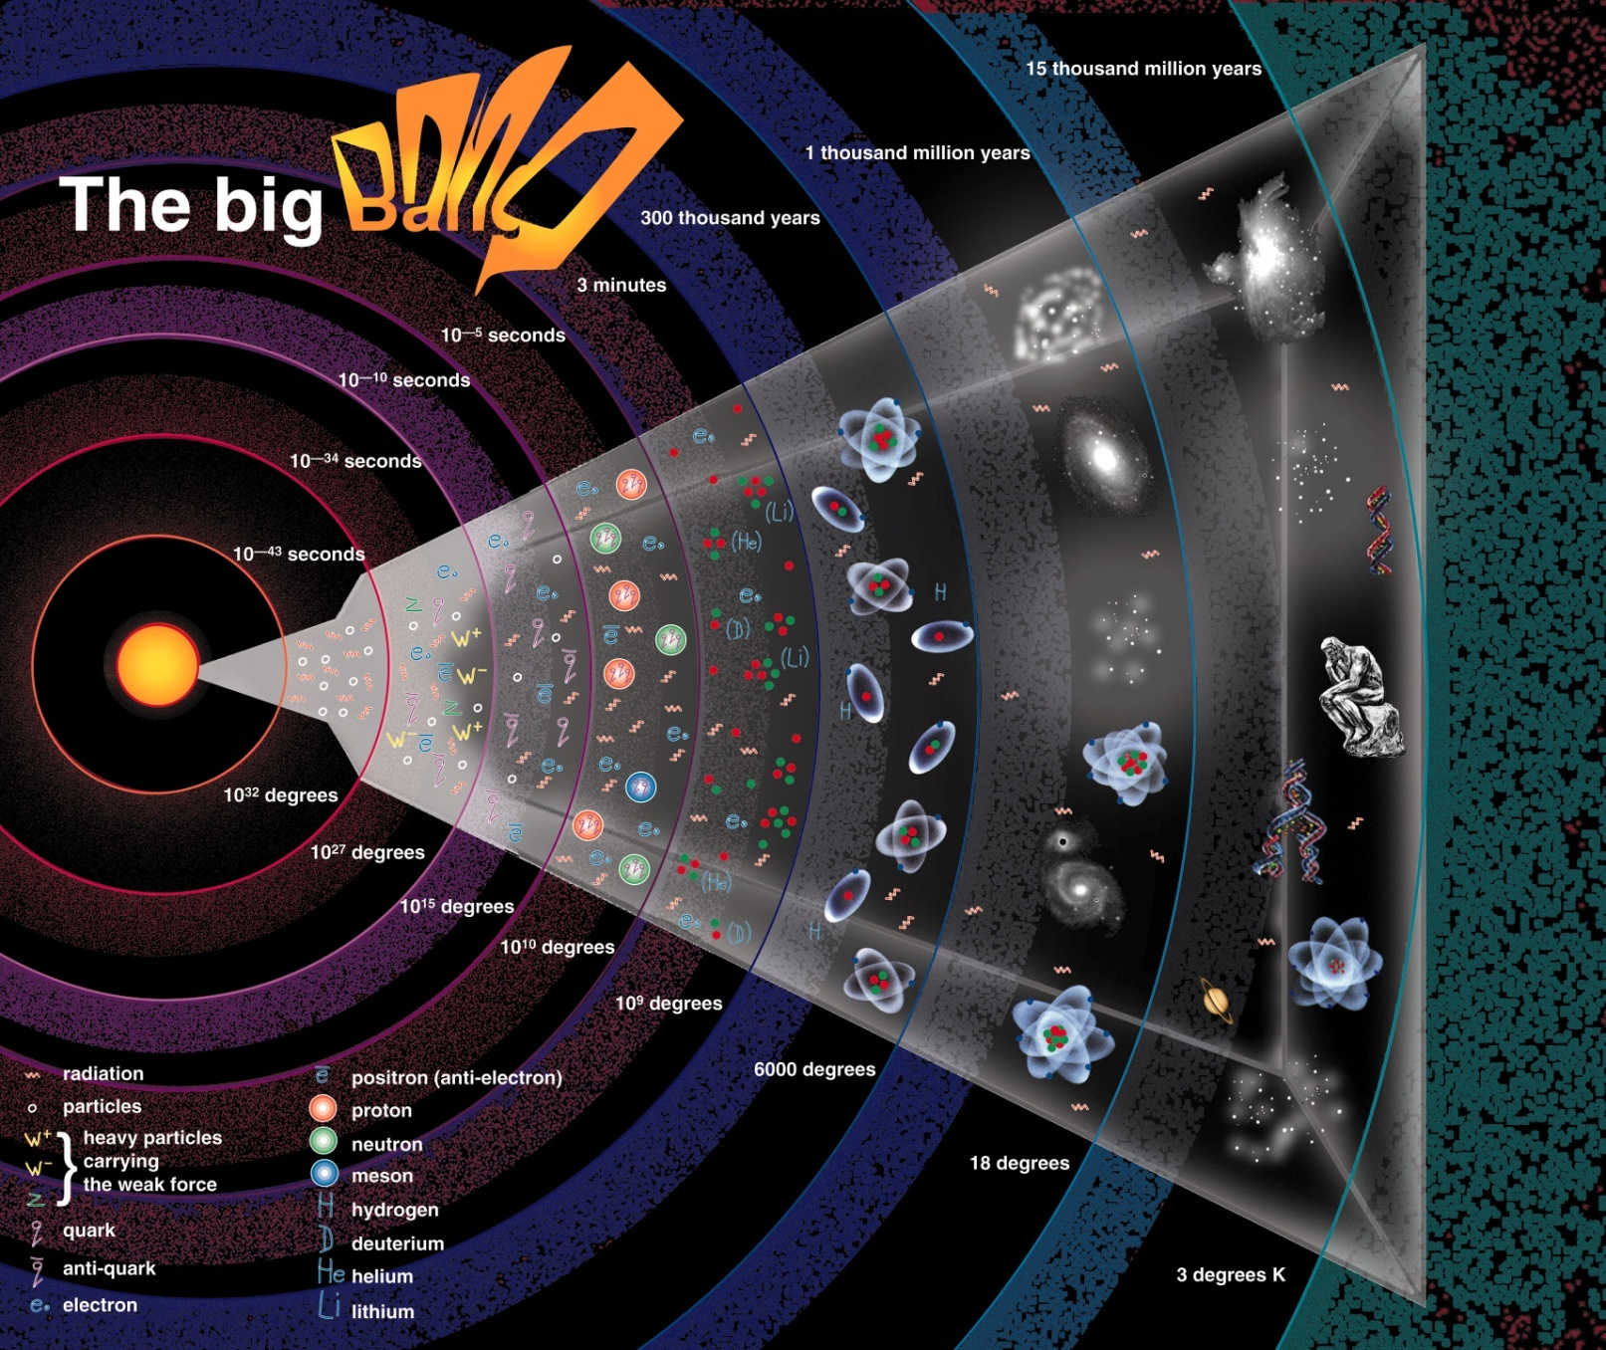
Cosmology
The Study of the Universe as a Whole

Slide 2
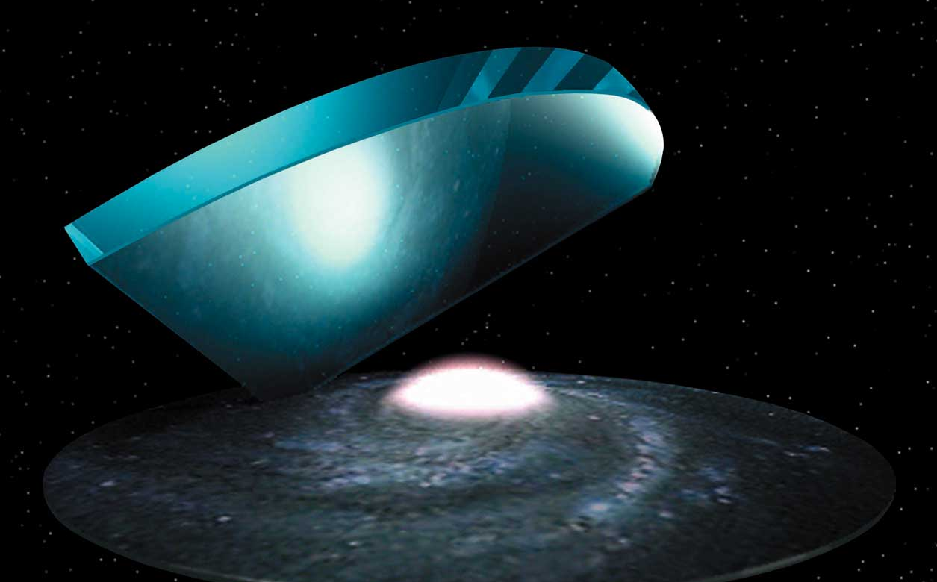
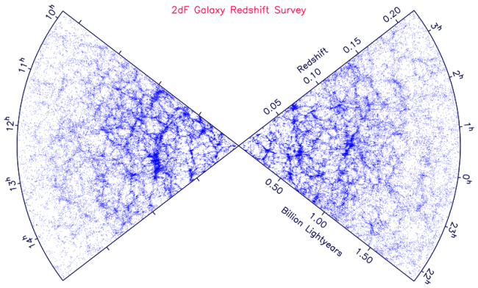
What is the largest kind of structure in the universe? The ~100-Mpc filaments, shells and voids? On larger scales, things look more uniform.
600 Mpc

Slide 3
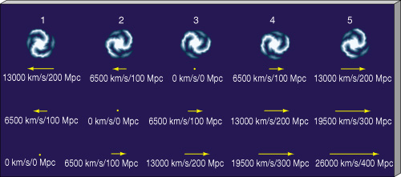
Given no evidence of further structure, assume:
The Cosmological Principle
On the largest scales, the universe is roughly homogeneous (same at all places) and isotropic (same in all directions). Laws of physics same.
Hubble's Law might suggest that everything is expanding away from us, putting us at center of expansion. Is this necessarily true?
(assumes H₀ = 65 km/sec/Mpc)

Slide 4





But does the expansion have a center at all? If so, there must be a 3d boundary to define it. If we were at center, universe would be isotropic (but only from our location) but not homogeneous:
Finite volume of galaxies expanding away from us into...what, empty space?
Then part of universe has
galaxies and part doesn’t.
Us
But if we were not at center, universe would be neither isotropic nor homogeneous:
Us

Slide 5
So if the CP is correct, there is no center, and no edge to the Universe!
Best evidence for CP comes from Cosmic Microwave Background Radiation (later).
The Big Bang
All galaxies moving away from each other. If twice as far away from us, then moving twice as fast (Hubble's Law). So, reversing the Hubble expansion, all separations go back to zero. How long ago?

Slide 6
H₀ gives rate of expansion. Assume H₀ = 75 km / sec / Mpc. So galaxy at 100 Mpc from us moves away at 7500 km/sec. If speed constant, how long did it take to move 100 Mpc from us?
time =
=
= 13 billion years
distance
velocity
100 Mpc
7500 km/sec
1
H₀
(Experts note that this time is just ). Larger H₀, younger universe.
This is the “Hubble time” but is only an estimate, because 1) if H₀ constant, speed increases as separation increases, and 2) H₀ wasn’t constant (see later).
Big Bang: we assume that at time zero, all separations were infinitely small. Universe then expanded in all directions. Galaxies formed as expansion continued.

Slide 7
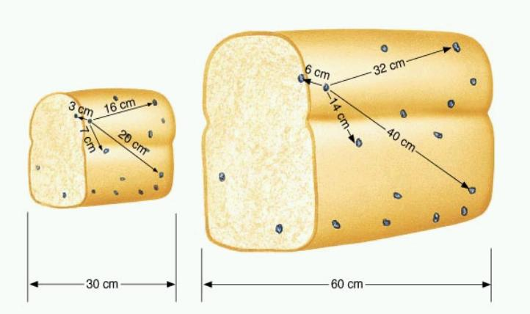
But this is not galaxies expanding through a pre-existing, static space. That would be an explosion with a center and an expanding edge.
If CP is correct, space itself is expanding, and galaxies are taken along for the ride. No center or edge, but the distance between any two points is increasing.
A raisin bread analogy provides some insight:

Slide 8
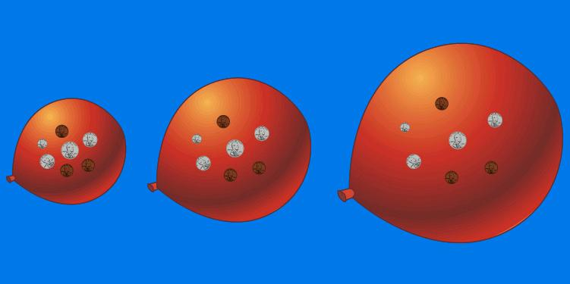
But the bread has a center and edge. Easier to imagine having no center or edge by analogy of universe as a 2-d expanding balloon surface (this is
only one possible analogy for our universe’s geometry):
Now take this analogy "up one dimension". The Big Bang occurred everywhere at once, but "everywhere" was very close together. This does not mean we are expanding into a real 4th dimension.
Read Flatland by Edwin Abbott: www.ofcn.org/cyber.serv/resource/bookshelf/flat10 )

Slide 9
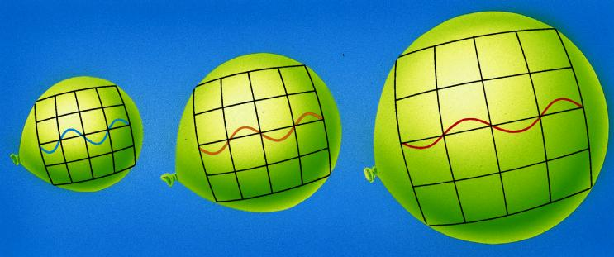
If all distances increase, so do wavelengths of photons as they travel and time goes on.
When we record a photon from a distant source, its wavelength will be longer. This is like the Doppler Shift, but it is not due to relative motion of source and receiver. This is correct way to think of redshifts of galaxies.

Slide 10
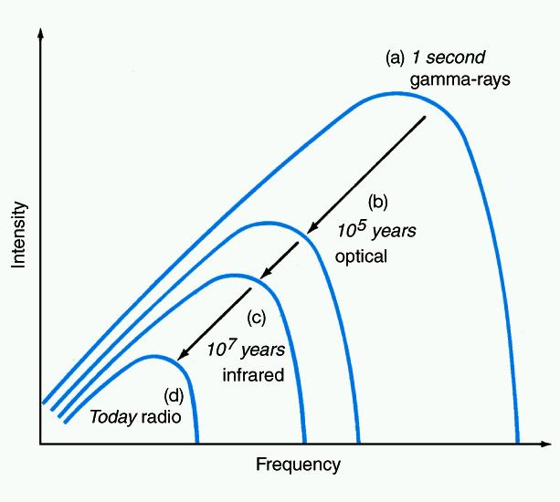
The Cosmic Microwave Background Radiation (CMBR)
A prediction of Big Bang theory in 1940's. "Leftover" radiation from early, hot, dense universe, uniformly filling space (i.e. isotropic, homogeneous). Predicted to have perfect black-body spectrum.
Photons stretched as they travel and universe expands, but spectrum always black-body. Wien's Law: temperature decreases as wavelength of brightest emission increases => was predicted to be ~ 3 K now.

Slide 11
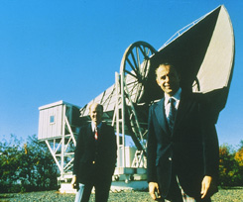
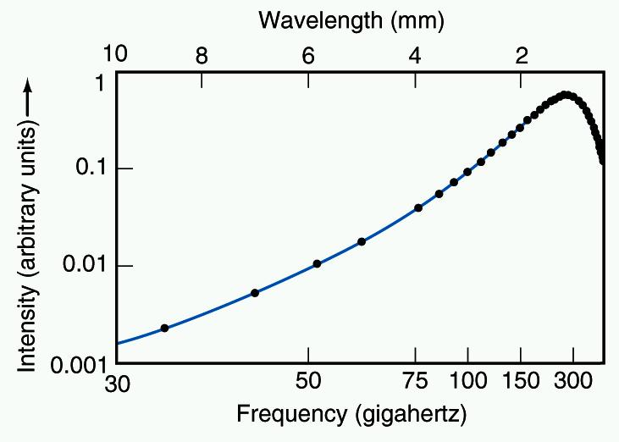

Found in 1964 by Penzias and Wilson. Perfect black-body spectrum at T = 2.725 K. Uniform brightness (and thus temperature) in every direction.
Points are data on the spectrum of the CMBR from the COBE satellite (1989). Curve is a black-body spectrum at T=2.725 K.
1% of the “snow” on a blank TV channel is this radiation!

Slide 12
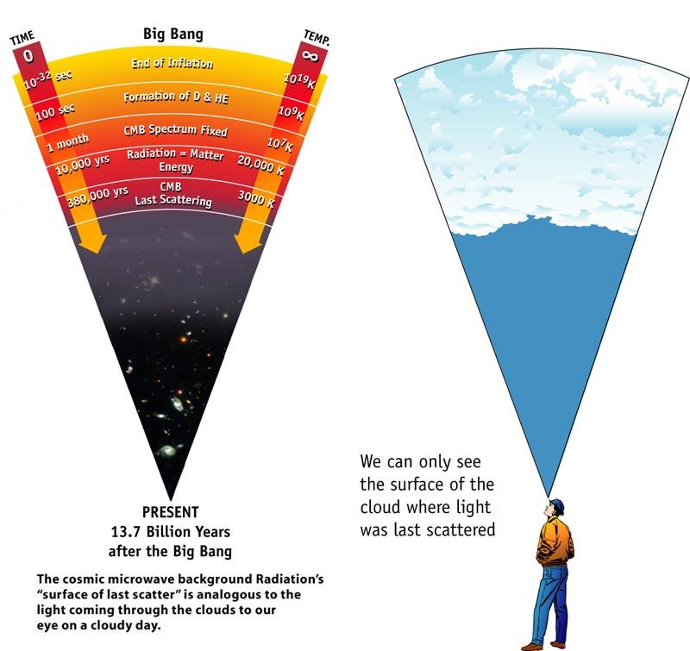
Opaque
Transparent

Slide 13
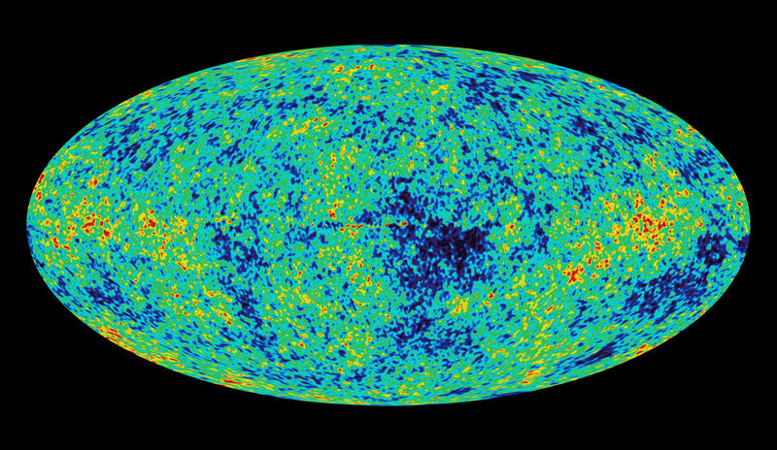
All-sky map of the CMBR temperature, constant everywhere to one part in >10⁴ ! For blackbody radiation, this means brightness is very constant too (Stefan’s law).
(WMAP satellite)
Deviations are -0.25 milliKelvin (blue) to +0.25 milliKelvin
(red) from the average of 2.725 Kelvin.

Slide 14

That the CMBR comes to us from every direction is best evidence that Big Bang happened everywhere in the universe. That the temperature is so constant in every direction is best evidence for homogeneity on large scales.
IF the Big Bang happened at one point in 3-d space:
Later, galaxies form and fly apart. But radiation from Big Bang streams freely at speed of light! Wouldn't see it now.

Slide 15
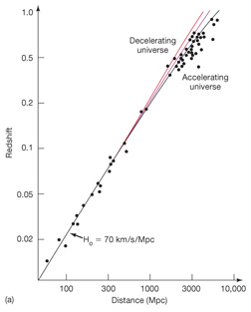
The Expansion of the Universe Seems to be Accelerating
The gravity of matter should retard the expansion. But a new distance indicator shows that the expansion rate was slower in the past!
Carbon-detonation (Type I) supernovae: from ones in nearby galaxies, know luminosity. In distant galaxies, determine apparent brightness. Thus determine distance. Works for more than 3000 Mpc. From redshifts, they are not expanding as quickly from each other as galaxies are now.
The expansion rate was smaller in past (i.e.
for distant
galaxies)
Redshift (fractional shift in wavelength of spectral lines)
Taking this into account, best age estimate of Universe is 13.8 Gyrs.

Slide 16
The Cosmological Constant, Λ
Introduced by Einstein in 1917 to balance gravitational attraction and create static Universe (turned out to be wrong!). Can think of Λ as repulsive force that exists even in a vacuum. But accelerating universe indicates there is a Λ. More generally called "dark energy". We have little idea of its physical nature.
The measured acceleration implies that there is more “dark energy” than the energy contained in matter.

Slide 17
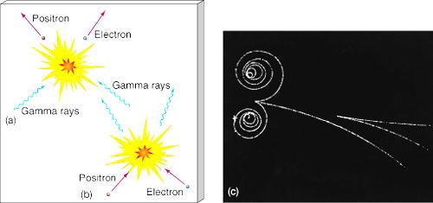
The Early Universe
The First Matter
At the earliest moments, the universe woud have been dominated by high-energy, high-temperature radiation. Photons had enough energy to form particle-antiparticle pairs. How? E=mc².
pair production
annihilation

Slide 18
Up to time < 0.0001 sec, and T > 10¹³ K, gamma rays could form proton-antiproton pairs.
Up to time < 15 sec, and T > 6 x 10⁹ K, electron-positron pairs could form.
Annihilation occurred at same rate as formation, so particles coming in and out of existence all the time.
As T dropped, pair production ceased, only annihilation. A tiny imbalance (1 in 10⁹) of matter over antimatter led to a matter universe
(cause of imbalance not clear, but other such imbalances are known to occur).

Slide 19
Primordial Nucleosynthesis
Hot and dense universe => fusion reactions.
At time 100-1000 sec (T = 10⁹ - 3 x 10⁸ K), helium formed.
Stopped when universe too cool. Predicted end result: 75% hydrogen, 25% helium.
Oldest stars' atmospheres (unaffected by stellar nucleosynthesis) confirm Big Bang prediction of 25% helium.

Slide 20
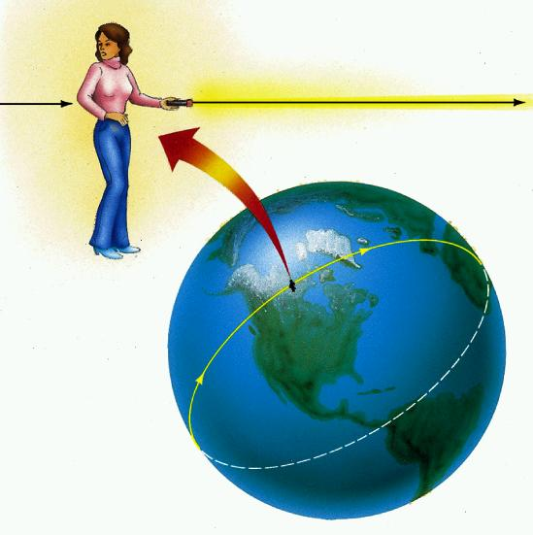

The Geometry of Curved Space
In general relativity, the geometry of the universe depends on the total mass and energy of the universe (including dark energy).
Possibilities:
1) Space curves back on itself (like a sphere). "Positive" curvature.

Slide 21

2) “Saddle-like”, with curvature in the opposite sense in different dimensions: "negative" curvature.
3) A more familiar “flat” geometry.
Latest CMBR measurements are consistent with an extremely flat universe (curved universe still possible, with enormous radius of curvature).

Slide 22
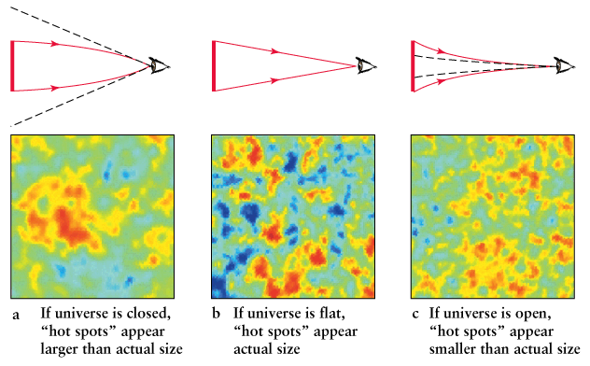
Sizes of patches in CMBR constrain geometry of universe.
Curvature of universe makes it act like lens (like black hole).
measure this angle (∼ 1°)
some
known
size
we know this distance
Size of patches simply related to speed of light and age of universe
when CMBR photons started streaming freely. This we know quite
well. Also know how far away we are looking. Then angular size
of patches tells us how light has traveled to us => curvature of space.

Slide 23
Successes of the Big Bang Theory
1) It explains the expansion of the universe.
2) It predicted the cosmic microwave background radiation, its uniformity, its current temperature, and its black-body spectrum.
3) It predicted the correct helium abundance (and lack of other primordial elements).

Slide 24
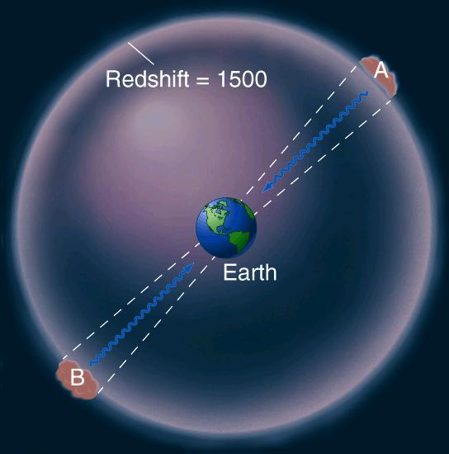
Inflation
A problem with microwave background:
Microwave background reaches us from all directions.
Temperature of background in opposite directions nearly identical. Yet even light hasn't had time to travel from A to B (only A to Earth), so A can know nothing about conditions at B, and vice versa. So why are A and B almost identical? This is “horizon problem”.

Slide 25
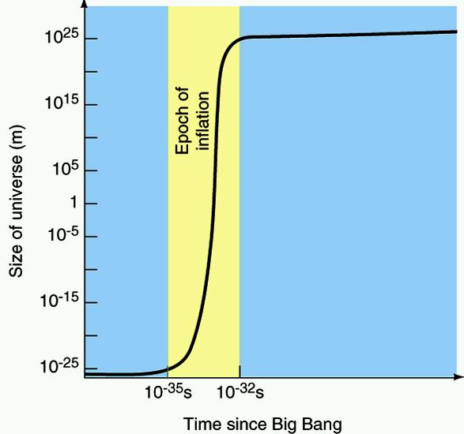
Solution: Inflation. Theories of the early universe predict that it went through a phase of rapid expansion.
Separation between two points (m)
If true, would imply that points that are too far apart now were once much closer, and had time to communicate with each other and equalize their temperatures.

Slide 26
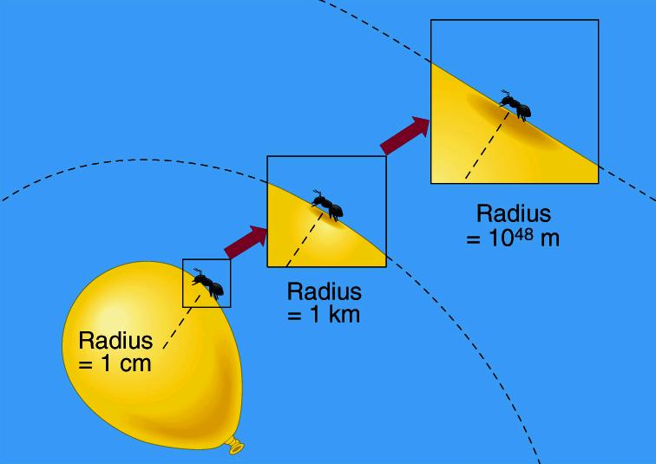
Inflation also predicts universe has nearly flat geometry, consistent with CMBR observations:

Slide 27
Misconceptions about the Big Bang
“The universe was once small.” The observable universe, which is
finite, was once small. The nature of the entire universe at early times
is not yet understood. It is consistent with being infinite now (or has
enormous radius of curvature).
“The Big Bang happened at some point in space.” The CMBR
showed that it happened everywhere in the universe.
3. “The universe must be expanding into something.” It is not expanding
into “empty space”. That would imply the Big Bang happened at some
location in space. It is a stretching of space itself.

Slide 28
4. “There must have been something before the Big Bang.”
The Big Bang was a singularity in space and time (like the center of a black hole). Our laws of physics say the observable universe had infinitesimally small size, and infinite temperature and density. Such “infinities” indicate a breakdown of our theories.
In these conditions, we don’t have a physics theory to describe the nature of space and time. At the Big Bang, time took on the meaning that we know it to have.
"Before" is only a relevant concept given our everyday understanding of time. We must await a better understanding of the nature of space and time. Such theories are in their infancy.
Why did Big Bang occur? We don’t know.
Shouldn’t be surprising that these concepts are hard to grasp.
So was the heliocentric Solar System 400 years ago.

Slide 30
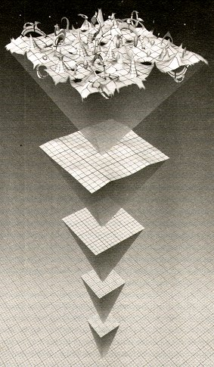
On microscopic scales, mass-energy
can come in and out of existence for
short times. Smaller scale => bigger
fluctuations. Since space-time geometry dictated by mass-energy, space and time become ever more jumbled. At t< 10⁻⁴³ s, we have no description of space and time!
String theory is one attempt at this.

Slide 31
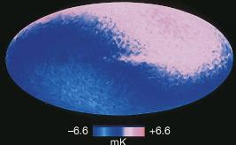
Plot of how the black-body temperature of the background radiation varies over the sky (the Galactic disk runs across the middle).
Our motion relative to this background causes a Doppler shift, so that the temperature varies by a few milliKelvin (blue-pink difference).

Slide 33

Or consider universe as a 2d infinite flat rubber sheet, expanding in
all directions.
Now take these analogies "up one dimension". The Big Bang occurred everywhere at once, but "everywhere" was very close together.

