Slide 1
From Aristotle to Newton
The history of the Solar System (and the universe to some extent) from ancient Greek times through to the beginnings of modern physics.

Slide 2

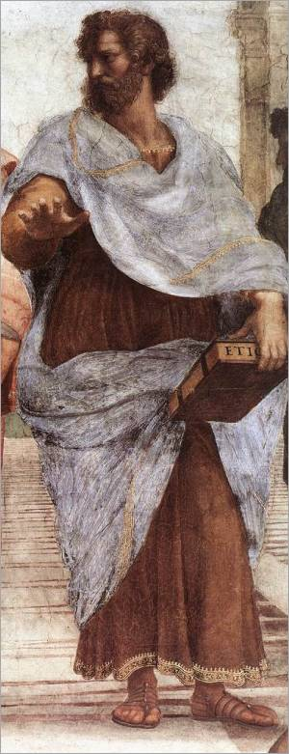
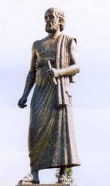

The “Geocentric Model”
Ancient Greek astronomers knew of Sun, Moon, Mercury, Venus, Mars, Jupiter, Saturn, and stars.
Aristotle vs. Aristarchus (3rd century B.C.):
Aristotle: Sun, Moon, Planets and stars rotate around fixed Earth.
Aristarchus: Used eclipses and phases to show Sun bigger than Earth (and Moon smaller), so guessed Earth orbits Sun. Also guessed Earth spins on axis once a day => apparent motion of stars.
Aristotle: But there's no wind or parallax.
Difficulty with Aristotle's Geocentric model: "Retrograde motion of the planets".

Slide 3
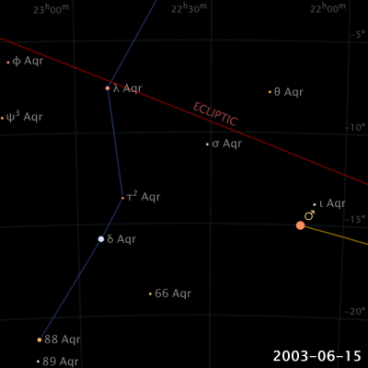
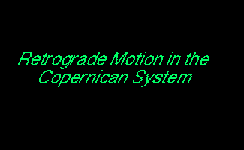
Planets generally move in one direction relative to the stars, but sometimes they appear to loop back. This is "retrograde motion".
See also animation
on Nebraska-Lincoln
webpage

Slide 4
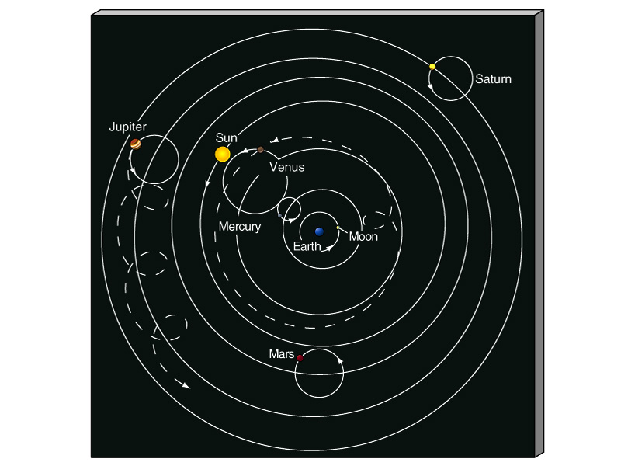
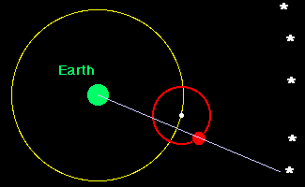
But if you support geocentric model, you must attribute retrograde motion to actual motions of planets, leading to loops called “epicycles”.
Ptolemy's geocentric model (A.D. 140)

Slide 5
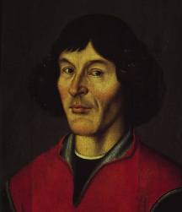
"Heliocentric" Model
Rediscovered by Copernicus in 16th century.
Put Sun at the center of everything. Also Earth
spins on axis once a day.
Much simpler. Almost got rid of retrograde motion.
But still didn’t predict the positions and motions of the planets better than the geocentric model (due to wrong assumptions about Earth’s motion).
Not generally accepted then.
Copernicus 1473-1543
Notes:
Gingerich physics today article: elliptical and varying speed except Earth (its motion was transformed from Ptolemy’s epicycles, which he assumed were of constant speed)

Slide 6
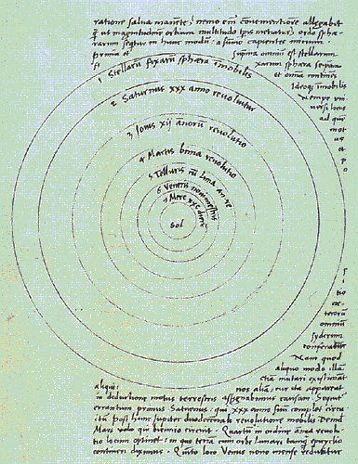
Illustration from Copernicus' work showing heliocentric model.

Slide 7
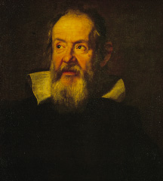
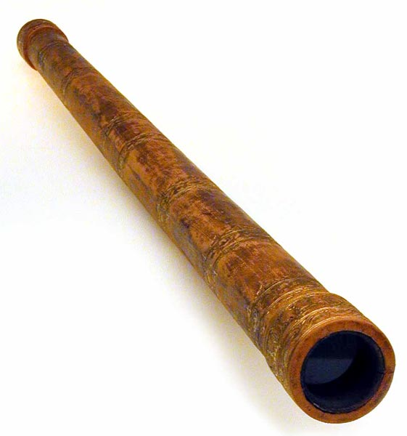
Galileo (1564-1642)
Built his own telescope in 1609.
Discovered four moons orbiting Jupiter => Earth is not center of all things!
Discovered phases of Venus, inconsistent with geocentric model.
Co-discovered sunspots. Deduced Sun rotated on its axis.

Slide 8
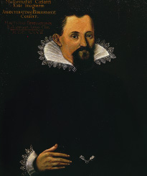
Kepler (1571-1630)
Used Tycho Brahe's precise data on apparent planet motions and relative distances.
Deduced three laws of planetary motion, which explained their positions and motions much better than Copernicus’ model.

Slide 9
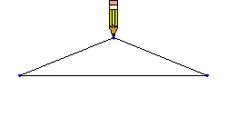
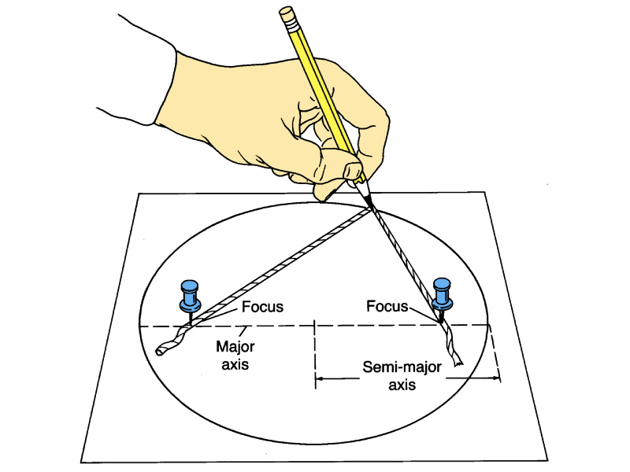
Kepler's First Law
The orbits of the planets are elliptical (not circular) with the Sun at one focus of the ellipse.
Ellipses
eccentricity =
(flatness of ellipse)
distance between foci
major axis length
Nebraska-Lincoln eccentricity
demonstrator

Slide 10
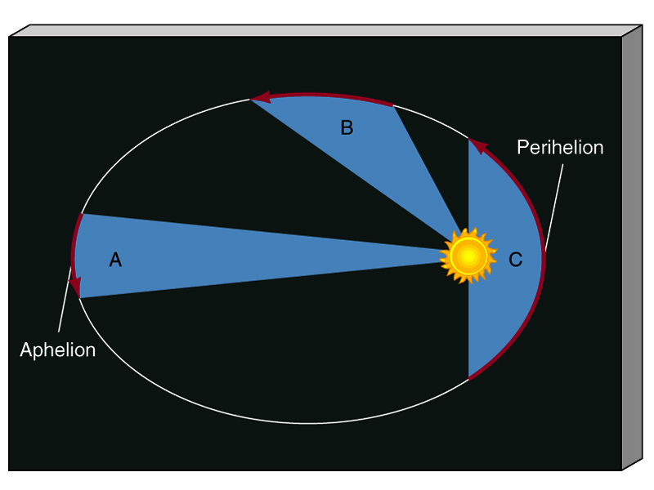
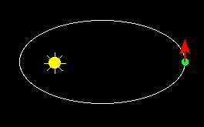
Kepler's Second Law
A line connecting the Sun and a planet sweeps out equal areas in equal times.
slower
faster
Translation: planets move faster
when closer to the Sun.

Slide 11
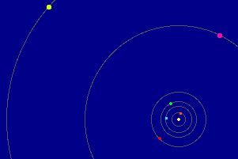
Kepler's Third Law
The square of a planet's orbital period, P, is proportional to the cube of its semi-major axis, a.
P² α a³
(for circular orbits, a=radius).
Translation: the larger a planet's orbit,
the longer the period.
See Kepler’s Laws simulator
on Nebraska-Lincoln webpage

Slide 12
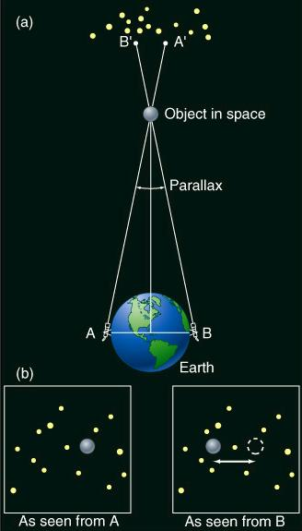
At this time, actual distances of planets from Sun were unknown, but were later measured. One technique uses parallax.
“Earth-baseline parallax” uses telescopes on either side of Earth to measure planet distances.
(See interactive figure in etext).

Slide 13
With the scale of the Solar System determined, can rewrite Kepler’s Third Law as:
P² = a³
as long as P is in years and a in AU.
So compare Earth and Neptune:
Object a (AU) P (Earth years)
Earth 1.0 1.0
Neptune 30.1 164.8

Slide 14
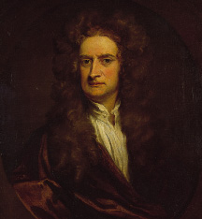
Newton (1642-1727)
Kepler played with mathematical shapes and equations and seeing what worked. Knew there
must be a physical basis, but that awaited Newton.
Newton's work based on experiments of how objects interact.
His three laws of motion and law of gravity described how all objects interact with each other.

Slide 15
Newton's First Law of Motion
Every object continues in a state of rest or a state of motion with a constant speed in a straight line unless acted on by a force.

Slide 16
Newton's Second Law of Motion
When a force, F, acts on an object with a mass, m, it produces an acceleration, a, equal to the force divided by the mass.
F
m
a =
or F = ma
acceleration is a change in speed or a change in direction of speed.

Slide 17
Newton's Third Law of Motion
To every action there is an equal and opposite reaction.
Or, when one object exerts a force on a second object, the second exerts an equal and opposite force on first.

Slide 18
Newton's Law of Gravity
For two objects of mass m₁ and m₂, whose centers are separated by a distance R, the force of their gravitational attraction is given by:
G m₁ m₂
R²
F =
F is the gravitational force.
G is the "gravitational constant".
An example of an "inverse-square law".
Your "weight" is just the gravitational force between the Earth and you.

Slide 19
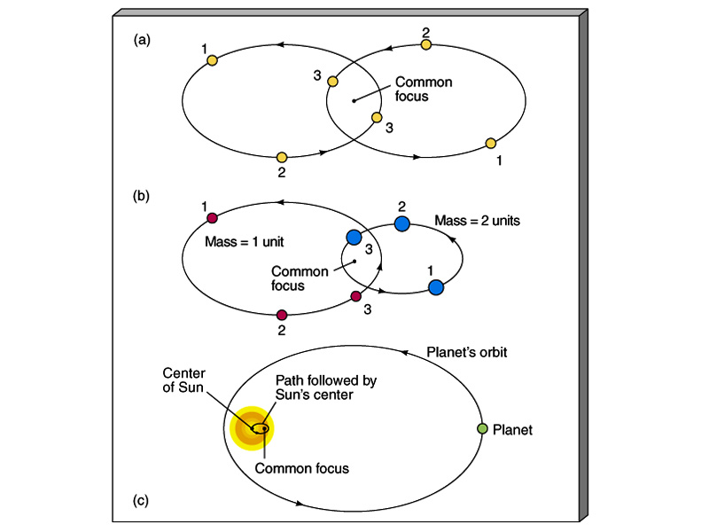
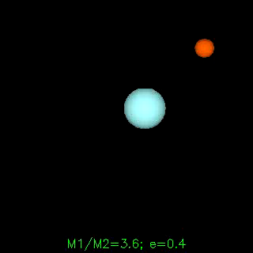
Newton's Correction to Kepler's First Law
The orbit of a planet around the Sun has the common center of mass (instead of the Sun) at one focus.
Equal masses
see UNL simulation:
“Influence of the Planets on the Sun”

Slide 20
Escape Velocity
Velocity needed to completely escape the gravity of a planet.
The stronger the gravity, the higher the escape velocity.
Examples:
Earth 11.2 km/s
Jupiter 60 km/s
Deimos (moon of Mars) 7 m/s = 15 miles/hour

Slide 21
Timelines of the Big Names
Galileo
1564-1642
Copernicus
Brahe
Newton
1473-1543
1473-1543
1546-1601
1642-1727
Kepler
1571-1630

