Slide 1
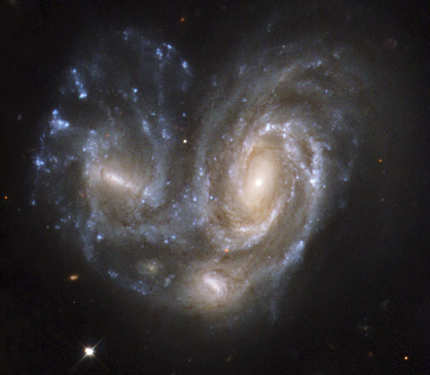
Galaxies - Chapter 24
vs.

Slide 2
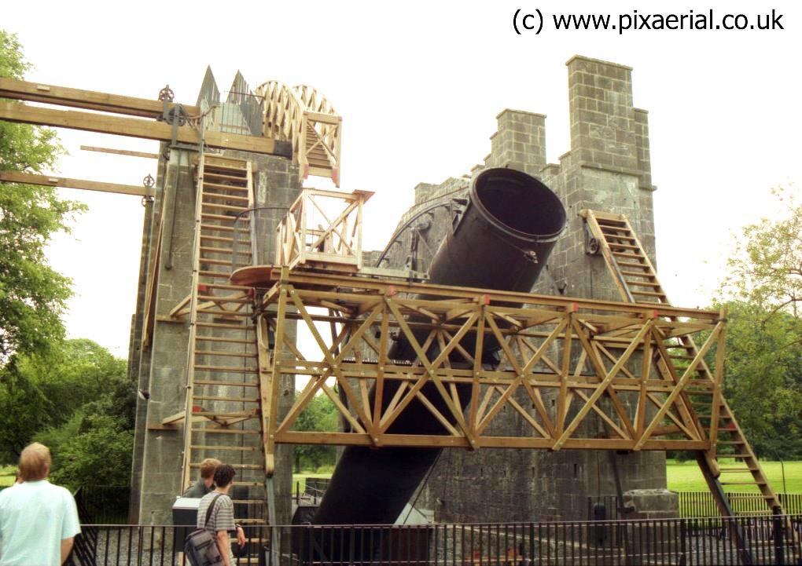
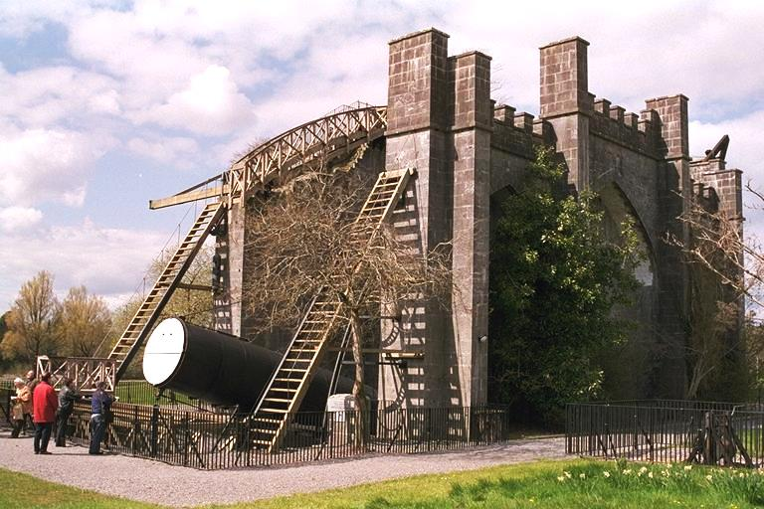
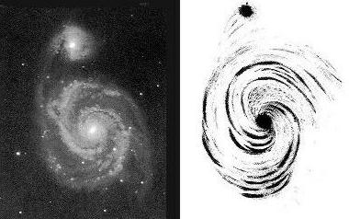
First spiral nebula found in 1845 by the Earl of Rosse. Speculated it was beyond our Galaxy.
1920 - "Great Debate" between Shapley and Curtis on whether spiral nebulae were galaxies beyond our own. Settled in 1924 when Edwin Hubble’s observations of the spiral nebulae showed individual stars in huge numbers.

Slide 3
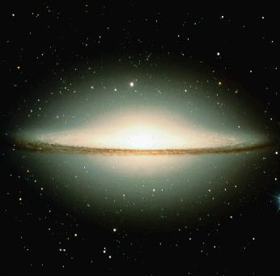
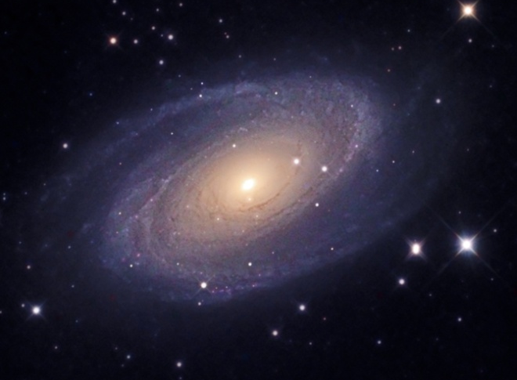
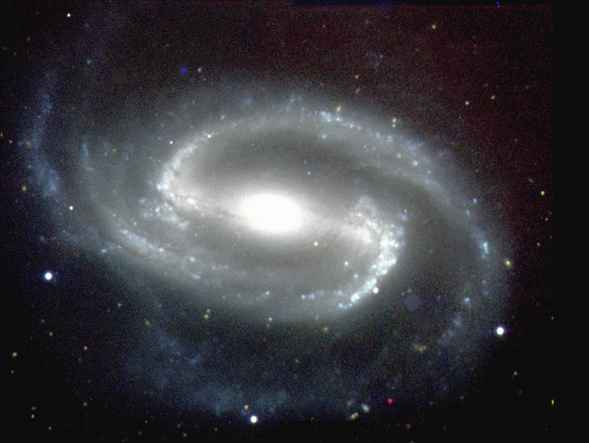
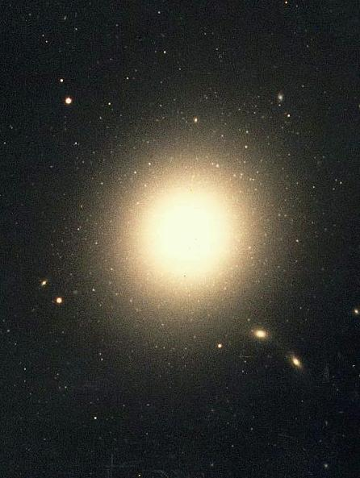
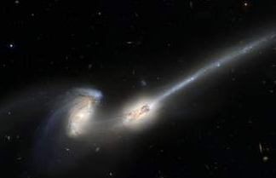
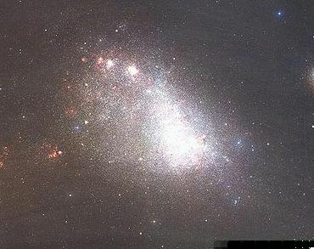
The Variety of Galaxy Morphologies

Slide 4
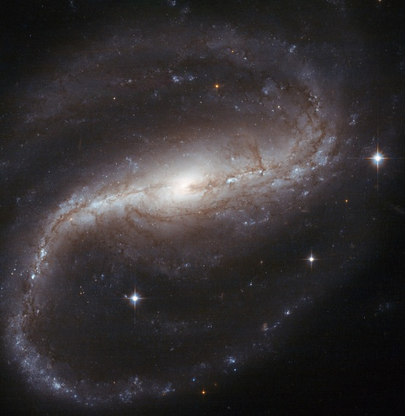
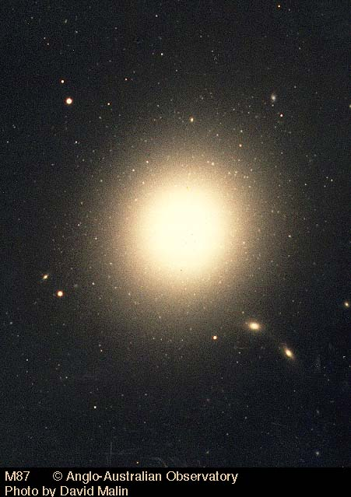
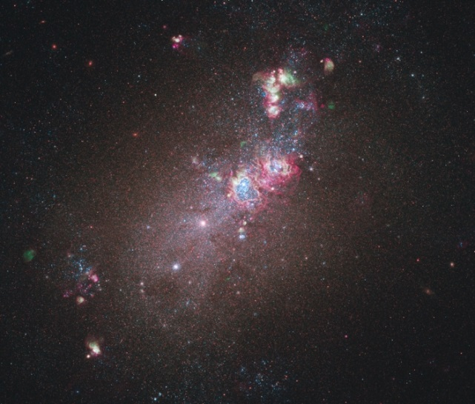
Galaxy Classification: “Hubble types” (based on optical appearance)
Spirals Ellipticals Irregulars
barred unbarred E0 - E7 Irr I Irr II
SBa-SBc Sa-Sc “hints of truly
structure" irregular
a barred spiral
an irregular galaxy
an elliptical galaxy
First classified by Hubble in 1924 => "tuning fork diagram“:

Slide 5
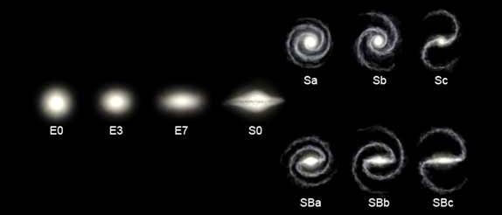
increasing apparent flatness
bulge less prominent,
arms more loosely wrapped
disk and large bulge, but no spiral
Hubble types still used today.
Milky Way is an SBbc, between SBb and SBc.
Ignores some notable features, e.g. viewing angle for ellipticals, number of spiral arms for spirals. Many refinements since, but these are the basics.
What the current structure says about a galaxy’s evolution is still active research area.

Slide 6
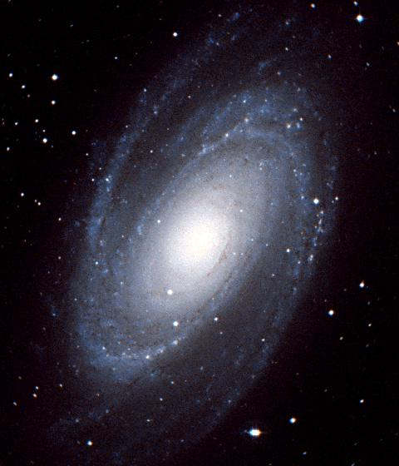
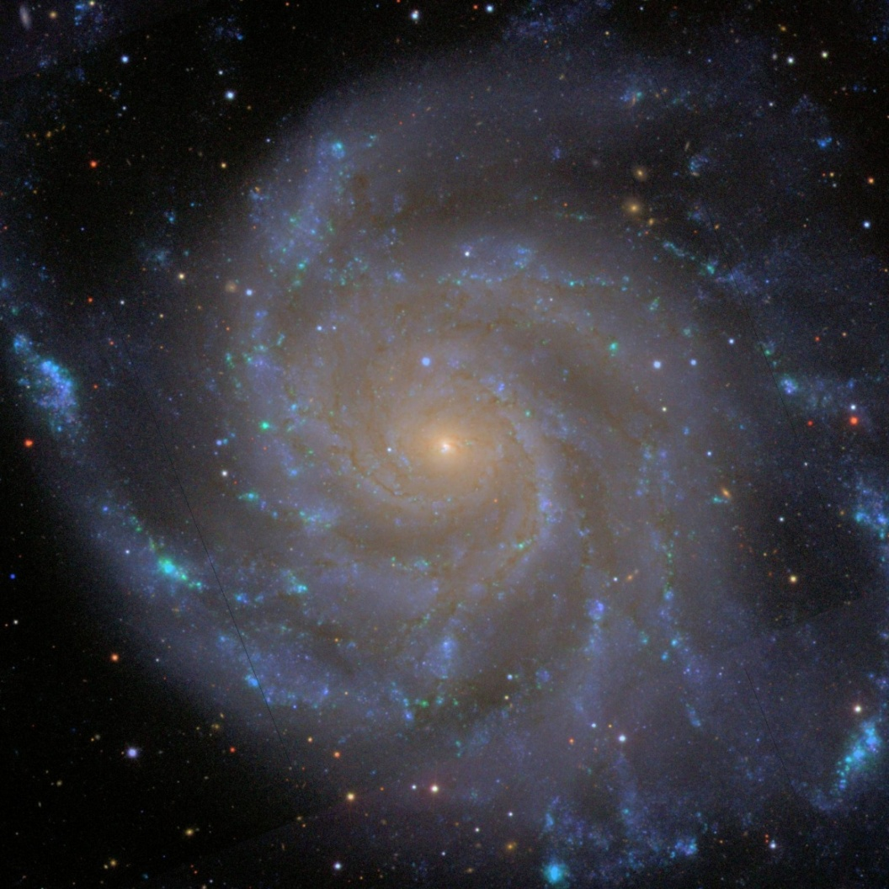
Sa vs. Sb vs. Sc galaxies
Messier 81 – Sa galaxy
Messier 101 – Sc galaxy

Slide 7
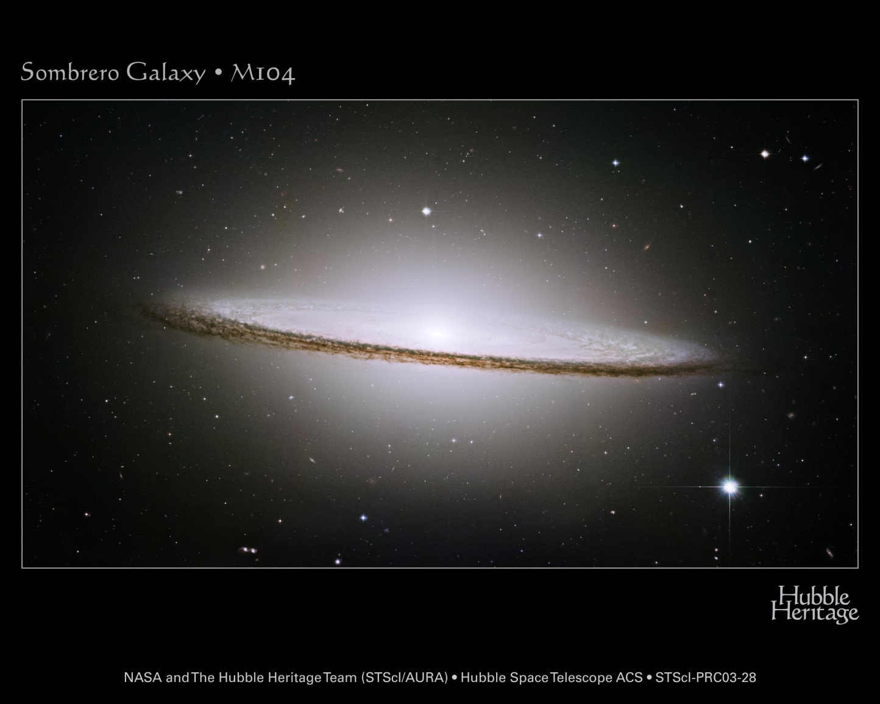
SO Galaxies
M104 – The “Sombrero” galaxy. Technically an Sa, but gives a sense of SO galaxies

Slide 8
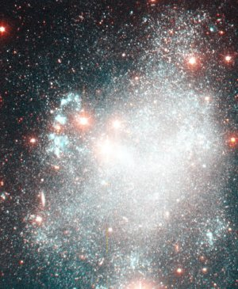
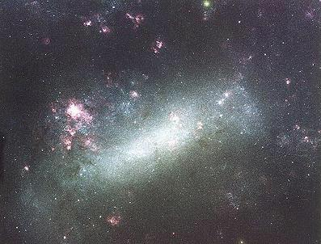
Irr I vs. Irr II
Irr II (truly irregular)
bar
poor beginnings
of spiral arms
Large Magellanic Cloud – Irr I
Holmberg II – Irr II
(this is a rather heterogeneous class, not so useful)
These are both companion galaxies of the Milky Way.

Slide 9
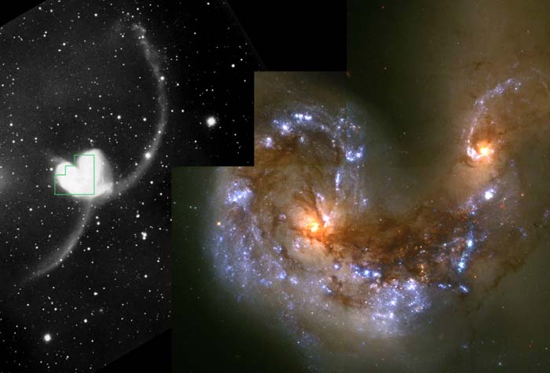
To be distinguished from irregulars: peculiars. Generally interactions and mergers (return to later).

Slide 10
Centaurus A (NGC5128), a collision between an E and an S galaxy.

Slide 11
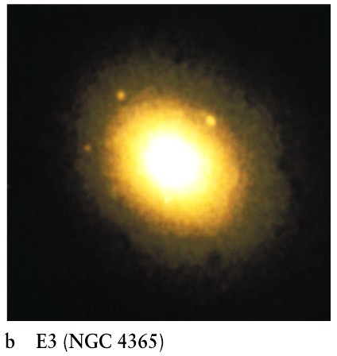
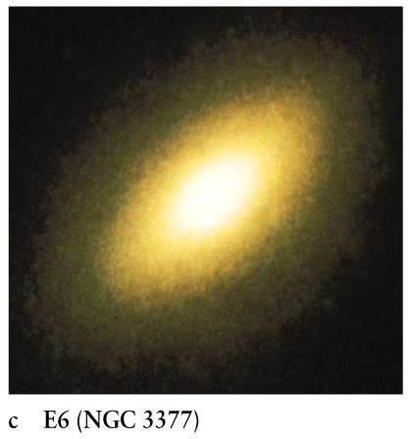
Ellipticity of ellipticals
Classify by observed degree of flattening, or ellipticity E0 → E7. In general, En where, if a=major (long) axis, b=minor (short) axis:
EO (M87)

Slide 12
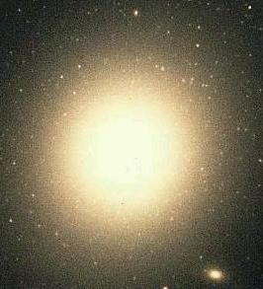
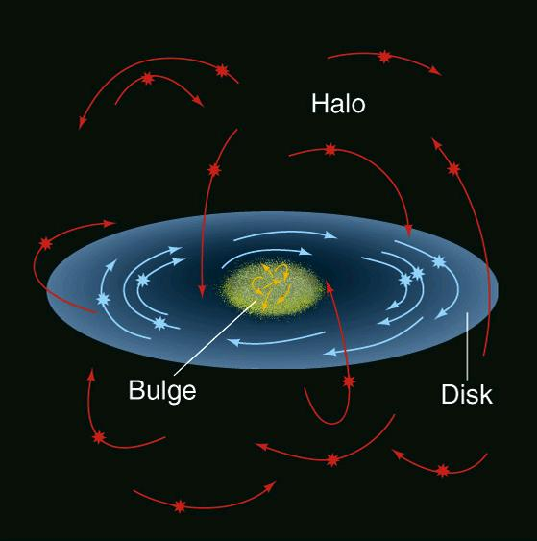
Ellipticals –basic properties
Similar to halos of spirals, but generally larger than spirals, with many more stars. Stellar orbits are like halo star orbits in spirals.
Stars in ellipticals also very
old, like halo stars.
Orbits in a spiral
An elliptical

Slide 13
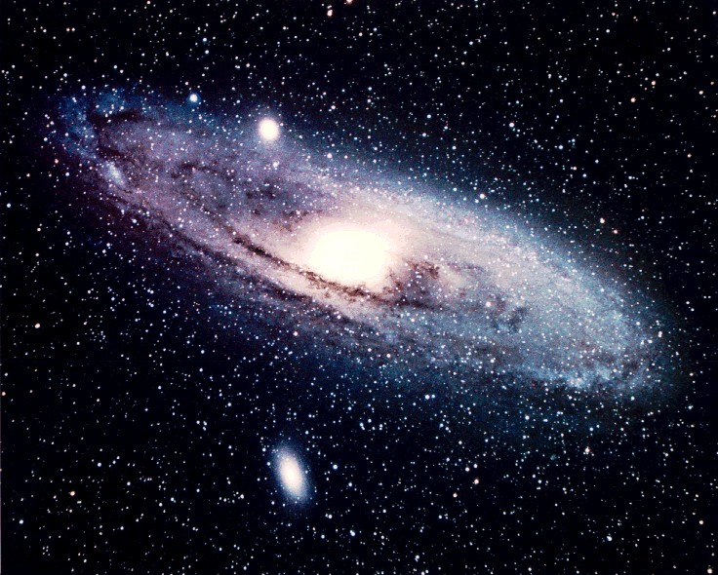
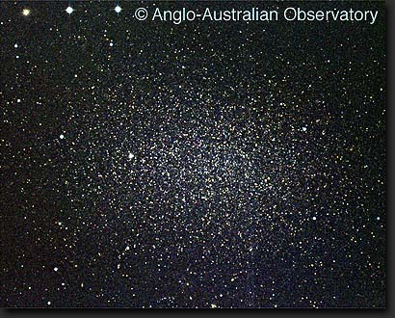
A further distinction for ellipticals and irregulars:
Giant vs. Dwarf
10¹⁰ - 10¹³ stars 10³ - 10⁹ stars
10's of kpc across few kpc across
Dwarf Elliptical NGC 205
Spiral M31
Dwarf Elliptical M32
Leo I, a dwarf Elliptical orbiting the Milky Way

Slide 14
In giant galaxies, the average elliptical has more stars than the average spiral, which has more than the average irregular.
What kind of giant galaxy is most common?
Spirals - about 77%
Ellipticals - 20%
Irregulars - 3%
But dwarfs are much more common than giants.

Slide 15
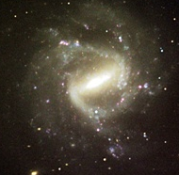
Galaxy Classification Time!
NGC 1073
a) Sa
b) Irr I
c) SBbc

Slide 16
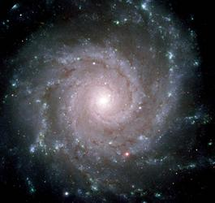
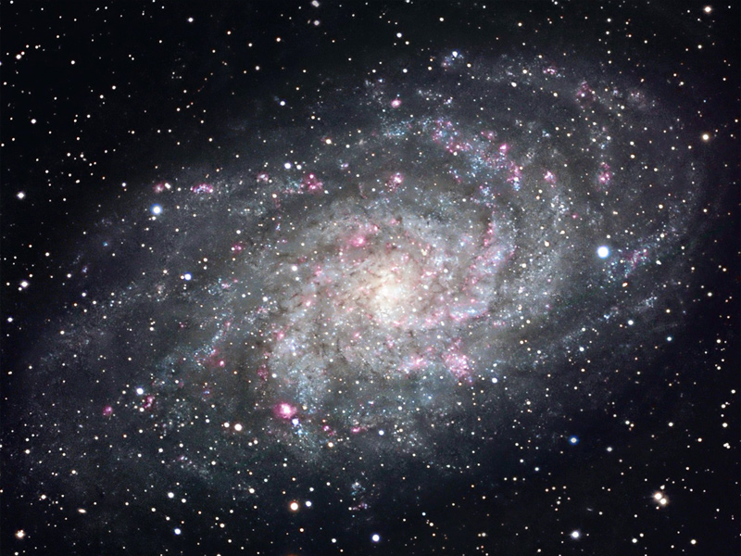
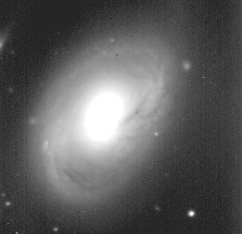
Which is the Sa galaxy?
b) M74
a) M33
c) M96
d)

Slide 17
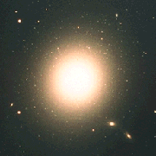
M87
a) E0
b) E5
c) E7

Slide 18
"Star formation history" also related to Hubble type:
Ellipticals: stars are old, red, dim. Little molecular or atomic gas for any more star formation.
Spirals still have star formation, and gas.
Luminous, massive, short-lived stars make spirals bluer than ellipticals
Irregulars have a variety of star formation histories.

Slide 19
Integrated optical spectra of galaxies contain much information about content and history
Elliptical
Spiral

Slide 20
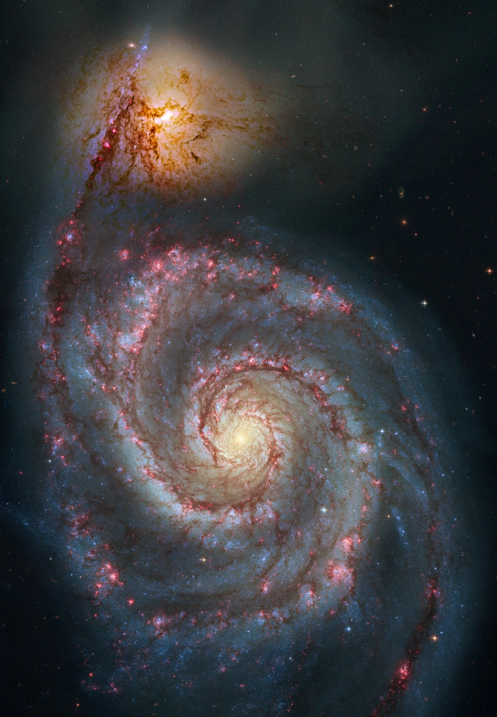
Galaxies across the electromagnetic spectrum – M51
Hubble Space Telescope – showing blue starlight, dust absorption and HII regions
Near-Infrared (2 micron) showing old stars

Slide 21
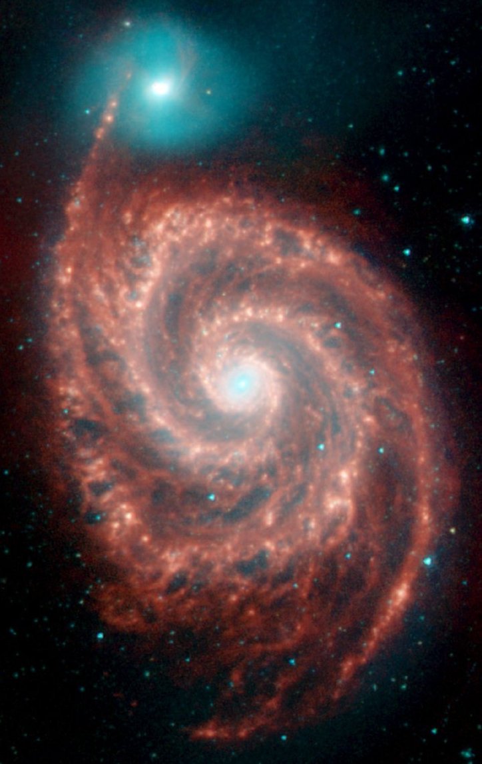
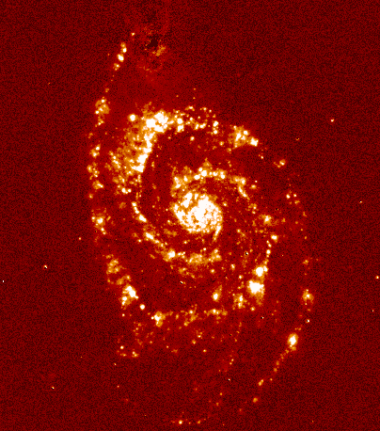
8 micron (Spitzer) showing small hydrocarbon grains
Hα emission showing HII regions

Slide 22
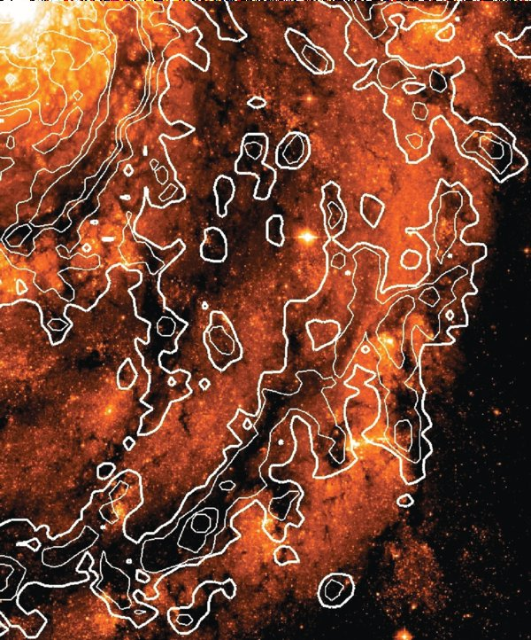
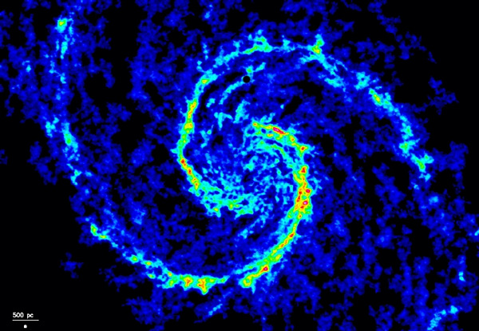
CO (Plateau de Bure interferometer)
showing molecular gas
CO contours overlaid on HST blue filter –
dust shows you where molecular gas is
(there is much more H₂ than HI in this
galaxy).

Slide 23
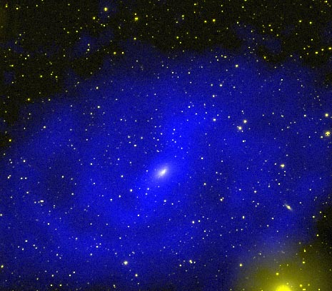
NGC 2915. White is optical showing starlight. Blue is 21-cm image from VLA showing HI. Galaxy is much bigger than you would think from the stars alone!

Slide 24
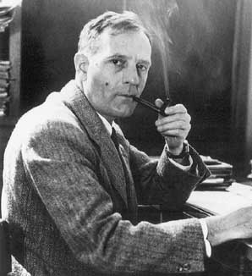
Distances to galaxies
Cepheids – used by Hubble, 1924 to show that “spiral nebulae” like M31 were further from the Sun than any part of the Milky Way, therefore galaxies in their own right.

Slide 25
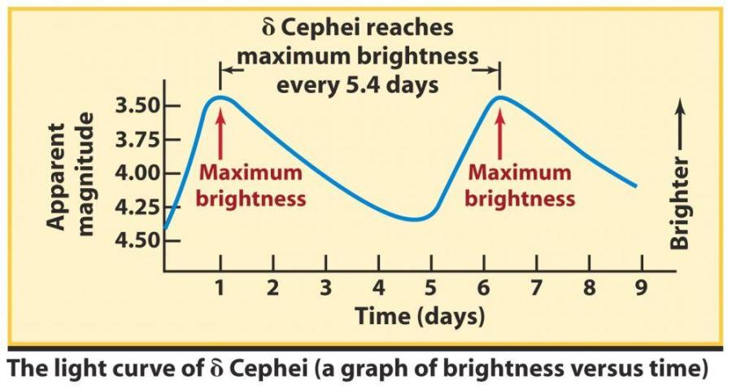
Review of Cepheids
Cepheids are very bright (100’s-10,000’s x L),
massive, variable stars. Can be isolated in nearby
galaxies.
The light curve yields average incident flux F (or apparent magnitude m), and the period (P).

Slide 26
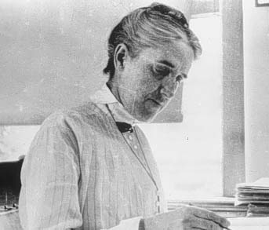
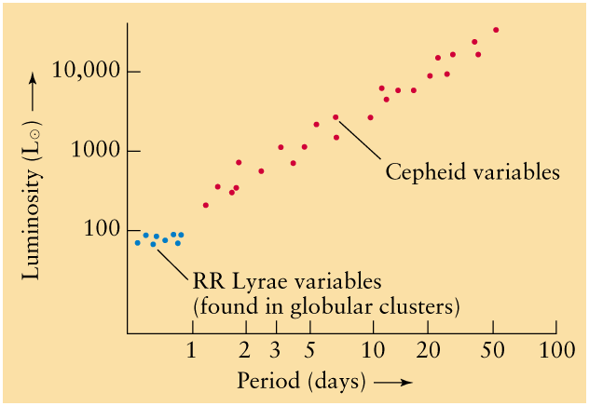
From Cepheids whose distances are independently known, can convert incident flux to luminosity.
Find that P and L are related.
Henrietta Leavitt
The modern calibration of the P-L relation (also now known as the Leavitt Law) is from Cepheids in the Milky Way (with very recent HST trig parallax distances), and the Large Magellanic Cloud, whose distance we can estimate independently. Thus “bootstrapping”.
Thus, if they can be identified in nearby galaxies, measure
their period and average incident flux. P-L relation gives
luminosity, and thus distance:

Slide 27
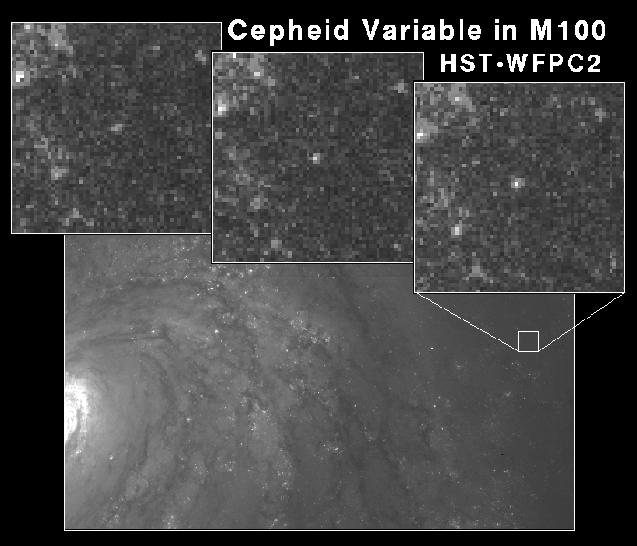
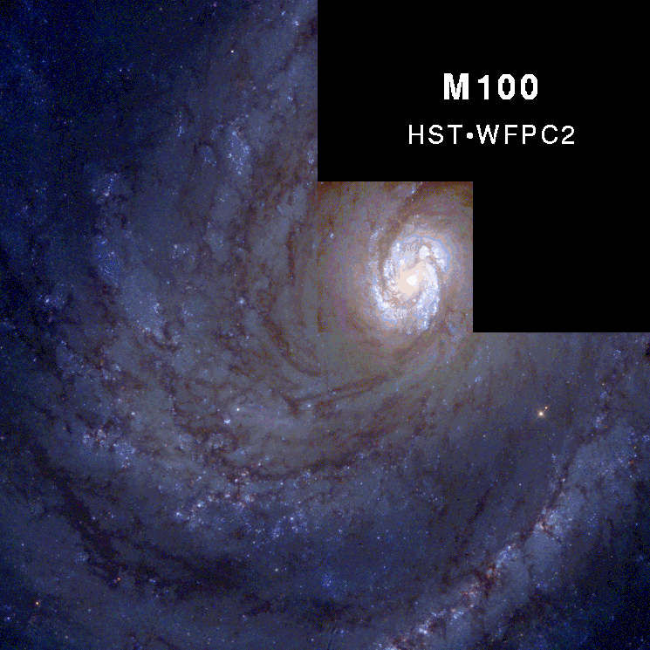
A key goal of the Hubble Space Telescope was to measure Cepheids in more distant galaxies than is possible from the ground. Successful to about 25 Mpc. Gives distances with about 10% accuracy.
Notes:
889 Cepheids in 31 galaxies, tied down the scales to about 10%. Uncertainties: distance to the LMC used as a zero point, and the metallicity effects.

Slide 28
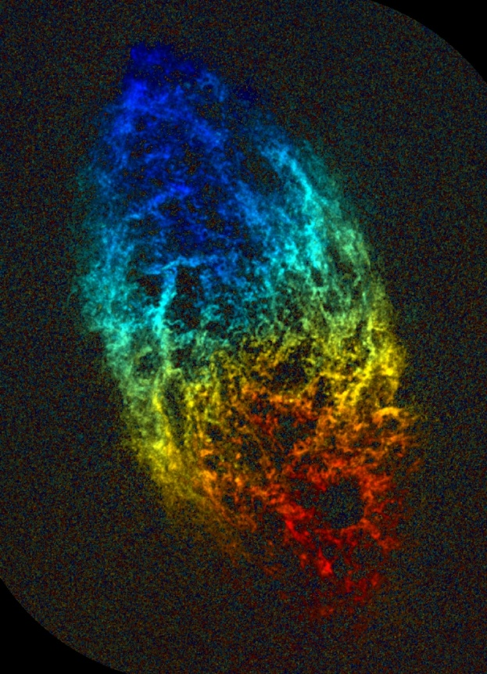
Are there other ways to estimate distances? Yes.
Tully-Fisher relation
For nearby spirals, (flat) rotation speed correlates with optical or near-IR luminosity (known from, e.g., Cepheids). Reasons not well understood (good to think about why), but correlation good.
So measure distant galaxy’s rotation speed, infer luminosity. Measure incident flux. Distance again from:
Successful to >100 Mpc.
color coded HI velocities in M33 with VLA

Slide 29
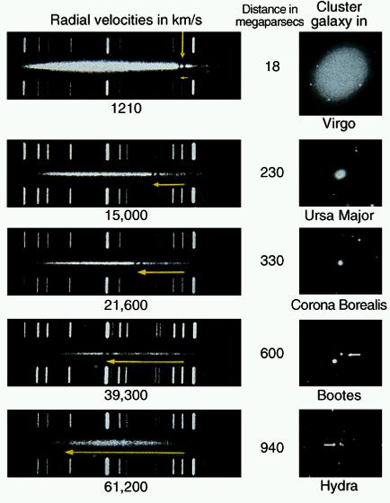
Hubble’s Law
In 1912, Slipher used spectra of "spiral nebulae" to find essentially all of them are receding from us, that is, show “redshifted” spectral lines.
Calcium absorption
lines

Slide 30
The redshift
The redshift is denoted by z
where z is the redshift, λ₀ is the rest wavelength of the spectral line, and λ is the observed (shifted) line from the galaxy.
The recession “velocity” is then V = cz (but is it really a velocity? We’ll come back to that). Valid for small redshifts < 0.3 or so, beyond which General Relativity must be considered.

Slide 31
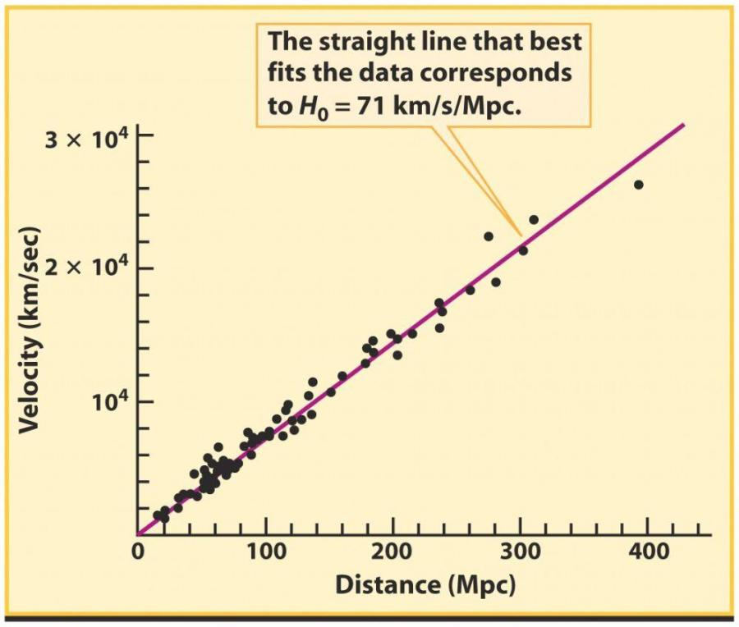
Slipher’s result mysterious until Hubble estimated distances using Cepheids. Found redshifts and distances are related:
Hubble’s Law:
V=H₀d
where the slope H₀
is Hubble's constant.
Units of H₀ are km/s/Mpc.
Best modern value is ~70 km/s/Mpc.
Now can find distance to a galaxy by measuring redshift.
Works to much further distances than Cepheids or Tully-Fisher.
Note: at such large distances, now looking well into past.

Slide 32
Note: textbooks are wrong
For redshifts > 0.3 or so, our text (and most texts) say to use Special Relativity equation for recession velocities:
Later, we will learn that redshifts caused by “Hubble expansion” are not due to galaxies having a velocity relative to space, which is what Special Relativity addresses. It is due to space itself expanding and stretching photons as they travel. Redshift due to Hubble expansion measures expansion of space since radiation emitted. This is part of General Relativity. Will return to this in Cosmology.

Slide 33
Implications of Hubble’s Law
A new way to find distance and thus the scale of the Universe.
The Universe is expanding.
The Universe has an age. Long ago the Universe was compact – the Big Bang.

Slide 34
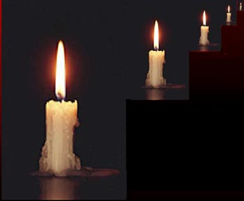
Type Ia Supernovae
All should have about same L since all result from detonation of WD of about same mass. Indeed true in nearby galaxies.
Extremely luminous (peak at a few x 10⁹ L). Can see in galaxies > 10⁹ parsecs away!
Like Cepheids, these are “standard candles”.
Why useful? Can look for deviations from Hubble’s Law at great distances (i.e. early times).

Slide 35
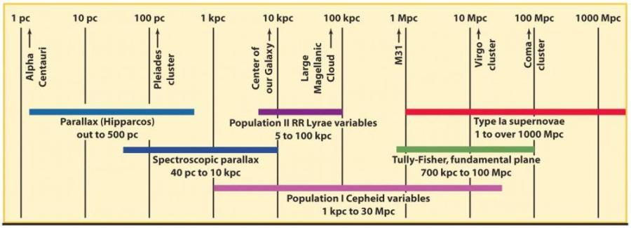
The "Distance Ladder"
(almost 10,000 Mpc)
Cluster HR diagrams
Hubble’s Law (to about
2000 Mpc)

Slide 36
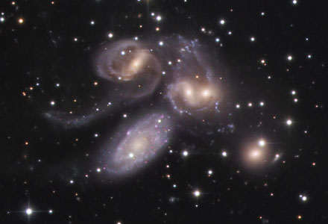
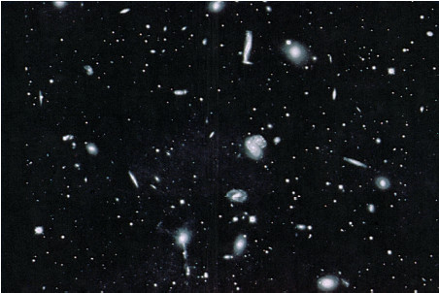
Structures of Galaxies
Galaxies tend to form groups and clusters. Rough
dividing line: 100 members.
Stefan’s Quintet
The Hercules Cluster

Slide 37
The Local Group
The MW and Andromeda are the two giant galaxies in a loose collection of more than 50 galaxies.
Many orbit the MW, and many orbit M31. The rest have orbits governed by the entire gravity of the Local Group.
Most galaxies in the Local Group are dwarfs. New ones still being found. About 20 found since 2004, most with Sloan Digital Sky Survey in NM!

Slide 38
The Local Group
Groups have irregular structure. (Does not show all the
recently found dwarfs).

Slide 39
Clusters
10² - 10⁴ galaxies
Size a few Mpc
Larger ones tend to
have regular, more
spherical structure, like
a globular cluster
The Coma cluster

Slide 40
The center of the Virgo cluster, the closest cluster to the Local Group

Slide 41
Depiction of all known
members (about 2500) of Virgo Cluster

Slide 42
Mass in clusters
Quasi-spherical: orbits are like stars in a halo or Elliptical. Measure galaxies’ Doppler shifts.
Rough estimate: as we did for MW, for a galaxy of mass m orbiting with speed v in a cluster of mass M:
Then,
(How do we get good estimate of V? How do we get R?)
Result: typical speeds 400-1200 km/s, radii 1-10 Mpc,
so masses up to 10¹⁵ M. Luminous matter 10x less => Dark Matter again! First done by Zwicky in 1933.

Slide 43
In many clusters, even most of the “normal” matter is not in galaxies, but in hot gas between them (revealed by X-rays).
Notes:
Sparke and Gallagher: in rich clusters, there is 10x more such gas than mass in galaxies. They say it cannot all have come from galaxies, unlike in groups. In rich clusters, the metallicity averages about 1/3 solar.

Slide 44
Superclusters: they contain clusters and groups
Sizes up to 50 Mpc, 10¹⁵ - 10¹⁶ M.
Often long and filamentary in shape.

Slide 45
Local Supercluster
Dominated by the Virgo Cluster.
Size: ~30 Mpc, mass: ~10¹⁵ M
The Local Group is on the outskirts of the Local Supercluster, and “falling into” the Virgo Cluster at about 300 km/s now (how do we measure this, and what do we mean by it?)
30 Mpc

Slide 46
Large Scale Structure
Large scale structure of the Universe (“2MASS” project): redshifts for 45,000 galaxies. Color coded by redshift. Furthest here about 115 Mpc.

Slide 47
The local
universe
500 Mpc
What about
on even larger
scales?

Slide 48
Slices through Large Scale Structure
We see filaments of clusters and superclusters, (occupying ~10% of the Universe), surrounding voids of 25-50 Mpc diameter (5-10 times fewer galaxies than in superclusters).

Slide 49
How Do Galaxies Form?
More difficult to understand than star formation. All happened long ago.
But the further we look, the further back we look in time:
e.g. 1000 Mpc => 3 Gyr
Hence push to identify the faintest, furthest galaxies in
order to understand formation and evolution. Because of the
distance, angular sizes are small. Emission greatly redshifted. Can’t watch galaxies evolve but must infer evolution from snapshots of different times. All this makes it difficult!
Old idea: a galaxy forms from a single large collapsing cloud of gas, like Solar Nebula.
New idea: observations and theory indicate that "sub-galactic" fragments of size several hundred parsecs were the first things to form. Hundreds might merge to form a galaxy.

Slide 50
The Hubble Ultra Deep Field
Only about 200” across.
Distant (i.e. younger) galaxies are much smaller and disorganized vs. today’s galaxies: consist of “building blocks”. Looking back as far as only 0.8 Gyr after Big Bang, or z ≈ 6.

Slide 51
Redshifts determined for many galaxies in this field. Can relate redshift to distance, and thus get, e.g., true sizes of galaxies. Can also relate redshift to age of Universe when light was emitted, and thus study how sizes changed with time.
Result: galaxies grew with time. Galaxies with z=6 about 10 times smaller in diameter than today.
What kind of light do we see with optical filters from a galaxy with z=6?
James Webb Space Telescope will do much
better, being much more sensitive and optimized
for IR observations, with higher resolution.

Slide 52
Schematic of galaxy formation
Hundreds of fragments of stars and gas may merge to form one large S or E.
Today’s dwarfs: leftover fragments presumably
Don’t forget: most of the mass is dark matter and this must govern the way in which galaxies form. Computer simulations of galaxy formation and evolution, incorporating as much physics at as high a resolution as is feasible, are a great help.

Slide 53
Should show star/gas fragments – not uniform looking cloud!
Also, spirals and
ellipticals have properties so different that they cannot have been formed out of gas clouds with similar initial conditions, e.g. angular momentum. And it is becoming clear that not all galaxy properties are dictated at formation...

Slide 54
The Milky Way is still accreting dwarf galaxies (“minor mergers”)
Tidal force stretches dwarfs out
when they approach MW, removing
many stars from dwarf. Artist’s
impression of tidally stripped stream of stars from Sag. dwarf. Predicted in
simulations. Later found observationally.

Slide 55
Tidally stripped stars from a small galaxy orbiting NGC 5907

Slide 56
New dwarfs found and tidally stripped stars around M31

Slide 57
Large Galaxy Interactions and “Major” Mergers
Large galaxies sometimes come near each other, especially in groups and clusters.
Tidal force can draw stars and gas out of them => tidal tails in spirals.
Galaxy shapes can become badly distorted.
“Major mergers”: two large galaxies
Simulation

Slide 58
Interactions and mergers also lead to "starbursts": unusually high rates of star formation at centers of merging pairs, lasting probably only 10⁸-10⁹ years. Can be 10’s to 1000’s times brighter than Milky Way.

Slide 59
Simulations show giant ellipticals may be mergers of two or more spirals. Rotational motion of spirals disrupted, orbits randomized. Gas rapidly consumed into stars in a starburst – little left over. Since ellipticals have old stars, such mergers must have peaked long ago.
It now seems galaxy properties are set by both formation and subsequent merger (major and minor) activity.

Slide 61
Density effects
E and S0 galaxies appear in the highest density regions - the cores of rich clusters.
S galaxies are found in the outskirts, and in groups.
The cluster Abell 2199 and its dominant cD galaxy NGC 6166
Giant elliptical formed by many mergers.

Slide 62
Ring galaxies: where one galaxy passes
vertically near the center of a disk galaxy
Sometimes a galaxy may pass right through another one, creating a ring galaxy.
Hubble image of The “Cartwheel” galaxy
Which galaxy is the intruder?

Slide 63
Neither: a bridge of atomic gas connects to a more distant galaxy. The gas was stripped out of the small galaxy by the tidal force during the interaction.

Slide 64
Another Ring Galaxy: AM 0644-741
(as seen at Satellite Coffee on Montgomery)

Slide 65
Holmberg II
a) Irr II
b) Sc
c) Irr I

Slide 67
600 kpc
Several hundred pc
Another deep Hubble image. Small fragments contain several billion stars each (and gas, presumably). May merge to form one large galaxy or a few. Looking back 10 Gyr (to age 3.7 Gyr).
James Webb Space Telescope will do much
better, being much more sensitive and optimized
for IR observations, with higher resolution.

Slide 68
In some starbursts, supernova rate so high that the gas is ejected from disk in a powerful outflow.
NGC 3079
M82

