Slide 1
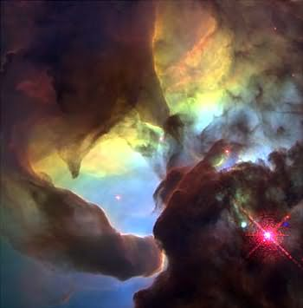
The interstellar medium (ISM) (Section 18.2, bits of 18.7,18.8)
Space between stars is not a vacuum but
is filled with gas.
Why is the ISM important?
Stars form out of it
Stars end their lives by returning gas to it
Evolution of gas in ISM and stars is crucial
to the evolution of galaxies
The ISM has
a wide range of structures
a wide range of densities (10⁻³ -10⁷ atoms/cm³; not dealing with g/cm³ now!)
a wide range of temperatures (10 K - 10⁷ K)
is dynamic

Slide 2
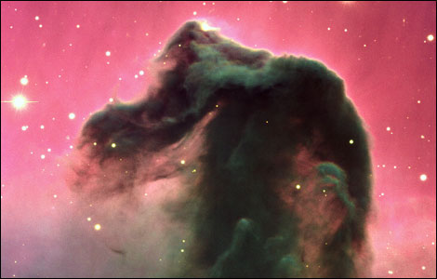
Overview of the ISM
The ISM consists of gas and dust. Dust comprises 1-2% of the ISM mass. Total mass of Milky Way ISM about 5x10⁹ M. About 10% as much mass in gas as in stars.
Gas is in a few “phases”, meaning different temperatures and densities.
Notes:
Optical image from the VLT. SF region just below the easternmost star in Orions belt.

Slide 3
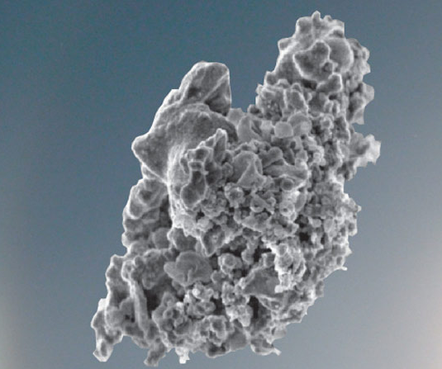
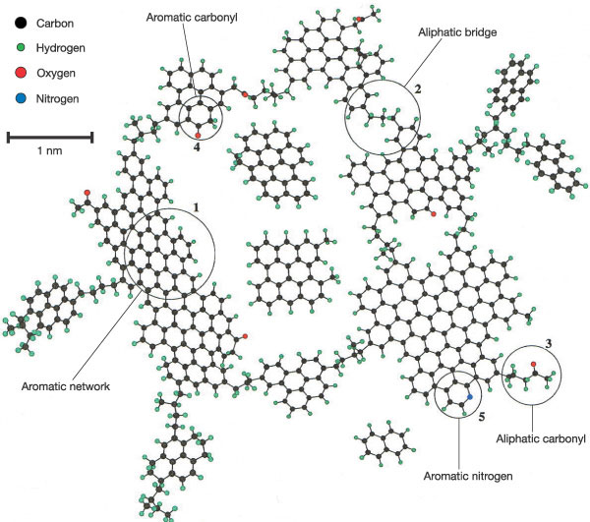
Dust particles
Where there is gas, there is dust (except in hottest gas where dust may be destroyed).
Larger grains with carbon, graphite, silicates, size ~ 10⁻⁸ -10⁻⁶ m
(vast majority of dust mass)
Small grains/large molecules of
~ 50 - 10³ atoms (hydrocarbons)
They cause “extinction” and
“reddening”

Slide 4
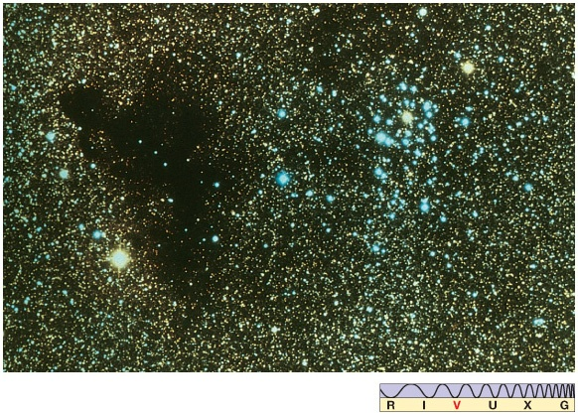
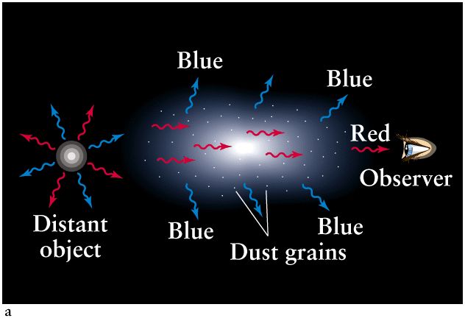
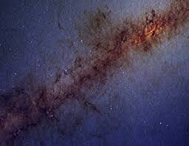
Extinction is reduction in optical brightness
Strong wavelength dependence on absorption and scattering => reddening

Slide 5
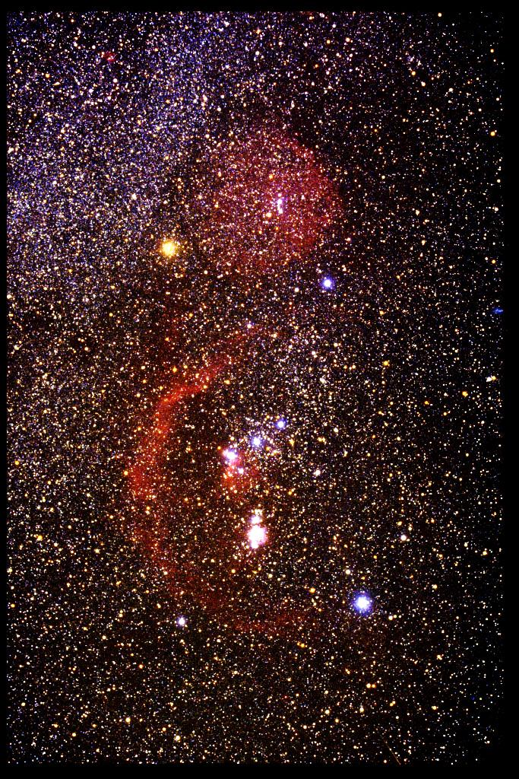
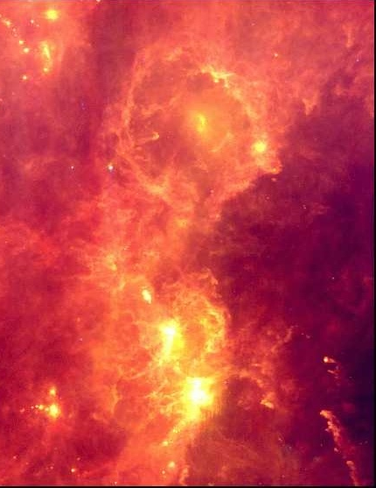
Orion at visible wavelengths
What happens to radiation absorbed by dust?
Orion at IR wavelengths (100μm): larger dust grains absorb UV/visible light and warm up to 10’s-100’s of K. Acting like blackbodies, they re-radiate in the IR. These dominate emission from dust and mass of dust.

Slide 6
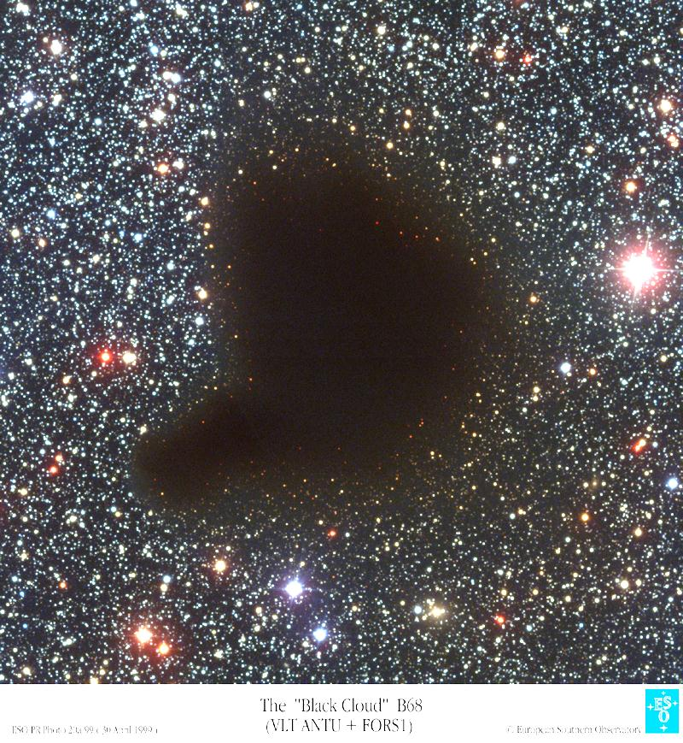
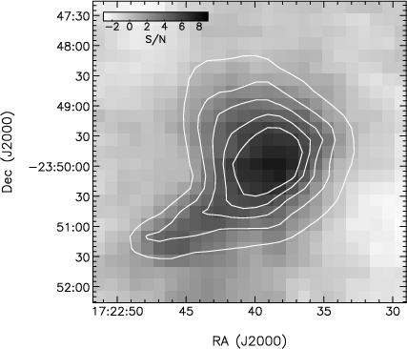
Dark cloud Barnard 68 at optical wavelengths
At 850 μm showing dust re-emission of starlight

Slide 7
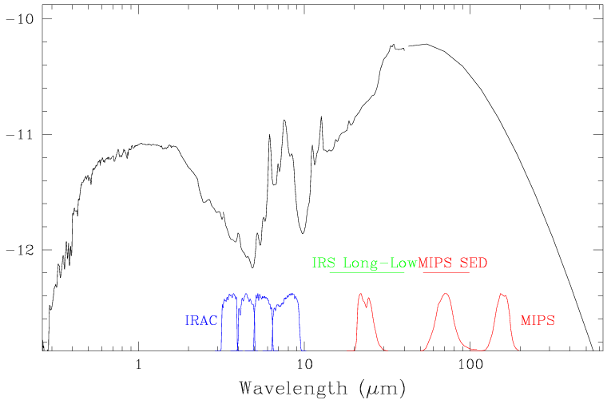
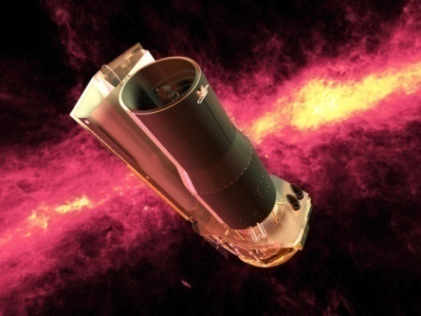
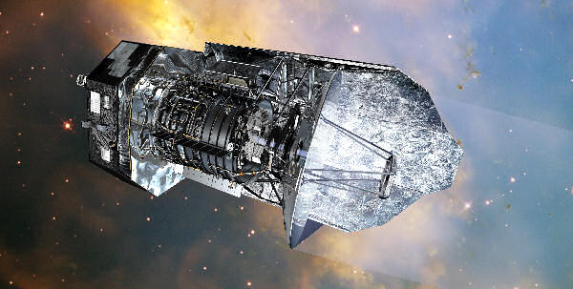
Optical and infrared spectrum of a whole galaxy (Messier 82)
Combined dust infrared
emission (larger grains)
Emission features from small grains/large molecules
Combined
starlight
Spitzer
Space
Telescope
brightness
absorption due to silicate grains
Herschel
Space
Telescope
Optical | <---------------- Infrared ------------------>

Slide 8
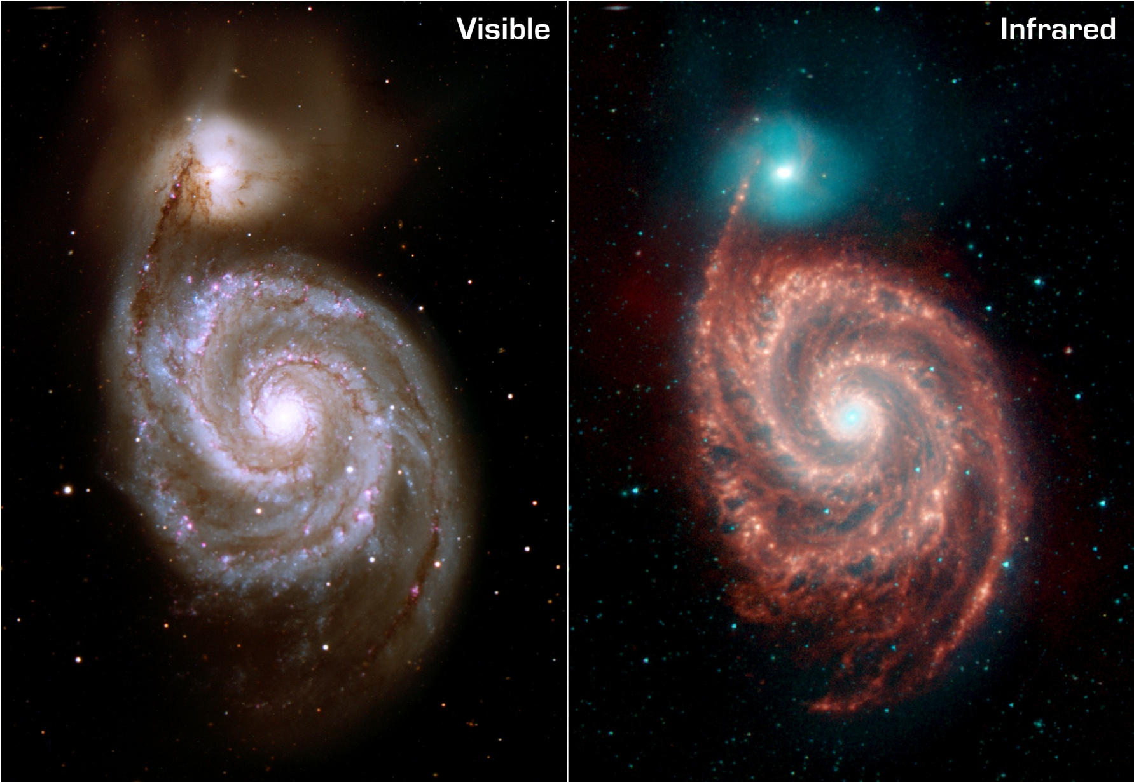
Messier 51 in visible light and infrared emission from small grains/large molecules
responsible for 8 μm (shown in red) emission feature (Spitzer Space Telescope)

Slide 9
The main ISM component: gas
Interstellar gas is either neutral or ionized
Neutral gas either atomic or molecular
We refer to the gas by the state of H
number density
of particles: atoms,
molecules, or electrons
(~ ions)
Component | Phase | T(K) | n(cm⁻³)
Neutral | Cold (molecular) | 10-50 | 10³-10⁷
 | Cool (atomic) | 100 | 1
 | Warm (atomic) | 8x10³ | 10⁻¹
Ionized | Warm | 10⁴ | 10⁻²,10-10⁴
 | Hot | 10⁶ - 10⁷ | 10⁻⁴-10⁻³
Notes:
Density is number density, number of atoms or molecules per cubic centimeter.

Slide 10
Molecular clouds
Cold (~10 K), dense (n ~ 10³–10⁷ molecules/cm³) well defined clouds
Masses: 10³ - 10⁶ M
Sizes: a few to 100 pc
In the Galaxy: ~5000 molecular clouds, totaling 2 ×10⁹ M, or nearly half the ISM mass
Often buried deep within neutral atomic clouds
Sites of star formation
Molecular clouds are seen as dark clouds in the optical.

Slide 11
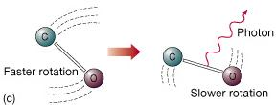
Most abundant is H₂, but it radiates very weakly, so other "trace" molecules observed: CO, H₂O, NH₃, HCN etc, even glycine (C2H5NO2) the simplest of the amino acids (building bocks of proteins).
These molecules undergo rotational energy level transitions, emitting photons at wavelengths of millimeters. Levels excited by low energy collisions at these low T’s. e.g. CO, lowest transition at λ = 2.6 mm or 115 GHz.
Some emission
lines from molecules
in the Orion molecular
cloud. This is only tiny
part of mm-wave spectrum!

Slide 12
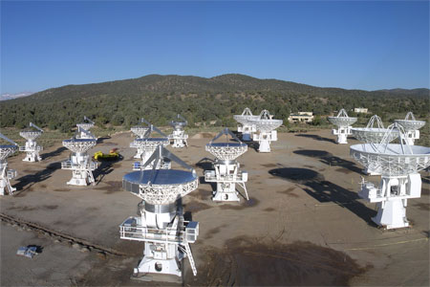
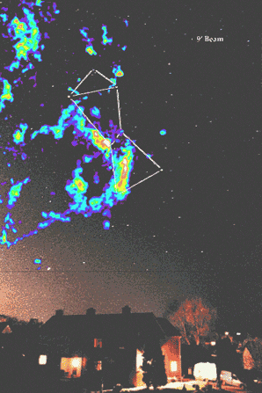
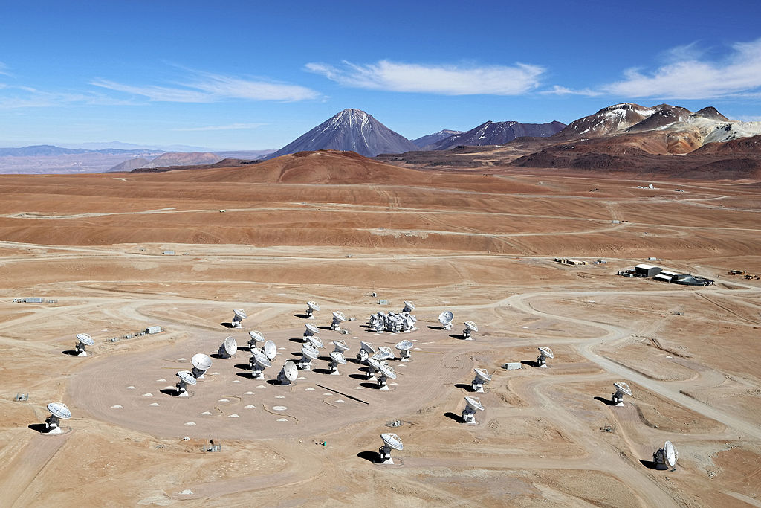
CARMA
False color radio map of CO in the Orion Giant Molecular Cloud complex.
Molecular rotational transitions observed with mm-wave radio telescopes (or arrays),
such as the ALMA array in Chile and the CARMA array in California.
CO is most commonly observed tracer of
molecular gas. Brightest emission.
CO map of Orion Molecular Cloud at 2.6mm or 115 GHz. 400,000 M of gas.
ALMA

Slide 13
Component | Phase | T(K) | n(cm⁻³)
Neutral | Cold (molecular) | 10-50 | 10³-10⁷
 | Cool (atomic) | 100 | 1
 | Warm (atomic) | 8x10³ | 10⁻¹
Ionized | Warm | 10⁴ | 10⁻²,10-10⁴
 | Hot | 10⁶ – 10⁷ | 10⁻⁴-10⁻³
Notes:
Density is number density, number of atoms or molecules per cubic centimeter.

Slide 14
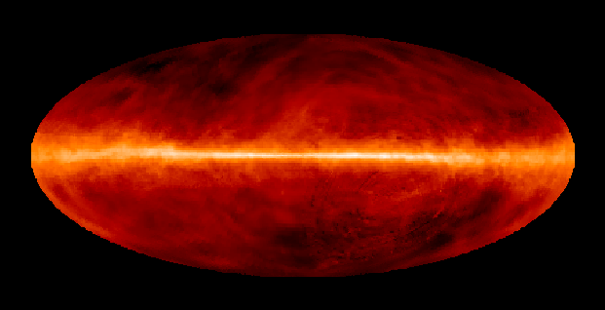
Atomic gas - HI
Diffuse gas filling a large part (half or so?) of the interstellar space
2 ×10⁹ M in the Galaxy, making up nearly half the ISM mass
HI in the Milky Way.
So what wavelength
is this emission?

Slide 15
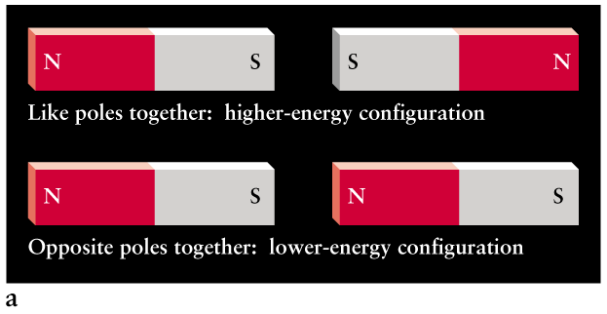
Gas too cold for collisions to excite H out of ground state. But H with electrons in n=1 level still emits energy through the “spin-flip transition”.
How? Electrons and protons have a quantum mechanical property called spin. Classically, it’s as if these charged particles are spinning. Spinning charged particles act like magnets:

Slide 16
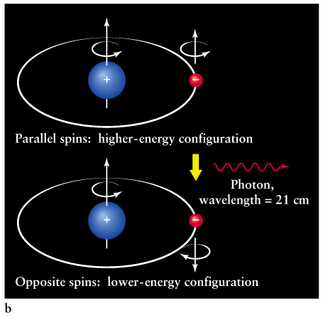
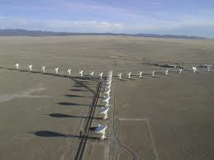
The spin-flip transition produces a 21-cm photon (1420 MHz).
(excited as a result of collision)
VLA
Low-frequency photon => transition happens even in cool gas

Slide 17
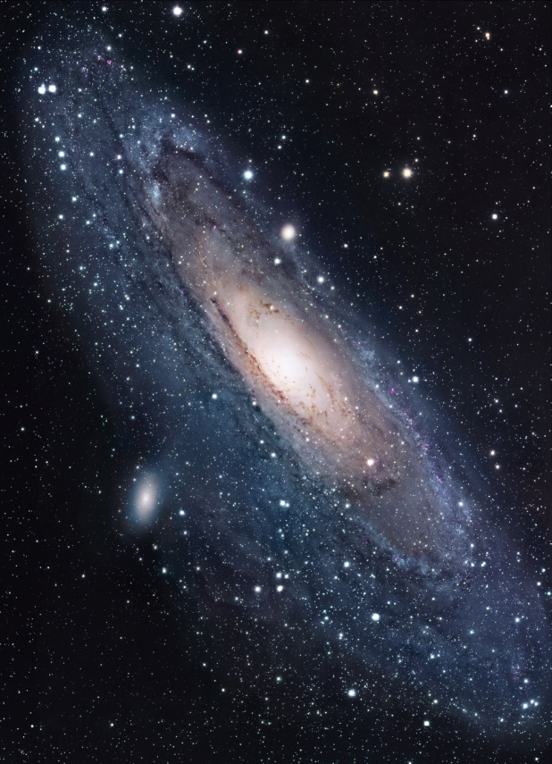
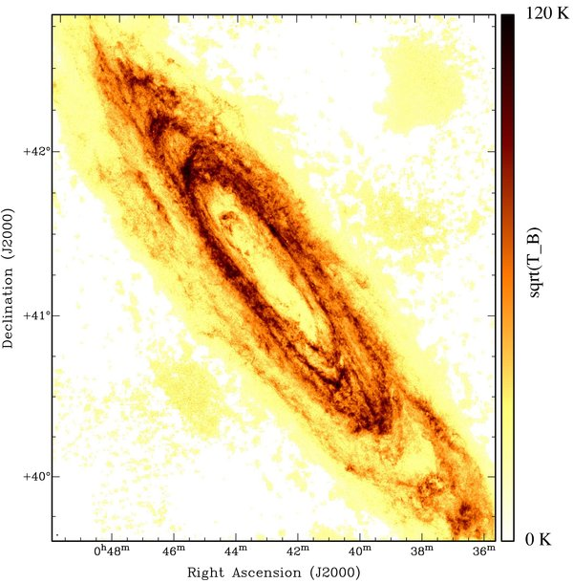
Map of 21-cm emission from Milky Way
Map of 21-cm emission from M31

Slide 18
Component | Phase | T(K) | n(cm⁻³)
Neutral | Cold (molecular) | 10-50 | 10³-10⁷
 | Cool (atomic) | 100 | 1
 | Warm (atomic) | 8x10³ | 10⁻¹
Ionized | Warm | 10⁴ | 10⁻²,10-10⁴
 | Hot | 10⁶ – 10⁷ | 10⁻⁴-10⁻³
Well-defined structures: HII regions (or emission nebulae)
Diffuse Ionized Gas (DIG)

Slide 19
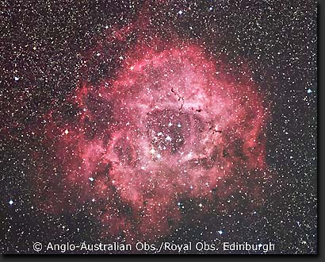
HII regions (or emission nebulae)
nebula = cloud (plural nebulae)
H essentially completely ionized
n ~ 10 – 5000 cm⁻³
T≅10⁴ K
Sizes 1-20pc, well defined structures
associated with star forming regions
Rosette Nebula
Hot, tenuous gas => emission lines (Kirchhoff's laws)

Slide 20
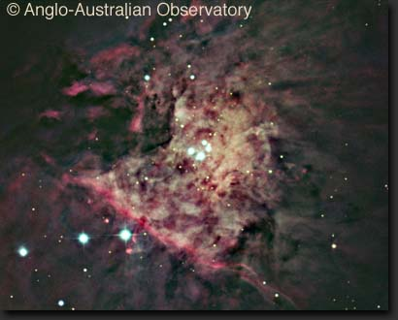
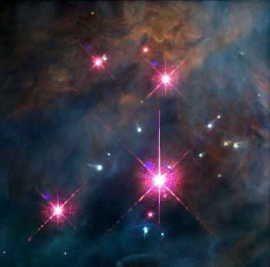
In the Orion Nebula, the Trapezium stars provide energy for the whole nebula.
HII regions were once molecular gas, but molecules broken apart, then atoms
ionized and heated by UV radiation from newly formed massive stars. Stellar winds
can also disperse gas, but densities still high compared to most types of ISM gas.
Hubble Space Telescope

Slide 21
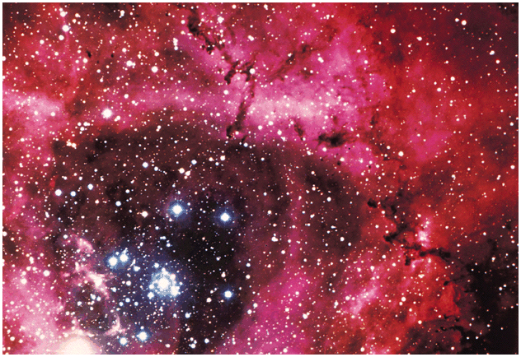
UV energies are required to ionize the atoms
Provided by hot and massive O, B stars (collisions rarely have enough energy to ionize at these temperatures). Gas warm and ionized only as long as these stars are there ~ 10⁷ years. Low mass stars forming too, but short-lived high mass ones provide the best signposts of recent star formation.
Dominant emission: Balmer α (i.e. Hα), at λ = 656 nm. Gives red color.

Slide 22
Hα requires H atoms, and isn't all the H ionized? Not quite.
Sea of protons and electrons
Once in a while, a proton and electron will rejoin to form H atom.
Usually rejoins to a high energy level. Then electron moves to lower levels.
Emits photon when it moves downwards. 3-2 transition dominates optical emission. Atom soon ionized again.

Slide 23
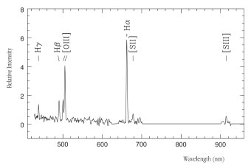
Lines from other elements predominantly in ionized states. Radiation ionizes
them, collisions cause emission line in ion.

Slide 24
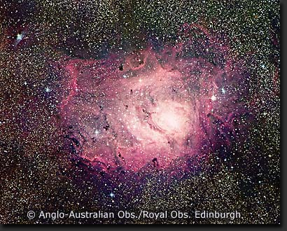
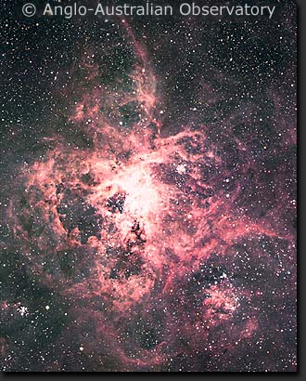
Lagoon Nebula
Stellar winds, turbulence and supernova explosions give HII regions complicated structure.
Tarantula Nebula

Slide 25
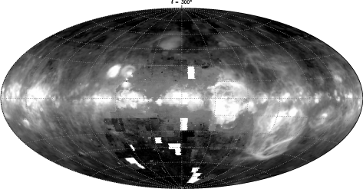
Diffuse Ionized Gas in Milky Way (from Wisconsin Hα mapper (WHAM)).
Much of it quite filamentary. Also see many HII regions.

Slide 26
Component | Phase | T(K) | n(cm⁻³)
Neutral | Cold (molecular) | 10-50 | 10³-10⁷
 | Cool (atomic) | 100 | 1
 | Warm (atomic) | 8x10³ | 10⁻¹
Ionized | Warm | 10⁴ | 10⁻²,10-10⁴
 | Hot | 10⁶ – 10⁷ | 10⁻⁴-10⁻³

Slide 27
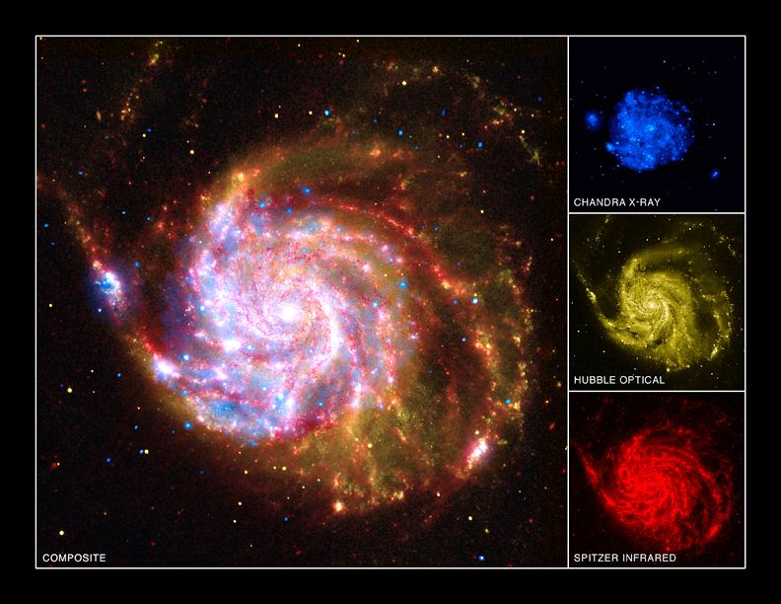
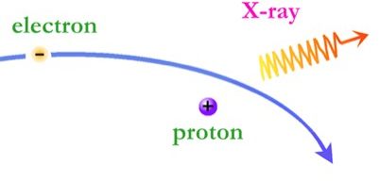
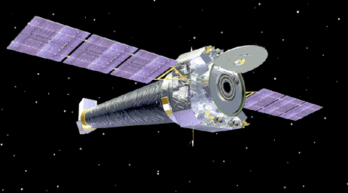
X-ray emission in galaxy Messier 101. ISM emission from
“Bremsstrahlung” process (also some line emission from highly ionized elements). Hot regions probably heated by combination of many supernovae
Chandra X-ray
observatory

Slide 28
Other ISM components
Magnetic fields (10⁻⁹ -10⁻¹² Teslas, widespread)
Cosmic Rays (high energy particles, interact with magnetic fields ⇒ radio emission)
Supernova remnants (radio, optical, x-ray – more later)
Planetary Nebulae (isolated objects – more later)
Reflection nebulae (light scattered by dust – blue)

Slide 29
Star Formation
Motivating star formation: we see young star clusters (and HII regions) embedded in regions of dense molecular gas

Slide 30
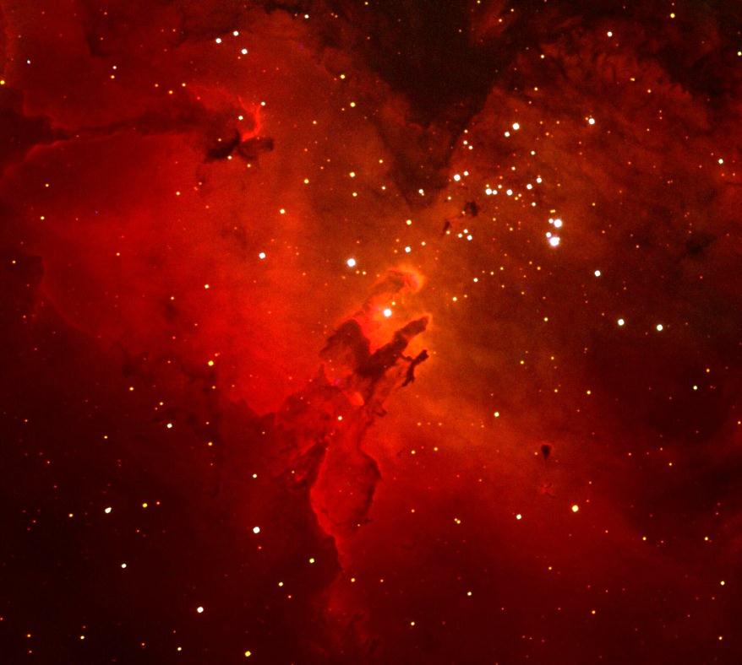
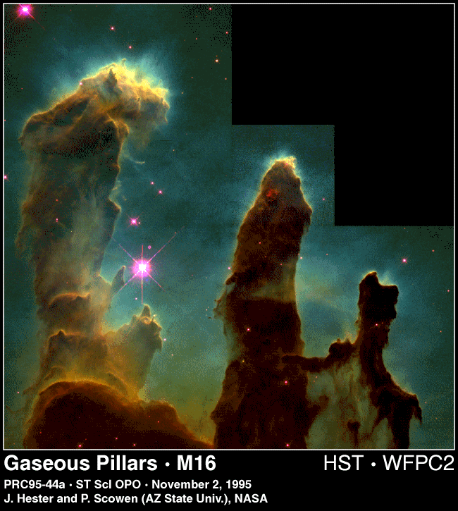

Slide 31
Star formation (sections 18.3-18.8)
Gravitational collapse
Start with a collection of matter (e.g. a molecular cloud) somewhere in space and let gravity work on it. What happens?
It will collapse eventually unless something resists it.
What can resist gravitational collapse?
Gas pressure (particles in collapsing gas run into each other)
Radiation pressure (if matter becomes hot enough)
Magnetic pressure
Angular momentum (keeps stuff spinning instead of collapsing)
Turbulence
Dispersal due to, e.g., winds or supernovae from existing stars
Collapse if gravity stronger than these effects.
Some molecular clouds (or parts thereof) may be stable, others unstable to collapse (other parts may be being dispersed).
Notes:
In stars gas and radiation pressure supports the star from collapse - defines the size of a star. At large scales, magnetic pressure and angular momentum has to be overcome in early stages of star formation.

Slide 32
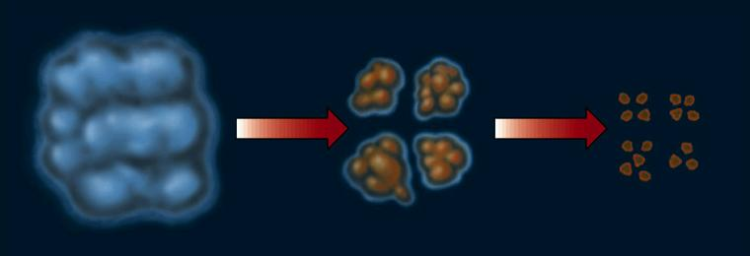
Coldest, densest ISM structures (most prone to collapse) are molecular clouds (yet how much denser is a star than a molecular cloud?)
Molecular clouds observed to be clumpy – structure on many scales
Clusters of new stars are observed in some of them
If a clumpy cloud does collapse, clumps eventually start collapsing on their own, and cloud fragments (Jeans 1902). Fragments continue to collapse, they fragment, etc.

Slide 33
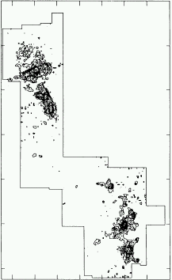
Map of CS emission in Orion molecular cloud, showing fragments about 10² - 10³ x denser than average gas in cloud.

Slide 34
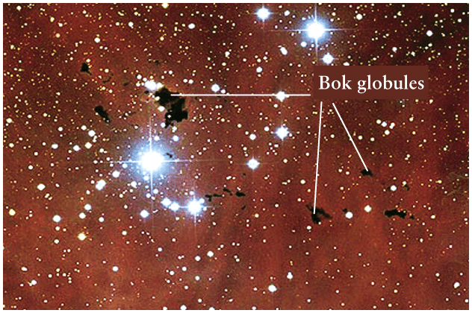
Optically, such dense clumps might appear as dark “Bok globules”

Slide 35
Now follow one fragment. Destined to form star (or binary, etc.)
First, gravity dominates and collapse is almost free-fall. Fragment is gaining energy! Energy shared and turned into random motions by collisions. Energy initially escapes as radiation (in molecular rotational transitions), temperature rises little. This stage takes millions of years.
Once density high enough, radiation has trouble escaping, T starts to rise, pressure (P= nkT) begins to slow collapse. Spectrum starts to become blackbody (hot dense objects).
Sources still cooler than stars, and generally embedded in much gas and dust – best seen in infrared for both reasons. But they become very luminous, driven by conversion of gravitational potential energy.

Slide 36
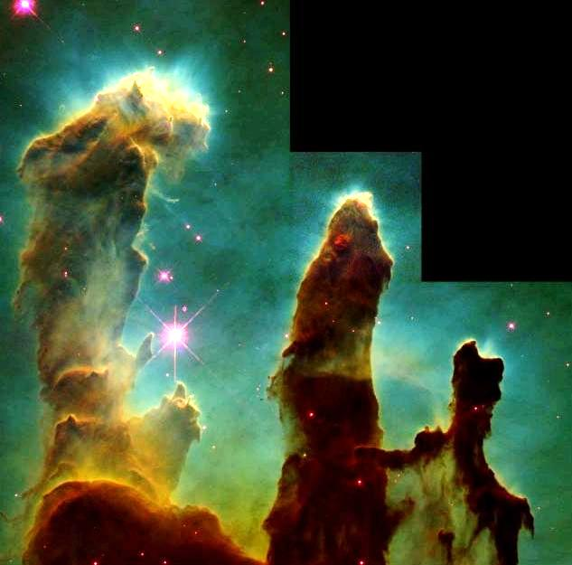
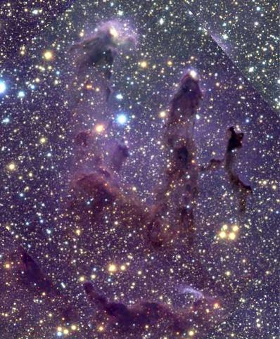
Eagle Nebula
protostars not seen in visible light
visible light
near infrared

Slide 37
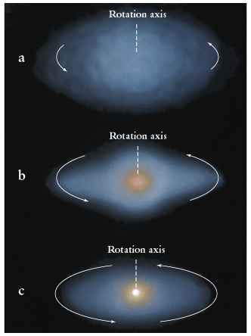
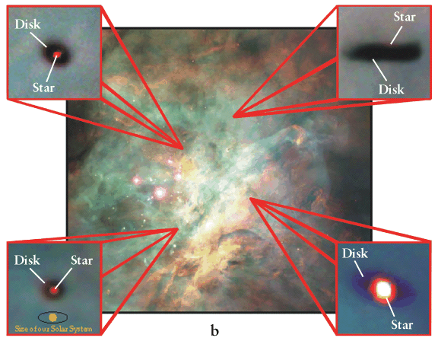
Initial rotation and conservation of angular momentum will cause the formation of a flattened disk around the forming star. Disk material may feed star (“accretion disk”).
We observe these now with HST!
Orion. Trapezium cluster on left

Slide 38
At some point the luminosity is large enough to blow away most of the surrounding gas. Strong winds observed in protostars (“T Tauri stars” and “Herbig-Haro objects”). Most gas never made it onto star. Planets may form in protostellar disk if it survives.
Finally, protostar core hot enough to ignite nuclear H fusion. It becomes a star. Pressure from fusion stops collapse => stable.

Slide 39
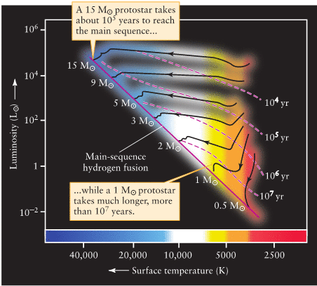
Once sufficiently hot and dense, can follow evolution on H-R diagram. Theory worked out by Hayashi = > Hayashi tracks.
Basic evolution is to lower radii. Luminosities of low-mass protostars large. Higher mass: fusion starts earlier and stabilizes luminosity, while surface continues to shrink.

Slide 40
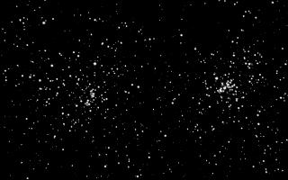
Open clusters provide evidence for the theory
Stars tend to form in groups or in clusters, presumably due to fragmentation
Clusters very useful because all stars form at about the same time and are
at the same distance.
There are two types of clusters – open and globular.
Open clusters
Newly formed, 10² - 10⁴ stars.
Confined to the plane of the Galaxy
Often seen near HII regions and molecular clouds.
The double cluster H and χ Persei.

Slide 41
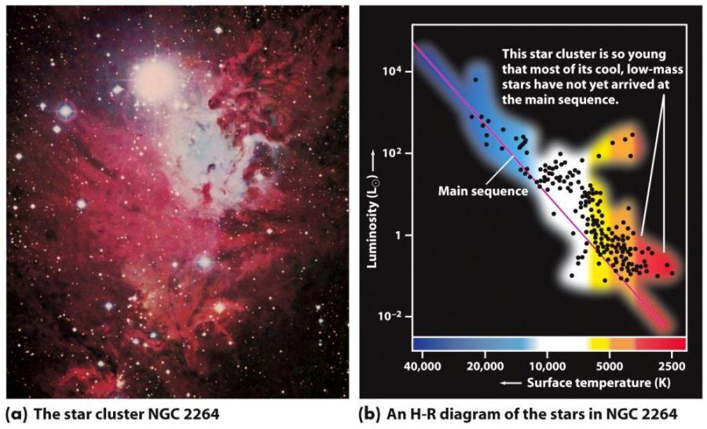
A young open star cluster – note that low mass stars haven’t quite reached main sequence yet.

Slide 42
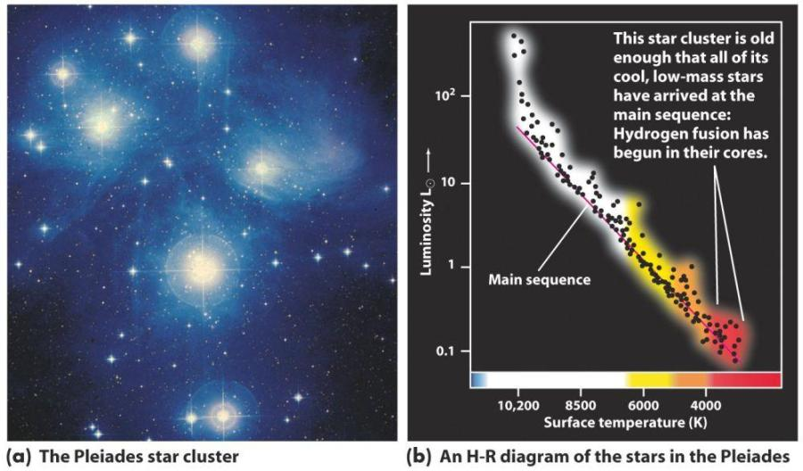
The Pleiades are older. All stars have reached the main sequence. Highest mass ones are already evolving off.

Slide 43
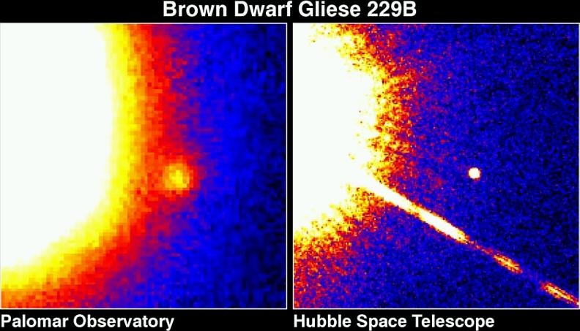
Brown Dwarfs
Some protostars not massive (< 0.08 M) enough to begin fusion. These are Brown Dwarfs or failed stars. Very difficult to detect because so faint and cool. Best seen in infrared. First seen in 1994. Now ~2000 known.
Brown dwarfs slowly cool off by radiating internal heat.
Two new spectral classes, L (T<2500 K) and T (T<1300 K) were created.
Recently, Y (roughly 300<T<500) proposed.

Slide 44
Mass of star measured to be 0.085M, mass of brown dwarf 0.066M

Slide 45
Brown dwarfs in Orion
IR image showing brown dwarfs in the Orion constellation.
Easiest to spot in star forming regions, since they are still young and more luminous.

Slide 46
What is most massive star possible? If too massive, radiation pressure overwhelms gravity, drives matter out. Never forms stable star.
Eta Carina with HST.
M ~ 100 – 150 M

Slide 47
Initial Mass Function (IMF)
Do more low mass or high mass stars form? Number of stars formed
as function of mass follows a “power law”:
N(M) α M^{-2.3} for M > 0.5 M
IMF “turns over” near 0.5 M
N(M)
0.5
100-150
M(M)

