Slide 1
The Interstellar Medium (ISM)
Gas Between the Stars
Why study it?
Stars form out of it.
Stars end their lives by returning
gas to it.
The ISM has:
a wide range of structures
a wide range of densities (10 ⁻³ - 10 ⁷ atoms / cm³)
a wide range of temperatures (10 K - 10 ⁷ K)

Slide 2
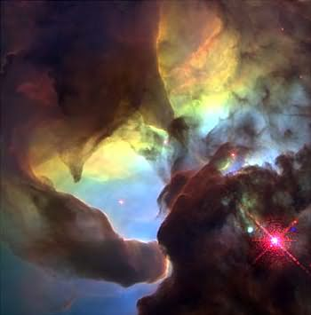
Compare density of ISM with Sun or planets:
Sun and Planets: 1-5 g / cm³
ISM average: 1 atom / cm³
Mass of one H atom is 10⁻²⁴ g!
So ISM is about 10²⁴ times less dense
than a star or planet!

Slide 3
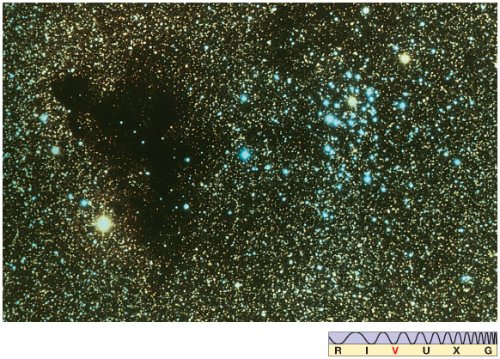
ISM consists of gas (mostly H, He) and dust. 98% of mass is in gas, but dust, only 2%, is also observable.
Effects of dust on light:
1) "Extinction"
Blocks out light
2) "Reddening"
Blocks out short wavelength light better than
long wavelength light => makes objects appear redder.

Slide 4
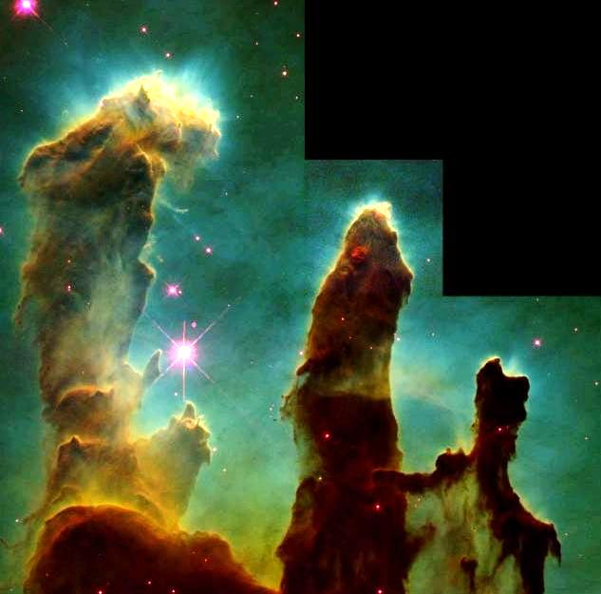
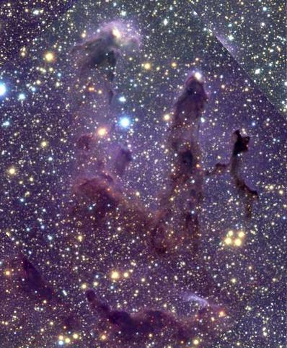
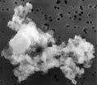
visible light
infrared
protostars not seen in visible light
Longer wavelength radiation is not so easily absorbed by dust!
Grain sizes typically 10⁻⁵ cm. Composed mainly of silicates, graphite and iron.

Slide 5
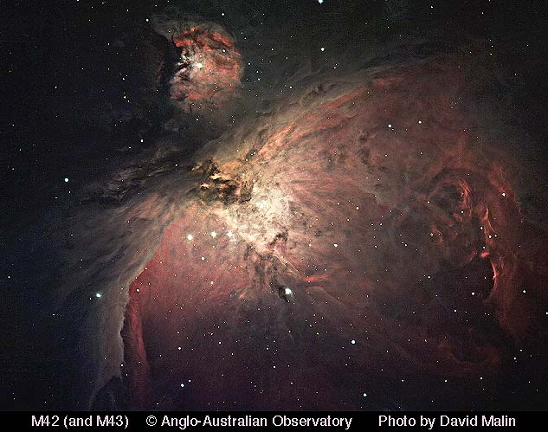
Gas Structures in the ISM
Emission Nebulae or H II Regions
Regions of gas and dust near stars just formed. Seen in visible light.
The Hydrogen is almost fully ionized.
Temperatures near 10,000 K
Sizes about 1-20 pc.
Hot tenuous gas => emission lines (Kirchhoff's Laws)
link

Slide 6
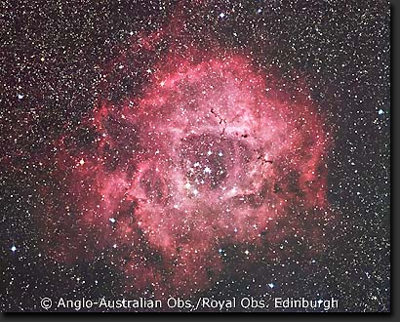
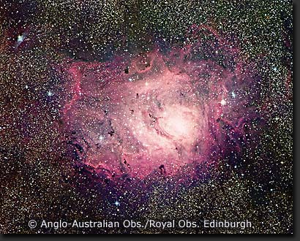
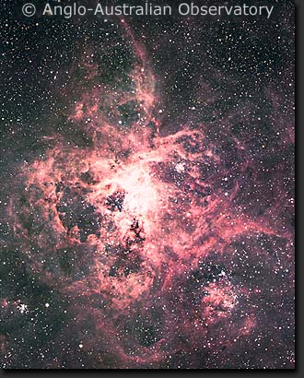
Rosette Nebula
Lagoon Nebula
Tarantula Nebula
Red color comes from one emission line of H (tiny fraction of H is atoms, not ionized).

Slide 7
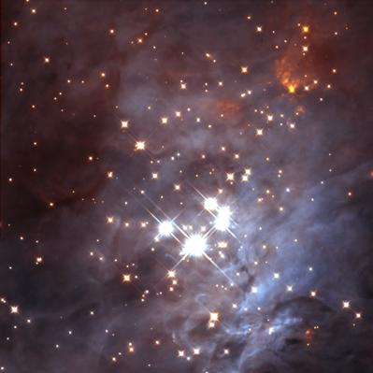
Why is the gas ionized and why does it trace star-forming regions?
Remember, takes energetic UV photons to ionize H.
Hot, massive stars produce huge amounts of these.
Such short-lived stars spend all their lives in the stellar nursery of their birth, so emission nebulae mark sites of ongoing star formation.
Many stars of lower mass are forming too, but emit few UV photons.
Why "H II Region?
H I: Hydrogen atom
H II: Ionized Hydrogen
. . .
O III: Oxygen missing two electrons
etc.
Trapezium young open cluster in Orion

Slide 8
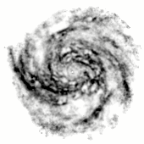
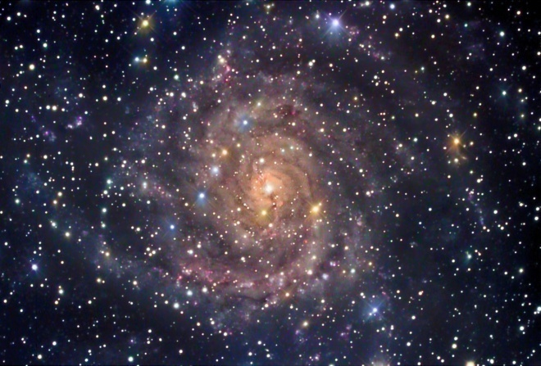
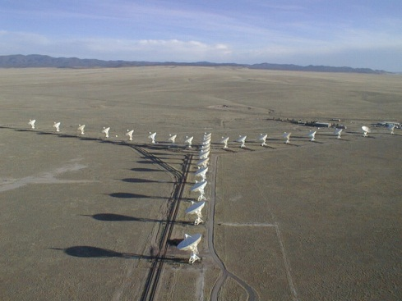
Atomic Gas and 21-cm radiation
Gas in which H is atomic.
Fills much (most?) of interstellar space. Density ~1 atom / cm³.
Too cold (~100 K) to give optical emission lines.
Primarily observed through radiation of H at wavelength of 21 cm.
Accounts for almost half the mass in the ISM: about 2 x 10⁹ M_{Sun} !
21-cm
emission
map of IC 342
from VLA
Galaxy IC 342 in visible light

Slide 9
Molecular Gas
It's in the form of cold (about 10 K) dense (about 10³ - 10⁷ molecules / cm³)
clouds.
Molecular cloud masses: 10³ - 10⁶ M_{Sun} !
Sizes: a few to 100 pc.
1000 or so molecular clouds in ISM. Total mass about equal to atomic mass.
Optically, seen as dark dust clouds.

Slide 10
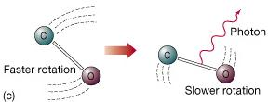
We can observe emission from molecules. Most abundant is H₂ (don't confuse with H II), but its emission is extremely weak, so other "trace" molecules observed:
CO (carbon monoxide)
H₂O (water vapor)
HCN (hydrogen cyanide)
NH₃ (ammonia)
etc. . .
These emit photons with wavelengths near 1 mm when they make a rotational energy level transition. Observed with radio telescopes.

Slide 11
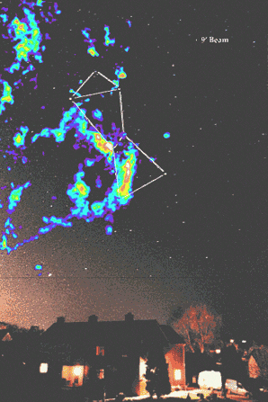
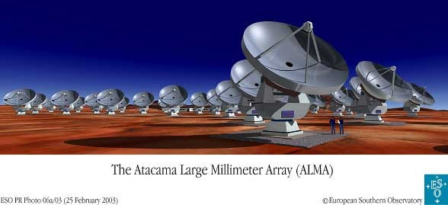
False-color of CO emission from Orion molecular cloud complex.
Best studied case. 500 pc away.
400,000 M_{Sun} of gas.
Note complicated structure!
approximate position of Orion nebula

Slide 12
Star Formation
Stars form out of molecular gas clouds. Clouds must collapse to form stars (remember, stars are ~10²⁰ x denser than a molecular cloud). Stars observed to form in clusters.
Probably new molecular clouds form continually out of less dense gas. Some collapse under their own gravity. Others may be more stable. Not well understood.
Gravity makes cloud want to collapse.
Outward gas pressure resists collapse, like air in a bike pump.

Slide 13
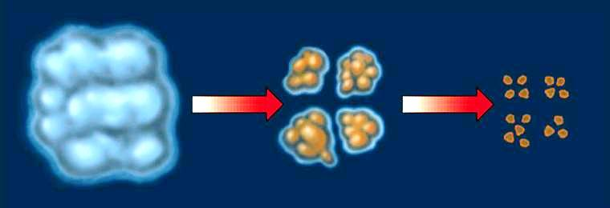
When a cloud starts to collapse, it should fragment. Fragments then collapse on their own, fragmenting further. End product is 100’s or 1000’s of dense clumps each destined to form star, binary star, etc.
Hence a cloud gives birth to a cluster of stars.

Slide 14
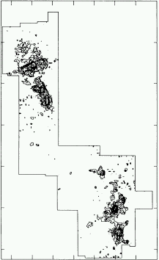
Fragments in Orion molecular cloud, about 1000 x denser than average gas in cloud.

Slide 15
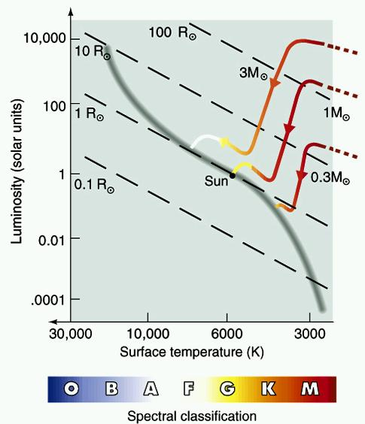
As a clump collapses, it starts to heat up.
Eventually hot and dense enough => spectrum approximately black-body. Becomes very luminous.
Now a protostar. May form proto-planetary disk.
Protostar and proto-planetary disk in Orion (IR)
1700 AU
Can place on HR diagram.
Protostar follows “Hayashi
tracks”

Slide 16
Finally, fusion starts, stopping collapse: a star!
Star reaches Main Sequence at end of
Hayashi Track
One cloud (10³ - 10⁶ M_{Sun})
forms many stars, mainly in clusters,
in different parts at different times.
Massive stars (50-100 M_{Sun}) take about 10⁶ years to form, least massive (0.1 M_{Sun}) about 10⁹ years. Lower mass stars more likely to form.
In Milky Way, a few stars form every year.

Slide 17
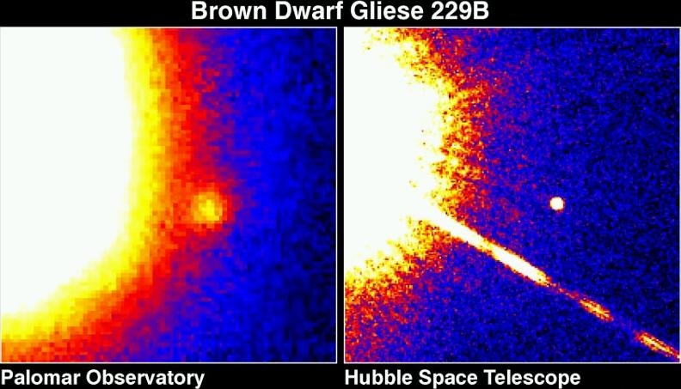
Brown Dwarfs
Some protostars not massive (< 0.08 M_{Sun}) enough to begin fusion. These are Brown Dwarfs or failed stars. Very difficult to detect because so faint. First seen in 1994. They just cool with age. How many are there?

Slide 19
The Eagle Nebula
Molecular cloud surface illuminated by nearby hot stars.
Radiation evaporates the surface, revealing a dense globule - a protostar.
Other hot stars illuminating
these clouds
Shadow of the protostar protects a column of gas behind it.
Eventually structure separates from the cloud, and the protostar will be uncovered.
1 pc

Slide 20
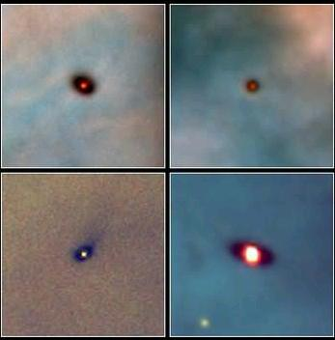
Newly formed stars in Orion with Protoplanetary Disks (Hubble)

Slide 21
Why red? From one bright emission line of H. But that requires H atoms, and isn't all the H ionized? Not quite.
Sea of protons and electrons
Once in a while, a proton and electron will rejoin to form H atom.
Can rejoin to any energy level. Then electron moves to lower levels.
Emits photon when it moves downwards. One transition produces red photon. This dominates emission from nebula.

Slide 22
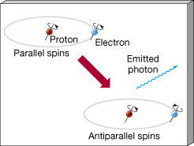
Origin of 21-cm photon:
The proton and electron each have “spin”. A result from quantum mechanics: if both spinning the same way, atom's energy is slightly higher. Eventually will make transition to state of opposite spins. Energy difference is small -> radio photon emitted, wavelength 21-cm.

