Slide 1
The Solar System (Sections 4.1 and 4.3 only)
Ingredients?
Planets
Their Moons, Rings
Comets
Asteroids
Meteoroids
Kuiper Belt Objects
The Sun
A lot of nearly empty space

Slide 2
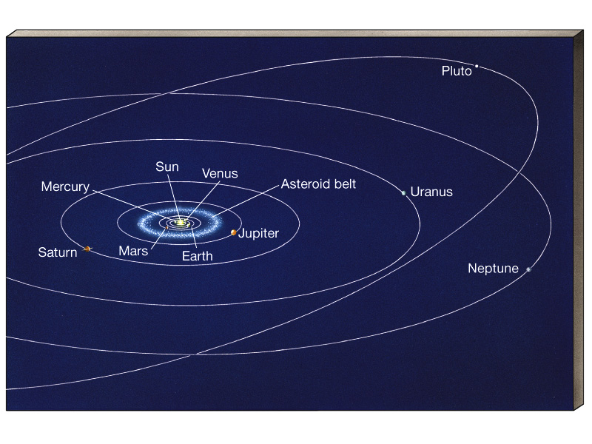
Solar System Perspective

Slide 3
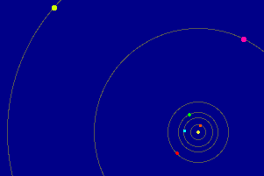
Orbits of Planets
All orbit in same direction.
Most orbit in same plane.
Elliptical orbits, but low eccentricity for most, so nearly circular.

Slide 4
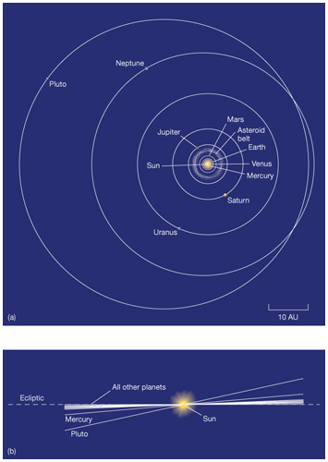
Exceptions:
Mercury Pluto
(no longer a planet)
orbital tilt 7º orbital tilt 17.2º
eccentricity 0.21 eccentricity 0.25

Slide 5
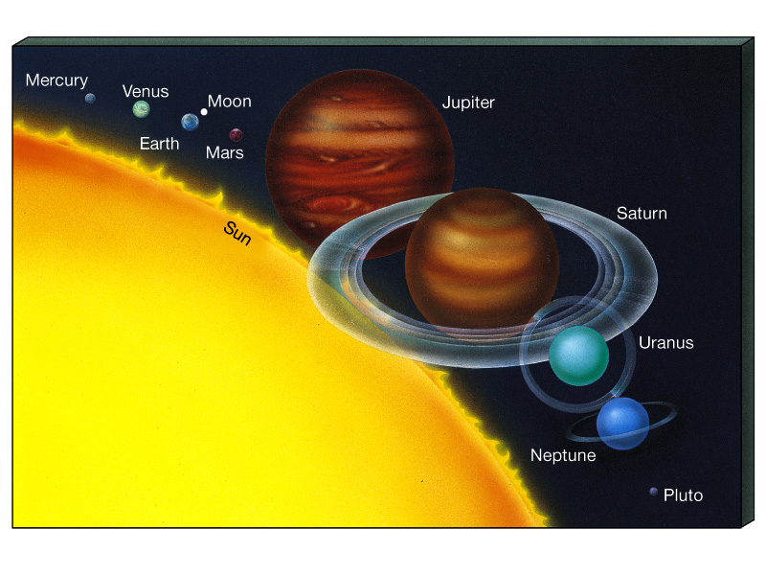
Sun, Planets and Moon to scale
(Jupiter’s faint rings not shown)

Slide 6
Two Kinds of Planets
"Terrestrial"
Mercury, Venus,
Earth, Mars
"Jovian"
Jupiter, Saturn, Uranus, Neptune
Close to the Sun
Small
Far from the Sun
Large
Mostly Rocky
High Density (3.9 -5.5 g/cm³)
Mostly Gaseous, Liquid
Low Density (0.7 -1.6 g/cm³)
Slow Rotation (1 - 243 days)
Fast Rotation (0.41 - 0.72 days)
Few Moons
No Rings
Main Elements Fe, Si, Mg, O
Many Moons
Rings
Main Elements H, He

Slide 7
How did the Solar System Form?
We weren't there. We need a good theory. Check predictions against other forming solar systems. What must it explain?
- Solar system is very flat.
- Almost all moons and planets orbit and spin in the same direction. Orbits nearly circular.
- Planets are isolated in space.
- Terrestrial - Jovian planet distinction.
- Leftover junk (comets, asteroids, etc).
Not the details and oddities – such as Venus’ and Uranus’ retrograde spin.

Slide 8
Early Ideas
René Descartes (1596 -1650) nebular theory:
Solar system formed out of a "whirlpool" in a "universal fluid". Planets formed out of eddies in the fluid.
Sun formed at center.
Planets in cooler regions.
Cloud called "Solar Nebula".
This is pre-Newton and modern science. But basic idea correct, and the theory evolved as science advanced . . .

Slide 9
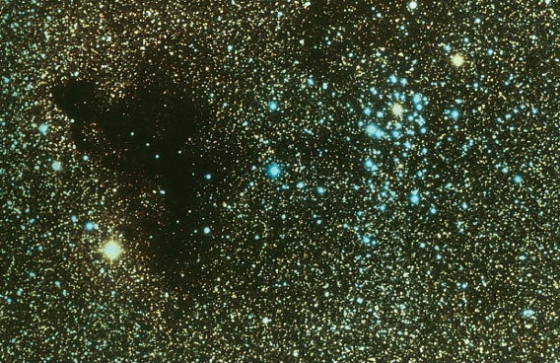
A cloud of interstellar gas
a few light-years,
or about 1000
times bigger than
Solar System
The associated dust blocks starlight. Composition mostly H, He.
Too cold for optical emission but some radio spectral lines from molecules. Doppler shifts indicate clouds rotate at a few km/s.
Some clumps within clouds collapse under their own weight to form stars or star clusters. Clumps spin at about 1 km/s.

Slide 10
But why is Solar System flat, and why do planets orbit faster than 1 km/s?
Pierre Laplace (1749 - 1827): an important factor is "conservation of angular momentum":
When a rotating object contracts, it speeds up.
"momentum"
"angular momentum" (a property of a spinning or orbiting object)
mass x velocity
mass x velocity x "size"
of spin or orbit
of spinning object or orbit
Well demonstrated by ice skaters . . .

Slide 11
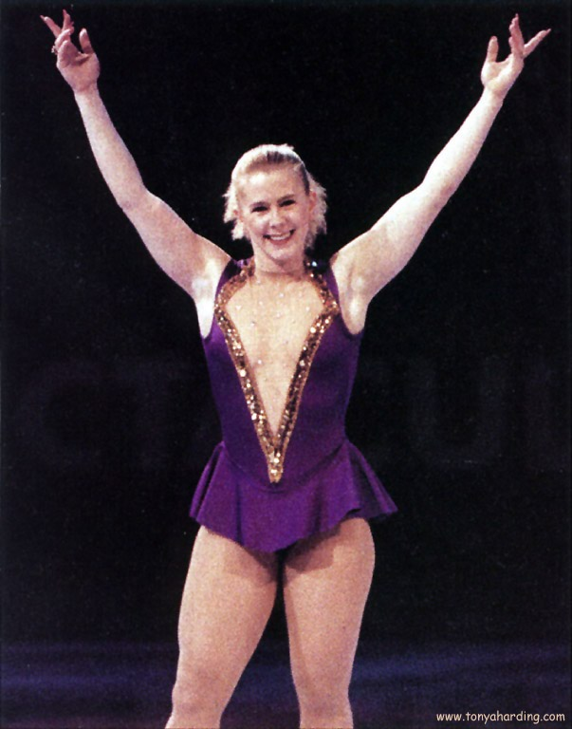

Slide 12
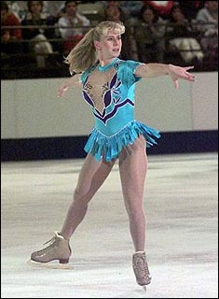
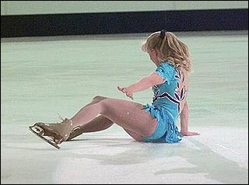
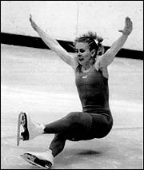
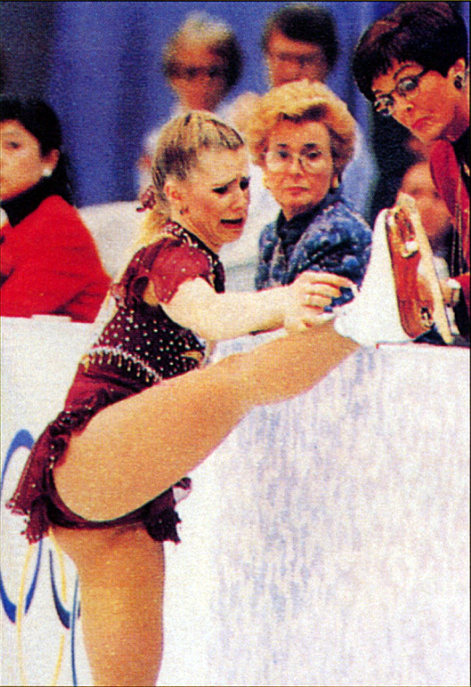

Slide 13
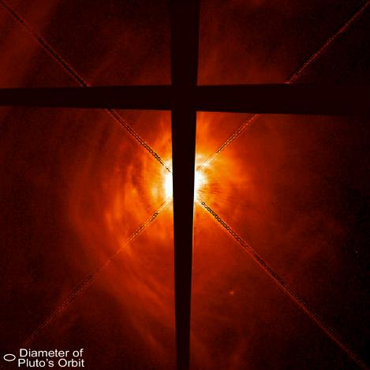
So, as nebula contracted it rotated faster.
Could not remain spherical! Faster rotation tends to fling matter outwards, so it collapsed faster along rotation axis => it became a flattened disk, like a pizza crust.
Hubble is seeing these now!

Slide 14
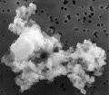
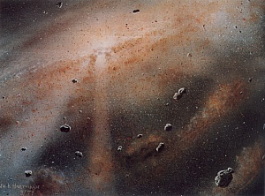
Now to make the planets . . .
Solar Nebula: 98% of mass was gas (H, He)
2% in dust grains (Fe, C, Si . . .)
Condensation theory:
1) Dust grains act as "condensation nuclei": gas atoms stick to them => growth of first clumps of matter.
About 0.1 microns
2) Accretion: Clumps collide and stick => larger clumps. Eventually, small-moon sized objects: "planetesimals".
3) Gravity-enhanced accretion: objects now have significant gravity. Mutual attraction accelerates accretion. Bigger objects grow faster => a few planet-sized objects.

Slide 15
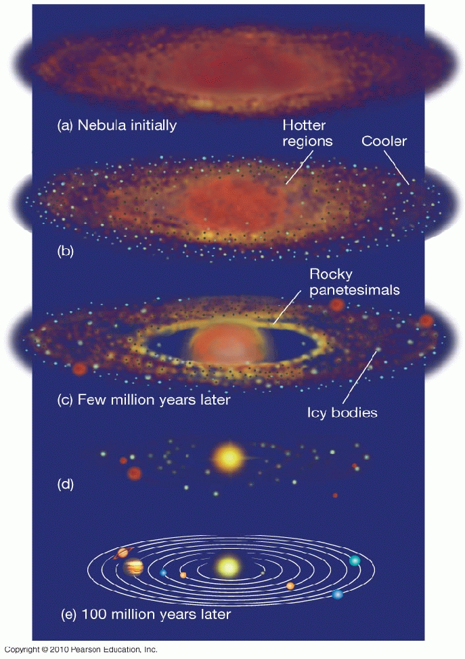
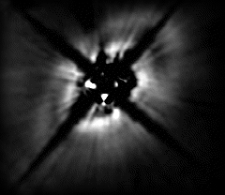
initial gas and dust nebula
dust grains grow by accreting gas, colliding and sticking
continued growth of clumps of matter, producing planetesimals
planetesimals collide and stick, enhanced by their gravity
Hubble observation of disk around young star with ring structure. Unseen planet sweeping out gap?
result: a few large planets. Much
leftover debris

Slide 16
Terrestrial - Jovian Distinction
Outer parts of disk cooler: ices form (but still much gas), also ice "mantles" on dust grains => much solid material for accretion => larger planetesimals => more gravity => even more growth.
Jovian solid cores ~ 10-15 M_{Earth} . Strong gravity => swept up and retained large gas envelopes of mostly H, He.
Inner parts hotter (due to forming Sun): no ice. Accretion of gas atoms onto dust grains relatively inefficient.
Composition of Terrestrial planets reflects that of initial dust –
not representative of Solar System, Milky Way, or Universe.

Slide 17
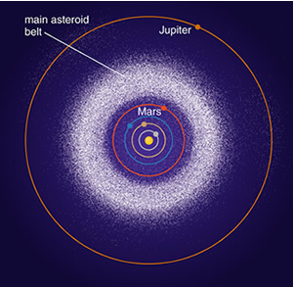
And Finally . . .
Leftover planet building blocks are the asteroids, meteoroids, Kuiper Belt Objects and comet “nuclei”. But most swept up by Jupiter, fell into Sun, or ejected from Solar System.
Remaining gas swept out by Solar Wind.
Asteroid Belt
Perhaps a planet was going to form there. But Jupiter's strong gravity disrupted planetesimals' orbits, ejecting them out of Solar System. The Belt is the few left behind.

Slide 19
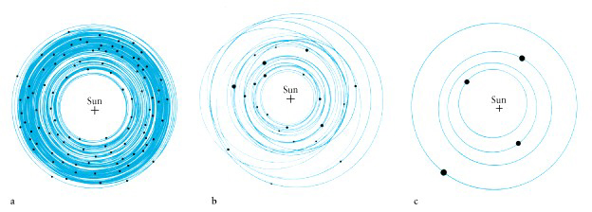
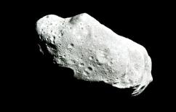
Result from computer simulation of planet growth
Shows growth of terrestrial planets. If Jupiter's gravity not included, fifth terrestrial planet forms in Asteroid Belt. If Jupiter included, orbits of planetesimals there are disrupted. Almost all ejected from Solar System.
Simulations also suggest a few Mars-size objects formed in Asteroid Belt. Their gravity modified orbits of other planetesimals, before they too were ejected by Jupiter's gravity.
Asteroid Ida

