Slide 1
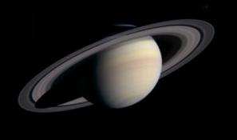
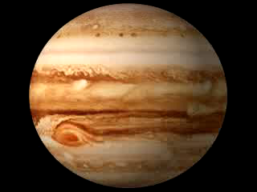

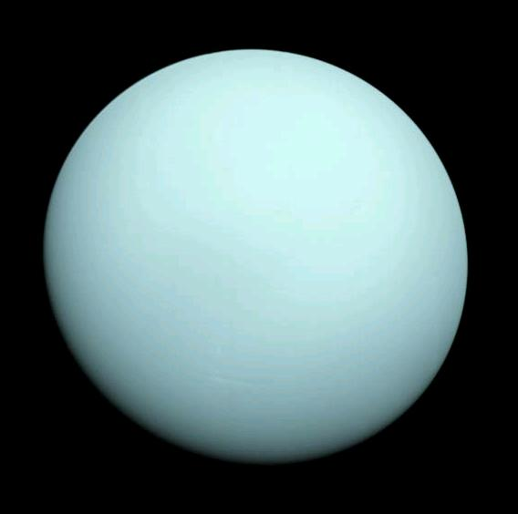
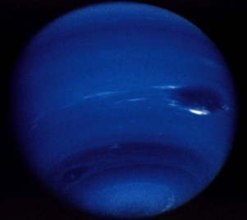
The Jovian Planets
Jupiter
Saturn
Uranus
Neptune
(roughly to scale)

Slide 2
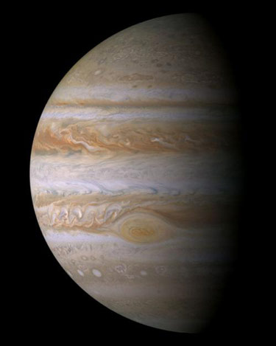
Discoveries
Jupiter and Saturn known to ancient astronomers.
Uranus discovered in 1781 by William Herschel.
Neptune predicted to exist by John Adams and Urbain Leverrier because of irregularities in Uranus' orbit. Discovered in 1845 by Johann Galle.

Slide 3
Basic Properties
Mass
(M_{Earth})
Radius
(R_{Earth})
Orbit semi-major axis (AU)
Orbital Period (years)
Jupiter
Saturn
Uranus
Neptune
318
95
15
17
11
9.5
4
3.9
5.2
9.5
19.2
30.1
11.9
29.4
84
164
(0.001 M_{Sun})
Major Missions
Launch
Planets visited
Voyager 1
Voyager 2
Galileo
Cassini
1977
1979
1989
1997
Jupiter, Saturn
Jupiter, Saturn, Uranus, Neptune
Jupiter
Jupiter, Saturn

Slide 4
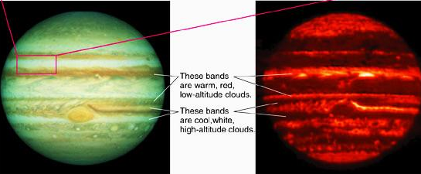
Jupiter's Atmosphere and Bands
Whiteish "zones" and brownish "belts".
Optical – colors dictated by how molecules reflect sunlight
Infrared - traces heat in
atmosphere, therefore depth
So white colors from cooler, higher clouds, brown from warmer, lower
clouds. Great Red Spot – very high.

Slide 5
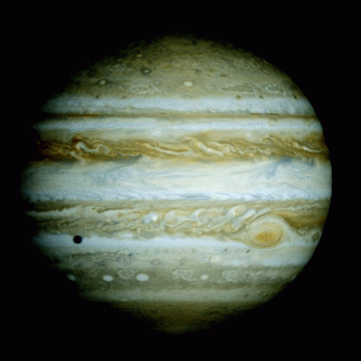
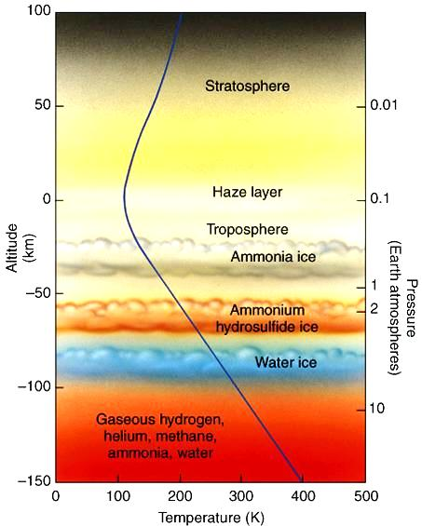
Composition: mostly H, some He, traces of other elements (true for all Jovians). Gravity strong enough to retain even light elements. Mostly molecular. Spectroscopy of reflected sunlight reveals which molecules present.
Altitude 0 km defined as top of troposphere (cloud layer)
(NH₃)
These molecules should all give white clouds. Molecules responsible for colors actually not clear!
NH₄SH

Slide 6
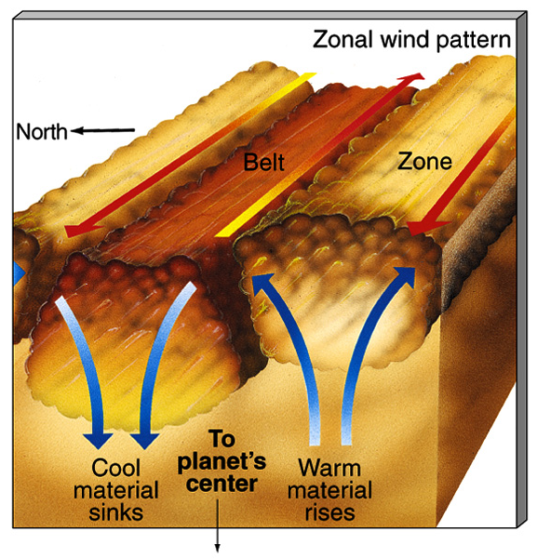
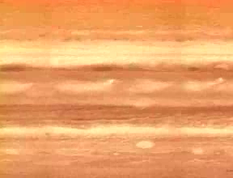
- Zones and belts mark a convection cycle. Zones higher up than belts.
- Zones were thought to be where warm gas rises, belts where cooled gas sinks. Now less clear after Cassini, which found rising gas and falling gas confined to the belts!
- Jupiter's rapid rotation stretches them horizontally around the entire planet.
- Winds flow in opposite directions in zones vs. belts. Differences are hundreds of km/hr.
backup link

Slide 7
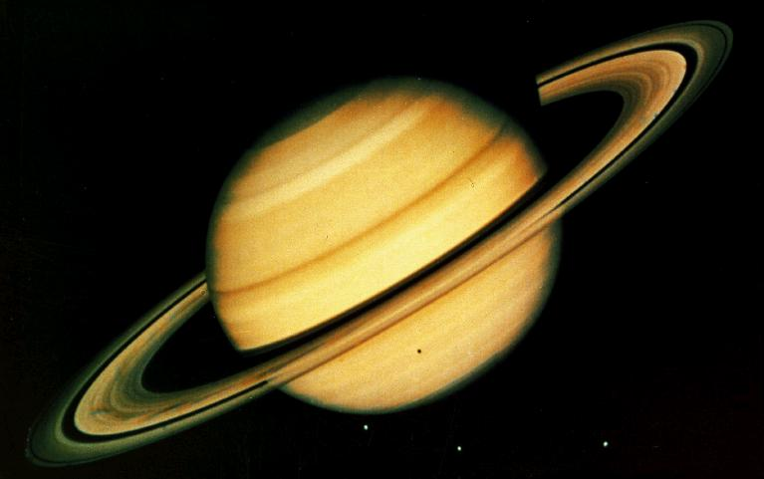

Other Jovian planets: banded structure and colors
More uniform haze layer makes bands less visible. Reason: weaker gravity allows clouds to
rise higher and spread out to create more uniform layer
Blue/green of Uranus and blue of Neptune due to methane. Colder than Jupiter and Saturn, their ammonia has frozen and sunk lower. Methane still in gas form. It reflects blue light.

Slide 8
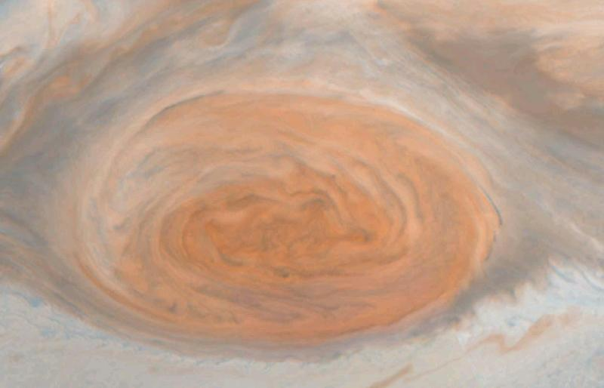
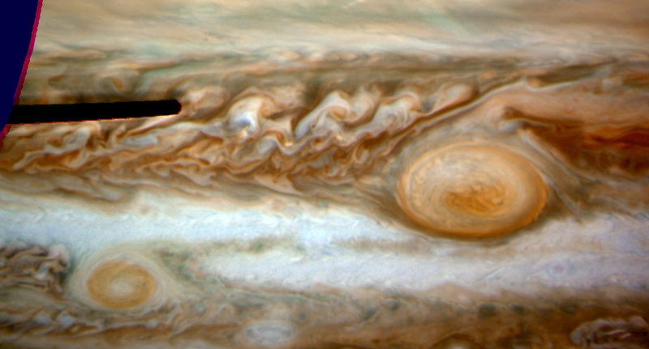
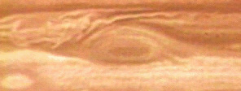
Storms on Jovian Planets
Jupiter's Great Red Spot: A hurricane twice the size of Earth. Has persisted for at least 340 years. Reaches highest altitudes.
New storm “Oval BA”
backup link

Slide 9
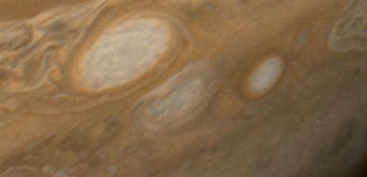
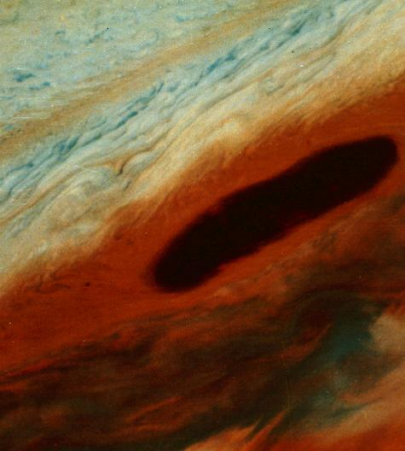
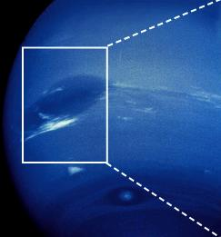
"white ovals" - may last decades
"brown ovals" - only seen near 20° N latitude. Not known why. May last years or decades
Neptune's Great Dark Spot: Discovered by Voyager 2 in 1989. But had disappeared by 1994 Hubble observations. About Earth-sized.
Why do these storms last so long?

Slide 10
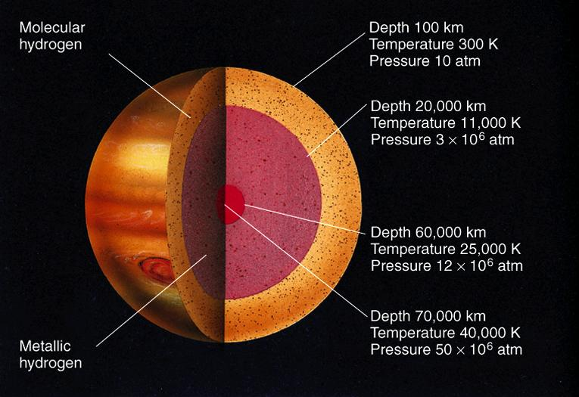
Jupiter's Internal Structure
Can't observe directly. No seismic information. Must rely on physical reasoning and connection to observable phenomena.
(acts like a liquid metal, conducts electricity)
Core thought to be molten or partially molten rock,
maybe 25 g/cm³, and of mass about 10-15 M_{Earth} .
Other Jovians similar. Interior temperatures, pressures and densities less extreme.

Slide 12
Rapid rotation causes Jupiter and Saturn to bulge:
Gravity
Gravity
without rotation
with rotation
Jupiter and Saturn rotate every ~10 hours. Radius at equator several % larger due to bulge.

Slide 13
Juno mission
Juno. Launched Aug 5, 2011. Arrives 2016. Will study
Atmospheric chemistry, internal structure, magnetosphere.
Careful gravity measurements should reveal whether it has
a solid core or not. Not expected in grav instab. Model.
May settle the zones/belts issue. Will probe chemistry
Deeper than before. Composition, temperature, clouds, motions.
Cost $1 billion.

Slide 14
Differential Rotation
Rotation period is shorter closer to the equator:
Near poles
At equator
Jupiter
Saturn
Uranus
9^{h} 56^{m}
10^{h} 40^{m}
16^{h} 30^{m}
9^{h} 50^{m}
10^{h} 14^{m}
14^{h} 12^{m}
How do we know? Tracking storms at various latitudes, or using Spectroscopy and Doppler shift.

Slide 15
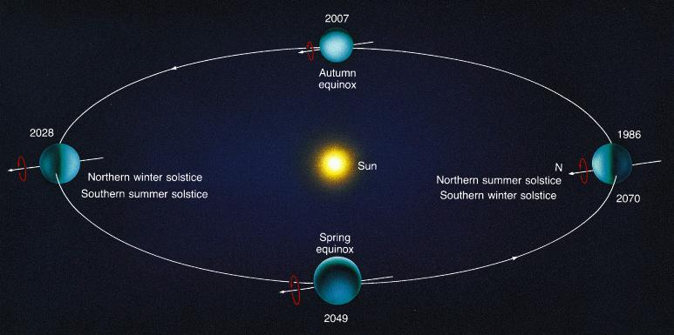
Uranus' rotation axis is tilted by 98º
Why? Unknown. Perhaps an early, grazing collision with another large body.

