Slide 1
Interested in majoring (or minoring) in physics or astronomy? Ask me how!

Slide 2
Please read about Drake Equation and the search for extraterrestrial
intelligence.

Slide 3
Extrasolar Planets
More than 700 discovered.
Main technique: detect Doppler Shift due to wobble of star caused by unseen planet. Only one successful when video made. > 500 found.

Slide 4
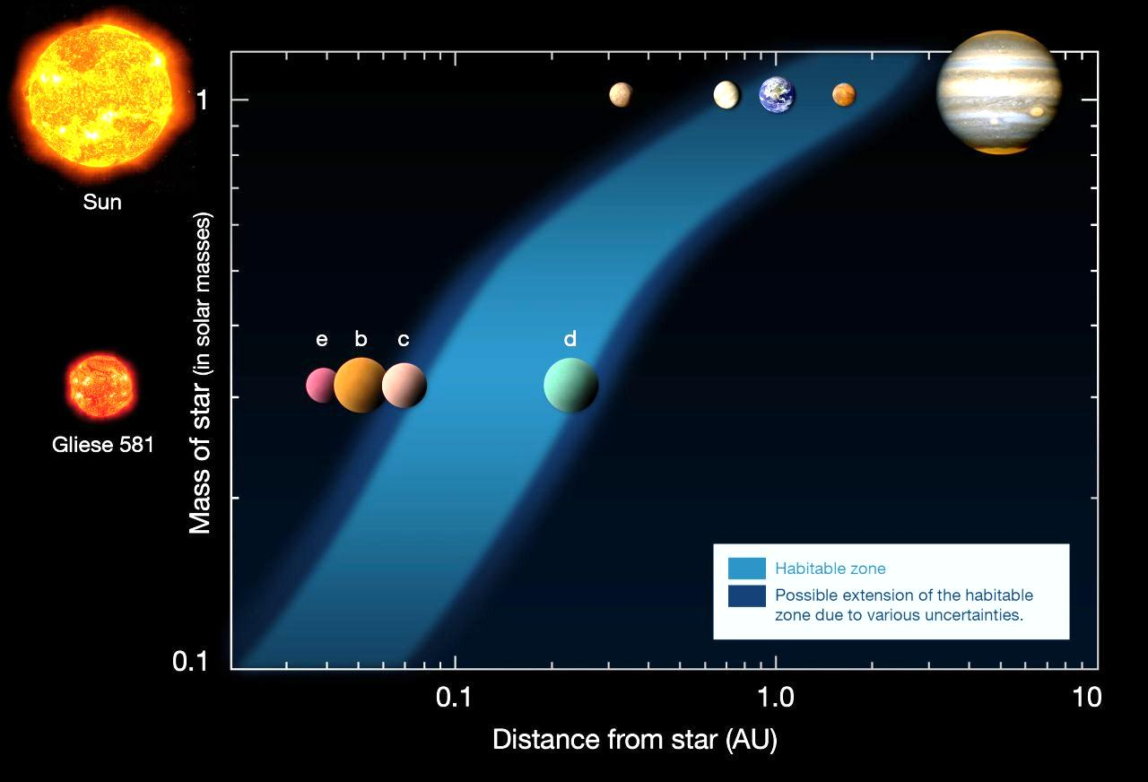
Extrasolar planet as low as 1.9 – 3 Earth masses found – April 2009. Using Doppler shift technique

Slide 5
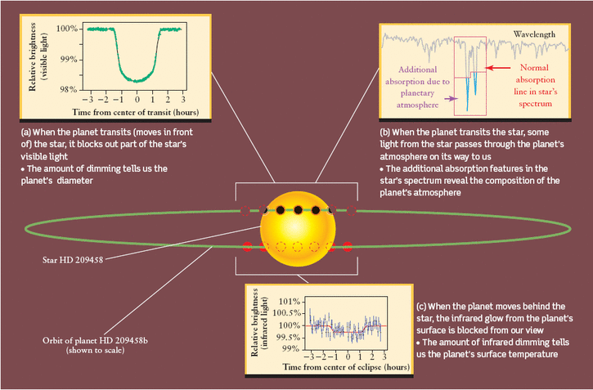
Second technique: detect eclipse of planet. Over 200 found.

Slide 6
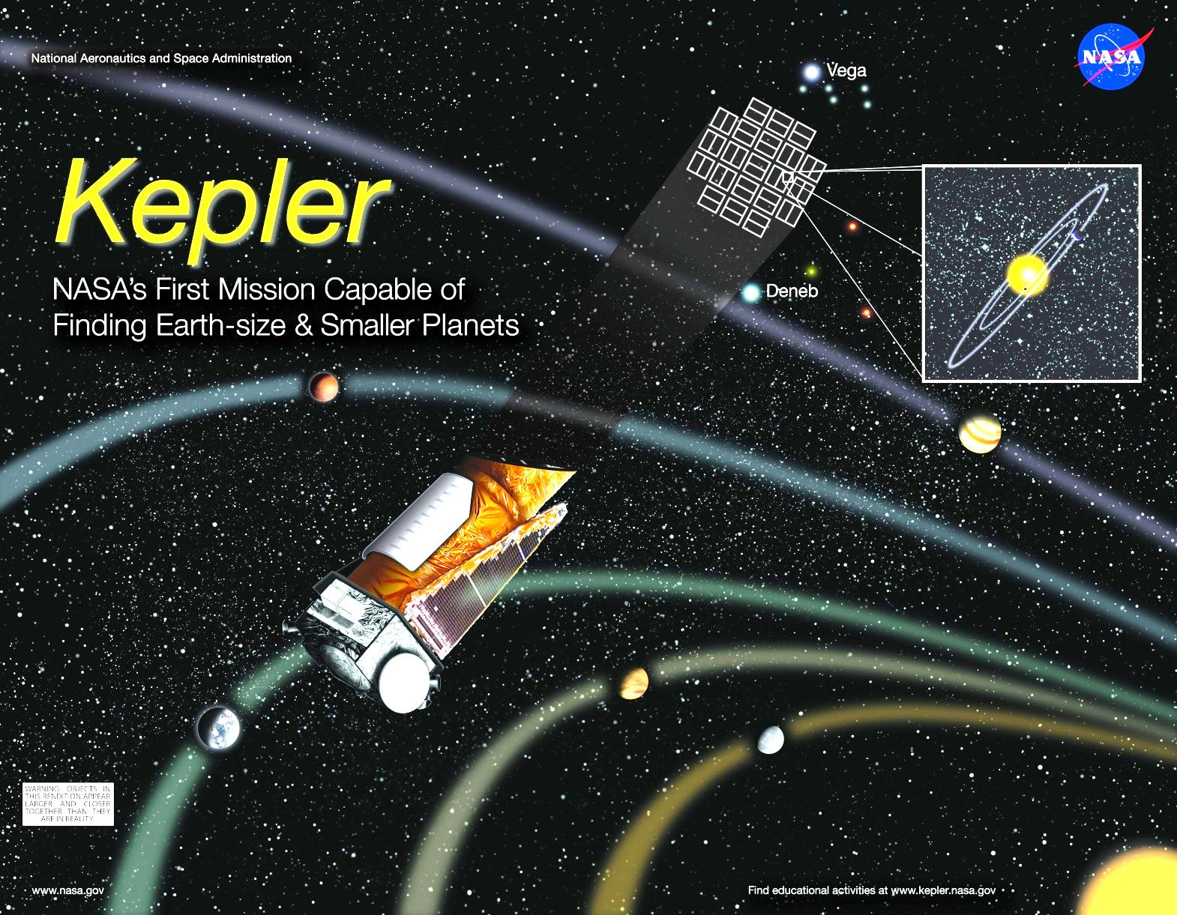
Kepler mission. Launched March 2009. Several years of data – still being analyzed. Detected eclipses. Yields only radii, not masses.

Slide 7
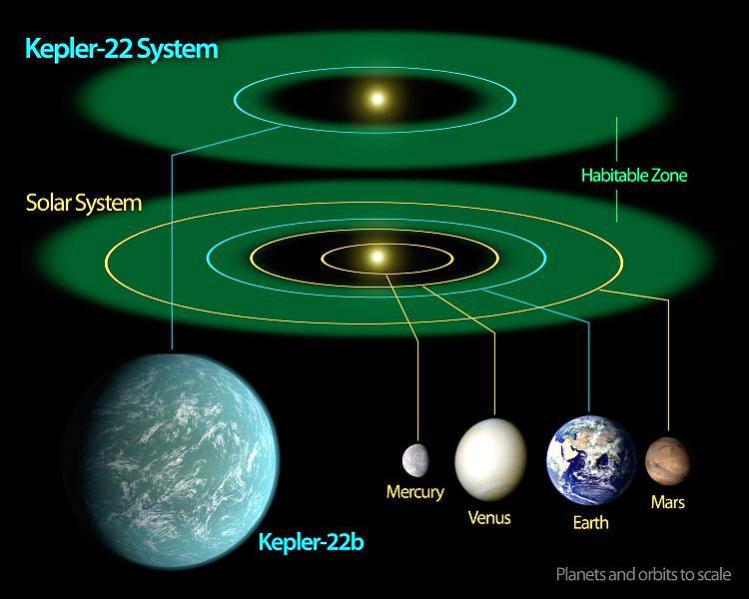
Dec 5, 2011: Kepler finds planet with R=2.4R_{Earth} in star’s
habitable zone. Mass unknown. Solid or gas/liquid?

Slide 8
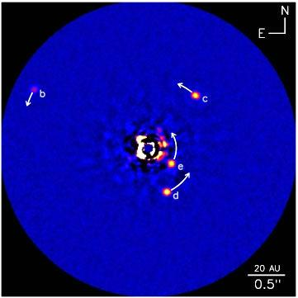
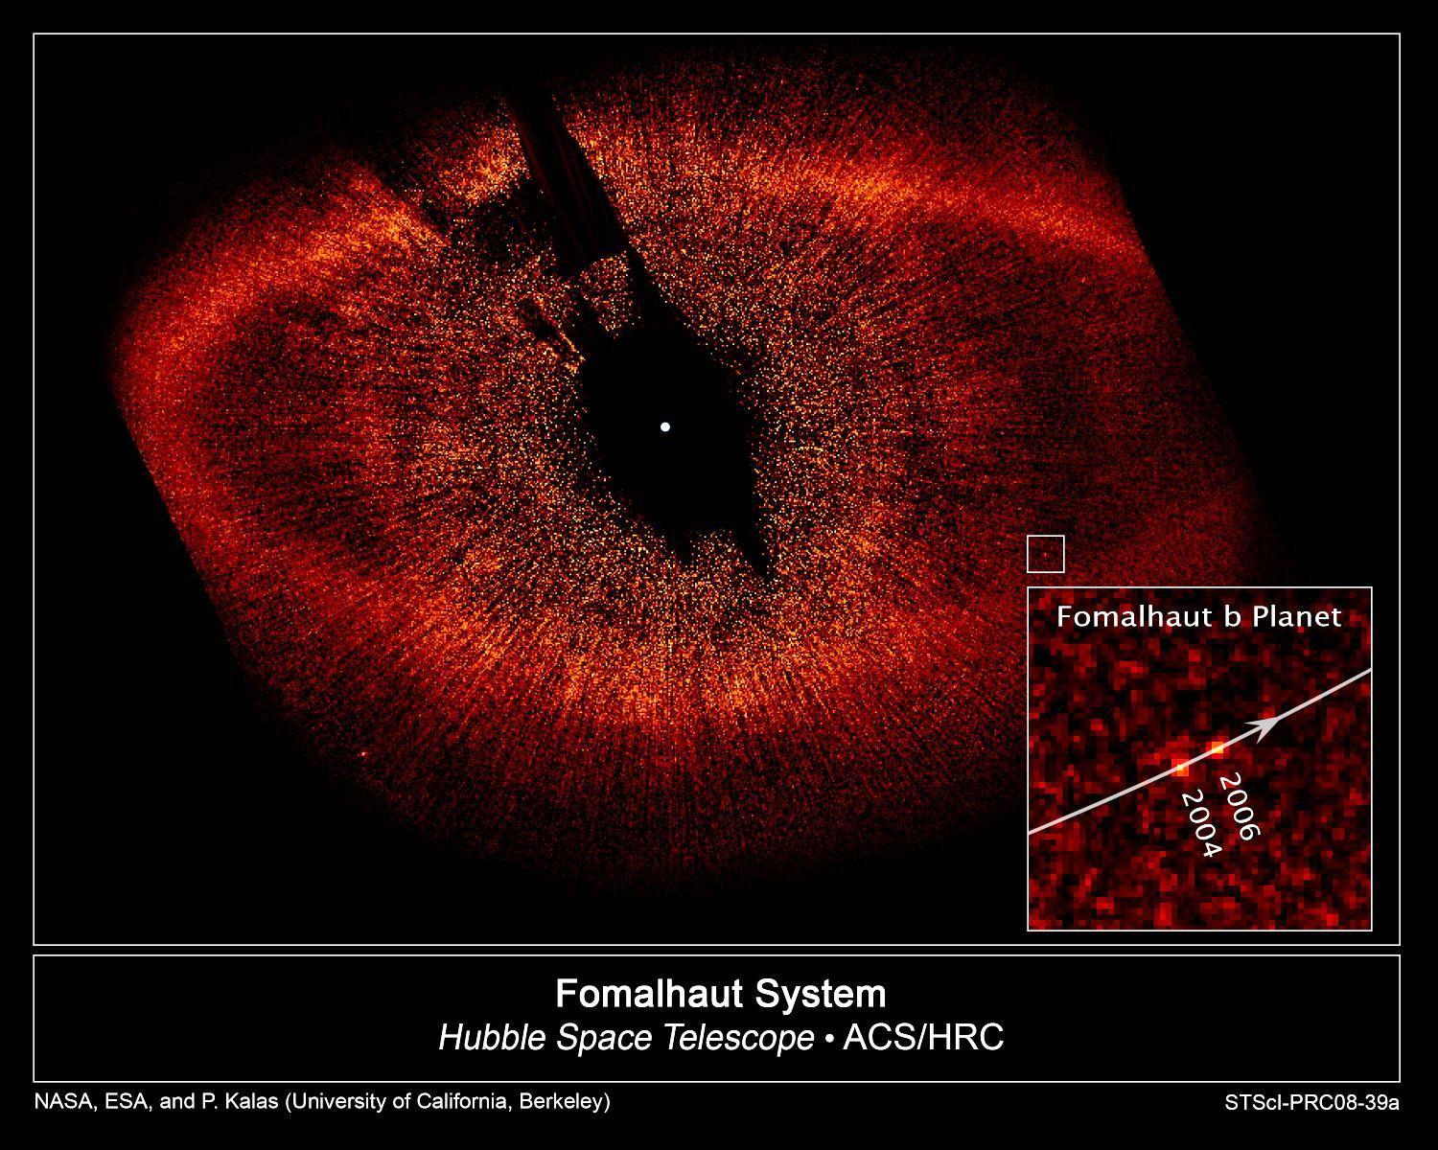
Third technique: direct imaging of planet.
29 found.
Others...
HR 8799

Slide 9
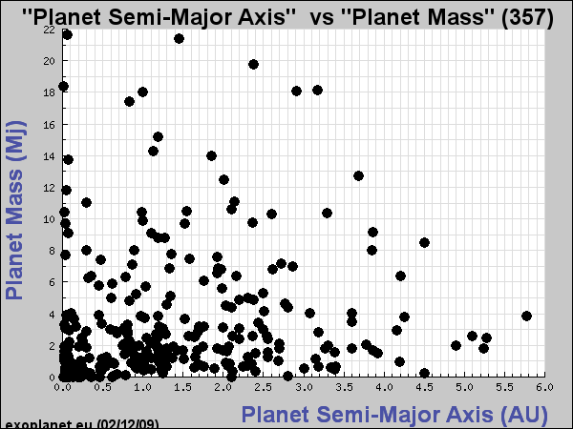
Most planets found are more massive than Jupiter – many are closer to
star than 1 AU (“hot Jupiters”)!
10 Jupiter Masses
1 Jupiter Mass
Earth
Jupiter

Slide 10
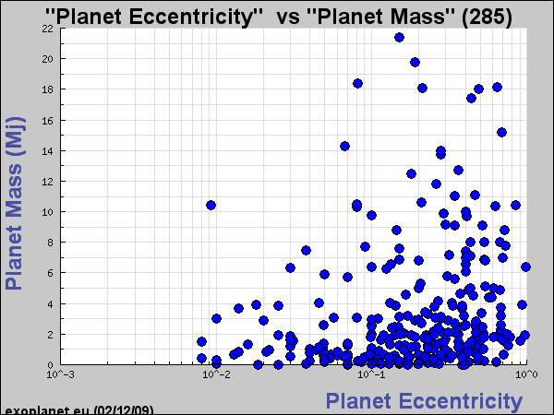
Most planets have eccentric orbits. Circular would be better for life!
0.01 0.1 1
(Earth)

Slide 11
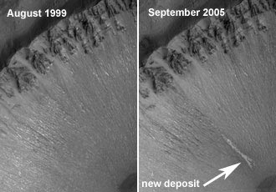
Is There Life Elsewhere in the Universe?
Elsewhere in the Solar System:
Conditions may be right for primitive life to exist on Mars (or existed in the past) and Europa. Possibly some complex molecules on Titan.
Water flow on Mars in
last few years?
Elsewhere in the Milky Way:
To address question of whether other intelligent life exists in the Milky Way, Frank Drake formulated the Drake Equation.

Slide 12
The Drake Equation
number of technological, intelligent civilizations in the Milky Way
rate at which new stars are formed
fraction of stars having planetary systems
average number of habitable planets within those planetary systems
x
x
=
fraction of those habitable planets on which life arises
fraction of those life-bearing planets on which intelligence evolves
fraction of those planets with intelligent life that develop technological society
average lifetime of a technological civilization
x
x
x
x
Each term is less certain than the preceding one! Only in last ten years have we addressed the second term.

Slide 13
Is There Life Elsewhere in the Universe?
Requirements for Life:
- Elements to build cells (C, H, O most important)
- Energy source to make chemical reactions happen to fuel
metabolism
- Liquid medium – water allows organic (C-based) molecules to dissolve and be carried into cells for metabolic reactions
These conditions occurred on Earth, but it's not clear whether life was then inevitable. Also, how unique are they?

Slide 14
Urey-Miller Experiment (1953)
Solution of water, methane, CO₂, ammonia, with electrical discharge
=> amino acids formed (building blocks of proteins, which control metabolism
Later experiments produced nucleotide bases (building blocks of DNA)
Yet to make cell or DNA through such experiments (although some cell-like objects created from mixing amino acids and heat). Not clear how robust life is and whether it required a fortunate set of accidents.
Alternative theory:
Organic molecules, maybe even amino acids and nucleotide bases came from comets and meteoroids (a lot of Earth's water may have come from comets)

