Slide 1
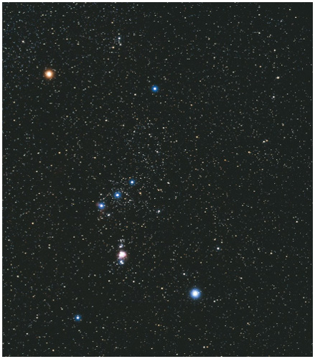
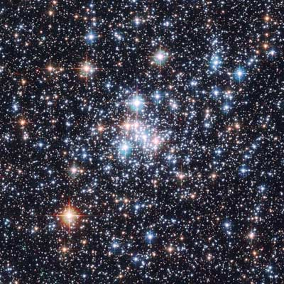
Measuring the Stars
How big are stars?
How far away?
How luminous?
How hot?
How old, and how much longer to live?
Chemical composition?
How are they moving?
Are they isolated or in clusters?

Slide 2
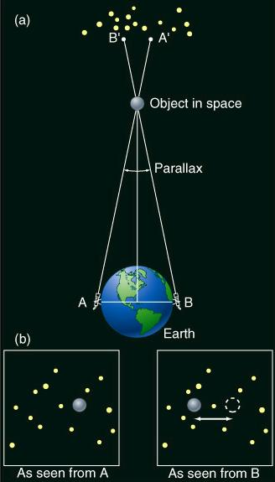
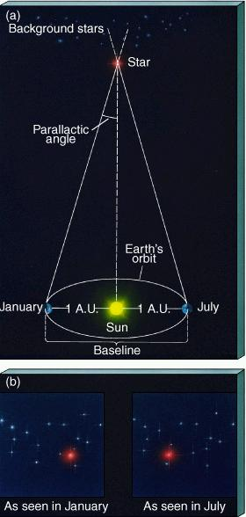
How Far Away are the Stars?
Earth-baseline parallax - useful in Solar System
Earth-orbit parallax - useful for nearest stars
Parallax animation

Slide 3
New distance unit: the parsec (pc).
Using Earth-orbit parallax, if a star has a parallactic angle of 1",
it is 1 pc away.
If the angle is 0.5", the distance is 2 pc.
1
Parallactic angle (arcsec)
Distance (pc) =
Closest star to Sun is Proxima Centauri. Parallactic angle is 0.7”, so distance is 1.3 pc.
1 pc = 3.3 light years
= 3.1 x 10¹⁸ cm
= 206,000 AU
1 kiloparsec (kpc) = 1000 pc
1 Megaparsec (Mpc) = 10 ⁶ pc

Slide 4
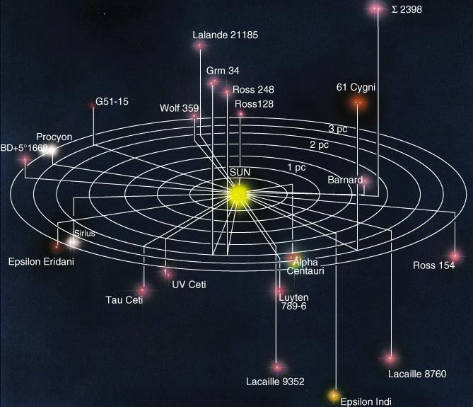
Earth-orbit parallax using ground-based telescopes good for stars within 30 pc (1000 or so). Tiny volume of Milky Way galaxy. Other methods later.
Our nearest stellar neighbors

Slide 5
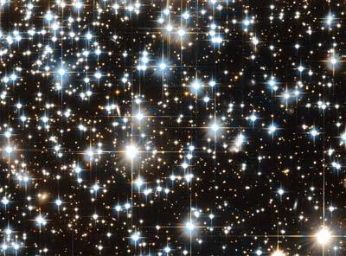
How Luminous are Stars?
Remember, luminosity of the Sun is
L_{Sun} = 4 x10²⁶ Watts
Luminosity also called “absolute brightness”.
How bright a star appears to us is the “apparent brightness”, which depends on its luminosity and distance from us:
apparent brightness α luminosity
(distance)²
So we can determine luminosity if apparent brightness and distance are measured:
luminosity α apparent brightness x (distance)²
Please read about magnitude scale.

Slide 6
How Hot are Stars at the Surface?
Stars have roughly black-body spectra. Color depends on surface temperature. A quantitative measure of “color”, and thus temperature, can be made by observing star through various color filters. See text for how this is done.
Betelgeuse
T=3000 K
Rigel
T=20,000 K

Slide 7
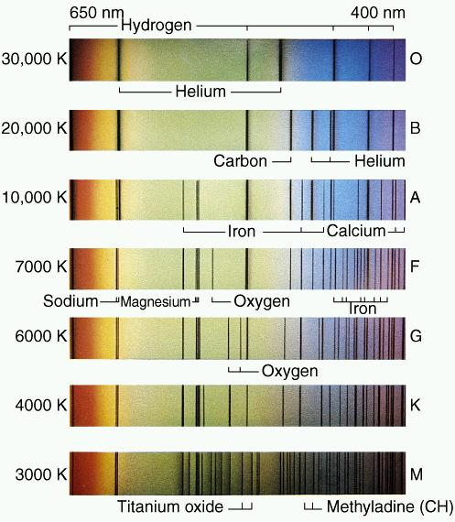
Classification of Stars Through Spectroscopy
Ionized helium. Requires extreme UV photons.
Only hottest stars produce many of these.
Pattern of absorption lines depends on temperature (mainly) and chemical composition.
Spectra give most accurate info on these as well as:
pressure in atmosphere
velocity of star towards or from us

Slide 8

Spectral Classes
Strange lettering scheme is a historical accident.
Annie Cannon
Spectral Class Surface Temperature Examples
O
B
A
F
G
K
M
30,000 K
20,000 K
10,000 K
7000 K
6000 K
4000 K
3000 K
Rigel
Vega, Sirius
Sun
Betelgeuse
Further subdivision: BO - B9, GO - G9, etc. GO hotter than G9. Sun is a G2.

Slide 9
Stellar Sizes
Almost all stars too distant to measure their radii directly. Need indirect method. For blackbodies, remember:
Luminosity α (temperature) ⁴ x (4 π R² )
Determine luminosity from apparent brightness and distance, determine temperature from spectrum (black-body curve or spectral lines), then find radius.

Slide 10
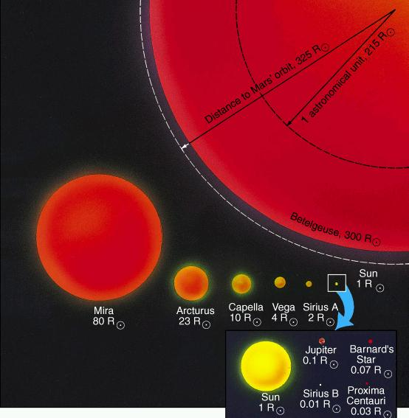
The Wide Range of Stellar Sizes

Slide 11
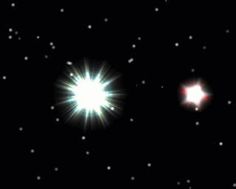
How Massive are Stars?
1. Binary Stars. Orbit properties (period, separation) depend on masses of two stars.
2. Theory of stellar structure and evolution. Tells how spectrum and color of star depend on mass.
Animation of a “visual binary”
Link if video
doesn’t work

Slide 12
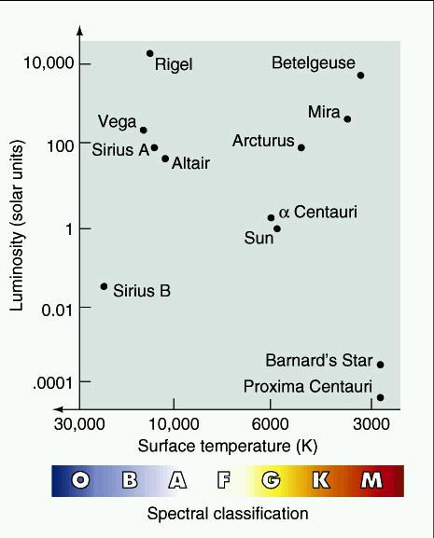
The Hertzsprung-Russell (H-R) Diagram

Slide 13
The Hertzsprung-Russell (H-R) Diagram
Evolved stars
Supergiants
Red Giants
Increasing Mass, Radius on Main Sequence
Sun
Type of
Dead star
Main Sequence
(“Normal” stars)
White Dwarfs
A star’s position in the H-R diagram depends on its mass and evolutionary state.

Slide 14
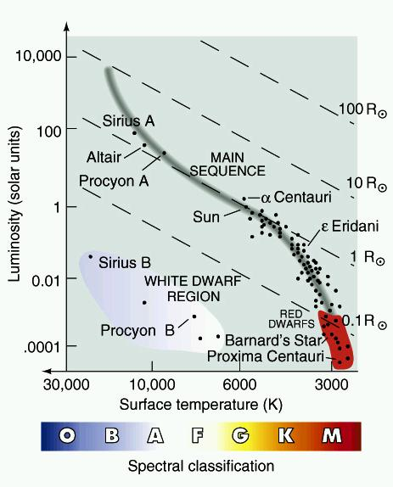
H-R Diagram of Nearby Stars
H-R Diagram of Well-known Stars
Note lines of constant radius!

Slide 15
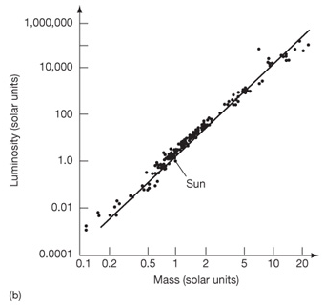
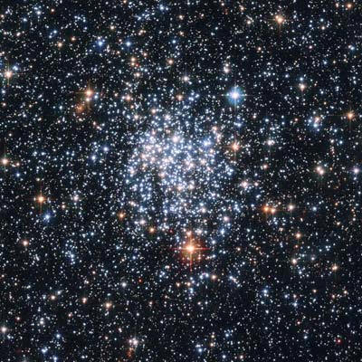
How does a star's Luminosity depend on its Mass?
L α M ³
(Main Sequence stars only!)

Slide 16
How Long do Stars Live
(as Main Sequence Stars)?
Main Sequence stars fuse H to He in core. Lifetime depends on mass of H available and rate of fusion. Mass of H in core depends on mass of star. Fusion rate is related to luminosity (fusion reactions make the radiation energy).
So,
lifetime α
mass of core
fusion rate
α
mass of star
luminosity
Because luminosity α (mass) ³,
mass
(mass)³
or
1
(mass)²
lifetime α
So if the Sun's lifetime is 10 billion years, a 30 M_{Sun} star's lifetime is only 10 million years. Such massive stars live only "briefly".

Slide 17
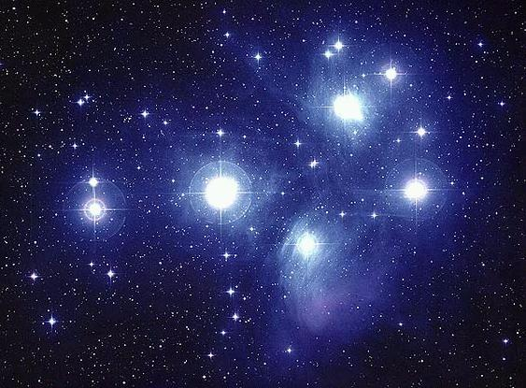
Star Clusters (11.6)
Two kinds:
1) Open Clusters
-Example: The Pleiades
-10's to 100's of stars
-Few pc across
-Loose grouping of stars
-Tend to be young (10's to 100's of millions of years, not billions, but there are exceptions)

Slide 18
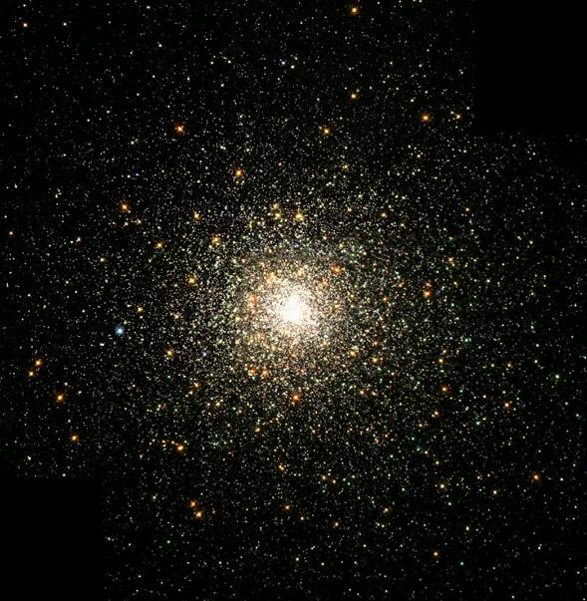
2) Globular Clusters
- few x 10 ⁵ or 10 ⁶ stars
- size about 20 pc
- very tightly packed, roughly spherical shape
- billions of years old
Clusters are crucial for stellar evolution studies because:
1) All stars in a cluster formed at about same time (so all have same age)
2) All stars are at about the same distance
3) All stars have same chemical composition

