Slide 1
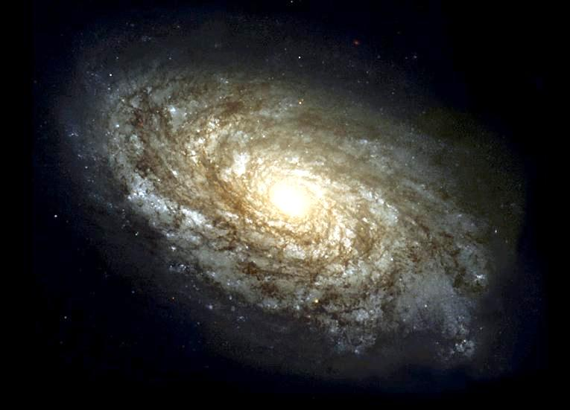
The Milky Way Galaxy
This is NOT the Milky Way galaxy! It’s a similar one: NGC 4414.

Slide 2
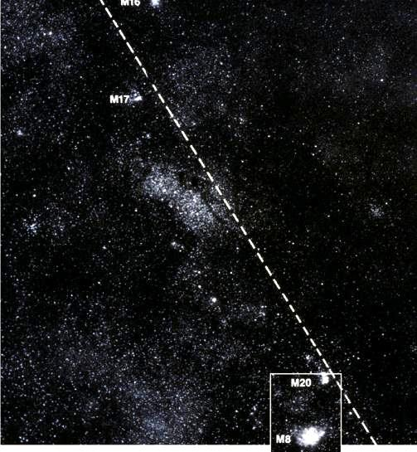
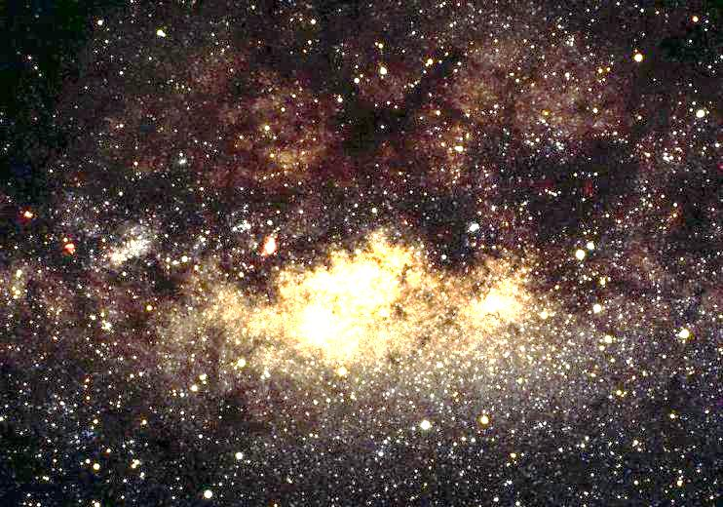
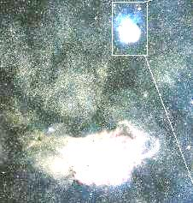
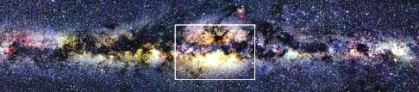
The Milky Way Galaxy

Slide 3
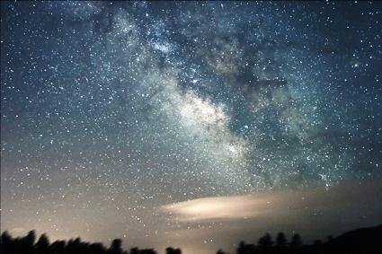
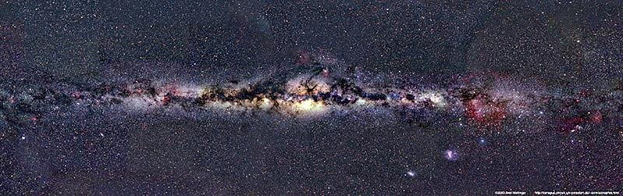
Interactive version

Slide 4
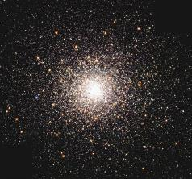
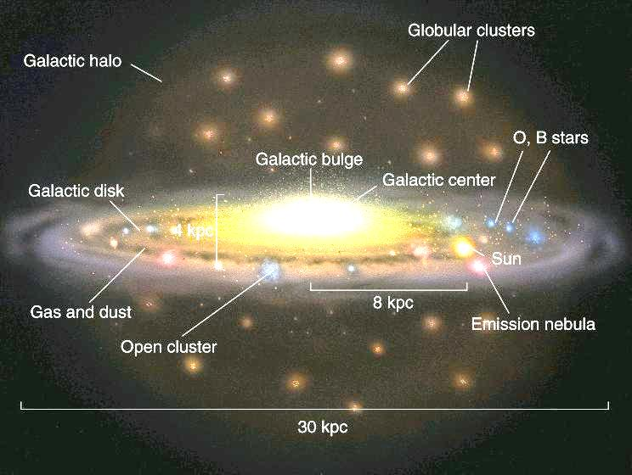
Take a Giant Step Outside the Milky Way
Artist's Conception
Example (not to scale)

Slide 5
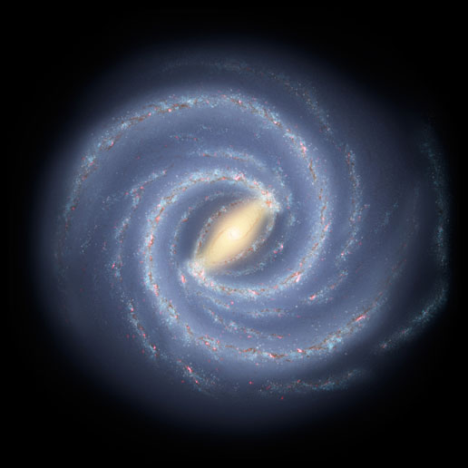
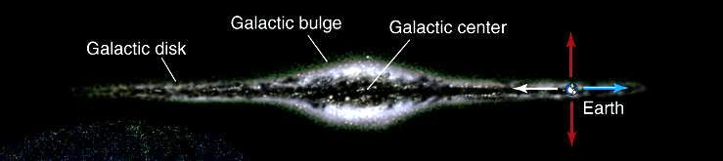
.
from above ("face-on")
see disk, with spiral and
bar structure, and bulge (halo too dim)
Sun
from the side ("edge-on")

Slide 6
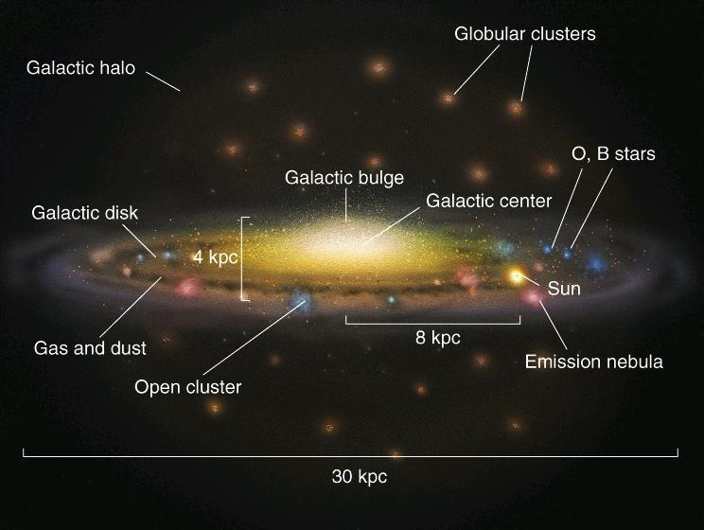
The Three Main Structural Components of the Milky Way
1. Disk
- contains young and old stars (~400 billion), gas, dust. Has spiral structure, bar
- vertical thickness roughly 100 pc - 2 kpc (depending on component. Most gas and dust in thin layer, most stars in thick layer)

Slide 7
2. Halo
- contains globular clusters, old stars, little gas and dust, much "dark matter"
- roughly spherical
3. Bulge
- old stars, some gas, dust
- central black hole of 3 x 10⁶ solar masses
- spherical

Slide 8
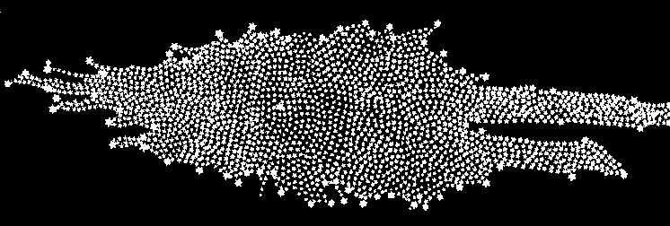
How did we discover size of Milky Way and our place within it?
Herschel (late 18th century): first map of Milky Way. Sun near
center.
Herschel’s Milky Way drawing
.
Sun
3 kpc

Slide 9
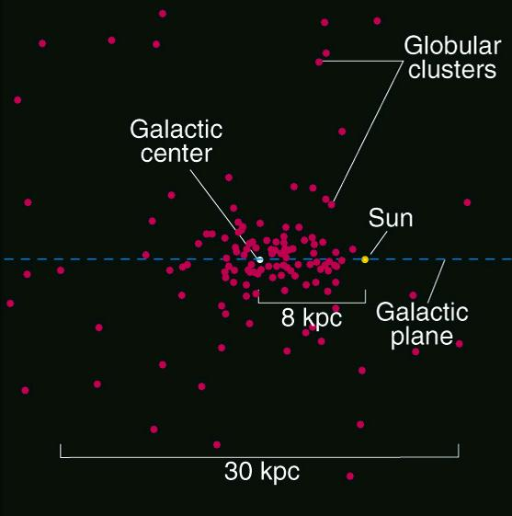
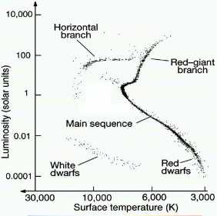
Shapley (1917) found that Sun was not at center of Milky Way
Shapley used distances to Globular Clusters to estimate that Sun was 16 kpc from center of Milky Way. Modern value 8 kpc.

Slide 10
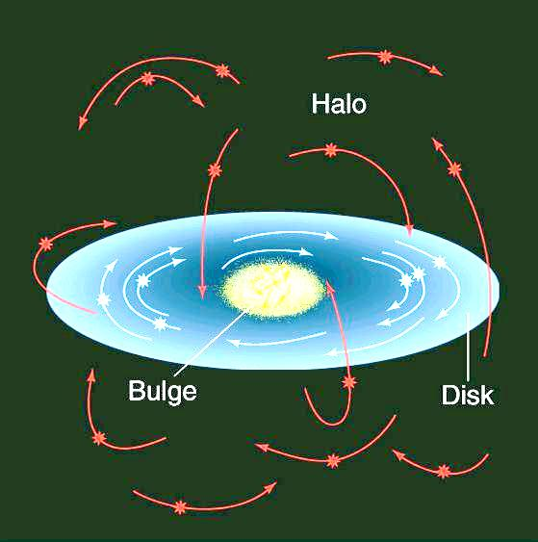
Stellar Orbits
Halo: stars and globular clusters swarm around center of Milky Way. Very elliptical orbits with random orientations.
Bulge: similar to halo.
Disk: rotates.

Slide 11
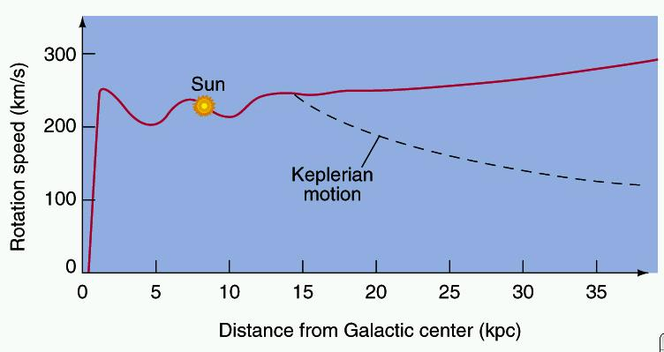
How Does the Disk Rotate?
Sun moves at 225 km/sec around center. An orbit takes 240 million years.
Stars closer to center take less time to orbit. Stars further from center take longer.
=> rotation not like a rigid body. Rather, "differential rotation".
Over most of disk, rotation velocity is roughly constant.
The "rotation curve" of the Milky Way

Slide 12
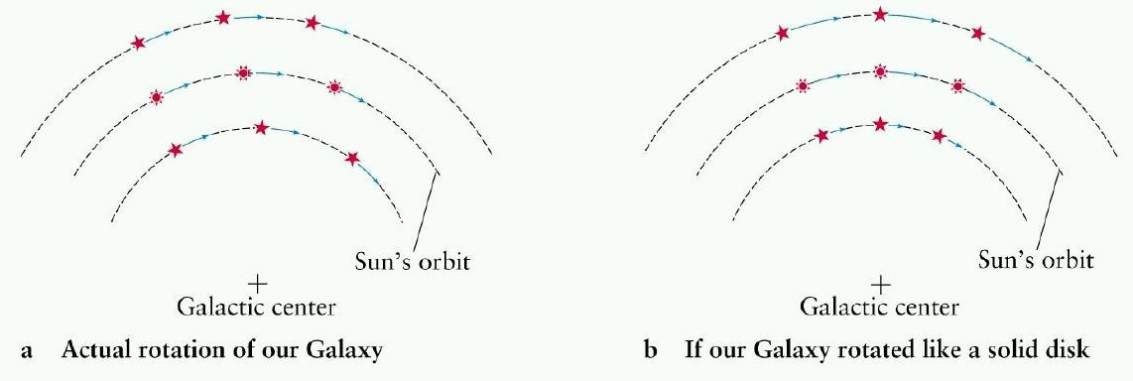

Slide 13
Spiral Structure of Disk
Spiral arms best traced by:
Young stars and clusters
Emission Nebulae
Atomic gas
Molecular Clouds
(old stars to a lesser extent)
Disk not empty between arms, just less material there.

Slide 14
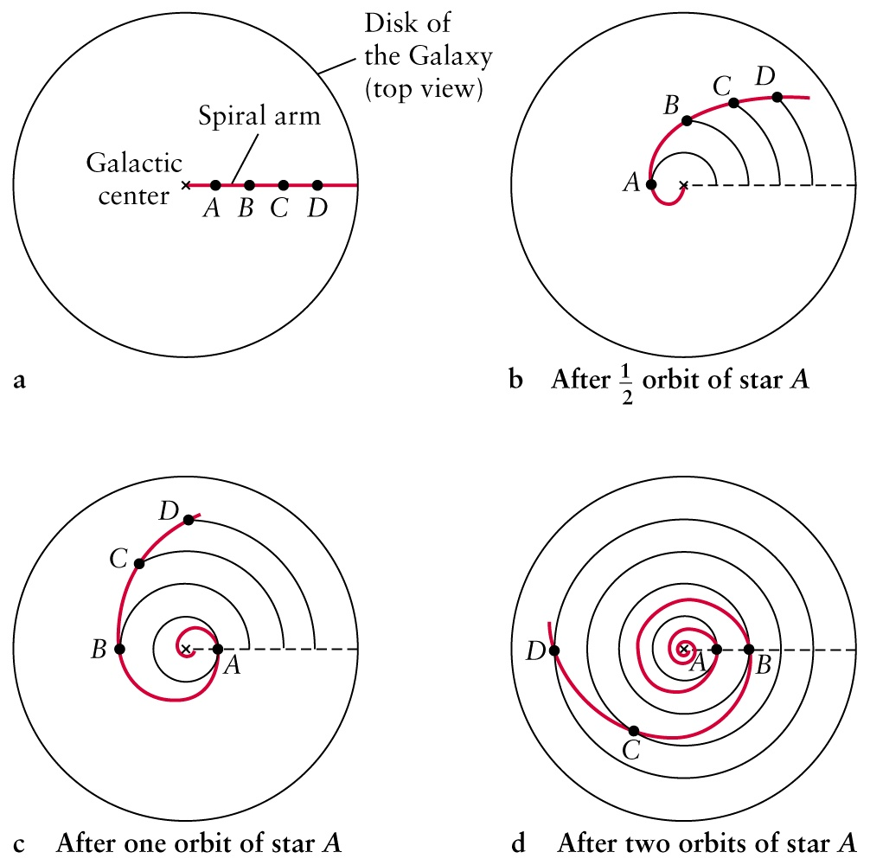
Problem: How do spiral arms survive?
Given differential rotation, arms should be stretched and smeared out after a few revolutions (Sun has made 20 already):
The Winding Dilemma

Slide 15
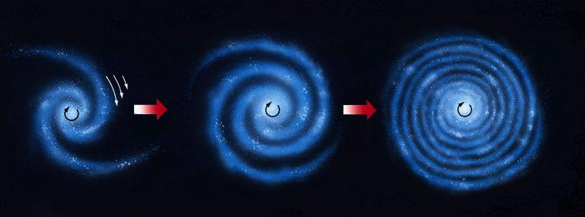
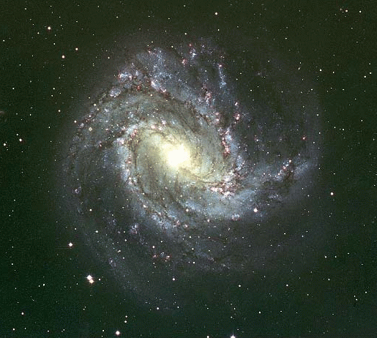
So if spiral arms always contain same stars, the spiral should end up like this:
Real structure of Milky Way (and other spiral galaxies) is more loosely wrapped.

Slide 16
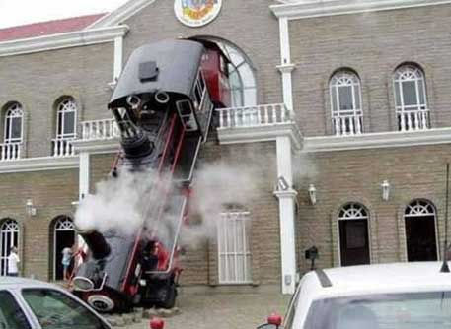
Proposed solution:
Arms are not material moving together, but mark peak of a compressional wave circling the disk:
A Spiral Density Wave
Traffic-jam analogy:

Slide 17
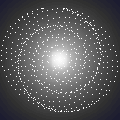
Replace cars by stars. The traffic jams are due to the stars' collective gravity: the higher gravity of the jams keeps stars in them for longer. Calculations and computer simulations show this can be maintained for a long time.
Traffic jam on a loop caused by merging
Not shown – whole pattern rotates

Slide 18
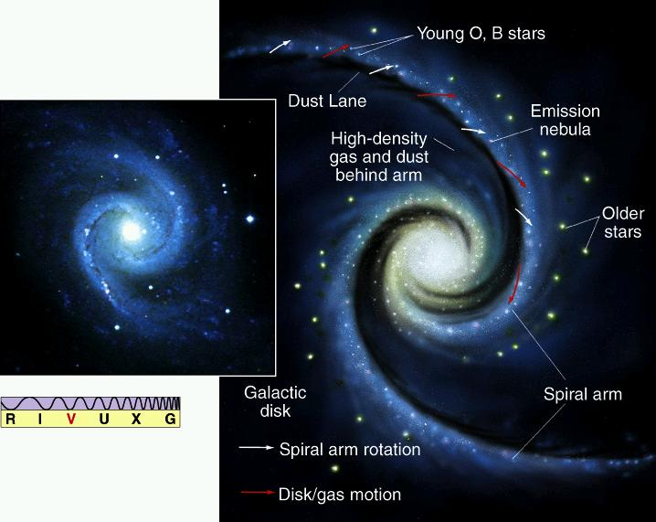
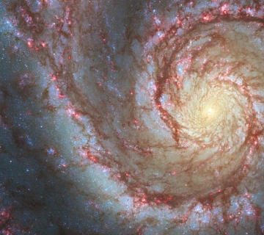
Gas pushed together in arms too => high concentration of dust => dust lanes. Dense, star-forming molecular clouds may form in arms => star formation concentrated there.
Bright young massive stars live and die in spiral arms. Emission nebulae mostly in spiral arms.
So arms always contain same types of objects, but individual objects come and go.

Slide 19
90% of Matter in Milky Way is Dark Matter
Gives off no detectable radiation. Evidence is from rotation curve:
10
Rotation
Velocity
(AU/yr)
Solar System Rotation Curve: when essentially all mass at center, velocity decreases with radius ("Keplerian")
5
1
1
10
20
30
R (AU)
observed curve
Milky Way Rotation Curve
Curve if Milky Way ended where radiating matter pretty much runs out.

Slide 20
Not enough radiating matter at large R to explain rotation curve => "dark" matter!
Dark matter must be about 90% of the mass!
Composition unknown. Probably mostly exotic particles that hardly interact with ordinary matter at all (except gravity). Small fraction may be brown dwarfs, dead white dwarfs.
Most likely it's a dark halo surrounding the Milky Way.
Mass of Milky Way
6 x 10¹¹ solar masses within 40 kpc of center.

Slide 22
Now imagine many trucks, circling around in a spiral pattern whose shape doesn't change.
car
car
car
car
car
car
car
car
car
car
car
car
car
car
car
car
car
car
car
car
car
car
car
car
car
car
car
car
car

Slide 23
Trucks not shown, but trucks on inner ring take same time to go around as ones on outer ring, even though cars in both rings go at same average speed.
car
car
car
car
car
car
car
car
car
car
car
car
car
car
car
car
car
car
car
car
car
car
car
car
car
car
car
car
car

Slide 24
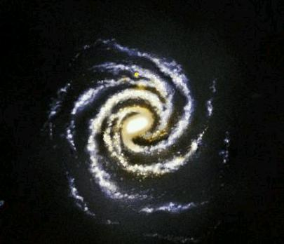
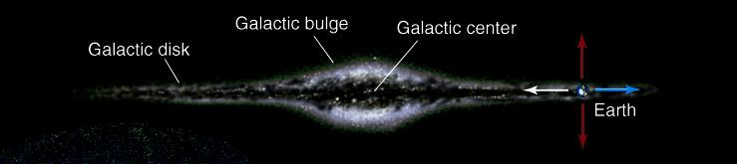
from above ("face-on")
see disk and bulge (halo
too dim)
Perseus arm
Orion spur
Sun
Cygnus arm
Sagittarius arm
Carina arm
from the side ("edge-on")

