Slide 1
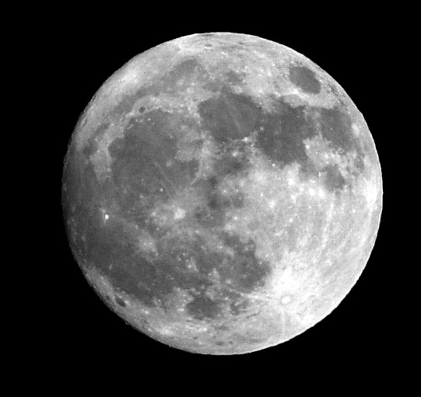
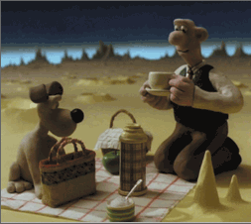
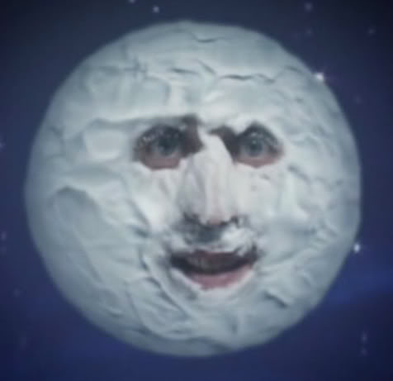
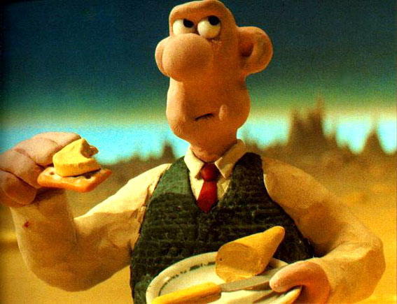
The Moon
“Jupiter! I did a song! You ain’t got one!”
"Camembert?"

Slide 2
The Moon
Mass
= 7.4 x 10²⁵ g
= 0.012 M_{Earth}  
= 1738 km
= 0.27 R_{Earth}
Radius
Density = 3.3 g/cm³
(Earth: 5.5 g/cm³)
Gravity = 1/6 that of Earth,
not zero!
Distance = 384,400 km

Slide 3
Clicker question:
Earthquakes are
concentrated along coasts
randomly distributed over the Earth’s surface
concentrated along plate boundaries
concentrated in mountainous regions

Slide 4
Clicker question:
What is the distance from the Earth to the Moon in our scale model?
3 m
6 m
12 m
24 m

Slide 5
We always see the same face of the Moon.
Animation showing this.
Clicker question: does the Moon spin on its axis?
Yes
No
So period of orbit = period of spin
Why?

Slide 6
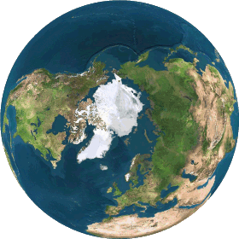
Tidal Locking
The tidal bulge in the solid Moon elongates it slightly (2-3 km) along axis pointing to Earth.
If spin period faster than orbit period, tidal bulge would have to move around surface (like Earth’s ocean tides), creating friction, which slows the Moon’s spin down until tidal bulge stops migrating.
Top view of Moon orbiting Earth
Earth

Slide 7
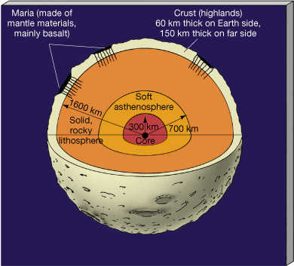
Lunar Structure
See new Grail mission results. Crust about 40 km thick
(mostly from Apollo seismic data)
Core (iron) and asthenosphere take up small fraction of volume compared to Earth case – the Moon is more rigid
No atmosphere: no wind erosion, or meteoroid burn-up. Surface reflects geologic history well.

Slide 8
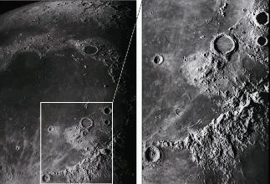
The Lunar Surface
- Large, dark featureless areas: "maria" or "seas".
- Lighter areas at higher elevation: "highlands".
- Many craters (due mostly to meteoroid impacts). No winds to erode them away.
- Highlands have 10x the crater density of maria.
Note: some homework questions refer to “maria” as “mare” (this is actually singular).

Slide 9
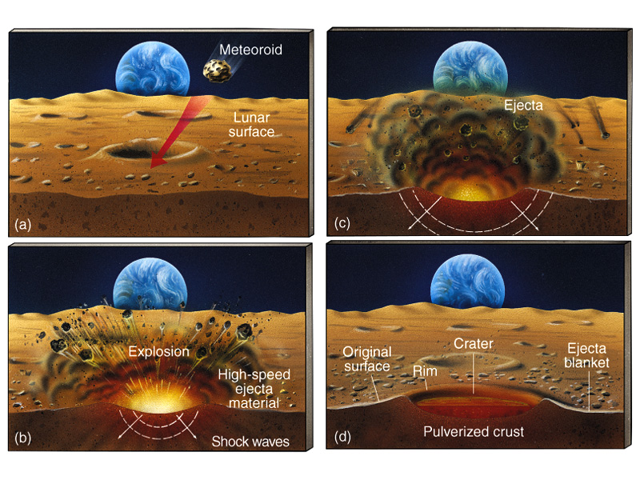
Cratering
- Impact speeds several km/sec
- "Ejecta blanket" of pulverized rock surrounds crater
- Impacts => "regolith": ~20 m thick layer of pulverized rock covering Moon.

Slide 10
Cratering Rates
Small meteoroids common, large ones rare. So same true for craters:
Crater size Occurrence
10 km
1 m
every 10 million years
every month
If no erosion, number of craters in an area tells you age of surface. So highlands older than maria.
Radiometric dating of moonrocks confirms this: highlands 4.5 billion years, maria 3.2-3.9 billion years.
Video of
impact

Slide 11
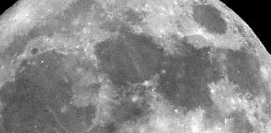
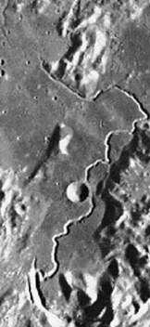
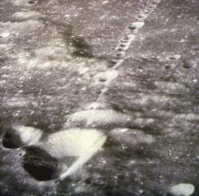
Lunar Volcanism (long ago)
Remember: volcanism is a way of losing internal heat
Evidence:
- Maria: result of old, widespread lava flows
(filled in largest, early impact craters)
- "Rilles": ditches indicating old lava flows
- Linear chains of craters (not due to impacts), probably marks
ancient fault, collapsed lava domes

Slide 12
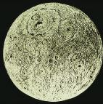
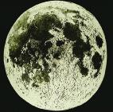
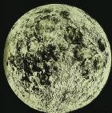
Moon's History
Age: 4.5 billion years
3.9 billion years ago:
heaviest meteoritic bombardment ended
3.9 - 3.2 billion years ago:
volcanism created maria. Maria are just the largest craters, filled in.
3.2 billion years -> present:
no volcanism, cratering continued at lower rate, no plate tectonics, geologically dead! Small bodies cool faster.

Slide 13
How did the Moon form?
We're not quite sure! Two older theories:
1) "Coformation": The Moon and Earth formed out of the same material at the beginning of the Solar System. Problem: Moon has different density and composition.
2) "Capture": The Moon was a stray body captured into orbit around Earth. Problem: extremely unlikely event, given Moon's size is a substantial fraction of Earth's.

Slide 14
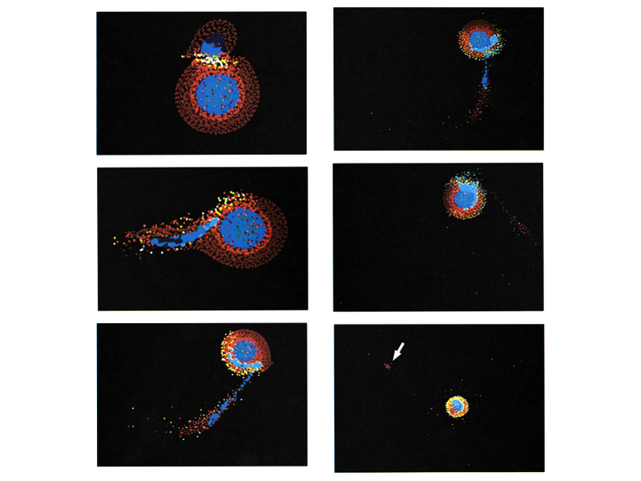
So now, Impact theory preferred:
Early in Solar System, when many large planetesimals around, a Mars-sized object hit the forming Earth, ejecting material from the upper mantle which went into orbit around Earth and coalesced to form Moon. Computer simulations suggest this is plausible.

Slide 15
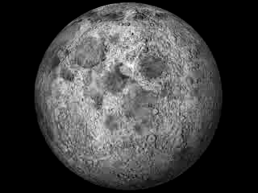
New LRO rotation link

Slide 16
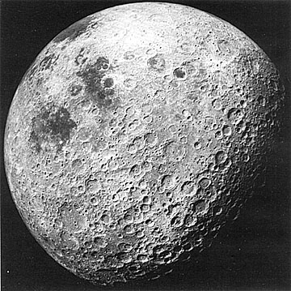
Side facing us
Far side

Slide 17
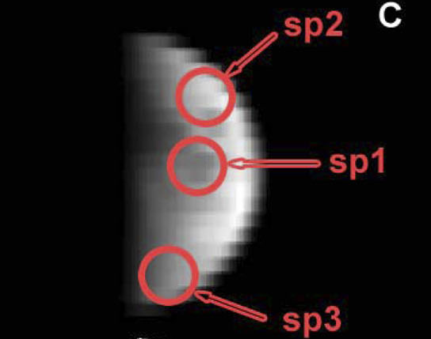
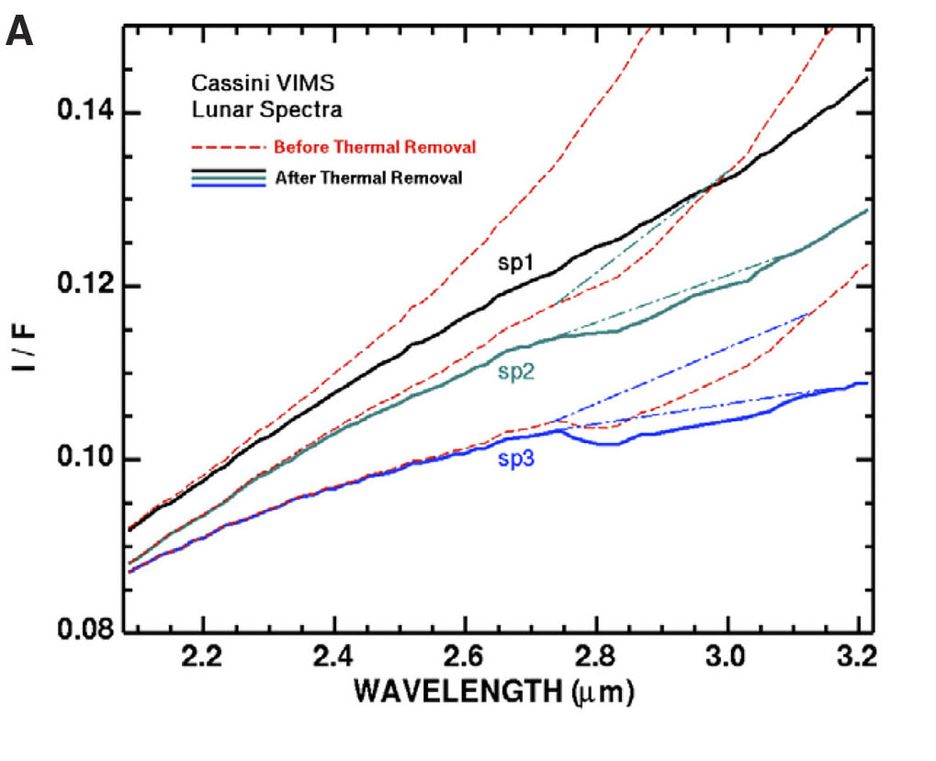
Water Ice on the Moon – Sept 2009
Data from Cassini mission
Absorption of infrared
beam by water and OH ice.
About 32 ounces of water
per ton.

Slide 18
How did the Moon form?
We're not quite sure! Three older theories:
1) "Fission": The material that would be the Moon was thrown off the Earth and coalesced into a single body. Problem: Earth not spinning fast enough to eject large amount of material.
2) "Coformation": The Moon and Earth formed out of the same material at the beginning of the Solar System. Problem: Moon has different density and composition.
3) "Capture": The Moon was a stray body captured into orbit around Earth. Problem: an extremely unlikely event, given Moon's size is a substantial fraction of Earth's.

Slide 19
So now, Impact theory preferred:
Early in Solar System, when many large planetesimals around, a Mars-sized object hit the forming Earth, ejecting material from the upper mantle which went into orbit around Earth and coalesced to form Moon. Computer simulations suggest this is plausible.
Moon formation movie

