Slide 1
Final states of a star:
1. White Dwarf
If initial star mass < 8 M_{Sun} or so.
Maximum WD mass 1.4 M_{Sun} ("Chandrasekhar limit").
2. Neutron Star
If initial mass > 8 M_{Sun} and < 25? M_{Sun} .
3. Black Hole
If initial mass > 25? M_{Sun} .

Slide 2
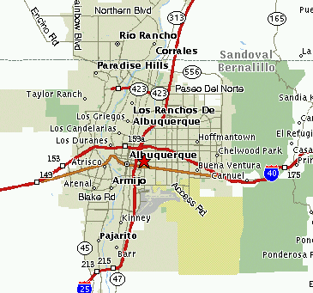

Neutron Stars
If star has mass 12-25 M_{Sun}, remnant of supernova expected to be a tightly packed ball of neutrons.
Diameter: 10 km only!
Mass: 1.4 - 3(?) M_{Sun}
Density: 10¹⁴ g / cm³ !
Rotation rate: few to many times per second!!!
Magnetic field: 10¹² x Earth's!
A neutron star over the Sandias?

Slide 3
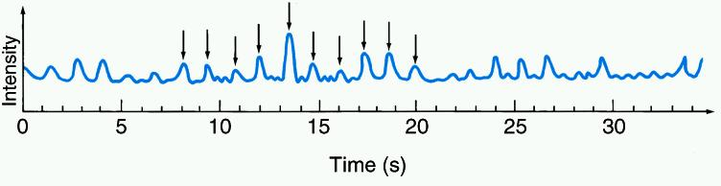
Pulsars
Neutron stars giving off periodic pulses of radiation (usually at radio wavlengths).
Discovered by Jocelyn Bell and Tony Hewish (Cambridge) in 1967. Nobel Prize to Hewish in 1974.
Explanation: "beamed" radiation from rapidly spinning neutron star.
Usually neutron stars are pulsars for 10⁷ years after supernova.

Slide 4
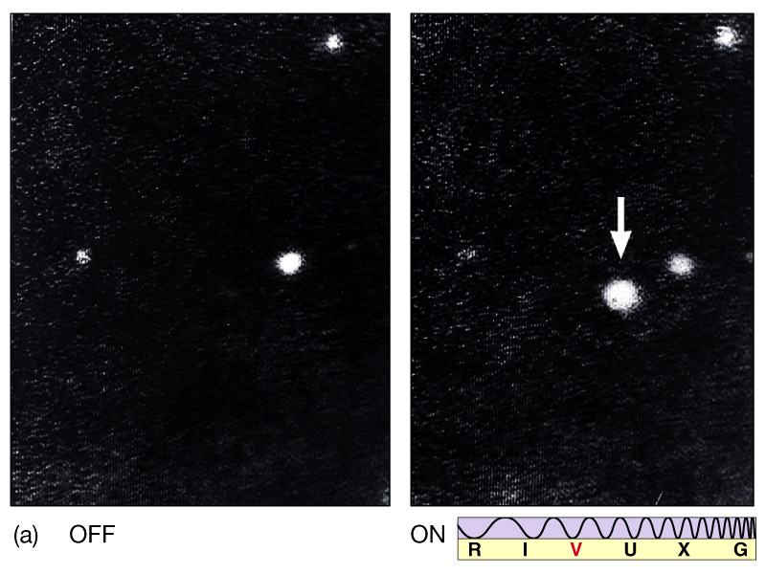
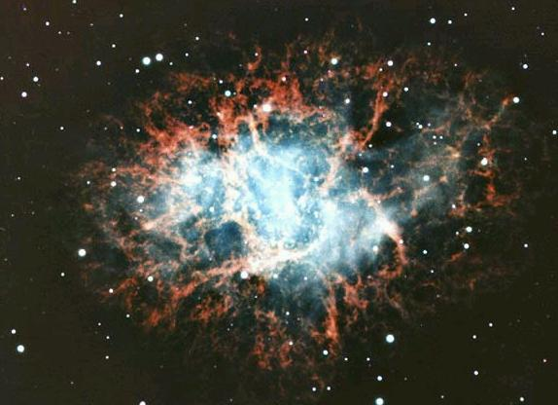
The Crab Pulsar

Slide 5
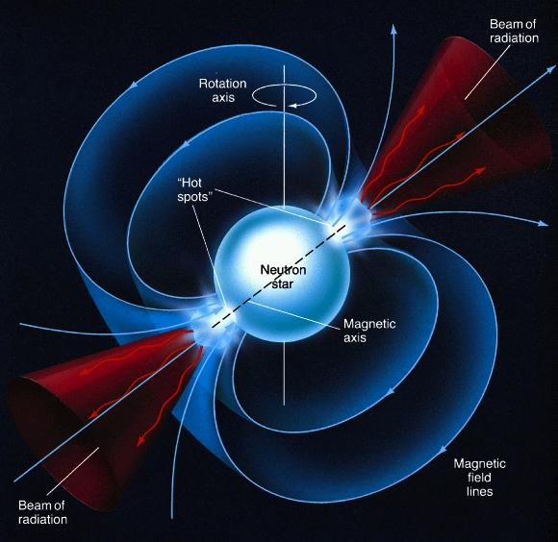
The Lighthouse model of a pulsar

Slide 6
Pulsars are incredibly accurate clocks!
Example: period of the first discovered "millisecond pulsar" is:
P = 0.00155780644887275 sec
It is slowing down at a rate of
1.051054 x 10 ⁻¹⁹ sec/sec
The slowing-down rate is slowing down at a rate of:
0.98 x 10 ⁻³¹ /sec

Slide 7
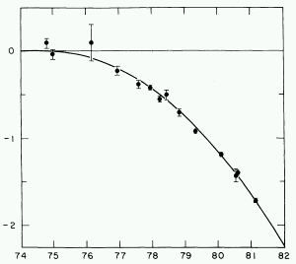
Pulsar Exotica
Binary pulsars: two pulsars in orbit around each other.
Einstein predicted that binary orbits should "decay", i.e. the masses would spiral in towards each other, losing energy through "gravitational radiation". Confirmed by binary pulsar.
Curve: prediction of decaying orbit. Points: measurements.
Planets around pulsars: A pulsar was found in 1992 to have three planets! Masses about 3 M_{Earth}, 1 M_{Earth}, and 1 M_{Moon} !
Nobody knows why a pulsar should have planets.
year
Millisecond pulsars: periods of 1 to a few msec. Probably accreted matter from a binary companion that made it spin faster.

Slide 8
