Slide 1
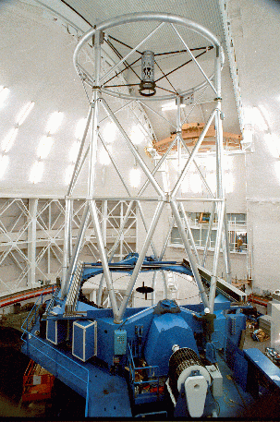
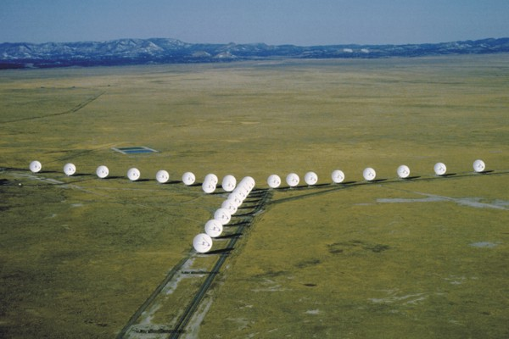
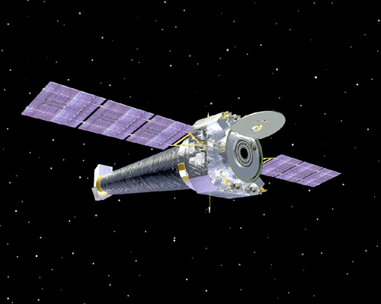
Electromagnetic Radiation
(How we get information about the cosmos)
Examples of electromagnetic radiation?
Light
Infrared
Ultraviolet
Microwaves
AM radio
FM radio
TV signals
Cell phone signals
X-rays

Slide 2

Radiation travels as waves.
Waves carry information and energy.
Properties of a wave
wavelength (λ)
crest
amplitude
trough
velocity (v)
λ is a distance, so its units are m, cm, etc.
Period (T): time between crest (or trough) passages
Frequency (ν): rate of passage of crests (or troughs), ν =
Also, v = λ ν
1
T
(units: Hertz or cycles/sec)

Slide 3
Radiation travels as Electromagnetic waves:
waves of electric and magnetic fields traveling together.
Examples of objects with magnetic fields:
a magnet
the Earth
Examples of objects with electric fields:
protons
electrons
}
"charged" particles that make up atoms.
Fields have a direction.

Slide 4
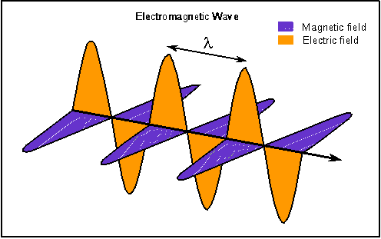
James Clerk Maxwell showed in 1865 that waves of weak electric and magnetic fields travel together => traveling “electromagnetic” waves.

Slide 5
The speed of all electromagnetic waves is the speed of light.
c = 3 x 10 ⁸ m / s
or c = 3 x 10 ⁵ km / s
light takes 8 minutes
Earth
Sun
c =
λν
or, bigger λ means smaller ν

Slide 6
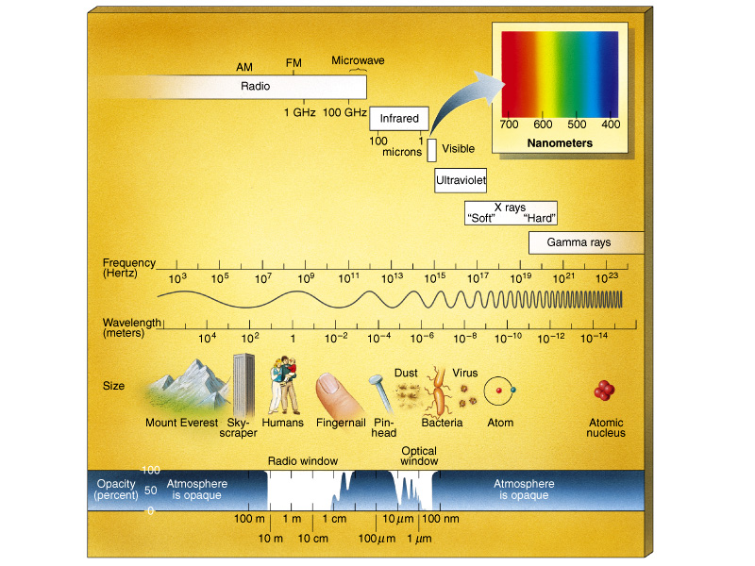
The Electromagnetic Spectrum
1 nm = 10 ⁻⁹ m , 1 Angstrom = 10 ⁻¹⁰ m
c =
λ ν

Slide 7
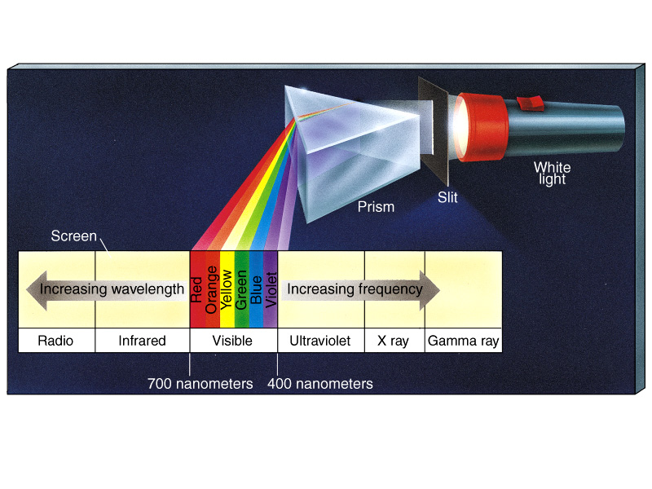
Refraction of light
All waves bend when they pass through materials of different densities. When you bend light, bending angle depends on wavelength, or color.

Slide 8
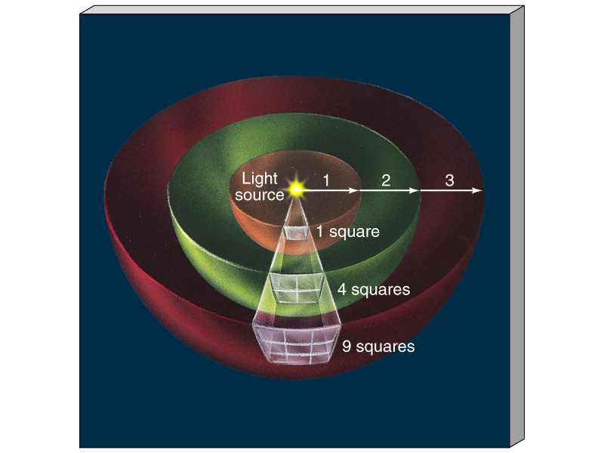
The "Inverse-Square" Law Applies to Radiation
Each square gets 1/4 of the light
Each square gets 1/9 of the light
apparent brightness α
1
D²
D is the distance between source and observer.

Slide 9
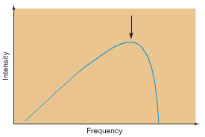
Why does the Sun have its color? The Black-Body Spectrum
We form a "spectrum" by spreading out radiation according to its wavelength (e.g. using a prism for light).
What does the spectrum of an astronomical object's radiation look like?
Many objects (e.g. stars) have roughly a "Black-body" spectrum:
Asymmetric shape
Broad range of wavelengths
or frequencies
Has a peak, depending on
object’s temperature
also known as the Planck spectrum.

Slide 10
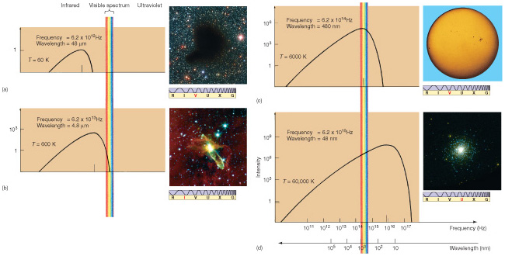
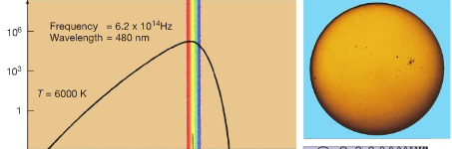
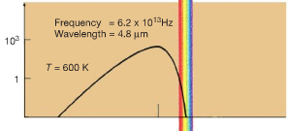
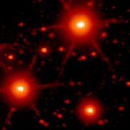
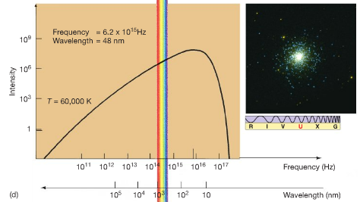
Approximate black-body spectra of stars of different temperature
cold dust
average star (Sun)
average star (Sun): 6000 K
Brightness
infrared visible UV
“cool" stars:
600 K
Very hot stars: 60,000K
very hot stars
infrared visible UV
frequency increases, wavelength decreases

Slide 11
Laws Associated with the Black-body Spectrum
Wien's Law:
1
T
λ_{peak brightness} α
(wavelength at which object is brightest is longer for cooler objects)
Stefan's Law:
Energy radiated per cm² of area on surface every second α T ⁴
(T = temperature at surface)
1 cm²

Slide 12
The total energy radiated from entire surface every second is called the
luminosity. Thus
Luminosity = (energy radiated per cm² per sec) x (area of surface in cm²)
For a sphere, area of surface is 4πR², where R is the radius.
So Luminosity α R² x T⁴

Slide 13
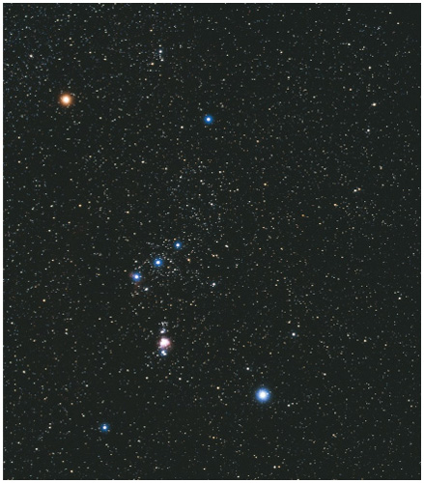
Betelgeuse
Rigel

Slide 14

The Doppler Effect
The frequency or wavelength of a wave depends on the relative motion of the source and the observer. True for all waves.
Observer measures
true wavelength
Observer measures
true wavelength
Observer measures
longer wavelength
Observer measures
shorter wavelength
(same if observer traveling
toward source)

Slide 16
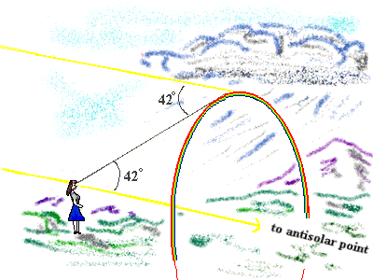
Rainbows (not on exam)
rred orange yellow green blue violet

Slide 17
What's happening in the cloud?
raindrop
Sun's ray
42º
40º

Slide 18
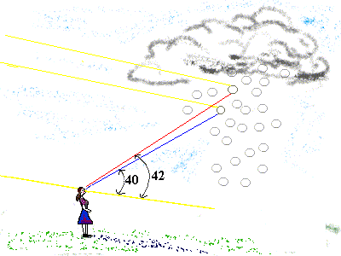
Ms. Gumby?

Slide 19
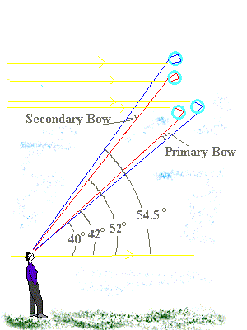
Double Rainbows

Slide 20
Things that waves do
1. Refraction
Waves bend when they pass through material of different densities.
air
water
swimming pool
prism
glass
air
air

Slide 21
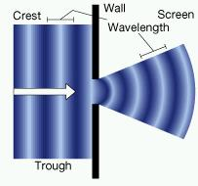
2. Diffraction
Waves bend when they go through a narrow gap or around a corner.

Slide 22
The Doppler Effect
Applies to all kinds of waves, not just radiation.
at rest
velocity v₁
you encounter more wavecrests per second => higher frequency!
velocity v₂
velocity v₁
fewer wavecrests per second => lower frequency!
velocity v₁
velocity v₃

Slide 23
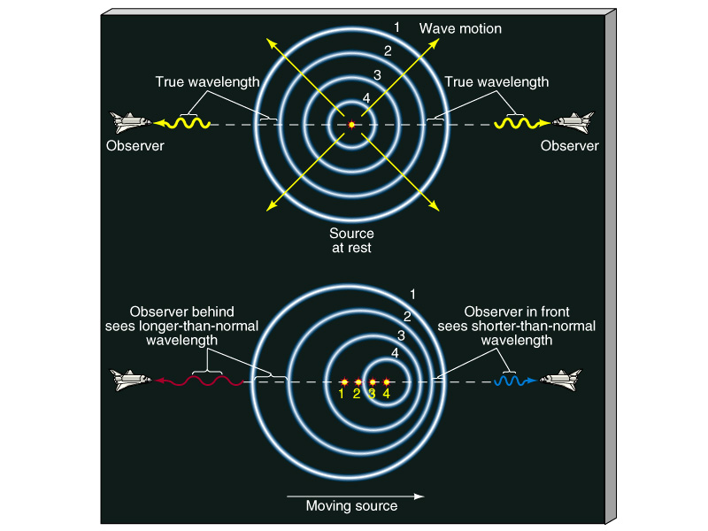
The Doppler Effect
Applies to all waves – not just radiation. The frequency or wavelength of a wave depends on the relative motion of the source and the observer.

