Slide 1
Foundations of Astronomy
The Metric System
(used by scientists and foreigners)
Mass
1 kilogram (kg) = 1000 grams (g)
100 kg = 220 lbs
We tend to use mass and weight interchangeably, but weight depends on gravity.
Distance
1 meter (m) = 100 centimeters (cm)
Volume
1 cubic centimeter or 1 cm³
(about the size of a sugar cube)

Slide 2
Density
Density = Mass (g / cm³)
Volume
Densities of Common Substances
Styrofoam 0.07 g / cm³
Oak 0.7
Water 1.0
Average Rock 2.4
Iron 7.9
Lead 11.3
Gold 19.3

Slide 3
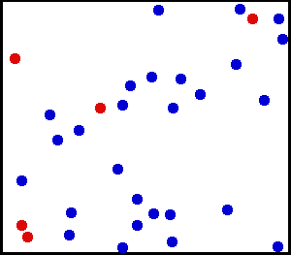
Temperature
The Celsius Scale:
0 ºC = freezing point of water
100 ºC = boiling point of water
The Kelvin Scale:
T(K) = T(ºC) + 273 ºC
"Absolute zero" 0 K = - 273 ºC
What is temperature?
Temperature of the air in this room is a measure of the energy in the random motions of the molecules.

Slide 4
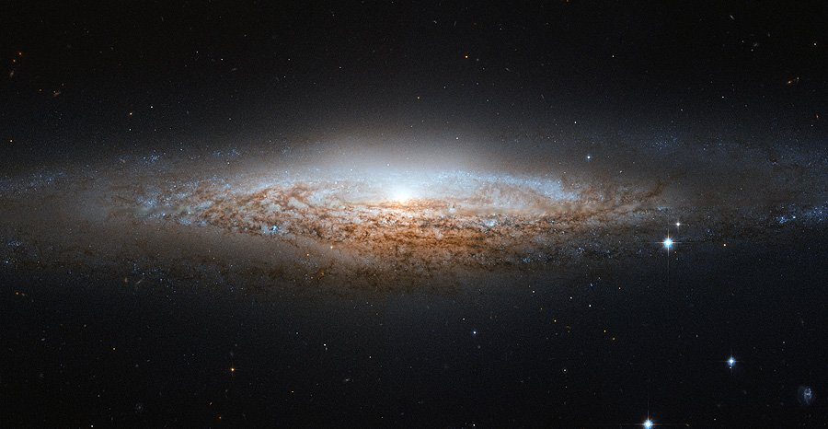
Angles
360º, or 360 degrees, in a circle.
90º
1º = 60' or arcminutes
1' = 60" or arcseconds
1" = 1000 mas or milli-arcseconds
20º
The Hubble Space Telescope can see detail down to 0.05”!

Slide 5
Scientific Notation
Powers, or exponents, of 10:
100 = 10² (= 10 x 10)
1000 = 10³ (= 10 x 10 x 10)
10 = 10¹
1 = 10⁰
0.1 = 10 ⁻¹
0.007 = 7 x 10 ⁻³
6,000,000,000,000,000,000,000,000 = 6 x 10²⁴ (mass of Earth in kg)
Add the exponents
4000 x 0.002
= (4 x 10³) x (2 x 10 ⁻³)
= 8 x 10⁰ = 8

Slide 6
In astronomy, we deal with:
1. Vast distances
- Radius of Earth = 6400 km = 6.4 x 10⁸ cm
- Distance to Sun = 1.5 x 10¹³ cm = 23,500 Earth radii = 1 Astronomical Unit (AU)
- Distance to next nearest star (Proxima Centauri): 270,000 AU = 4.3 "light years" (light year: distance light travels in one year, 9.5 x 10¹² km. Speed of light: c = 3 x 10⁸ m/sec)
- Size of Milky Way Galaxy: about 100,000 light years
- Distance to next large galaxy (Andromeda): 2 x 10⁶ light years

Slide 7
2. Huge masses:
- Mass of Earth = 6 x 10²⁴ kg = 6 x 10²⁷ g = 1 M_{Earth}
(or 6000 billion billion tons)
- Mass of Sun = 2 x 10³⁰ kg = 2 x 10³³ g = 1 M_{Sun}
= 1 "Solar Mass"
= 333,000 M_{Earth}
- Mass of Milky Way galaxy: 6 x 10¹¹ M_{Sun}

Slide 8
3. Long ages and times:
- Age of Earth and Solar System: 4.5 billion years
= 4.5 x 10⁹ years
- Lifetime of stars: about 10⁶ – >10¹² years
- Age of universe: about 10¹⁰ years
4. Very high and low temperatures:
- An interstellar "molecular cloud":
T = 10 K
- Center of Sun:
T = 1.5 x 10⁷ K

Slide 9
The Sky at Night
What do we see?
The Moon
Planets
Perhaps a meteor shower, comet, or other rare event
Stars - about 3000 visible
Milky Way
Other galaxies (if in the Southern Hemsiphere, see two others)
Patterns of stars – 88 constellations
Useful for finding our way around the sky,
navigating the oceans
Satellites, airplanes, clouds, lightning, light pollution ...

Slide 10
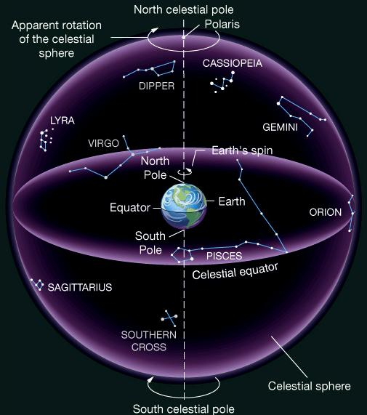
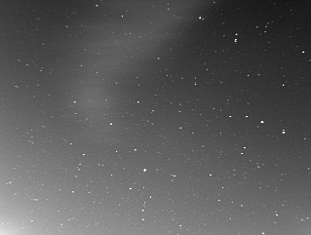
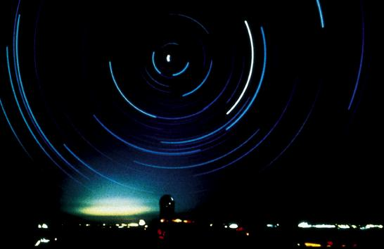
The Celestial Sphere
An ancient concept, as if all objects at same distance.
But to find things on sky, don't need to know their distance, so still useful today.
Features:
- Does not rotate with Earth
- Poles, Equator
- Coordinate System

Slide 11
The "Solar Day" and the "Sidereal Day"
Solar Day
How long it takes for the Sun to return to the same position in the sky (24 hours).
Sidereal Day
How long it takes for the Earth to rotate 360º on its axis.
These are not the same!

Slide 12
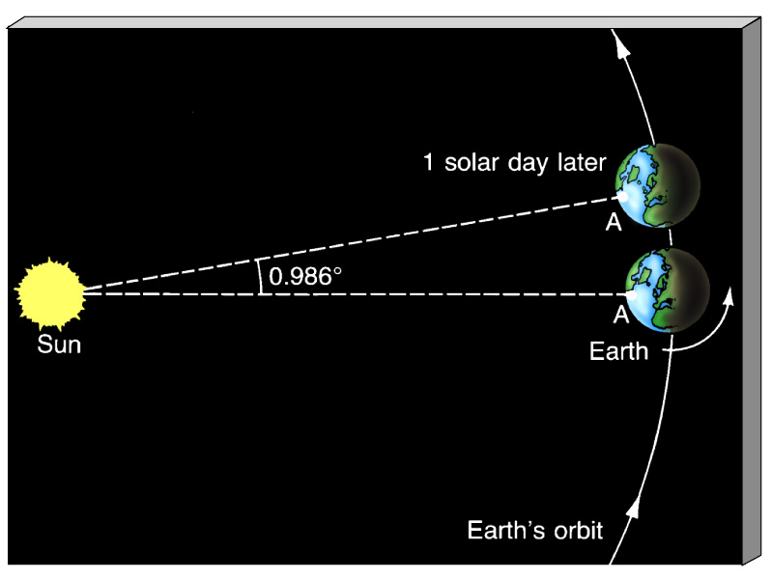
One solar day later, the Earth has rotated slightly more than 360º .
A solar day is longer than a sidereal day by 3.9 minutes
(24 hours vs. 23 hours 56 minutes 4.091 seconds).

Slide 13
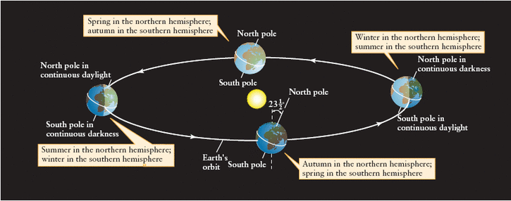
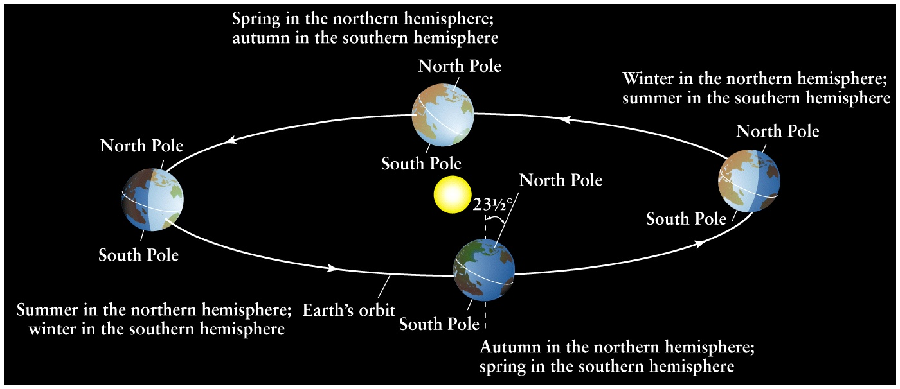
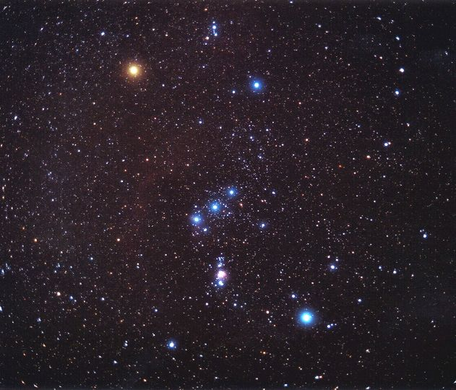
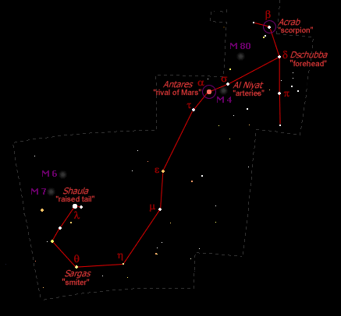
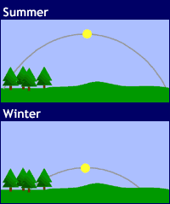
The Earth's rotation axis is tilted with respect to its orbit around the Sun => seasons.
Sun high in northern sky,
daytime longer
Orion
Scorpius
Sun low in northern sky, daytime shorter
Inclined view of Earth’s orbit

Slide 14
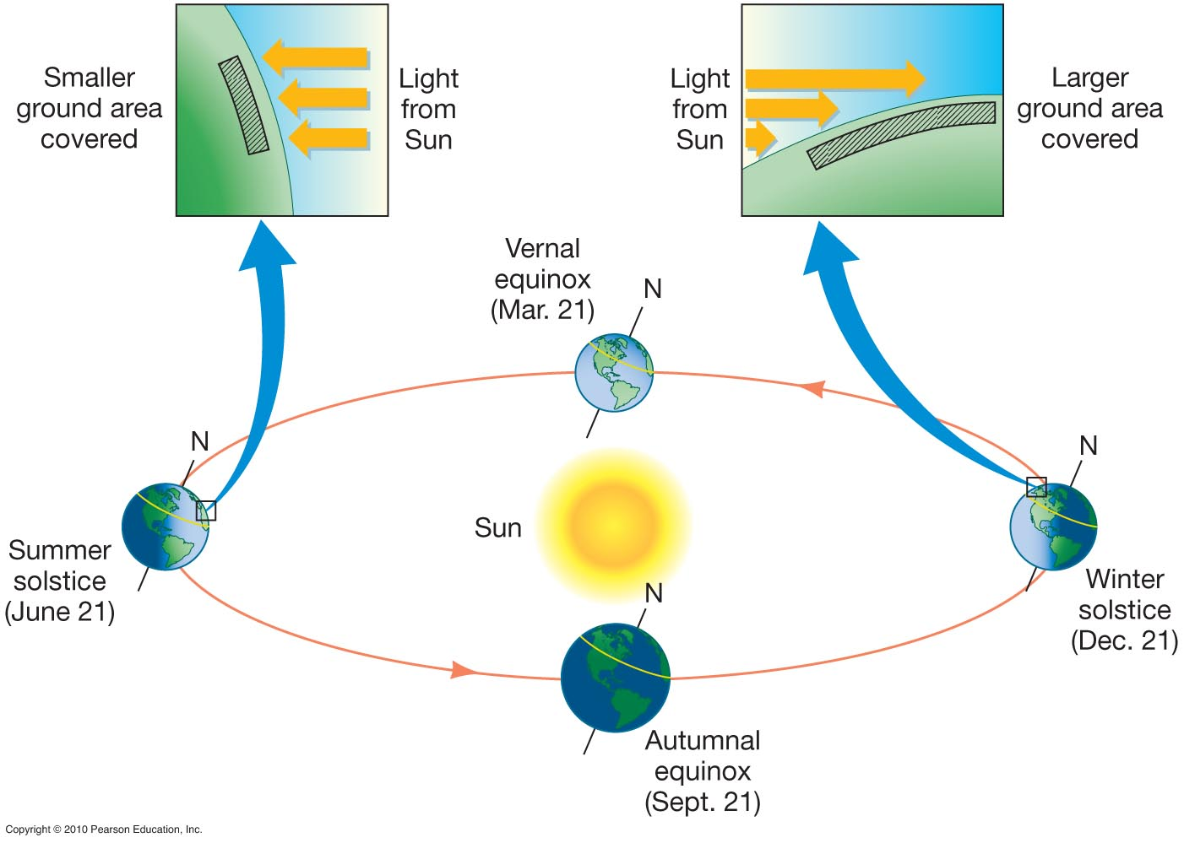

Slide 15
The Year
Scorpius
Orion
Inclined view of the Earth’s orbit
The Earth revolves around the Sun in 365.256 days (“sidereal year”). But the year we use is 365.242 days (“tropical year”). Why?

Slide 16
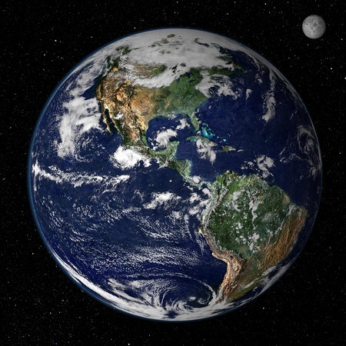
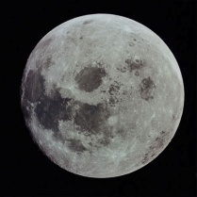
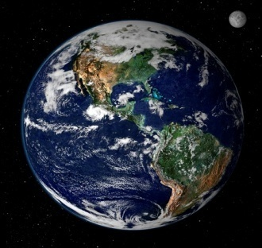
Precession
The Earth has a bulge. The Moon pulls on the side of the bulge closest to it, causing the Earth to wobble on its axis (how can we observe this wobble?)
Vega
*
*
Polaris
Spin axis
Precession
animation
Precession Period 26,000 years!

Slide 17

Now
Scorpius
Orion
Night
Day
Day
Night
Summer: July
Winter: January
13,000 years from now
Scorpius
Orion
Night
Night
Day
Day
Winter: July or January?
Summer: January or July?
We choose to keep July a summer month, but then in 13,000 years, summer occurs on other side of orbit!

Slide 18
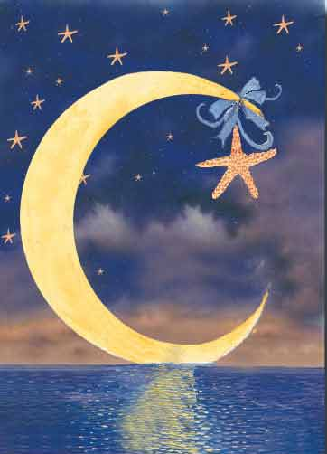

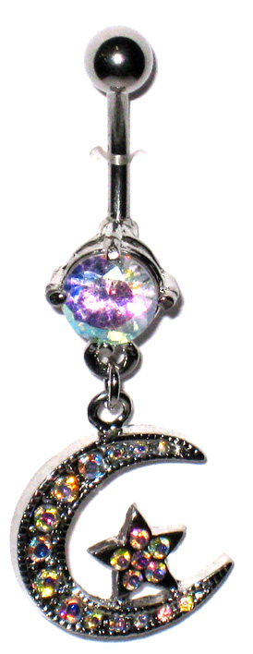
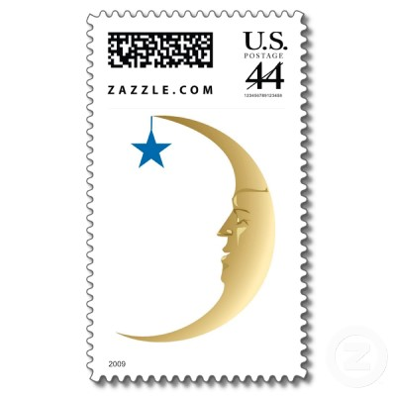


Slide 19
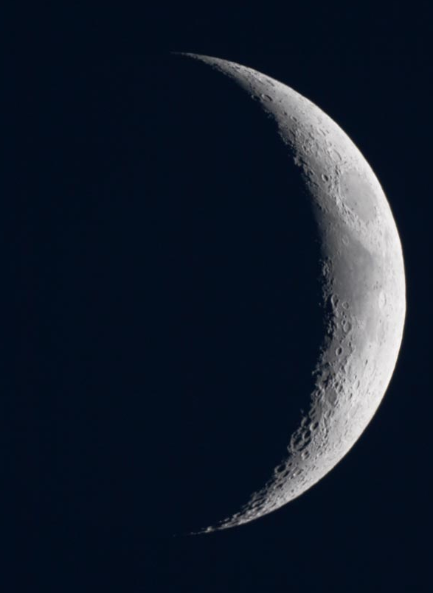
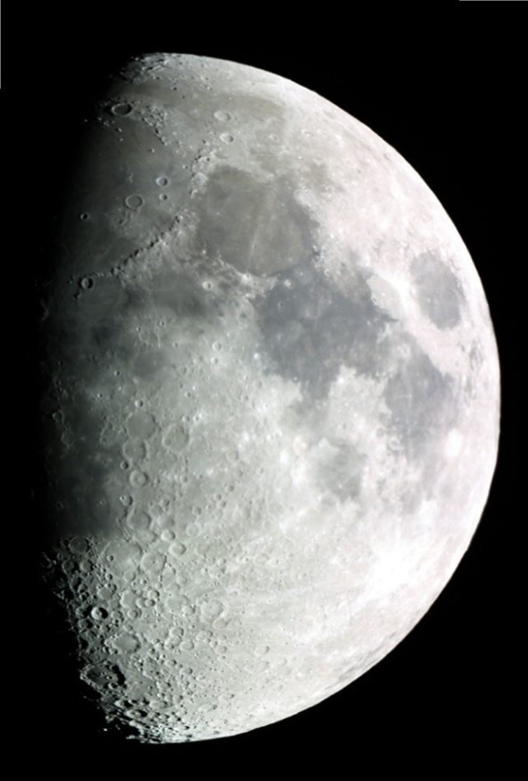
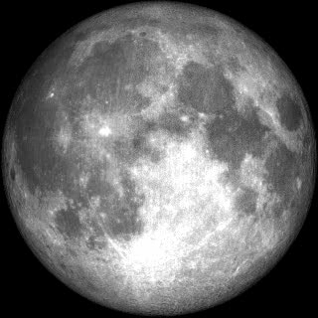
The Motion of the Moon
The Moon has a cycle of "phases", which lasts about 29 days.
Half of the Moon's surface is lit by the Sun.
During this cycle, we see different fractions of the sunlit side.
Which way is the Sun in each case?

Slide 20
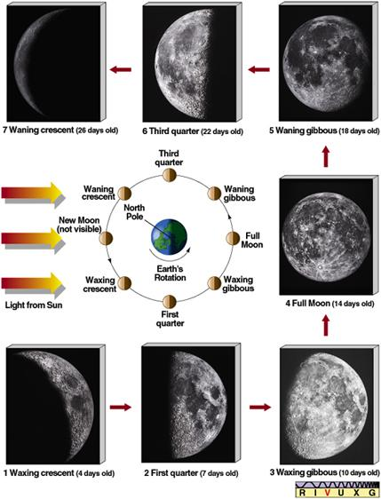
See Tutorial in
MasteringAstronomy
for animation.
Another animation

Slide 21
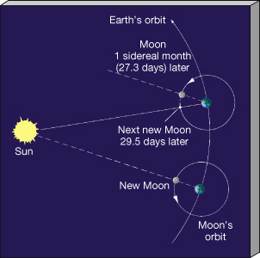
Cycle of phases slightly longer than time it takes Moon to do a complete orbit around Earth.
Cycle of phases or "synodic month"
Orbit time or "sidereal month"
29.5 days
27.3 days

Slide 22
Eclipses
Lunar Eclipse
When the Earth passes directly between the Sun and the Moon.
Sun
Earth
Moon
Solar Eclipse
When the Moon passes directly between the Sun and the Earth.
Sun
Moon
Earth

Slide 23
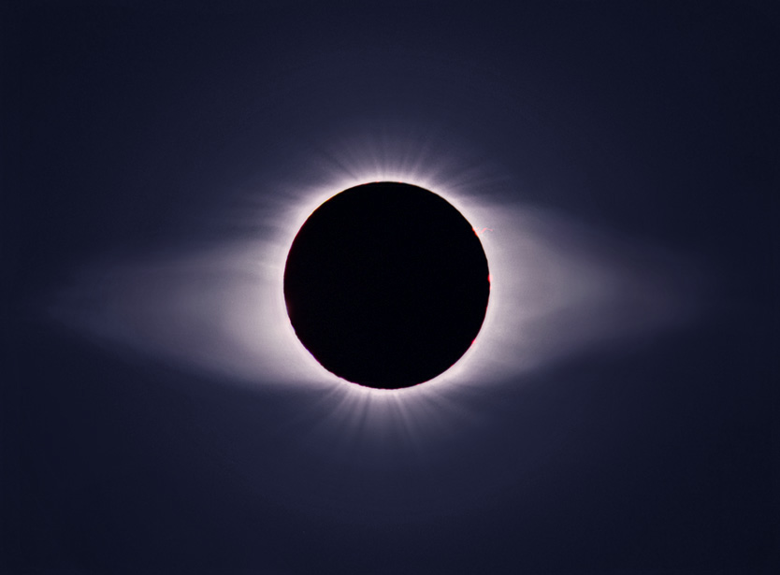
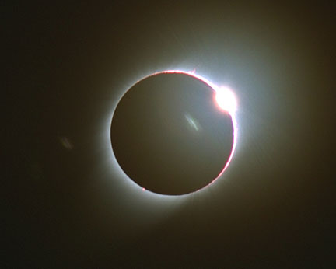
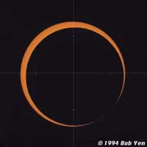
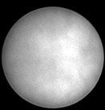
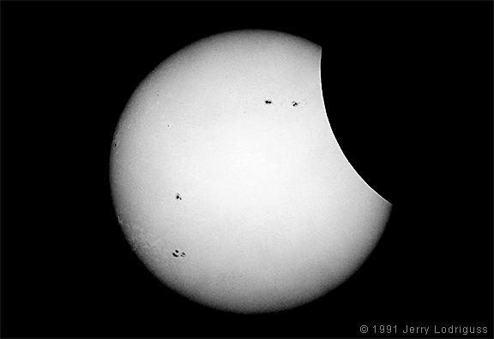
Solar Eclipses
Diamond ring effect - just before or after total
Total
Partial
Annular - why do these occur?

Slide 24
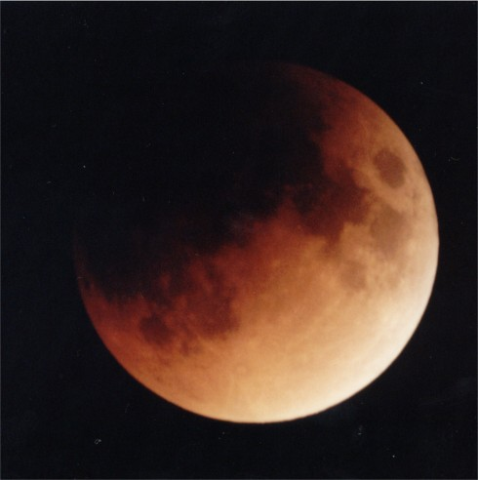
Lunar Eclipse

Slide 25
Why don't we get eclipses every month?
How can there be
both total and annular eclipses?

Slide 26
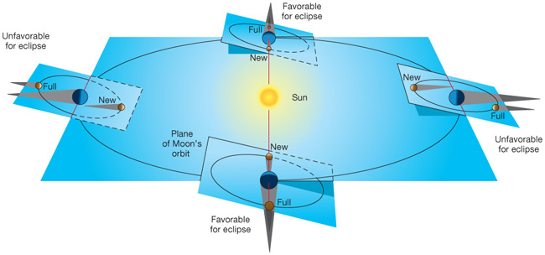
Moon's orbit tilted compared to Earth-Sun orbital plane (by 5.2º):
Moon
Moon's orbit slightly elliptical:
Distance varies by ~12%
Earth
Top view, exaggerated ellipse

Slide 27
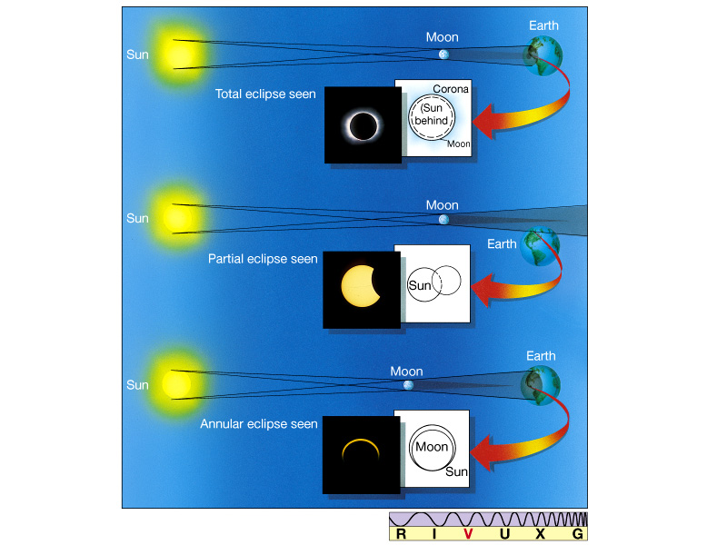
Types of Solar Eclipses Explained

Slide 28
Certain seasons are favorable for eclipses. Solar “eclipse season” lasts about 38 days. Likely to get at least a partial eclipse somewhere. Animation
It's worse than this! The plane of the Moon's orbit precesses (animation), so that the eclipse season occurs about 20 days earlier each year. Creates an 18 year “Saros” cycle.

Slide 29
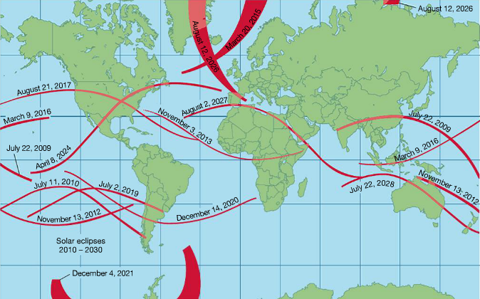
Recent and upcoming total solar eclipses

Slide 30
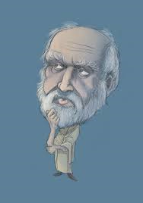

Eratosthenes Determines the Size of the Earth in about 200 B.C.
Sun's rays
Syene
Alexandria
N
7.2º
S
Earth

Slide 31
He knows the distance between the two cities is 5000 "stadia".
From geometry then,
7.2º
5000 stadia
=
360º
Earth's circumference
=> circumference is 250,000 stadia, or 40,000 km.
So radius is:
40,000 km
=
6366 km
2π
(very close to modern value, 6378 km!)

