Slide 1
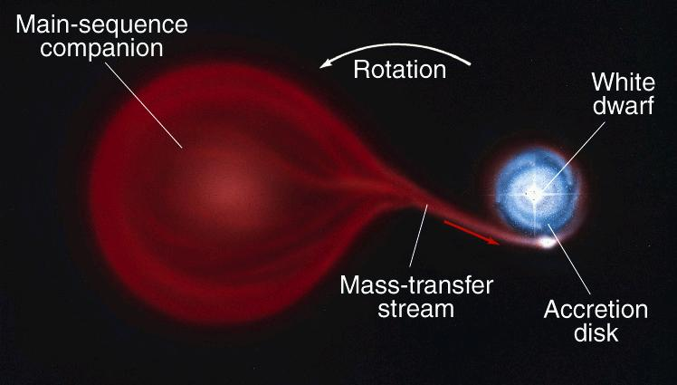
Stellar Explosions
Novae
White dwarf in
close binary system
WD's tidal force stretches out companion, until parts of envelope spill onto WD. Surface gets hotter and denser. Eventually, a burst of fusion. Binary brightens by 10,000's! Some gas expelled into space. Whole cycle may repeat every few decades => recurrent novae.

Slide 2
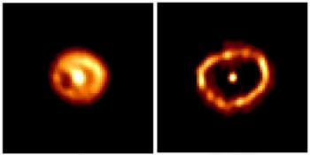
Nova Cygni with Hubble. Brightened in Feb 1992
400 AU
June 1993 Jan 1994
Recurrent nova animation

Slide 3
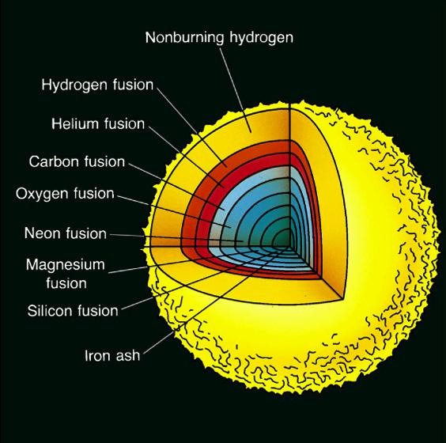
Death of a High-Mass Star
M > 12 M_{Sun}
Iron core
Iron fusion doesn't produce energy (actually requires energy) => core collapses in < 1 sec.
T ~ 10¹⁰ K, radiation disrupts nuclei,
p + e => n + neutrino
Collapses until neutrons come into contact. Rebounds outward, violent shock ejects rest of star => A Core-collapse or Type II Supernova
Ejection speeds 1000's to 10,000's of km/sec!
Remnant is a “neutron star” or “black hole”.
Such supernovae occur
roughly every 50 years
in Milky Way.

Slide 4
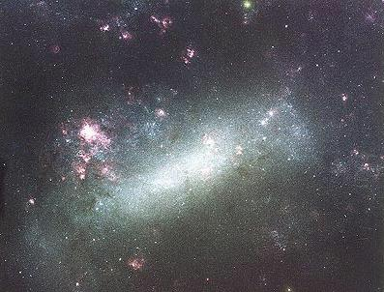
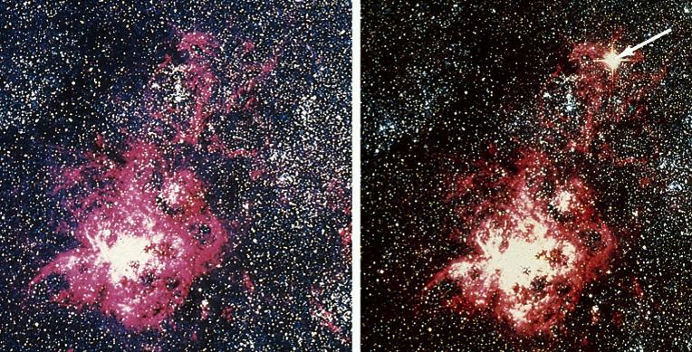
Supernova 1987A in the Large Magellanic Cloud

Slide 5
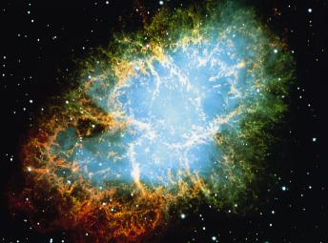
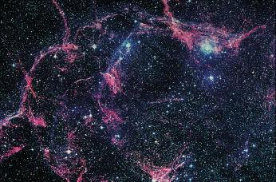
In 1000 years, the exploded debris might look something like this:
Crab Nebula: debris from a stellar explosion observed in 1054 AD.
2 pc
Or in 10,000 years:
Vela Nebula: debris from a stellar explosion in about 9000 BC.
50 pc

Slide 6
Making the Elements
Universe initially all H (p’s and e’s). Some He made soon after Big Bang before galaxies formed. Rest of elements made in stars, and returned to ISM by supernovae.
Solar System formed from such "enriched" gas 4.6 billion years ago. As Milky Way ages, the abundances of elements compared to H in gas and new stars are increasing due to fusion and supernovae.
Elements up to iron (⁵⁶Fe, 26 p + 30 n) produced by steady fusion (less abundant elements we didn’t discuss, like Cl, Na, made in reactions that aren’t important energy makers).
“Neutron capture” makes heavier elements (lead, gold, copper, silver, etc.) in cores and even heavier ones (uranium, plutonium, etc.) in supernova itself.

Slide 7
A Carbon-Detonation or “Type I” Supernova
Back to our accreting white dwarf in a binary system.
Despite novae, mass continues to build up on WD.
If mass grows to 1.4 M_{Sun} (the "Chandrasekhar limit"), gravity overwhelms pressure supporting the WD, so it contracts and heats up.
This starts carbon fusion everywhere at once.
Tremendous energy makes star explode. No remnant.

Slide 8
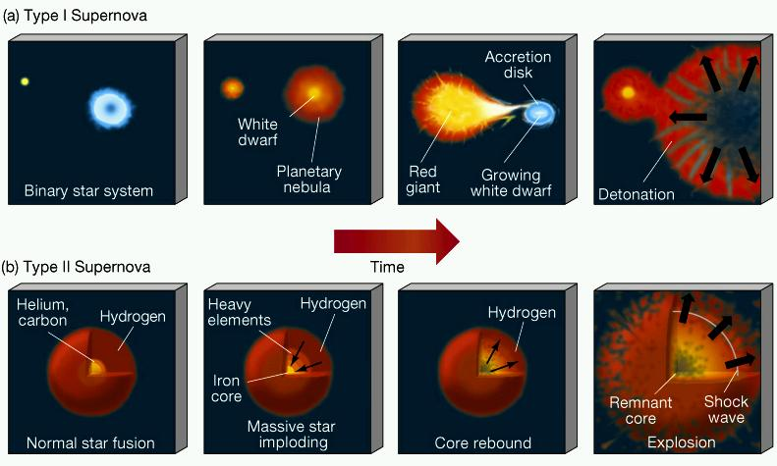
Remember, core collapse (Type I) and carbon-detonation (Type II) supernovae have very different origins

Slide 9
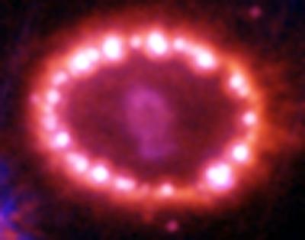
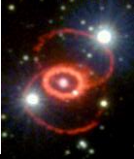
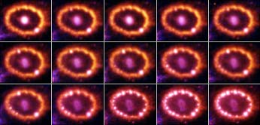
SN 1987A is evolving fast!
1994
2003
Expanding debris from star. Speed almost 3000 km/sec!
Light from supernova hitting ring of gas, probably a shell from earlier mass loss event.
Explanation for the three-ring
structure

