Slide 1
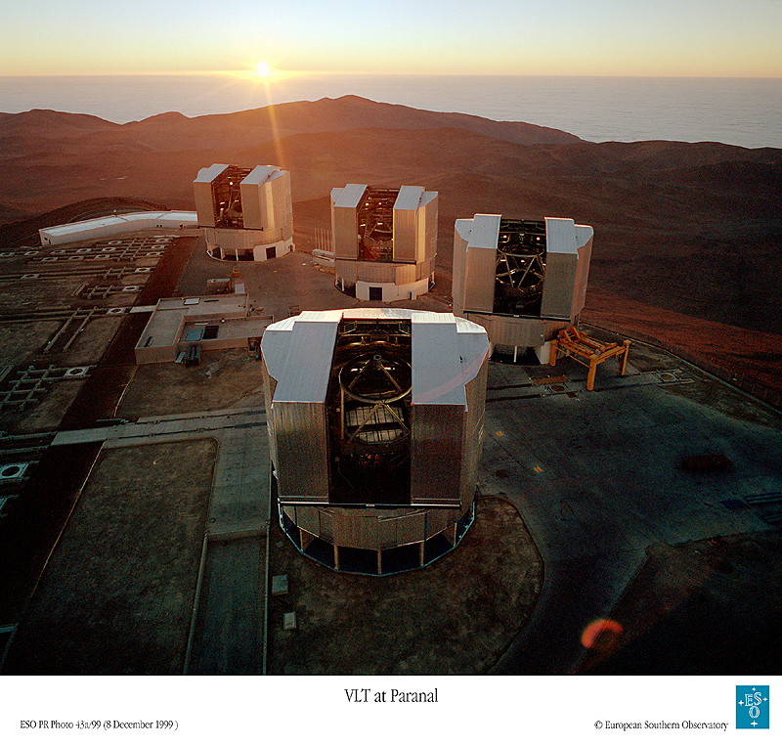
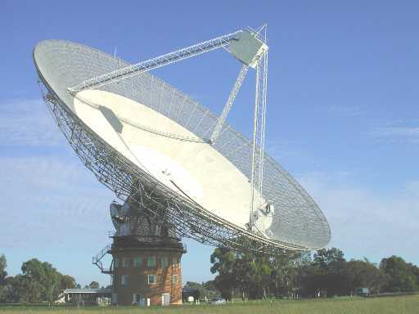
Telescopes

Slide 2
Light Hitting a Telescope Mirror
huge mirror near a star
*
*
small mirror far from a star
In the second case (reality), light rays from any single point of light are essentially parallel.

Slide 3
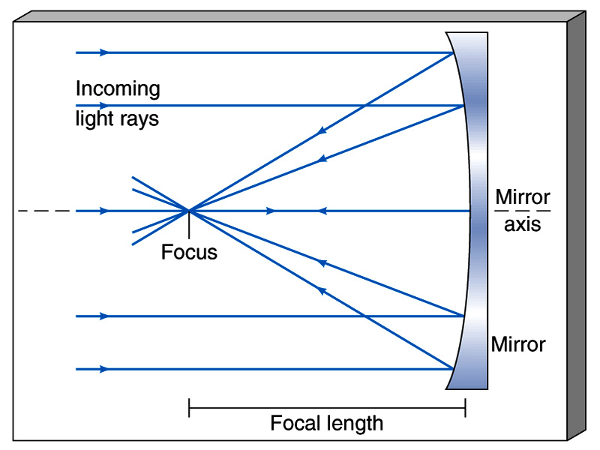
Parallel light rays from a distant source, all meet at one point, the focus.
*
*
CCD
Parallel light rays at another angle meet at another focus point in
same vertical plane, the “focal plane”.

Slide 4
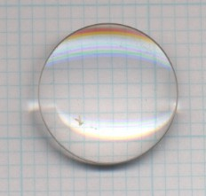
Optical Telescopes - Refracting vs. Reflecting
Refracting telescope
Focuses light with a lens (like a camera or eye).
object (point of light)
image at focus
Problems:
- Lens can only be supported around edge
- Some light absorbed in glass (especially UV, infrared)
- Air bubbles and imperfections affect image quality
- "Chromatic aberration"

Slide 5
Chromatic Aberration
Lens - different colors focus at different places.
white light
Mirror - reflection angle doesn't depend on color.

Slide 6
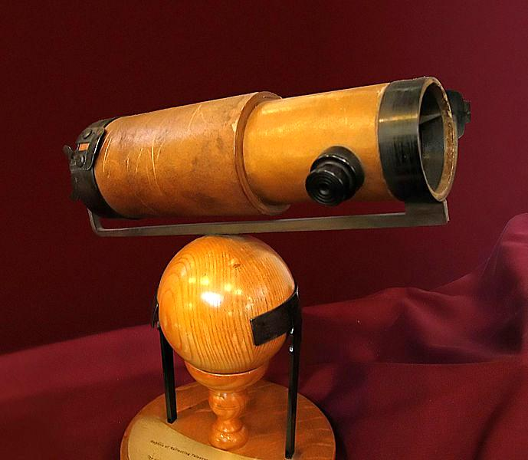
Reflecting telescope
Focuses light with a curved mirror.
object
image
- Can make bigger mirrors since they are supported from behind.
- No chromatic aberration.
- Reflects all radiation with little loss by absorption.

Slide 7
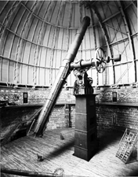
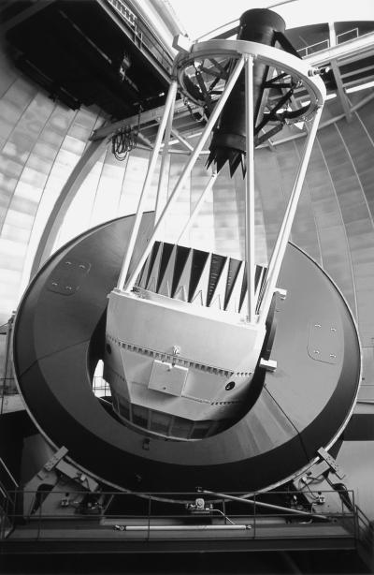
Refracting Telescope
Reflecting Telescope
Yerkes 40-inch (about 1 m). Largest refractor.
Cerro-Tololo 4 -m reflector.

Slide 8
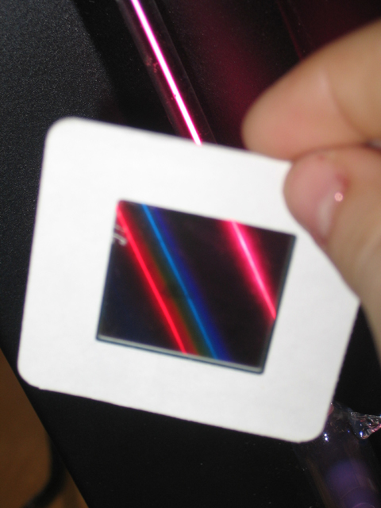
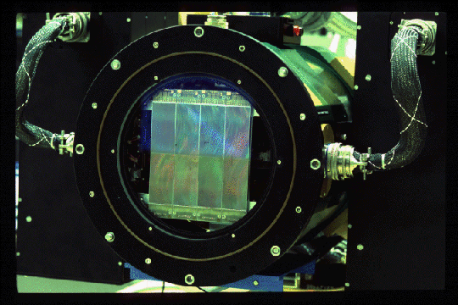
The Two Main Types of Observation
Imaging
Spectroscopy. For visible light, usually using a diffraction grating
Image or spectrum usually recorded on a CCD ("charge-coupled device")

Slide 9
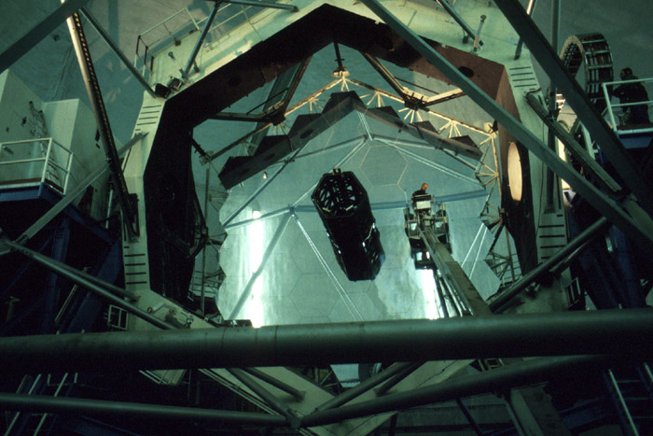
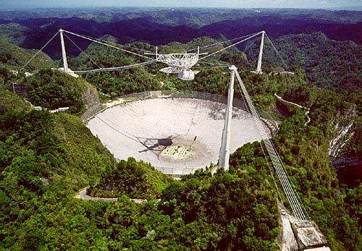
Mirror size
Mirror with larger area captures more light from a star. Can look at fainter objects with it.
Arecibo 300-m radio
telescope
Keck 10-m optical telescope
30-100 m optical telescopes now being considered!

Slide 10
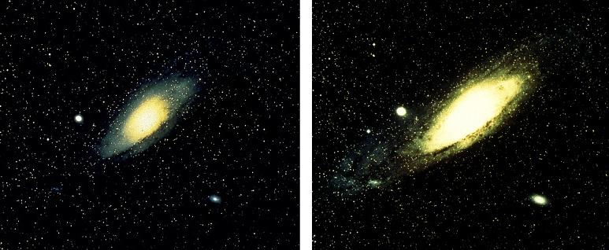
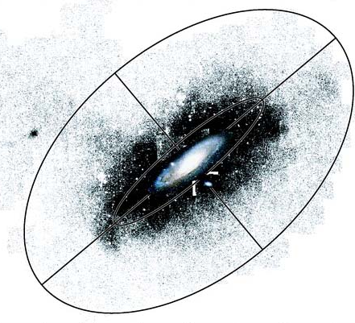
Image of Andromeda galaxy with optical telescope.
Image with telescope of twice the diameter, same exposure time.

Slide 11
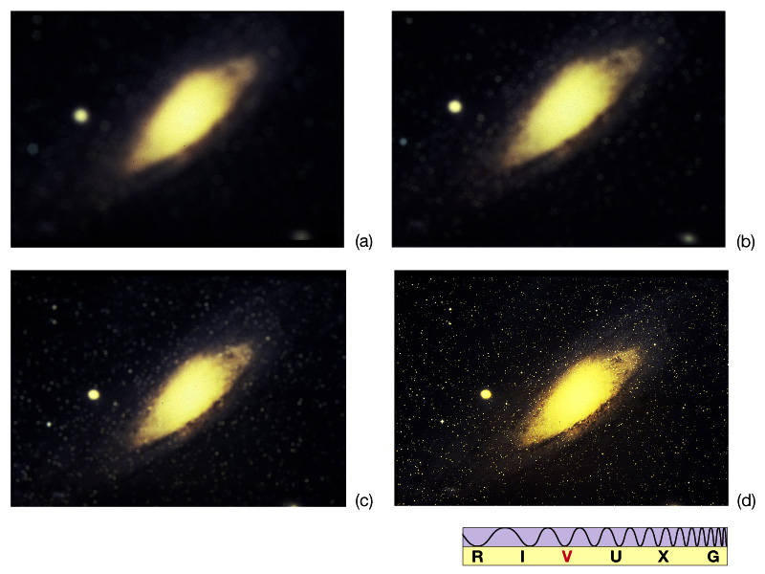
Resolving Power of a Mirror
(how much detail can you see?)
fuzziness you would see with your eye.
detail you can see with a telescope
on ground.

Slide 12
"Angular resolution“: smallest angle by which two objects can be separated and still be distinguished.
For the eye, this is 1' (1/60th of a degree). Or 100 km at
distance of the Moon.
wavelength
mirror diameter
angular resolution α
For a 2.5-m telescope observing light at 5000 Angstroms, resolution = 0.05".
But, blurring by atmosphere limits resolution of optical telescopes to about 1". This is called seeing.

Slide 13
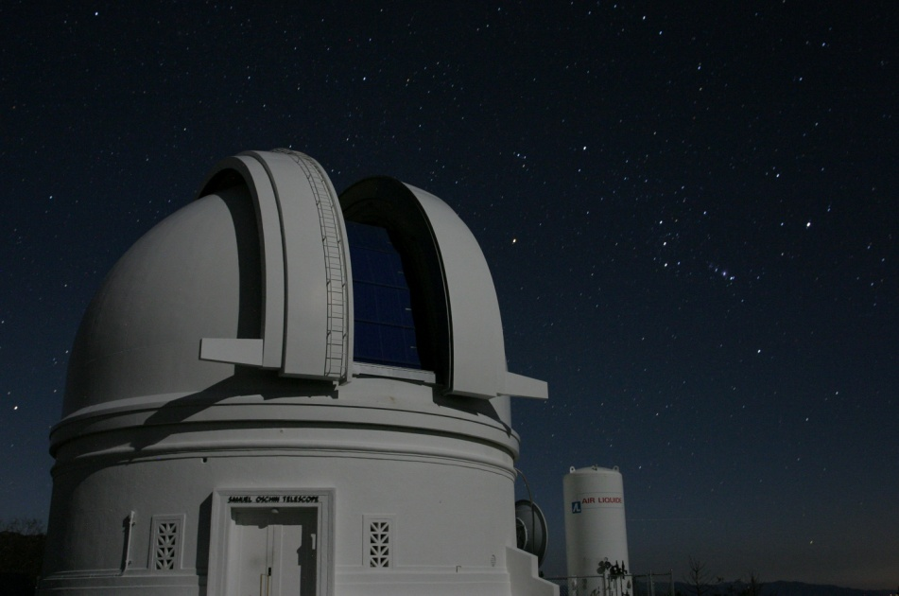
Seeing
*
Air density varies => bends light. No longer parallel
Parallel rays enter atmosphere
No blurring case. Rays brought to same focus.
*
Sharp image on CCD.
CCD
Blurring. Rays not parallel. Can't be brought into focus.
Blurred image.

Slide 14
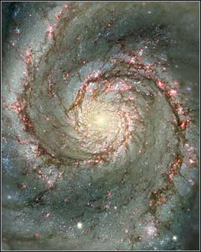
Example: the Moon observed with a 2.5 m telescope
1" => 2 km
0.05" => 100 m
Hubble Space
Telescope image,
0.05” resolution
Ground-based telescope image, 1” resolution

Slide 15
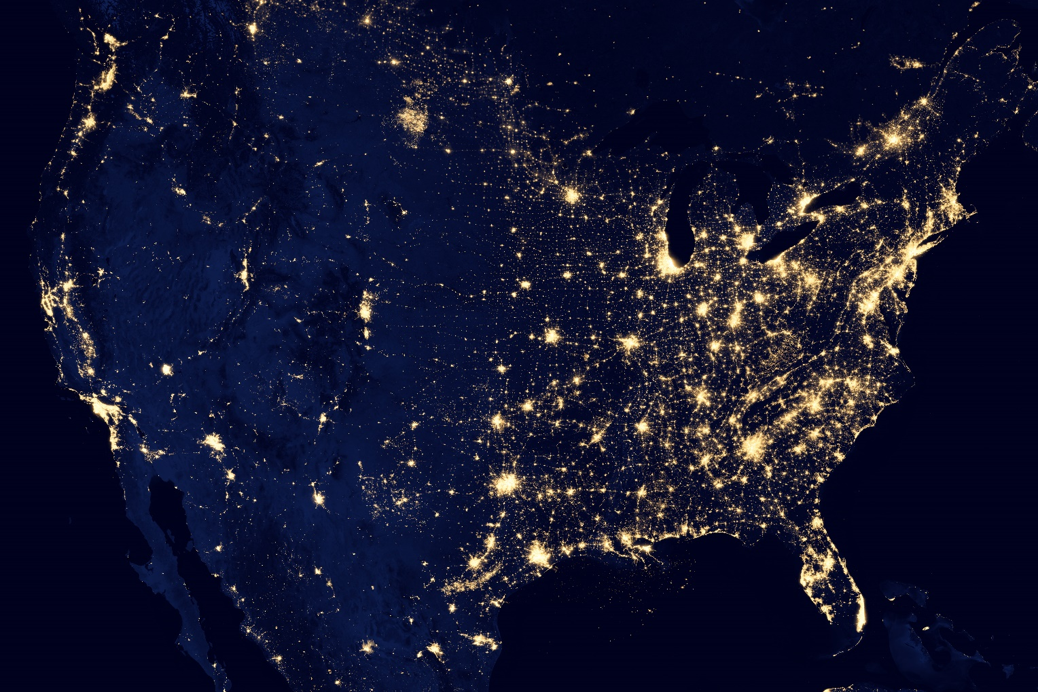
North America at night
So where would you put a telescope?

Slide 16
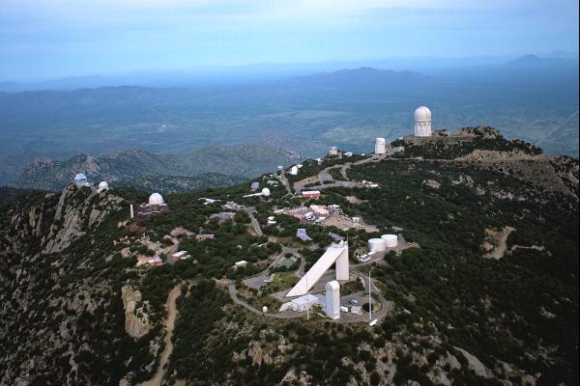
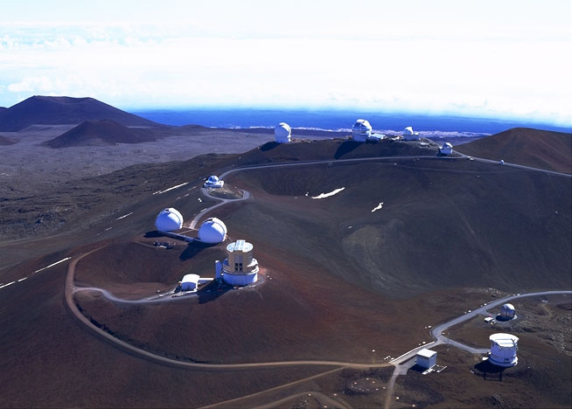
Kitt Peak National Observatory, near Tucson
Mauna Kea Observatory, Hawaii
Clear, dry sites, away
from city lights

Slide 17
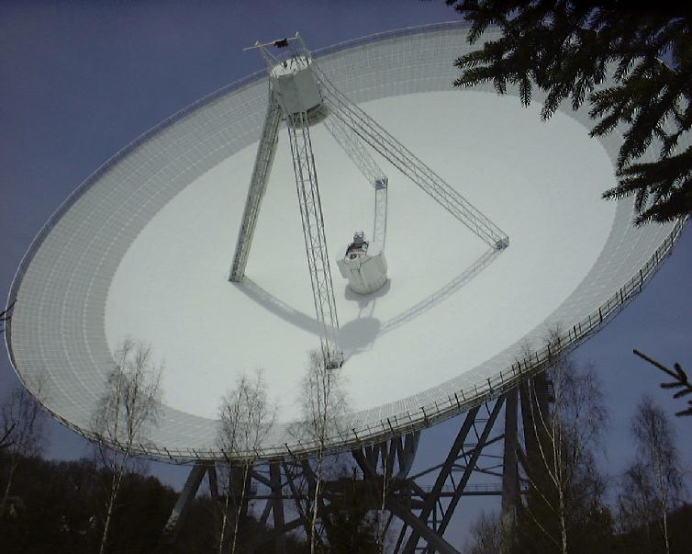
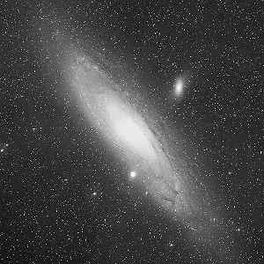
Radio Telescopes
Large metal dish acts as a mirror for radio waves. Radio receiver at focus.
Surface accuracy not so important, so easy to make large one.
But angular resolution is poor. Remember:
Effelsberg 100-m (Germany)
Andromeda galaxy –
optical
angular resolution α
wavelength
mirror diameter
D larger than optical case, but wavelength much larger (cm's to m's), e.g. for wavelength = 1 cm, diameter = 100 m, resolution = 20".
Andromeda radio
map with
Effelsberg telescope

Slide 18
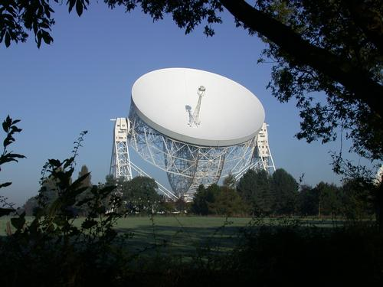
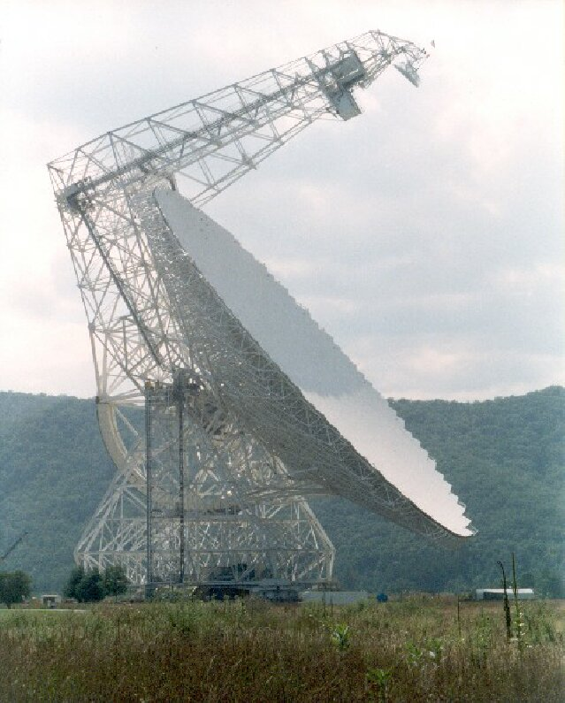
Parkes 64-m (Australia)
Jodrell Bank 76-m (England)
Green Bank 100-m telescope (WV)
Arecibo 300-m telescope (Puerto Rico)

Slide 19
Interferometry
A technique to get improved angular resolution using an array of telescopes. Most common in radio, but also limited optical interferometry.
D
Consider two dishes with separation D vs. one dish of diameter D.
By combining the radio waves from the two dishes, the achieved angular resolution is the same as the large dish.

Slide 20
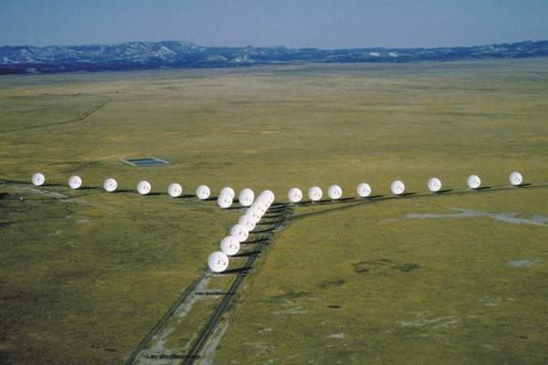
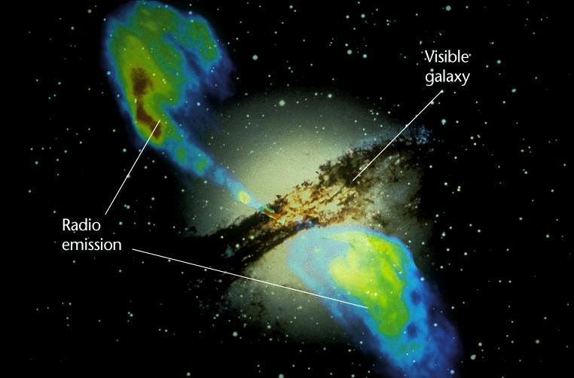
Example: wavelength = 1 cm, separation = 2 km, resolution = 1"
Very Large Array (NM). Maximum separation 30 km
Very Long Baseline Array. Maximum separation 1000's of km
VLA and optical image of Centaurus A

Slide 21
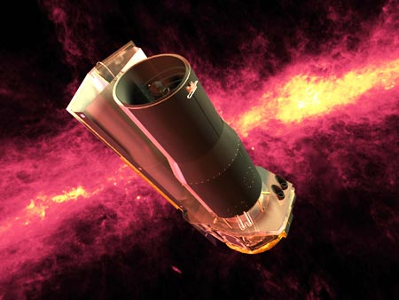
Astronomy at Other Wavelengths
Telescopes also observe infrared, UV, X-rays and gamma rays.
Mostly done from space because of Earth's atmosphere.
Infrared allows you to see radiation from
warm dust in
interstellar gas.
Spitzer Space
Telescope - infrared

Slide 22
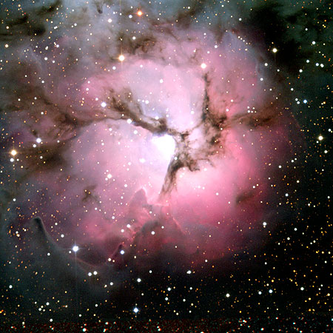
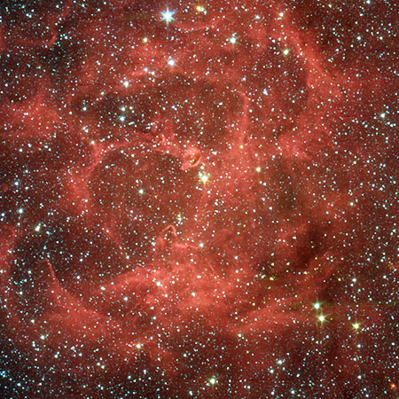
Infrared also allows you to see through dust. Dust is good at
blocking visible light but infrared gets through better.
Trifid nebula in visible light
Trifid nebula with Spitzer

Slide 23
Hubble Space Telescope and its successor-to-be(?): the James Webb
Space Telescope
Advantage of space for optical astronomy: get above blurring atmosphere – much sharper images.
Center of M51: HST (left; 0.05” resolution) vs.
ground-based (right; 1” resolution)

Slide 24
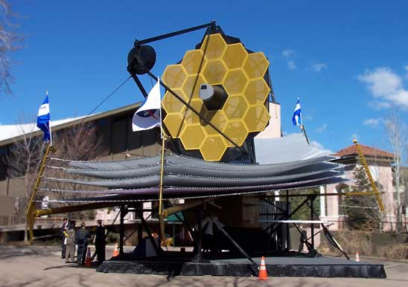
The JWST
Mock-up of JWST
Diameter 6.5 meters (vs. HST 2.5 meters) – much higher resolution and sensitivity. Will also observe infrared, whereas
Hubble is best at visible light.

Slide 26
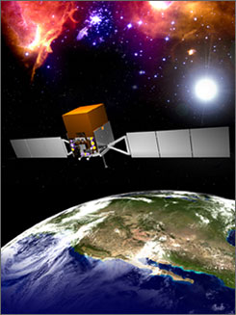
FERMI – Gamma Ray Telescope
Gamma rays are the most energetic
photons, tracing high-energy events in
Universe such as “Gamma-ray Bursters”.
Latest mission is Fermi – now launched
and taking good data.

