Slide 1
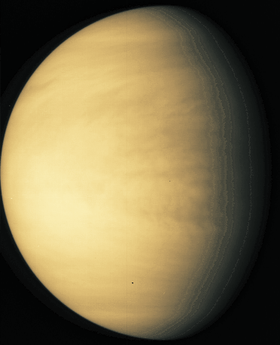
Venus
Mass = 0.82 M_{Earth}
Radius = 0.95 R_{Earth}
Density = 5.2 g/cm³
Average distance from Sun = 0.72 AU
Orbital period = 225 days
Spin period = 243 days (longer than orbital period, and retrograde!)

Slide 2
Venus' Atmosphere
- Pressure at surface is 90 x that of Earth's => much more gas in atmosphere.
- Consequence - meteoroids burn up easily. No impact craters less than about 3 km.
- 96.5% CO₂
- Yellowish color from sulfuric acid clouds and haze.
- Hot at surface - 730 K!
- Why so hot? Huge amount of CO₂ leads to strong greenhouse effect.

Slide 3
Early on, T may have been much lower (but still warmer than Earth). Oceans?
But if warm enough, T would start to rise because of...
Runaway Greenhouse Effect
1) Water and CO₂ evaporate from oceans into atmosphere.
2) Greenhouse effect more efficient.
3) Temperature rises.
4) More evaporation (back to #1).
=> complete evaporation of oceans. Thick atmosphere.
Alternatively, volcanic outgassing may never have produced oceans, like on Earth, because too hot. All gases stayed in atmosphere.

Slide 4
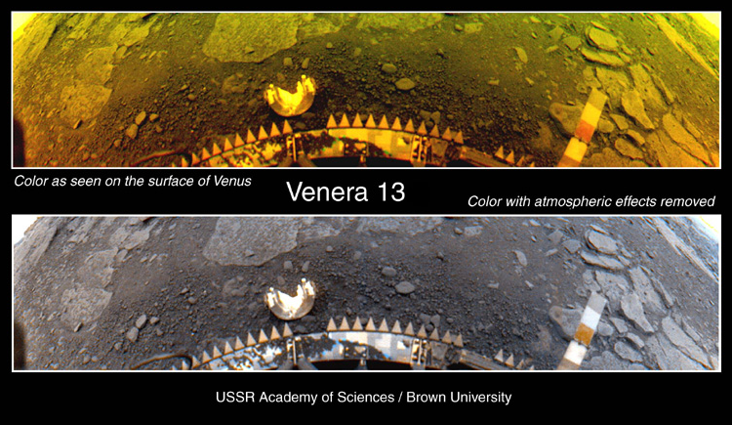
Missions to Venus
Soviet Venera 4 -18 (1967 - 1983)
Mariner 2, 5 and 10 (1962, 1967 and 1974)
Pioneer Venus (1978)
Magellan (1989)
Venera 13 photo of surface. Rocks are basalt and granite.
Color is due to atmosphere.
Color corrected
for atmosphere.

Slide 5
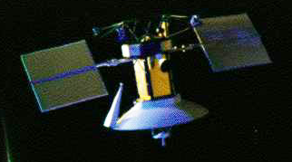
Radar penetrates atmosphere
"Radar Echo" technique measures altitude
Magellan probe
.
Time for signal to return tells you the altitude of surface feature.
Planet Surface

Slide 6
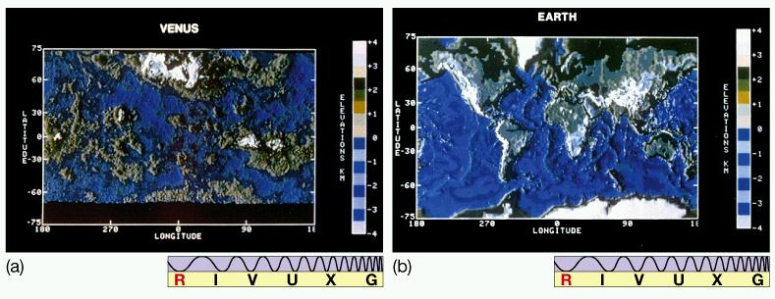
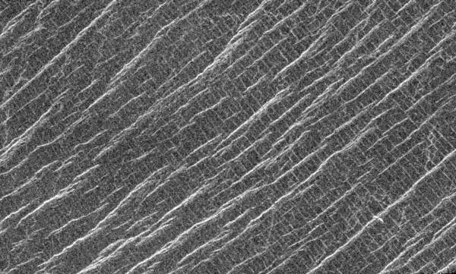
Altitude map created from Pioneer Venus radar. Flatter than Earth, no evidence for plate boundaries => no large scale plate tectonics. Volcanoes randomly distributed (Magellan).
But plenty of evidence of small-scale stresses and fractures => much
small-scale shifting of crust. Crust may
be thinner or softer than Earth’s. All “hot-spot” volcanism?
1 km

Slide 7
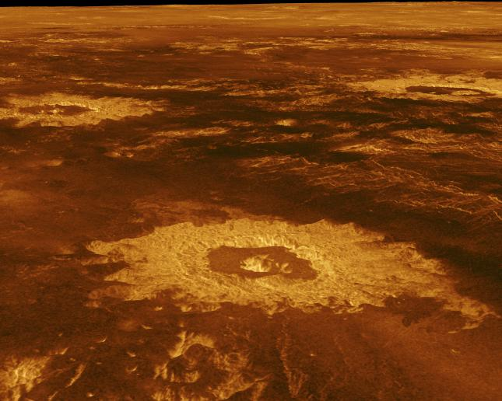
Impact Craters
Unlike Moon, impact craters distributed randomly over surface => all parts of surface have about same age.
Paucity of impact craters => surface is young, about 500 million years.

Slide 8
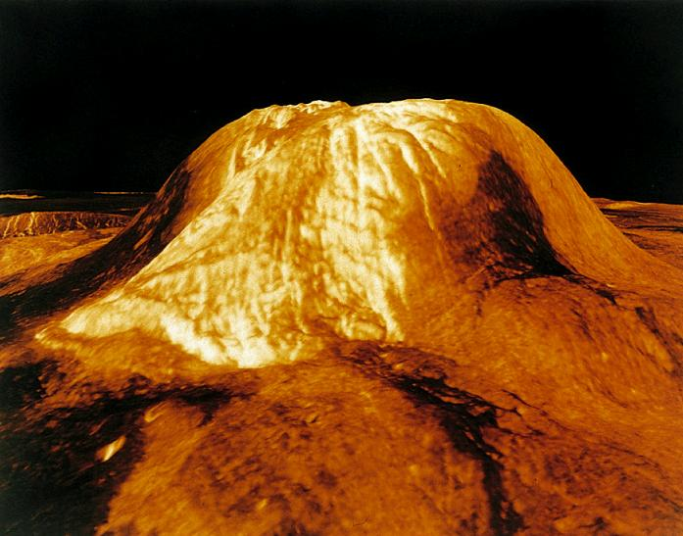
Volcanism
100 km
3 km
Shield volcano elevation map from Magellan radar data.
Volcanism may be ongoing, based on sulfur dioxide variations in atmosphere.
But very little resurfacing in past 500 million years.

Slide 9
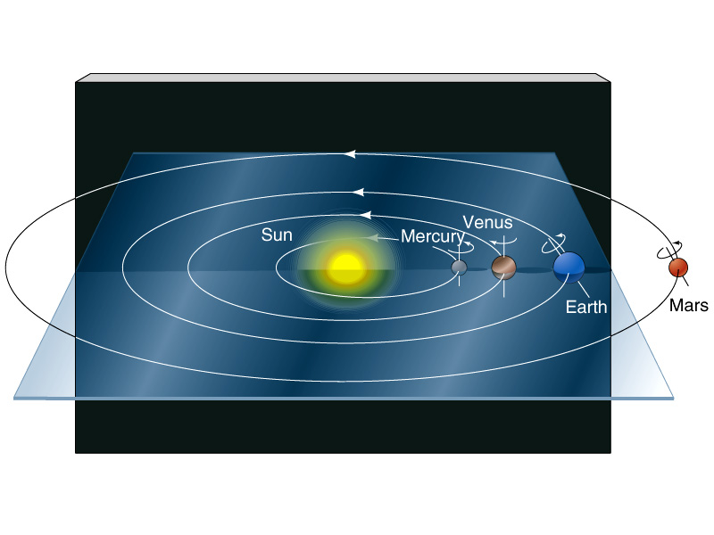
Terrestrial Planets' Spin

Slide 10
Volcanism
Shield volcano elevation map from Magellan radar data. About 100 km across. Volcanism may be ongoing, based on sulfur dioxide variations in atmosphere.
But very little resurfacing in past 200-500 million years.
Venus surface flyover

