Slide 1
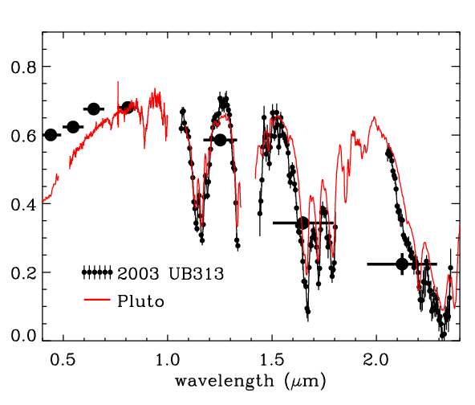
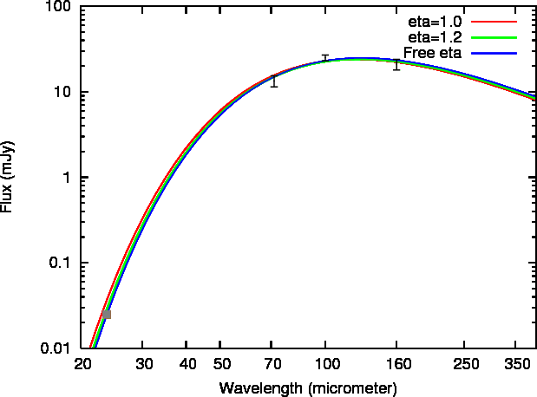
Spectra of KBOs
Eris
(gap in
spectrum)
KBO reflection spectra
A KBO blackbody spectrum
Notes:
highly reflective regions may be ice

