Slide 1
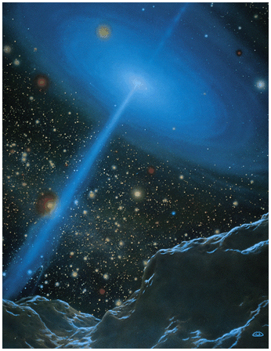
Active Galactic Nuclei: Ch 24 (except 24.4)
Key points:
Active Galactic Nuclei: powerful energy sources in “nuclei” (central ~1 pc) of some galaxies
Main types: Seyferts, radio galaxies and quasars. Other variants we’ll skip.
Power source: accretion of matter onto a supermassive black hole (SBH) of mass 10⁶ – few x 10⁹ M. Strong gravity means conversion of much grav. PE into KE and heat! Accreting matter should spin very fast by angular momentum conservation.

Slide 2
Active Galactic Nuclei (AGN)
~1% of large galaxies have an active nucleus. Yet now we think all large galaxies have a SBH – so most of the time it is not accreting material.
Active nucleus is compact and bright, sometimes outshining the whole galaxy. A galaxy with an AGN is called an “active galaxy”.
Display strong, broad emission lines, from hot, dense, highly excited gas (not just absorption lines from stars and narrow emission lines from HII regions), from a presumed, rapidly rotating “accretion disk”, too small to resolve. AGNs also bright in X-rays, radio.
Often see fast jets of ejected matter, perpendicular to presumed accretion disk.
Brightness varies rapidly. Can be used to constrain source size to just a few light days across at most (please read in 24.2).

Slide 3
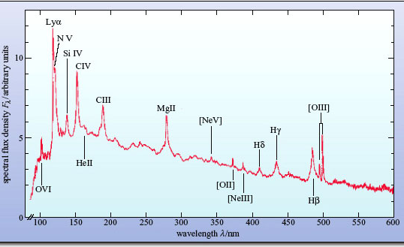
Normal galaxy and active galaxy nucleus spectra
Normal spiral galaxy
fig1apaola.jpg
Active galaxy nucleus. Emission lines: hot gas. Broad lines indicate fast gas motions – up to 10,000 km/s.
Continuum is also
from AGN, starlight
overwhelmed. Bright in UV.
Note: this is the rest-wavelength spectrum of a redshifted AGN.

Slide 4
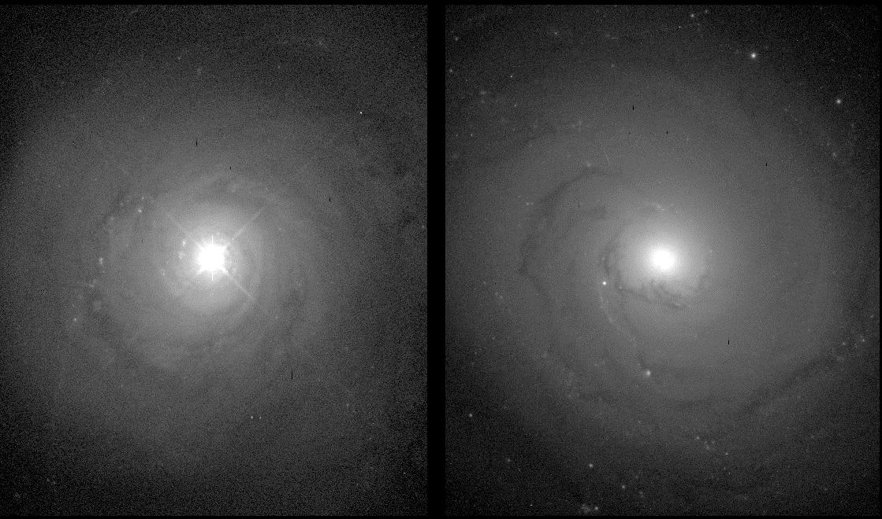
Discovery of AGN – Seyfert Galaxies
1940's: Carl Seyfert found 6 galaxies with:
Unusually bright (10³⁶ – 10³⁸ W), point-like nuclei embedded in spirals.
Strong, broad emission lines from the nuclei.
Seyfert galaxy Normal galaxy

Slide 5
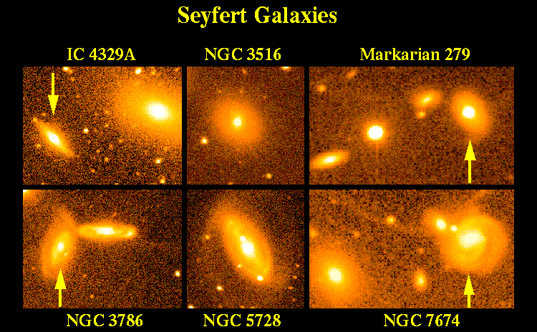
Spirals and SO’s – often with close companions, but often not. Recall: interactions and mergers send gas towards galaxy centers, where it can feed the SBH.
Seyferts are also bright in radio and X-rays, but not as bright as next AGN type…

Slide 6
Radio Galaxies
1950 - Radio Galaxies discovered in early radio surveys of the sky:
Galaxies at location of intense radio emission: ∼ 100 times that of a normal galaxy. Galaxies are E’s, usually with signs of recent encounter, or merger products, typically in galaxy clusters.
Later observations (with e.g. VLA) showed that Radio Galaxies typically have two huge “lobes”.
Jets of emission are also often seen, connecting nucleus to lobes. Generally in radio emission. Sometimes optical. Can be up to ~ 1 Mpc long. Highly relativistic, completely ionized gas.

Slide 7
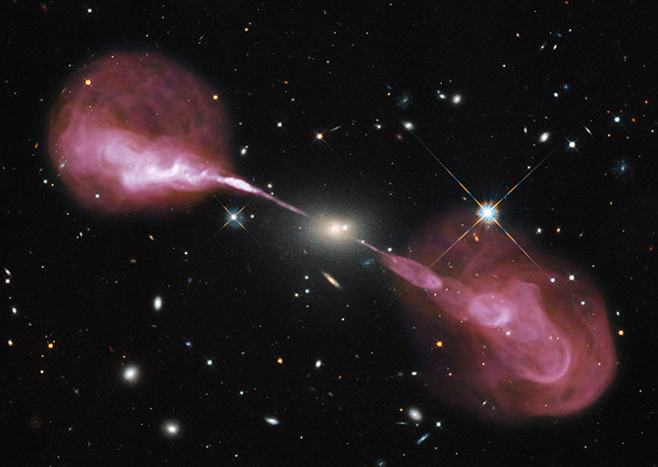
Hercules A
optical and
radio (VLA)
overlay
Jets remain narrow until the matter starts plowing into low density gas that surrounds galaxies in clusters (recall X-ray emitting gas in clusters),creating “lobes”.
(VLA)

Slide 8
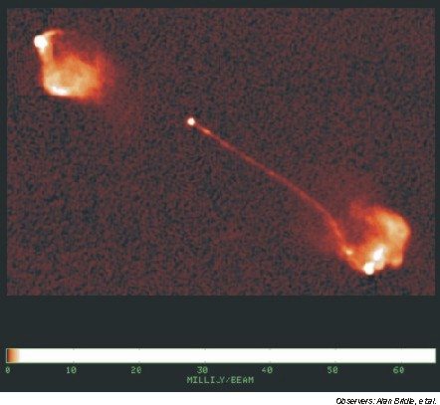
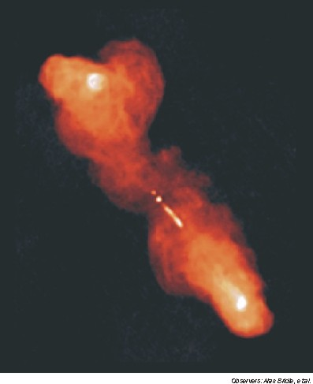
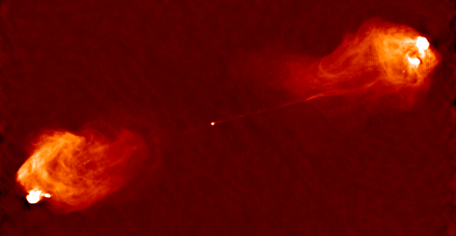
3C175
3C219
Cygnus A
All with VLA.
Sometimes see only one jet, due to “relativistic beaming”. Seyferts have
jets too, but just a few kpc and less powerful – they may also run into ISM of host galaxy.

Slide 9
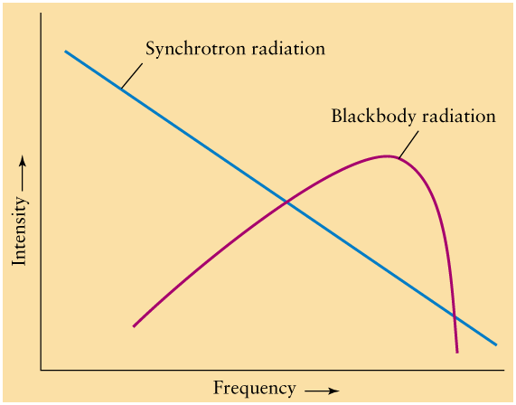
log
In all AGN, radio emission spectrum explained by synchrotron radiation - as in pulsars and supernova remnants – relativistic electrons spiraling in magnetic fields. Has a continuous spectrum. If electrons very energetic, can extend into optical and beyond.
log

Slide 10
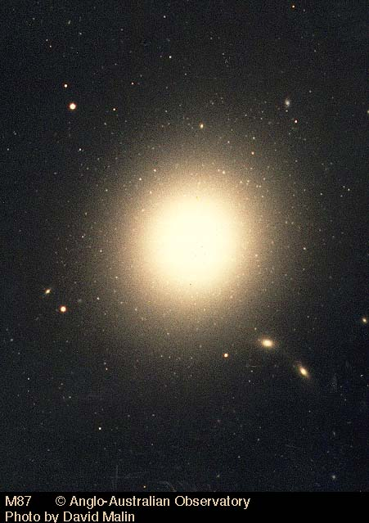
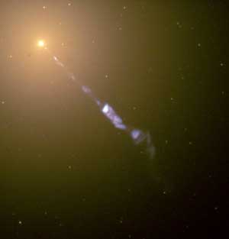
40 kpc

Slide 11
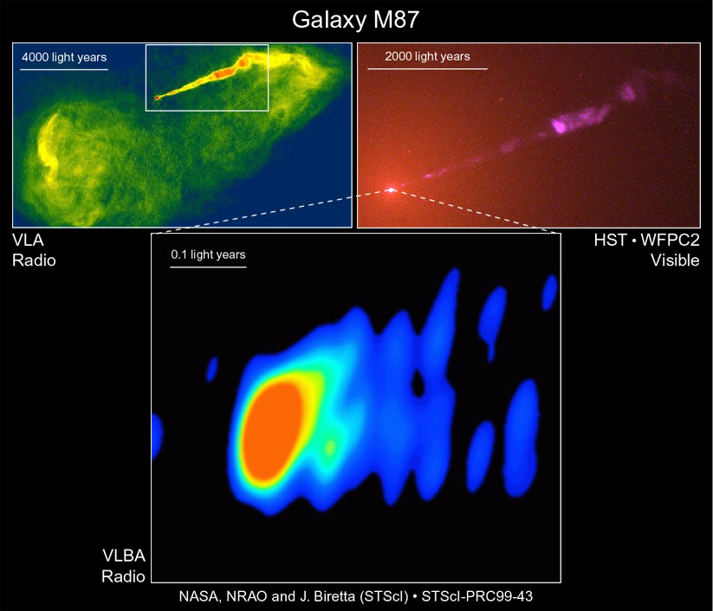
VLBA Movie
of jet

Slide 12
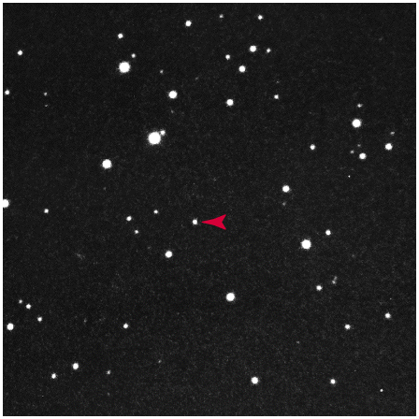
Quasars: some history
Some strong radio sources in the 3rd Cambridge catalogue had optical counterparts that looked like stars but had strange optical spectra with broad emission lines that at first couldn’t be identified.
Stars are typically not strong sources of radio wavelength emission.
These objects were called quasi-stellar radio sources, later shortened to quasars.
Quasar 3C48 in the visible.

Slide 13
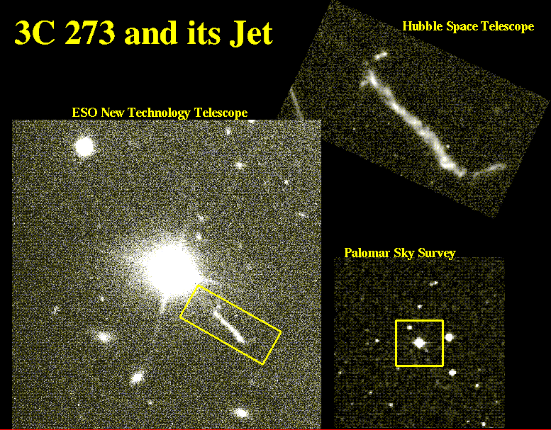
3C 273 was starlike but had a jet, which would be quite strange for a star.

Slide 14
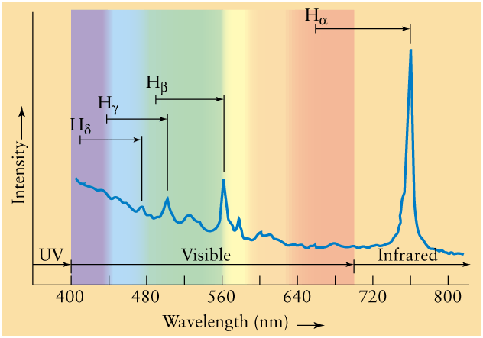
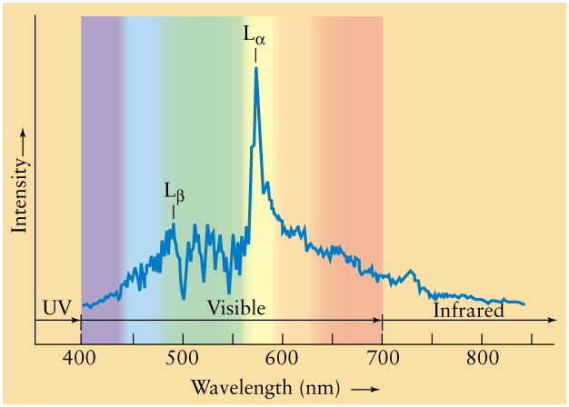
The spectra strangely showed emission lines, and at unfamiliar wavelengths. In 1963, Maarten Schmidt (Caltech) realized that they were simply hydrogen lines that were at unexpectedly (given there was no sign of any galaxy) large redshift. Implied enormous luminosities of 10³⁸ – 10⁴² W! 100’s of times more powerful than Seyferts.
z = (λ - λ₀)/ λ₀
Spectrum of a high-z quasar, z=3.773. UV emission shifted into optical.
Spectrum of a low-z quasar (3C 273), z=0.158.

Slide 15
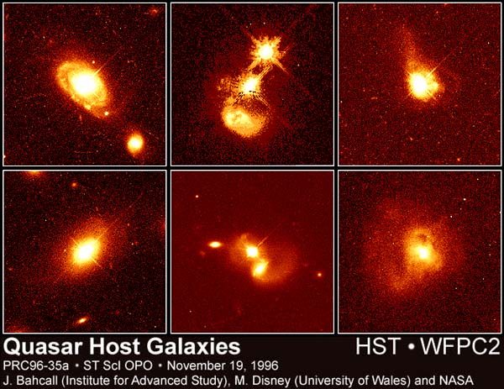
Are quasars really pointlike? No! But it took decades to find out. HST images finally showed quasars live in galaxies. Most are ellipticals, or spirals with large bulges, and close companions. Signs of interaction and merger common.

Slide 16
Huge redshifts => large distances, long time ago
For large redshifts, relation between redshift, distance and age of Universe when light emitted is complex.
But for redshift = 3 or so (typical quasar redshift), distances are thousands of Mpc, and Universe was about 2 Gyr old.
Highest known redshifts are about z=7. Universe was 800 Myr old when light emitted. So bright that they can be seen to such large distances.

Slide 17
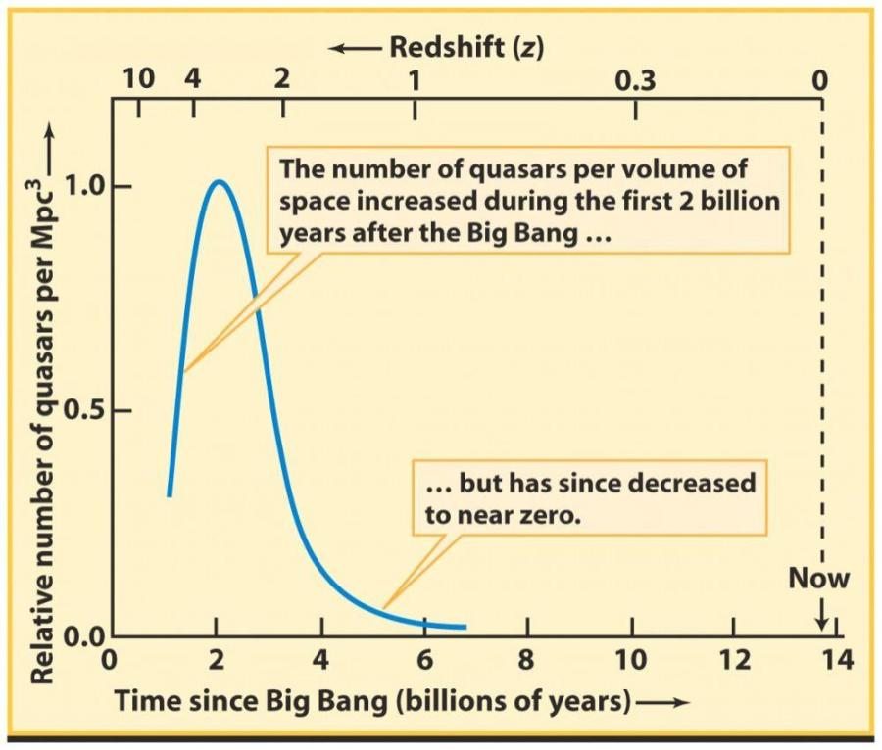
Quasars are basically extinct. They were a feature of the early evolution of galaxies, when they were unsettled and fuel was being channeled to centers.

Slide 18
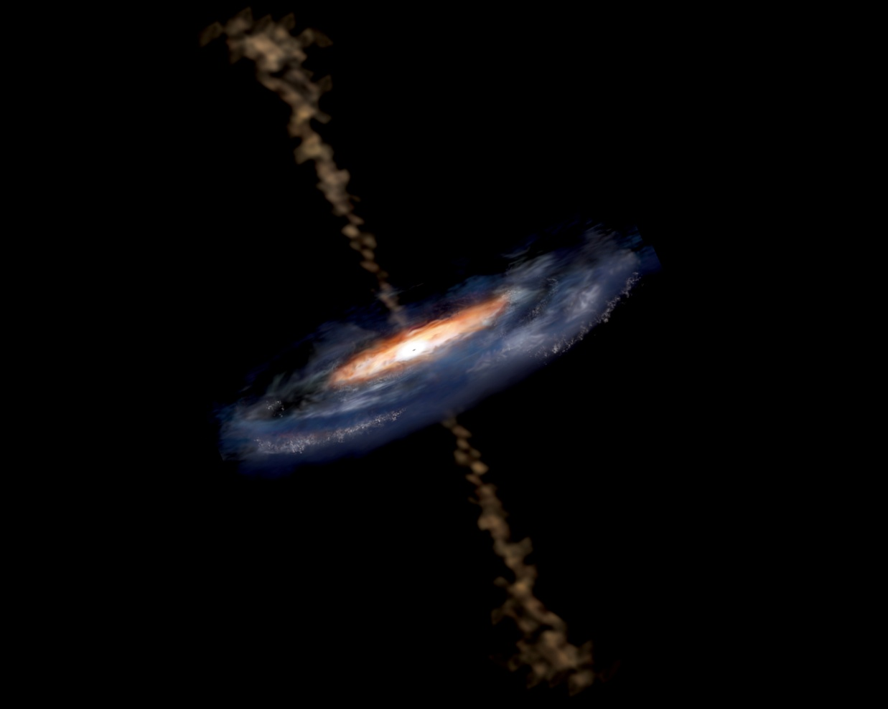
What are active galactic nuclei?
All are the same phenomenon: a SBH at the nucleus of a galaxy, with some material to feed it.
The differences between Seyferts, Radio Galaxies and Quasars (and other less important classes) come from:
- the mass of the black hole
- how fast the black hole is fed (related to mass)
- viewing angle (e.g. Quasars and Radio Galaxies may be same thing viewed at different angles [in latter, edge-on view of gassy-dusty accretion disk blocks view of central engine, so no bright quasar seen]).
Artist’s conception of inner
parsec or so.

Slide 19
Energy source
Enormous AGN power output comes from release of gravitational potential energy as gas falls toward black hole.
PE = -Gm_{gas}M_{bh}/r
Energy released when a particle falls toward a black hole is the difference between its potential energy when r = pc’s to kpc’s and when r => AU’s. Very large number!
Gas in accretion disk therefore has high energy. Ionized. Particles colliding and interacting make gas very hot, and much radiation energy is released => huge luminosities. Bright in x-rays too. Gas should move rapidly due to proximity to black hole – explains broad emission lines.

Slide 20
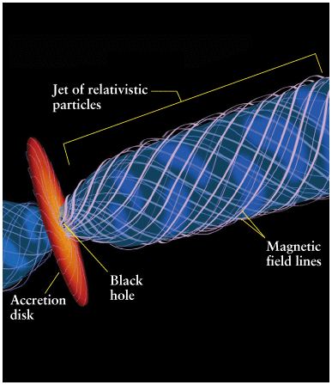
High temperatures and densities
result in enormous gas pressures
(P=nkT), and high luminosity leads to huge radiation pressure, especially in inner accretion disk – matter can be expelled away from disk in 2 jets.
Note: this is all just outside the
Event Horizon, of course.
Jets kept narrow by magnetic
fields. Differential rotation in
disk twists magnetic fields into
helical configuration. But details
not clear.

Slide 21
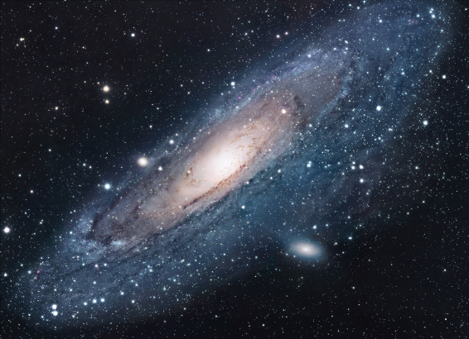
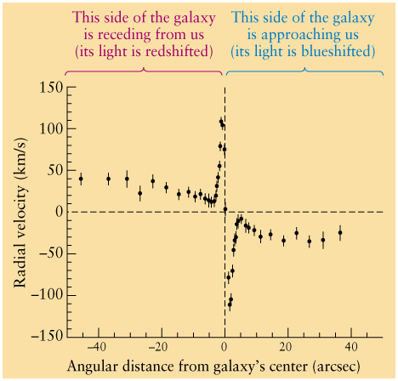
Modern observations that indicate the existence of inactive SBHs – e.g. high speed of stars in small rotating disk near core of M31 (recall stars orbiting MW SBH). Rotation speeds fall in “Keplerian” way, i.e. v α 1/R^{1/2}, indicating central mass dominates. Using M_{int}(R) = R[v(R)]²/G, observations suggest mass of 10⁸ M within 0.1 pc (0.03”). But no AGN activity.
HST image

Slide 22
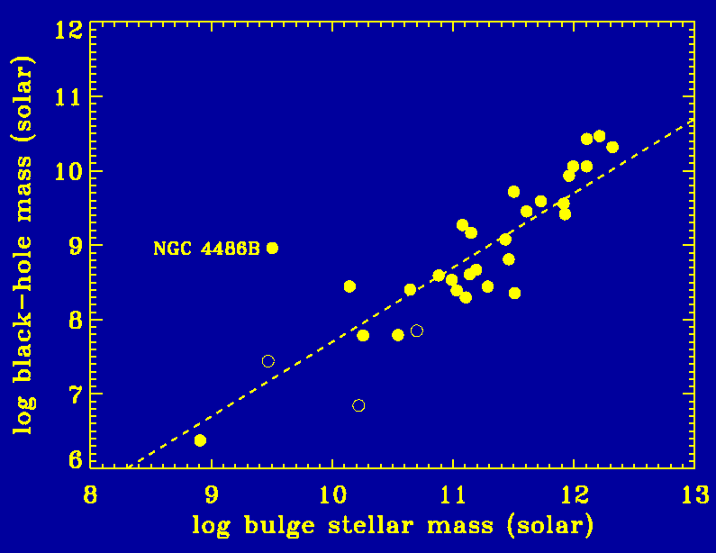
Open questions
Do most spirals and ellipticals have SBHs?
Probably, growing amount of dynamical evidence for their presence in many nearby, but otherwise inactive galaxy nuclei (including MW, M31)
How do they form?
we know how to make stellar
mass BHs but somehow they have
to grow into SBHs. Not clear how.
for some reason, mass of BH is
proportional to mass of bulge
(in spirals) or mass of elliptical.
Why?
How are they fueled?
Galaxy growth, mergers, interactions might dump gas into the nuclear region. All more common in past.
Stellar bars might be able to funnel gas to nucleus from disk in Seyferts.
Cannibalism of a gas-rich dwarf?
Spiral bulge or elliptical stellar mass

Slide 24
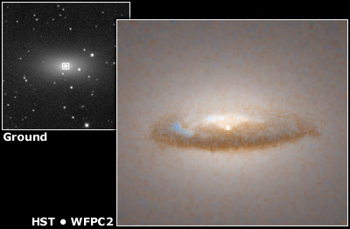

Slide 25
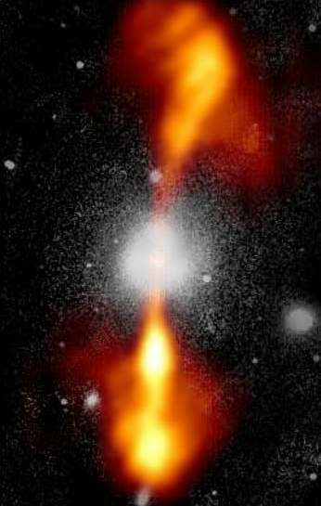
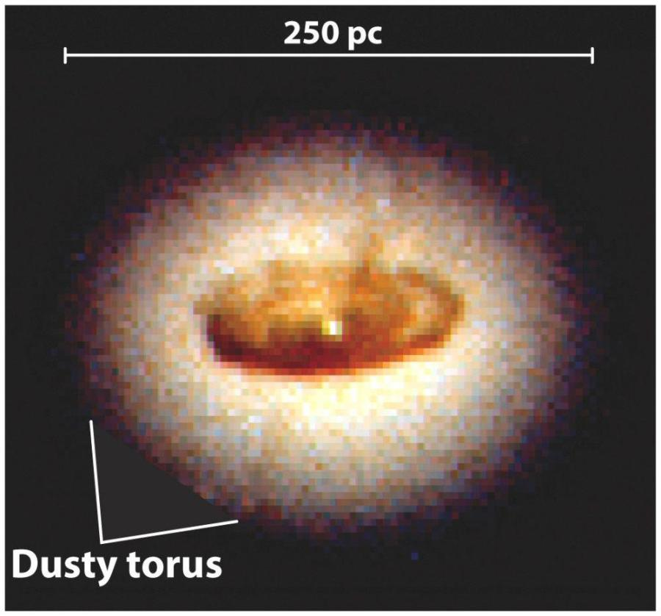
Artist’s conception of inner
parsec or so.
Can’t resolve inner parsec, but on larger scale can see dusty torus in NGC 4261 (HST).

Slide 26
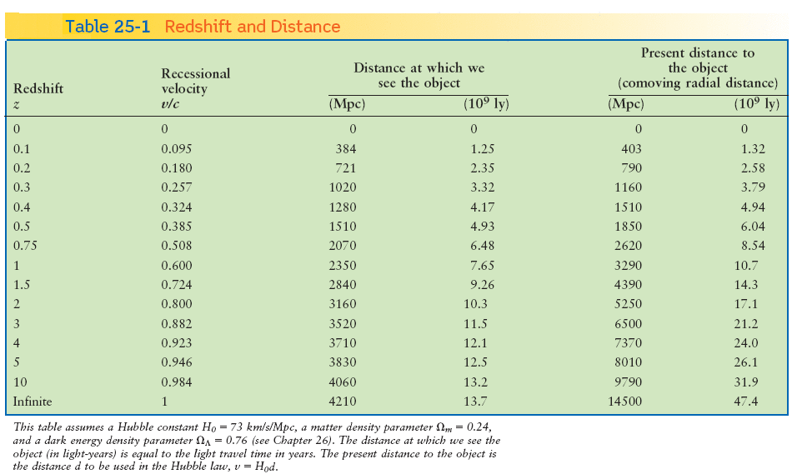
Light has taken so long to reach us (billions of years) that universe has expanded significantly. Must distinguish between distance light has traveled and distance to quasar now.

