Slide 1
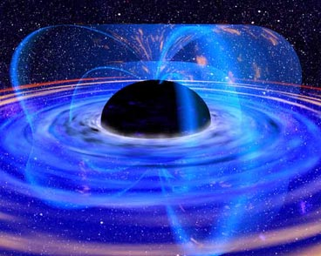
Black Holes - Chapter 21

Slide 2
The most massive stellar cores
If the core is massive enough (~3 M; total initial mass of star > 25 M or so), even neutron degeneracy pressure can be overwhelmed by gravity. A catastrophic collapse is inevitable => black hole.
Gravity so strong around black hole that Newton’s laws no longer work. Must turn to General Relativity.
(Fate of collapsed matter, we don’t know of any pressure that can stop collapse:
Volume → 0
Density → ∞ A “singularity”. We don’t have the physics for this!)

Slide 3
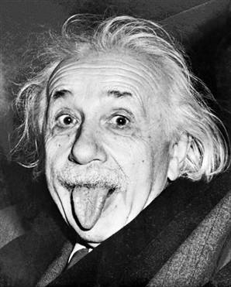
Relativity
Special Relativity: how space and time measurements differ for observers moving at different (but constant) speeds. Effects only noticeable if speeds are significant fraction of c.
General Relativity: how space and time measurements differ depending on acceleration, which Einstein showed is equivalent to gravity.
Matter distorts space and time.

Slide 4
Special theory of relativity
In Newtonian physics, space and time are absolute (how they appear to us in everyday life).
Einstein showed with this theory that this is not true: space and time measurement depends on your “frame of reference”, i.e. how fast you are moving.
Based on two principles:
  The speed of light is the same for all frames of reference.
  The laws of nature are the same for all frames of reference.
First principle also explained results of Michelson-Morley
experiment (1887): speed of light same both parallel and perpendicular to Earth’s motion. If true, leads to
strange consequences…

Slide 5
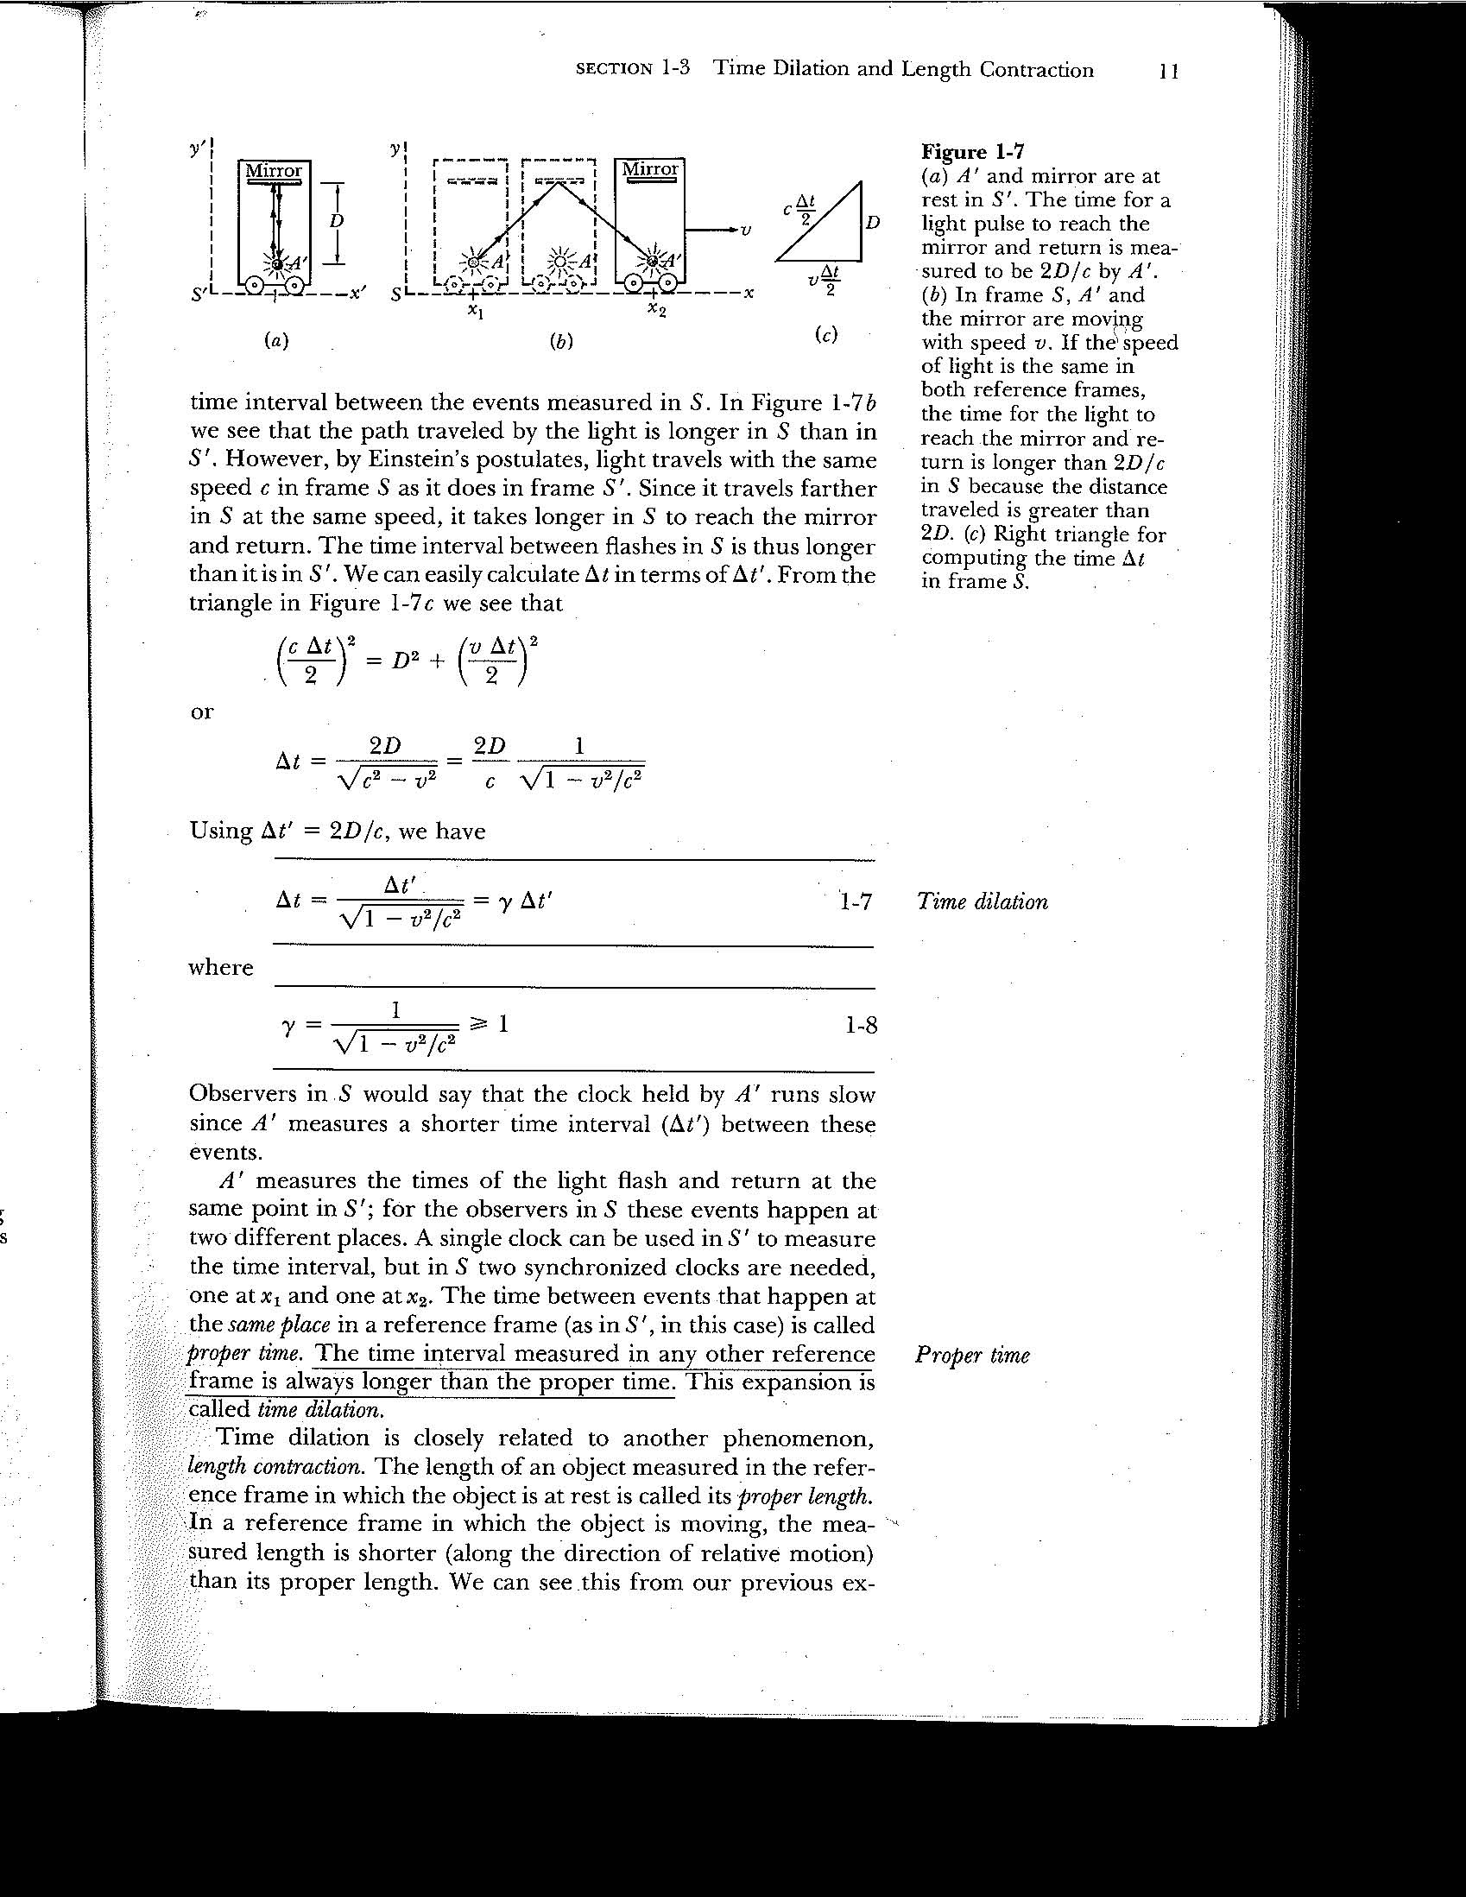
Light pulse leaves A’, bounces off mirror, returns.
In “primed” frame (a), moving with cart, this takes time Δt’ = 2D/c.
In stationary (“lab”) frame, light travels extra distance, but at same
speed. Time interval Δt must be longer.
“Time dilation”
γ also called Lorentz factor

Slide 6
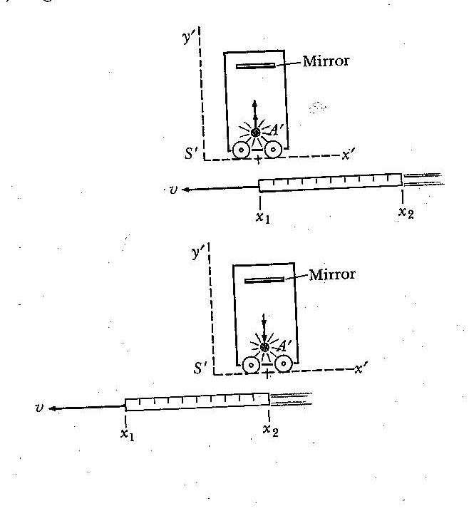
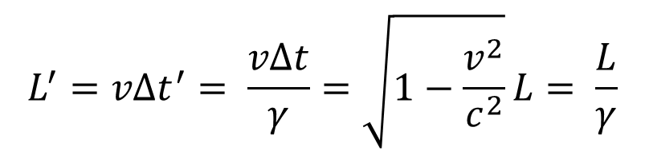
Likewise, lengths are contracted in direction of motion when measured from a moving frame. Consider rod stationary in unprimed (lab) frame. In primed frame, rod passes at speed v as light travels from A’ back to A’ in time Δt’. So rod length measured is Ľ = vΔt’.
In unprimed frame, cart travels a distance vΔt as it passes rod, so rod length L = vΔt.
$$L^{′}=vΔt^{′}= \frac{vΔt}{γ}=\sqrt{1−\frac{v^{2}}{c^{2}}}L= \frac{L}{γ}$$
“Length contraction”

Slide 7
If everything is relative, which reference frame measures longer
time, shorter distance?
First, “events” are things that happen at a certain spatial coordinate
and time. In our example, the launching of the light pulse is an event,
its reception is another.
“Proper time”: time interval between events in frame where they
both occur at same place. This is shorter time. This was the primed
frame in our experiment. Time is dilated in any other frame.
“Proper length”: length between two spatial coordinates measured
in frame where they are at rest. This is longer length. This was the
unprimed frame in our experiment. Length is contracted in any other
frame.

Slide 8
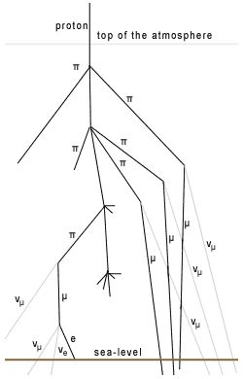
Example: muon decay in Earth’s atmosphere.
Muon half-life in its rest frame: 2 μs. Typically created at 9000 m
with speed 0.998c.
Given number measured at 9000 m, might expect few at sea-level:
only travel 600 m in 2 μs. But in our frame, lifetime is γ 2 μs ~ 30 μs.
So we get many.
In muon’s frame, height of atmos. contracted to 9000m/γ = 600 m.
Again, same large number will reach surface.

Slide 9
General Relativity
General Relativity: Einstein's (1915) description of gravity (extension of Newton's). It begins with:
The Equivalence Principle
Demonstrated by either of two thought experiments:
1) Freefall and weightlessness are equivalent
a) Imagine you are far from any source of gravity, thus weightless. If you shine a light or throw a ball, it will move in a straight line.

Slide 10
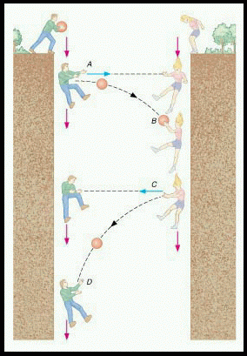
b) If you are in freefall (due to gravity), you are also weightless. Einstein says these are equivalent. So in freefalling reference frame, light and ball also travel in straight lines.
c) Now imagine two people in freefall on Earth, passing a ball. From their perspective, they pass it in a straight line. From a stationary perspective, it follows a curved path. So will a flashlight beam. But curvature of light path small because light is fast and Earth’s gravitational acceleration is small.

Slide 11
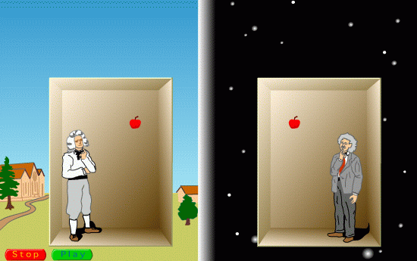
2) Gravity and acceleration are equivalent
An apple falling in Earth's gravity is the same as one falling in an elevator accelerating upwards in free space.
All effects you would observe by being in an accelerated frame of reference you would also observe when under the influence of gravity.

Slide 12
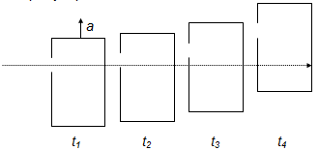


Bending of light in this case:
In an accelerating elevator in free space, straight path
of light appears curved
•
•
•
•
(equal time intervals)
Same thing must happen in a gravitational field.
Earth

Slide 13
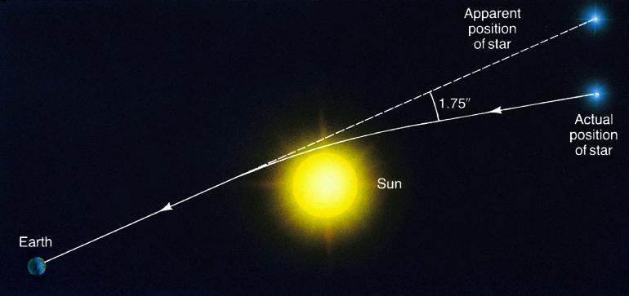
Testable Consequences of General Relativity:
1. Bending of light (just discussed)
Observed! In 1919 eclipse.

Slide 14
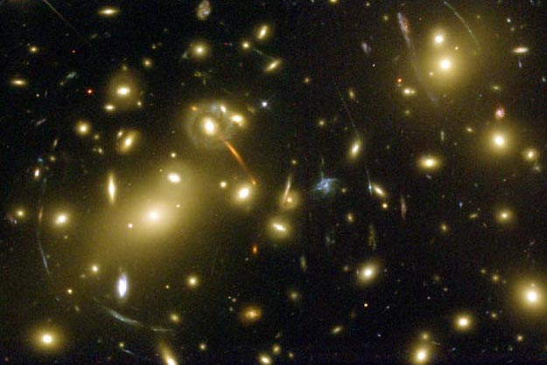
Gravitational lensing. The gravity of a foreground cluster of galaxies distorts the images of background galaxies into arc shapes.

Slide 15
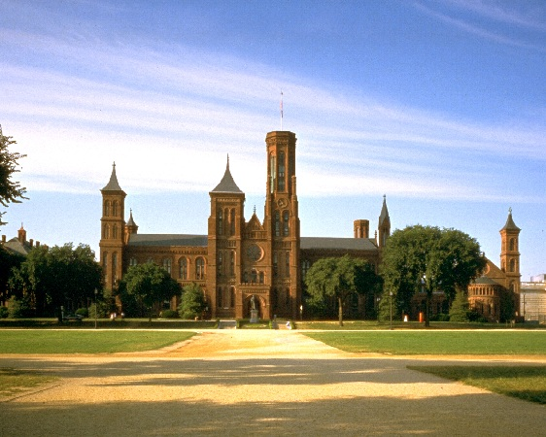
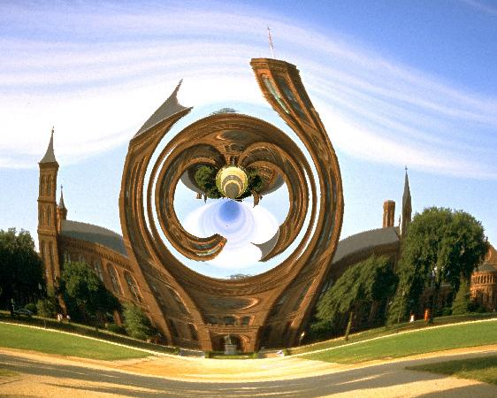
Saturn-mass
black hole

Slide 16
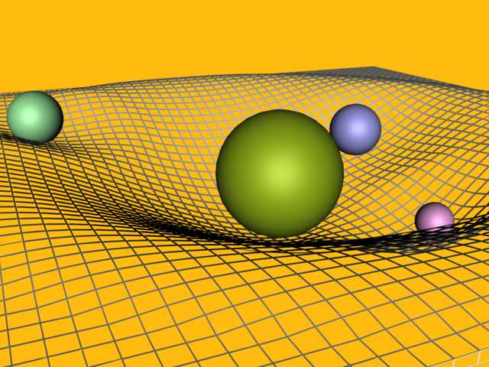
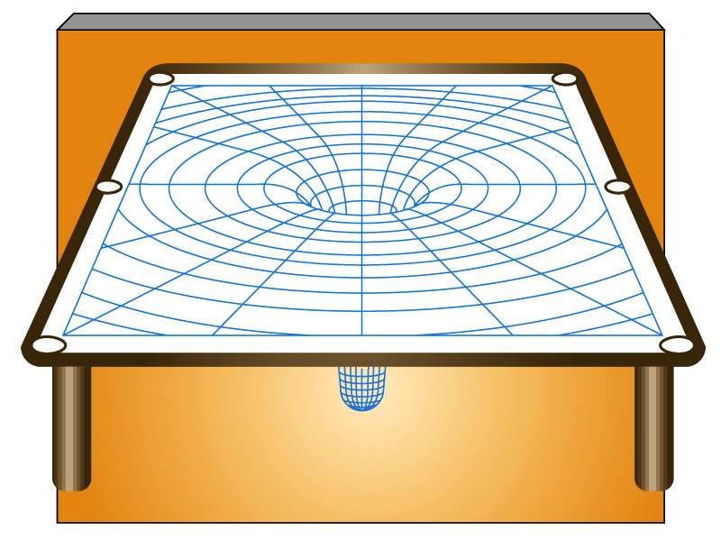
Einstein showed how the gravity of an object distorts, or curves, space around it, analogous to a rubber sheet in 2D. Freely falling objects passing through this curved space are forced to follow curved paths – they can’t go in straight lines. True even for massless particles.

Slide 17
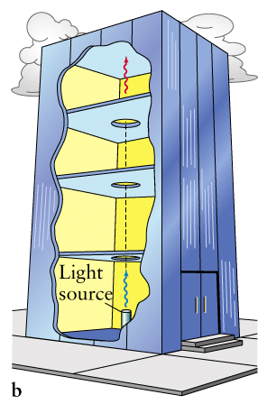
2. Gravitational Redshift
light received when elevator receding at some speed.
Consider accelerating elevator in free space (no gravity).
later, speed > 0
Received light has longer wavelength (or shorter frequency) because of Doppler Shift ("redshift"). Gravity must have same effect!
time zero, speed=0
light emitted when elevator at rest.
Verified in Pound-Rebka experiment.

Slide 18


If light emitted at radius r from center of mass M with wavelength λ₀, then λ₁ measured at another radius r₁ is:
At an infinite distance away:
Can also write left hand side as ν₀/ν₁.
What happens when r = 2GM/c²?
$$\frac{λ_{1}}{λ_{0}}= \frac{\sqrt{1− \frac{2GM}{r_{1}c^{2}}}}{\sqrt{1−\frac{2GM}{rc^{2}}}}$$
$$\frac{λ_{1}}{λ_{0}}= \frac{1}{\sqrt{1−\frac{2GM}{rc^{2}}}}$$
The photon will be redshifted to infinite wavelength or zero frequency - equivalently zero energy! It’s redshifted out of existence! (this is true not only at an infinite distance away but at any distance r₁ > 2GM/c²). Thus light can’t escape – a black hole.

Slide 19
3. Gravitational Time Dilation
A photon moving upwards in gravity is redshifted. Since
1
c
λ
1
T
= ν =
the photon's period gets longer. Observer 1
will measure a longer period than Observer 2. So they disagree on time intervals. Observer 1 would say that Observer 2's clock runs slow!
What happens to T if r = 2GM/c²?
2
Time interval becomes infinitely long. Observer 2’s time appears to stop according to Observer 1. Another way to define a black hole.

Slide 20
Escape Velocity
Velocity needed to escape the gravitational pull of an object, starting from a distance r from center.
v_{esc} =
2GM
r
If we set v_{esc} = c, then r < 2GM/c² is distance from center from which nothing can escape. Again, a black hole.

Slide 21
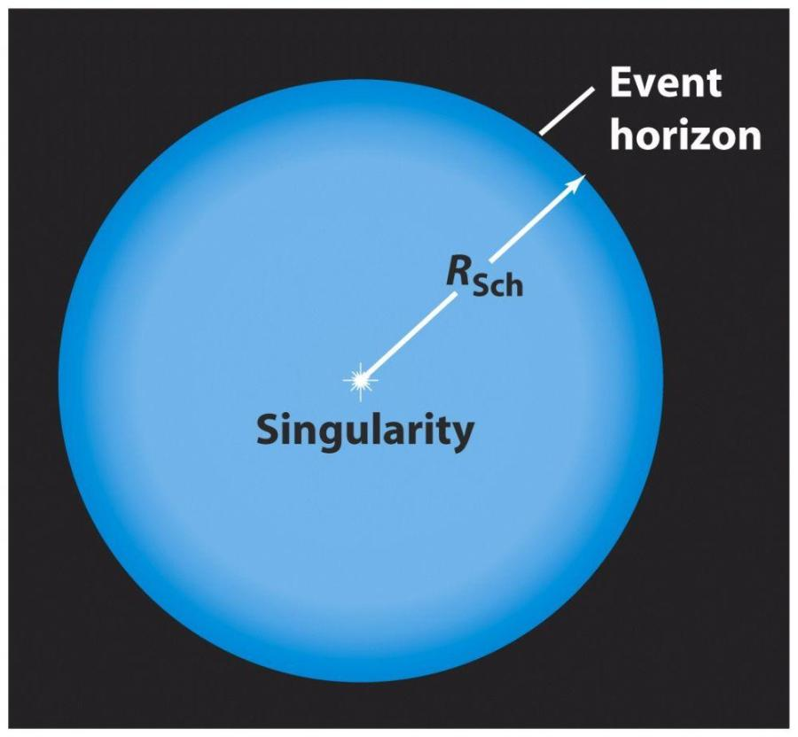
Schwarzschild Radius and Event Horizon
For an object of mass M, the Schwarzschild Radius is:
R_{S} = 2GM/c²
at which v_{esc}=c, infinite gravitational redshift and time dilation occur.
R_{S} (km) = 3 M (M)
For Earth, R_{S} = 1 cm. If you could
crush Earth to this size, it would be
a black hole.
Event Horizon is imaginary sphere
with radius R_{S}.

Slide 22
Black Holes
Result of collapse of core with about 3 M or more.
Core collapses to a point, a “singularity”. As long as it shrinks to a size < R_{S}, it is a black hole. For a 3 M object, R_{S} = 9 km. (We have never resolved this distance for any BH candidate).
Anything crossing over to inside the event horizon, including light, is trapped. We can know nothing more about it after it does so.

Slide 23
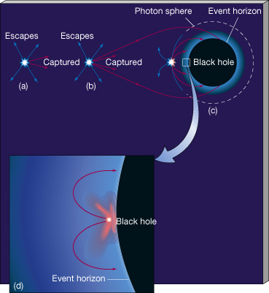
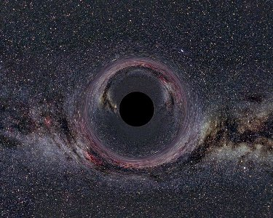
Black holes cause enormous space curvature. At event horizon it is so great that space "folds in on itself", i.e. anything crossing it is trapped.

Slide 24
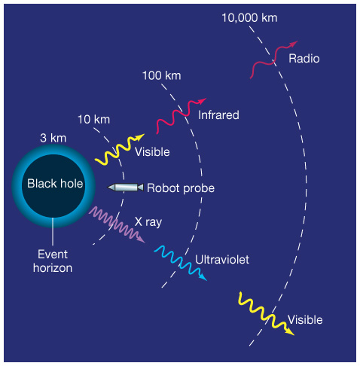
Other effects around Black Holes
1) Enormous tidal forces (Newtonian).
2) Gravitational redshift. Example, blue light emitted just outside event horizon may appear red to distant observer. Infinite redshift at event horizon.
3) Time dilation. Clock just outside event horizon appears to run slow to a distant observer. Clock approaches zero speed as it approaches event horizon.
None of these has actually been observed around a black hole, but 2) and 3) around other dense objects.

Slide 25
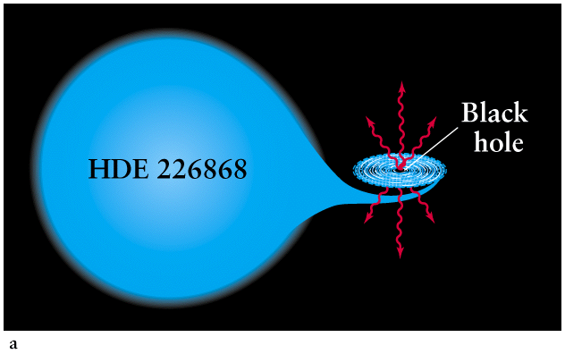
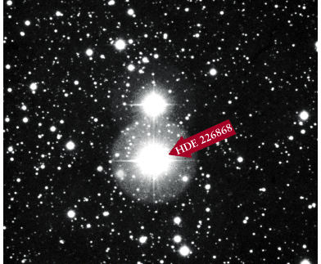
Do Black Holes Really Exist? Good Candidate: Cygnus X-1
- Binary system: 30 M star with unseen companion.
- Binary orbit => companion ~15 M. Neutron stars should be < 3 M
- X-rays => million degree gas falling into black hole.
Cygnus X-1

Slide 26
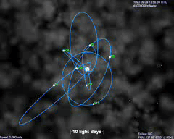
SgrA* at the center of the Milky Way
Supermassive black holes:
The dynamical center of the Milky Way is called SgrA*, and contains a supermassive black hole.
Confirmed by measuring orbits of stars around the dense center.
2000 AU=0.25”
Animation of stars orbiting the unseen mass

Slide 28
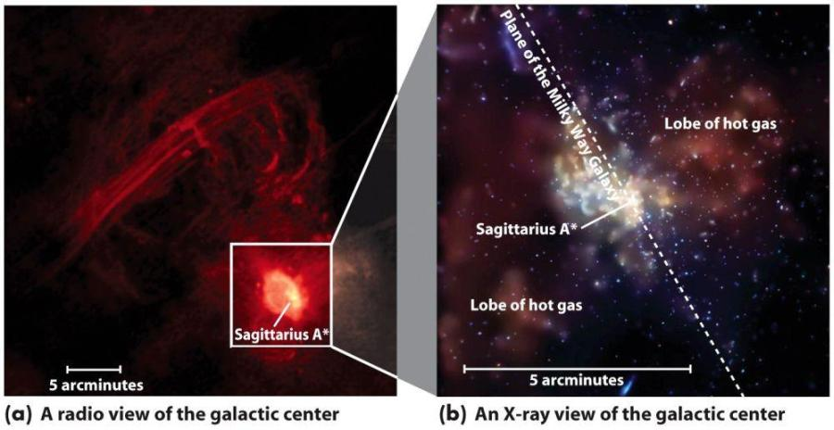
SgrA* at the center of the Milky Way
Supermassive black holes:
The dynamical center of the Milky Way is called SgrA*, and contains a supermassive black hole.

Slide 29
GR has to do with the way space and time are measured at different points in a gravitational well. All other physical quantities depend on these.
We said that a distant observer will see a clock deep inside a potential well run slowly, and at the BH event horizon, appear to stop altogether (but it will also appear to be infinitely thin in the radial direction). Does this mean that if you are deep inside a potential well, time appears to run slowly for you? It is all relative. For you, time appears to run normally, but a distant clock will appear to run very fast. If you were to climb out of the potential well, the rate at which your clock and the distant one run would start to become closer. If you are somehow paused at the event horizon itself, the distant clock would approach infinite speeds. Energies of distant things would appear to approach infinity too. This is one way of looking at why you can’t get out from the event horizon. You would have to transform from finite energies to infinite energies.
Any light sent from deep inside the well will be redshifted by the time it gets to a distant observer, because the way in which lengths are measured keeps changing as it climbs out of the well. From the event horizon, any light with a finite wavelength would be infinitely redshifted when it reaches a distant observer. What about a photon going into a black hole? An observer close to the event horizon would receive it with an enormous blueshift. What about the properties of this photon as per the distant observer? For light, it only makes sense to talk about what the distant observer will see for light coming out from near the event horizon, and what an observer near the event horizon will see for light coming in from a distance. You can’t talk about what a distant observer would “see” for light traveling into a black hole, as you can only see it if the light is coming towards you.

