Slide 1
Powers of Ten, Angles, Units, Mechanics
Chapters 1, 4

Slide 2
How does astronomy work?
In astronomy, we make observations and measurements:
Angles
Motions
Morphologies
Brightnesses
Spectra
Etc.
We interpret and explain in terms of physics:
Mechanics
Atomic and molecular processes
Radiation properties
Thermodynamic properties
Etc.
Robust theories in turn motivate the next observations, thus our
understanding is continually being refined.

Slide 3
Powers-of-ten notation
Astronomy deals with very big and very small numbers – we talk about galaxies AND atoms.
Example: distance to the center of the Milky Way can be inefficiently written as about 25,000,000,000,000,000,000 meters.
Instead, use powers-of-ten, or exponential notation. All the zeros are consolidated into one term consisting of 10 followed by an exponent, written as a superscript. Thus, the above distance is 2.5 x 10¹⁹ meters.

Slide 4
Examples of powers-of-ten notation
(Ch. 1.6):
One hundred = 100 = 10²
One thousand = 1000 = 10³ kilo
One million = 1,000,000 = 10⁶ mega
One billion = 1,000,000,000 = 10⁹ giga
One one-hundredth = 0.01 = 10⁻² centi
One one-thousandth = 0.001 = 10⁻³ milli
One one-millionth = 0.000001= 10⁻⁶ micro
One one-billionth = 0.000000001= 10⁻⁹ nano

Slide 5
Examples of power-of-ten notation
150 = 1.5 x 10²
84,500,000 = 8.45 x 10⁷
0.032 = 3.2 x 10⁻²
0.0000045 = 4.5 x 10⁻⁶
The exponent (power of ten) is just the number of places past the decimal point.
Notes:
Conversely, the exponent tells you how many times you have to multiply 10 together to get the number.

Slide 6
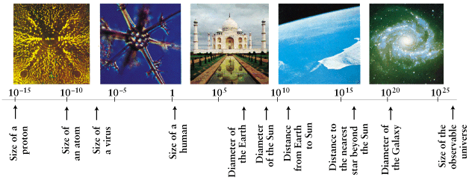
We can conveniently write the size of anything on this chart! (Sizes given in meters):
Cell is about 10⁻⁴m
Taj Mahal is about 60 meters high
Earth diameter is about 10⁷ m
An atom
Notes:
"Tadsch Mahal"

Slide 7
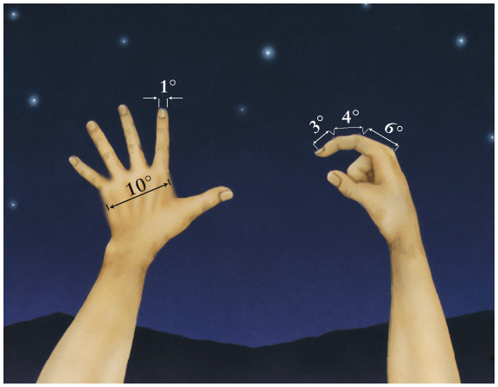
Angles
We must determine positions of objects on the sky (even if we don’t know their distances) to describe:
  The apparent size of a celestial object
  The separation between objects
  The movement of an object across the sky
You can estimate angles, e.g. the width of your finger at arm’s length subtends about 1 degree

Slide 8
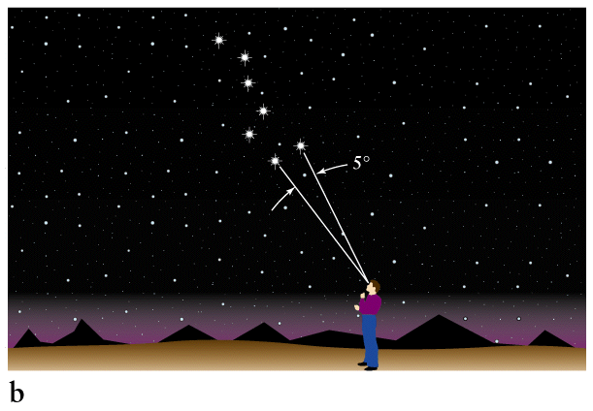
Example of angular distance: the “pointer stars” in the big dipper
The Moon and Sun subtend about one-half a degree

Slide 9
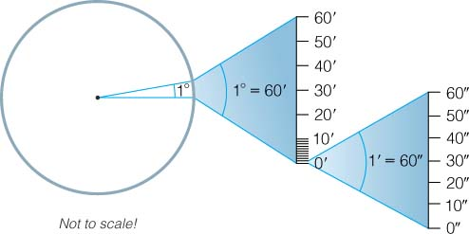
How do we express smaller angles?
One circle has 2π radians = 360°
One degree has 60 arcminutes (a.k.a. minutes of arc):
1° = 60 arcmin = 60'
One arcminute has 60 arcseconds (a.k.a. seconds of arc):
1' = 60 arcsec = 60”
One arcsecond has
1000 milli-arcseconds
(yes, we need these!)

Slide 10
Angular size - linear size - distance
Physical
size
D
Moving an object farther away
reduces its angular size.
d
The angular size depends on the linear (true) size AND on the distance to the object. See Box 1-1.
Use the small-angle formula:
where D = linear size of an object (any unit of length),
d = distance to the object (same unit as D)
α = angular size of the object (in arcsec, useful in astronomy),
206,265 is the number of arcseconds in a circle divided by 2π (i.e. it is the number of arcseconds in a radian).
Where does this formula come from?

Slide 11
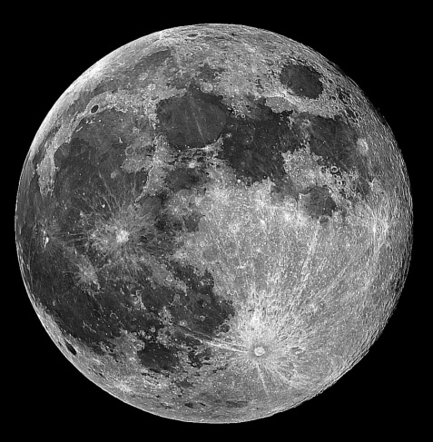
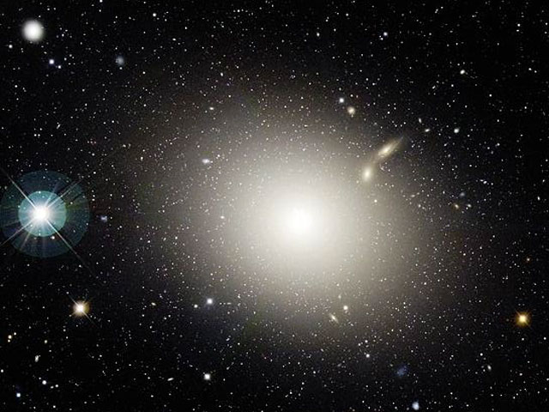
Examples
The Moon is at a distance of about 384,000 km, and subtends about 0.5°. From the small-angle formula, its diameter is about 3400 km.
M87 (a big galaxy) has angular size of 7', corresponding to diameter 40,000 pc (1 pc = about 300 trillion km) at its large distance. What is its distance?
The resolution of your eye is about 1’. What length can you resolve at a distance of 10 m?

Slide 12
Important note on Significant Figures
If you are given numbers in a problem with a certain degree of precision, your answer should have the same degree of precision. e.g. if you travel 1.2 m in 1.1 sec, what is your speed? 1.2/1.1 = 1.1, even though calculator says 1.0909090909090909…, the input numbers were only given to 2 sig fig, so the answer is too.

Slide 13
Units in astronomy
Every physical quantity has units associated with it (don’t ever leave them off!).
Astronomers use the metric system (SI units) and powers-of-ten notation, plus a few “special” units.
Example: Average distance from Earth to Sun is about 1.5 x 10¹¹ m = 1 Astronomical Unit = 1 AU
Used for distances in the Solar system.
This spring we are working on much larger scales. A common unit is the light-year (distance light travels in one year: 9.5x10¹⁵ m), but astronomers even more commonly use the “parsec”…

Slide 14
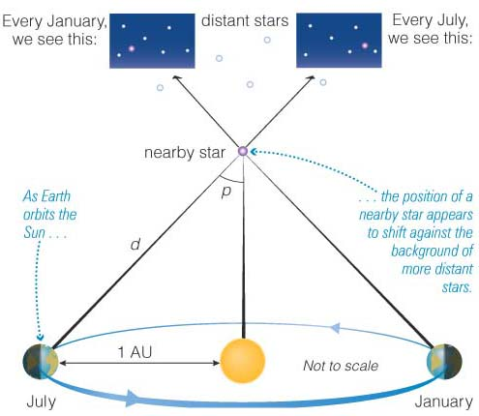
The parsec unit
Basic unit of distance in astronomy. Comes from technique of trigonometric or “Earth-orbit” parallax
Short for “parallax of one second of arc”
Note parallax is half the
angular shift of the star over
6 months
1 pc = the distance between Earth and a star with a parallax of 1”, alternatively the distance at which the radius of the Earth's orbit around the Sun (1AU) subtends an angle of 1”. 1 pc = 3.09 x 10¹⁶ m = 3.26 light years = 206,265 AU.

Slide 15
So how does trigonometric parallax relate to distance?
where p is the parallax and d is the distance.
1
p(”)
d (pc) =
The nearest star to Sun is 1.3 pc away.
Galaxies are up to 100 kpc across.
The most distant galaxies are 1000’s of Mpc away.

Slide 16
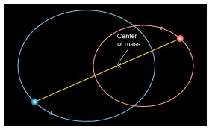
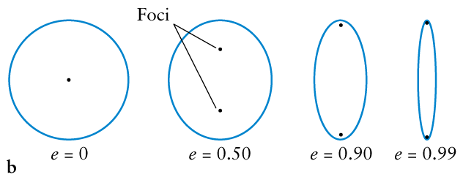
Important results from Mechanics
Two objects orbit in ellipses with the
center of mass as a common focus.
Ratio of distances to center of mass is always
Inverse of mass ratio.
Elliptical orbits and eccentricity
b
a c

Slide 17
Newton’s Law of Gravity
centripetal acceleration
(circular motion)
Newton’s form of
Kepler’s 3rd law
(a is mean separation of the objects over an orbit)
periastron and apastron: D_{peri} = a(1 - e), D_{ap} = a(1 + e)

Slide 18
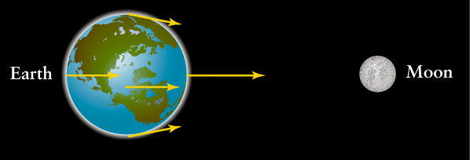
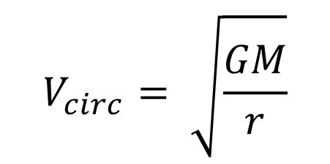
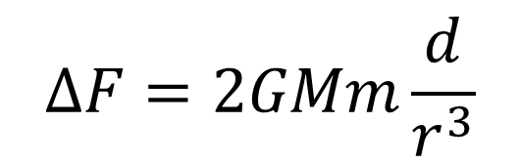
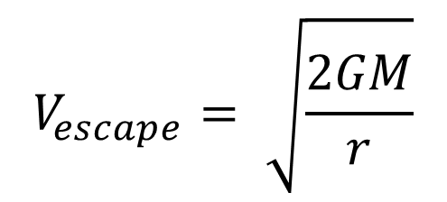
Circular speed for small mass, m, orbiting large mass, M
$$V_{circ}= \sqrt{\frac{GM}{r}}$$
Escape speed
$$V_{escape}= \sqrt{\frac{2GM}{r}}$$
r
Tidal force
$$ΔF=2GMm\frac{d}{r^{3}}$$
d

Slide 19
Circular motion in general
Understand the basic relationships between period,
frequency, angular frequency and velocity. We will
see these often.
Kinetic Energy and Gravitational Potential Energy
For a mass, m, moving at speed v, the KE is ½ mv².
For a mass m in the gravitational field of a mass M at
a distance R from its center, gravitational potential energy is given by -GMm/R. Defined to be zero at R=∞. Importantly, as m falls from higher R to lower R, the gravitation PE drops and the KE increases. The sum is conserved.
We will see several examples of this conversion.

Slide 21
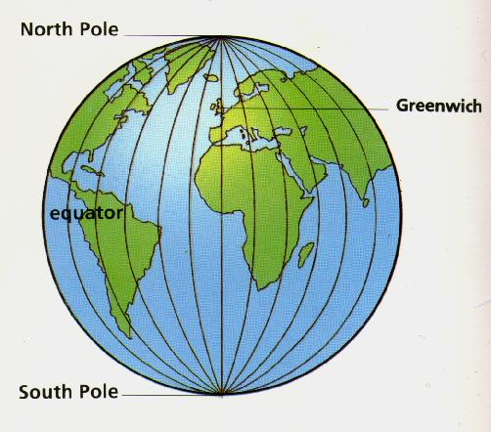
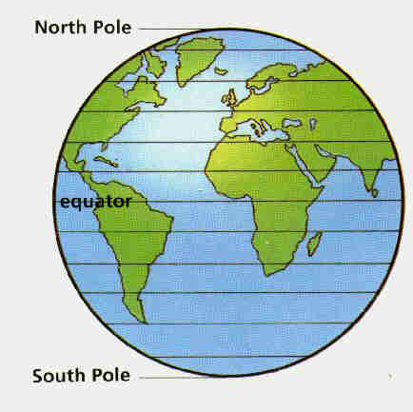
Coordinate systems (Box 2.1)
Purpose: to locate astronomical objects
To locate an object in space, we need three coordinates: x, y, z. Direction (two coordinates) and distance.
On Earth’s surface we use coordinates of longitude and latitude to describe a location

Slide 22
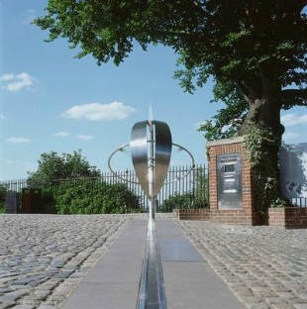
Position in degrees:
  Longitude: connecting the poles, 360º, or 180º East and 180º West
  Latitude: parallel to the equator, 0-90º N and 0-90º S
  A location is the intersect of a longitude and latitude line (virtual)
Albuquerque: 35º05' N, 106º39' W
0º
90º N
0º
90º S

Slide 23
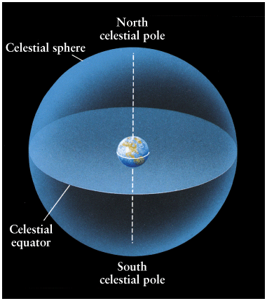
The celestial sphere
Same idea when we describe the position of a celestial object
The Sun, the Moon and the stars are so far away that we cannot perceive their distances.
Instead, the objects appear to be
projected onto a giant, imaginary
sphere centered on the Earth,
fixed to the stars, of arbitrary radius.
To locate an object, two numbers (angular measures), like longitude and latitude are sufficient.
Useful if we want to decide where to point our telescopes.

Slide 24
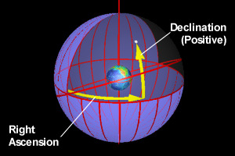
The Equatorial system
A system in which the coordinates of an object do not change.
The coordinates are Right Ascension and Declination, analogous to longitude and latitude on Earth.
The celestial sphere and the equatorial coordinate system appear to rotate with stars and galaxies, due to Earth’s rotation.
But are the coordinates of all objects unchanging?

Slide 25
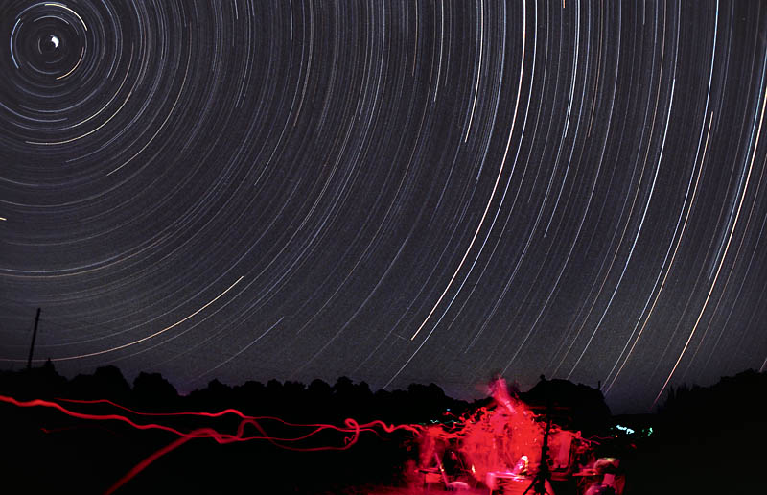

Slide 26
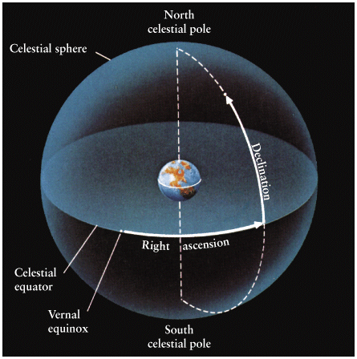
Right Ascension and Declination
Declination (Dec) is a set of imaginary lines parallel to the celestial equator.
Declination is the angular distance north or south of the celestial equator.
Defined to be 0° at the celestial equator, 90° at the north celestial pole, and -90° at the south celestial pole.
Right ascension (RA): imaginary lines that connect the celestial poles.

Slide 27
Right Ascension and Declination
Declination (Dec) is measured in degrees, arcminutes, and arcseconds.
Right ascension (RA) is measured in units of time: hours, minutes, and seconds.
Example 1: The star Regulus has coordinates
RA = 10^{h} 08^{m} 22.2^{s}
Dec = 11° 58' 02"

Slide 28
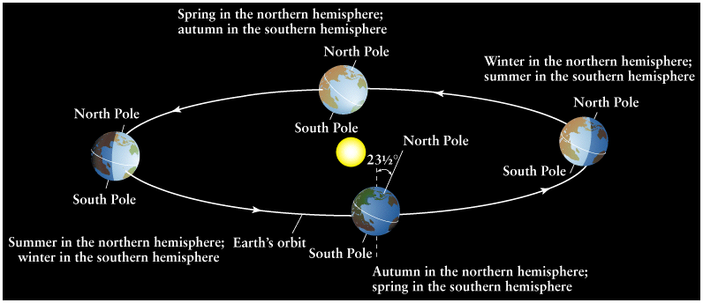
Zero point of RA: The vernal equinox, which is the point on the celestial equator the Sun crosses on its march north - the start of spring in the northern hemisphere. So the Sun is at RA = 0^{h} 0^{m} 0^{s} at midday on the date of the vernal equinox, and at RA = 12^{h} 0^{m} 0^{s} at midday on the autumnal equinox. Right ascension is the angular distance eastward from the vernal equinox.
Vernal equinox

