Slide 1
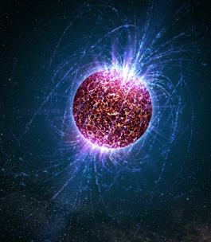
Neutron stars - Chapter 20.11

Slide 2
Neutron stars
The remains of cores of some massive stars that have become supernovae.
Cores are a degenerate gas of mostly neutrons.
So much compression at each stage of core contraction that final radius is ∼ 10 km. Mass ∼1.1 – 2 M. Density ∼ nuclear density. A sugar-cube volume on Earth would weigh as much as all of humanity.
Although mostly neutrons, also expect some protons and electrons. Outer crust of electrons and Fe nuclei (photodisintegration of Fe wasn’t perfect). Possibly a core of sub-nuclear particles.

Slide 3
More neutron star properties
Conservation of angular momentum: as a spinning object contracts, it speeds up. If L is angular momentum, I is “moment of inertia” and Ω is angular velocity –
L = IΩ α MR²Ω
is conserved = > the body spins very fast: observed periods msec – sec
(cf Sun: about 1 month).
Gravitational acceleration 10¹¹ times that on Earth: anything falling onto the surface would be ripped apart and smeared to an atom-thick layer on the surface.

Slide 4
Magnetic fields should be enormous too. Why?
The magnetic field of the star becomes concentrated as star collapses: magnetic flux (= magnetic field strength at surface x surface area) is conserved as star shrinks.
Surface area drops by ~10¹², so magnetic field strength increases by factor of 10¹²! Should be 10⁸ T (10¹² G) or so.
About 10⁸ estimated to exist in our galaxy (from IMF, estimate of initial mass necessary to form one, and estimate of star formation history). We have detected over 2500 of them. How?

Slide 5

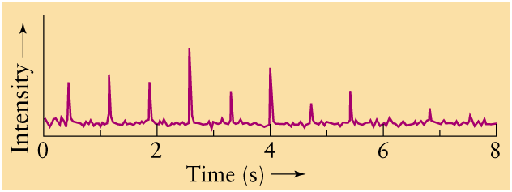
Pulsars
Neutron stars were first proved to exist with the discovery of pulsars by Jocelyn Bell Burnell in 1967. She found some radio sources that “pulsed”. Her advisor, Tony Hewish, got Nobel Prize in 1974 (what?).
Only natural phenomenon that could account for regular time variations with such short periods (down to 10⁻³ seconds) were rotating neutron stars.

Slide 6
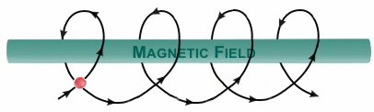
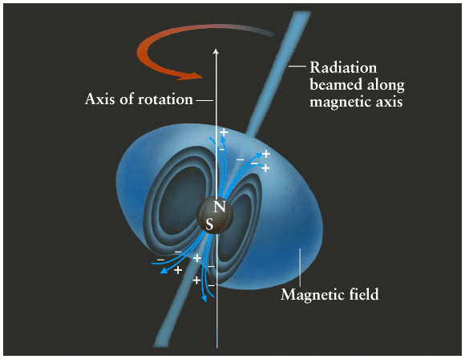
Lighthouse model for pulsars
Key point: (like planets) axis of rotation is NOT aligned with the magnetic axis. Strong electric fields are associated with strong magnetic fields and fast rotation. These pull charged particles off the surface near the magnetic poles at speeds close to c. Charged particles spiraling in magnetic field emit synchrotron radiation.
Continuous spectrum, usually emission in radio regime. If electrons very energetic, can get emission at shorter wavelengths.
Emission beamed in direction of motion. Consequently, we only see a fraction of pulsars – 20%(?).

Slide 7
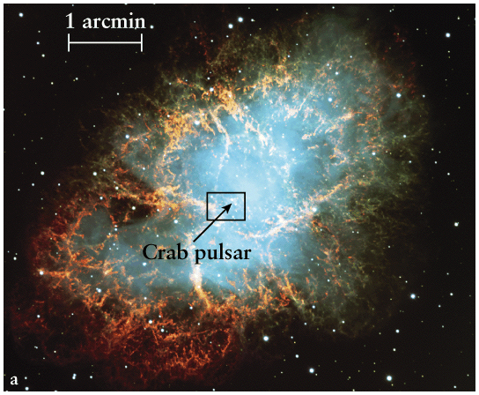
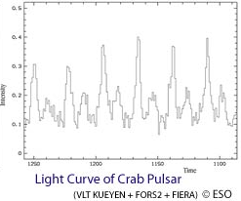
The Crab nebula contains a pulsar with a 33 msec period.
Pulsars slow down (Crab pulsar slows down 3x10⁻⁸ s/day).
Many other fast-spinning pulsars are associated with SNRs. Further evidence for our formation theory. Remnant disperses (in only 100,000 yrs or so) and pulsar is left.
Longest periods observed are a few seconds – beyond this the neutron star has probably lost so much rotational energy that they cannot radiate further. Most pulsars probably die when period reaches 1-2 sec. Given spindown rates, takes ∼ 10⁷ yr to slow down to 1-2 sec.

Slide 8
Pulsars are incredibly accurate clocks!
Example: period of the first discovered "millisecond pulsar" is:
P = 0.00155780644887275 sec
It is spinning down at a rate of
1.051054 x 10 ⁻¹⁹ sec/sec
The spindown rate is slowing down at a rate of:
0.98 x 10 ⁻³¹ /sec

Slide 9
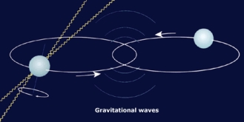
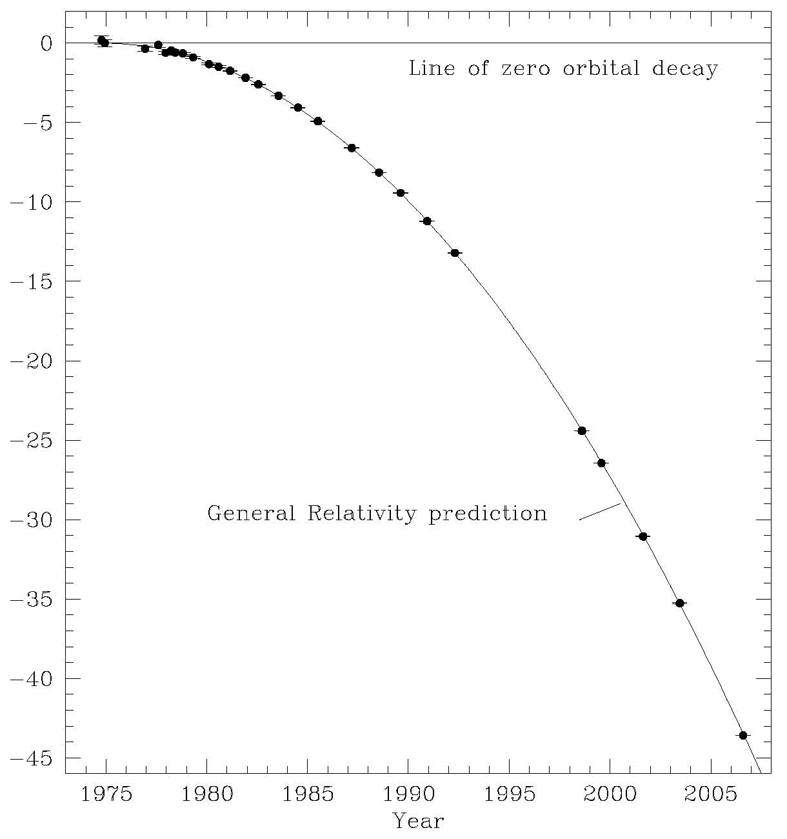
Pulsar Exotica
Binary pulsars: two neutron stars in orbit around each other, at least one of which is a pulsar. Several known.
Einstein predicted that binary orbits should decay, i.e. the masses would spiral in towards each other, losing energy through gravitational radiation. Confirmed by the first binary pulsar, PSR 1913+16, found in 1974 by Hulse and Taylor (Nobel Prize in 1993).
Can also determine accurate masses by measuring other effects of Einstein’s General Relativity: 1.4398 and 1.3886
+/- 0.0002 M.
Curve: prediction of decaying orbit. Points: measurements.

Slide 10
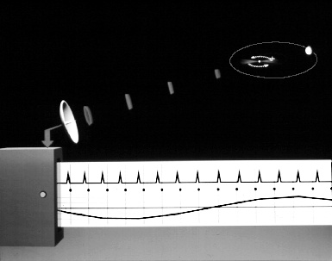
Planets around pulsars: A pulsar, PSR 1257+12, was found in 1992 to have three planets! Masses about 4.3 M_{Earth}, 3.9 M_{Earth}, and 1.6 M_{Moon} !
Nobody knows why a pulsar should have planets. But Spitzer Space Telescope has found debris disks around two pulsars in infrared. Leftover disk from supernova, eventually planets form?

Slide 11
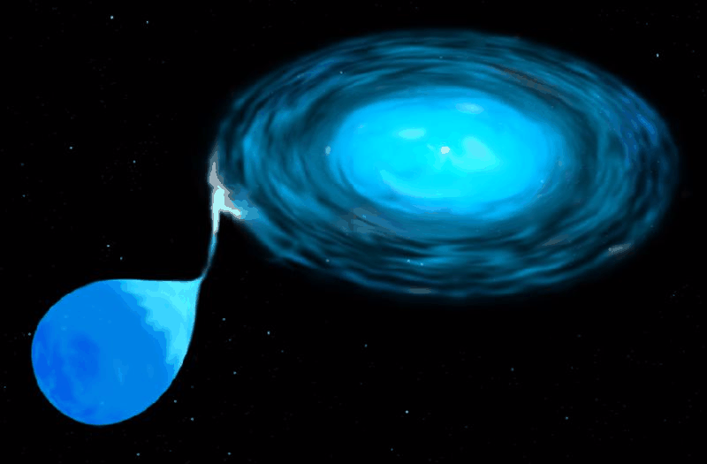
Millisecond pulsars: periods of 1-10 msec. Not found in SNRs. Probably accreted matter from a binary companion that made an old neutron star spin faster – a “recycled” pulsar.
gas spills over, forming rotating “accretion disk” around neutron star
Expanded giant or
supergiant star
Objects where this accretion is currently occurring are sources of X-rays, called “X-ray Binaries”.

Slide 12
Mass limit to neutron stars
Like white dwarfs and electron degenerate matter, neutron stars and neutron degenerate matter has an upper mass limit (~ 3 M, but not well understood).
When this is exceeded, the star collapses all the way to a black hole.

Slide 14
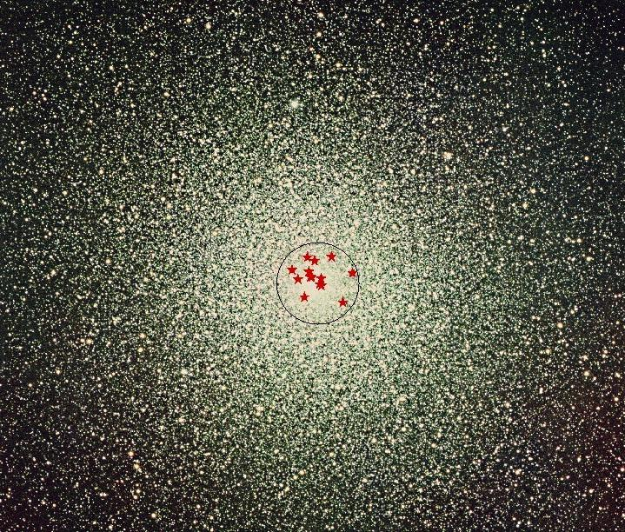
Pulsars in Globular Clusters (150 in 28 clusters). Vast majority
are millisecond pulsars – they are much more abundant than in the
Milky Way’s disk. About half in binaries. Should these exist?
Some pulsar locations in
47 Tucanae (23 known)
Recycling of dead neutron stars must be much more frequent in Globular Clusters. Probably from tidal capture, collision or “exchange reaction” of old Neutron Stars with another star. This may lead to close binary – mass transfer spins up Neutron Star and it becomes a pulsar again (excess of X-ray Binaries in Globular Clusters supports idea).

Slide 15
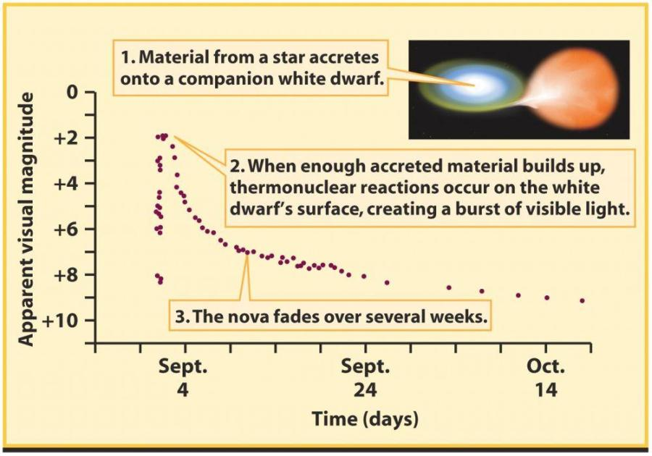
Novae
Novae are similar to X-ray bursters, but occur in a close binary system with a White Dwarf instead of a neutron star.
Accretion is weaker and will cause a hydrogen fusion outburst on surface of WD. Can repeat (years to decades). Eventually mass buildup may lead to carbon-detonation supernova.
10⁻⁴ x fainter than
supernova (which
peaks at about 10³⁶
W ∼ 10⁹ L).

Slide 16
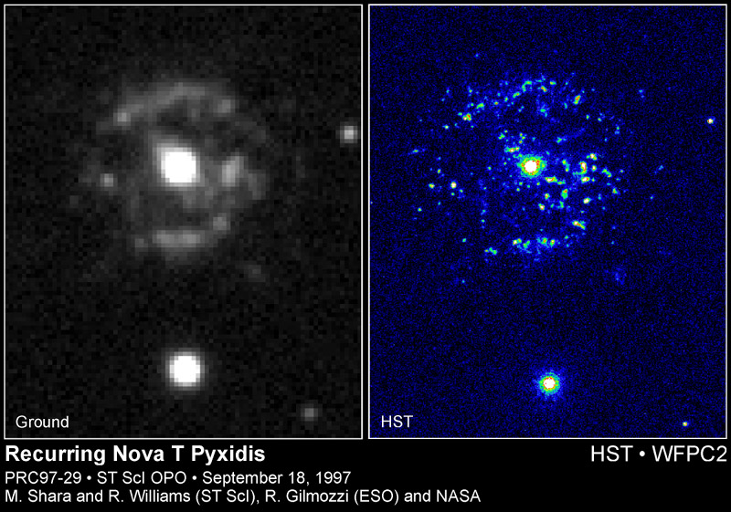

Slide 17
Pulsars
Neutron stars were first proved to exist with the discovery of pulsars by Jocelyn Bell Burnell in 1967. She found some radio sources that “pulsed”. Her advisor, Tony Hewish, got Nobel Prize in 1974 (what?).
Now about 2000 pulsars known.
http://www.jb.man.ac.uk/research/pulsar/Education/Sounds/index.html
Only natural phenomenon that could account for regular time variations with such short periods (down to 10⁻³ seconds) were rotating neutron stars.

Slide 18
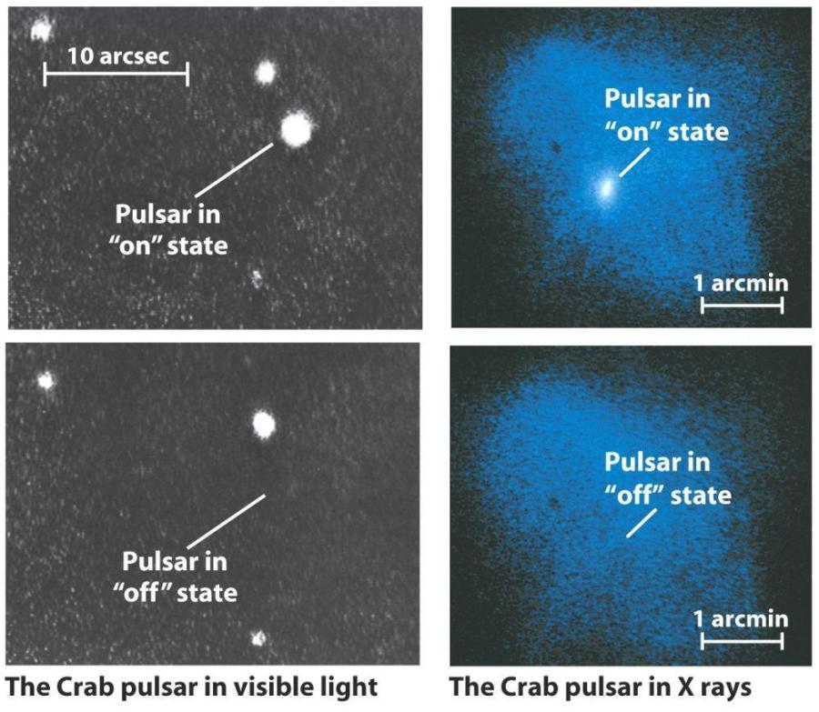
Pulsars are primarily a radio astronomy phenomenon, but a few are also seen in the visible, UV, X-ray, and gamma ray.
The Crab pulsar

