Slide 1
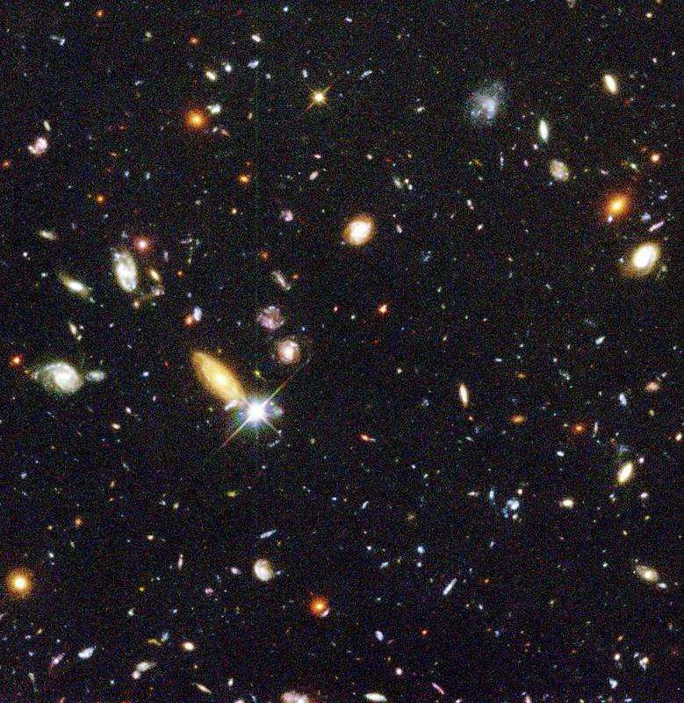
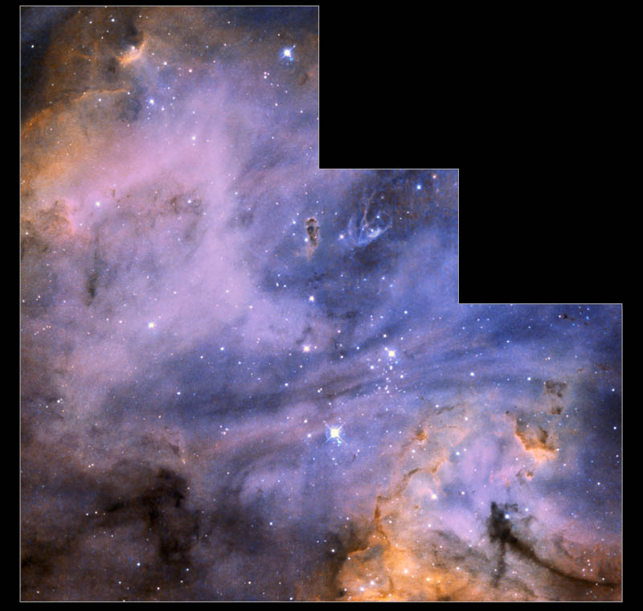
Properties of Electromagnetic Radiation
Chapter 5
Concepts:
Electromagnetic waves
Types of spectra
Temperature
Blackbody radiation
Dual nature of radiation
Atomic structure
Interaction of light and matter
Emission and absorption lines
Doppler shift
Notes:
What do you see around you? Not objects but LIGHT that has interacted with the objects. Via intuition and experience you interpret colors and patterns of light => turn that into information.

Slide 2
Radiation carries information
How hot is the Sun?
How does it compare to other stars?
What is the chemical composition of stars?
What is the nature of gas clouds between the stars?
How do stars and gas clouds orbit in galaxies?
How do we know that the Universe is expanding?
Radiation – light, radio waves, infrared, etc. – travels as
electromagnetic waves

Slide 3
What is light?
Light is an example of electromagnetic (EM) radiation
Electromagnetic radiation can be treated either as
  waves
  photons (“particles” of radiation)
Both natures have to be considered to describe all essential properties of radiation

Slide 4
What is a wave?
A wave is the transfer of energy from one point to another, without the transfer of material between the points
A wave is manifested by a periodic change in the properties of a medium that it travels through
Notes:
Periodic changes: pressure waves - sound, water waves, changes is height of water surface. A wave is a traveling disturbance.

Slide 5
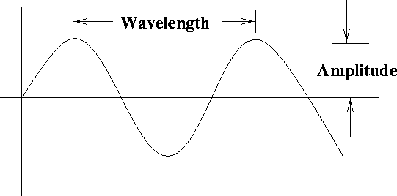
Properties of a wave
Amplitude: height of the wave (e.g. m for water waves)
Wavelength (λ): distance between adjacent crests (m)
Period: the time it takes for one complete wave cycle to pass a given point (s)
Frequency (ν): number of wave cycles that pass a point in 1s (Hz, or cycles/sec)
Speed: horizontal speed of a point on a wave as it propagates (m/s)
Period = 1/ν
Speed = λ/P = λν
Notes:
For a wave, the energy carried is proportional to the amplitude squared, (e.g Watts for radio station).

Slide 6
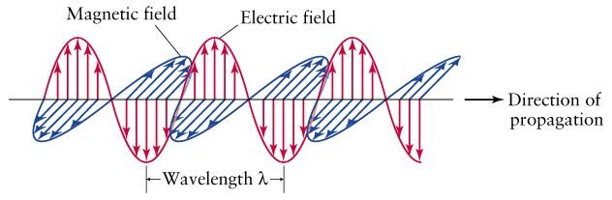
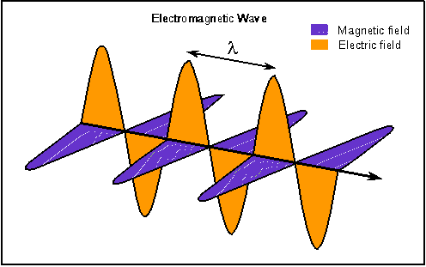
Electromagnetic waves
EM waves: self propagating, oscillating electric and magnetic fields.
Speed of all EM waves (in vacuum) is speed of light c = 3.00 x 10⁸ m/s.
c = λ ν, where λ is the wavelength, and ν is the frequency [Hz].
EM waves are different from other waves, since they don’t need a medium to propagate in!

Slide 7
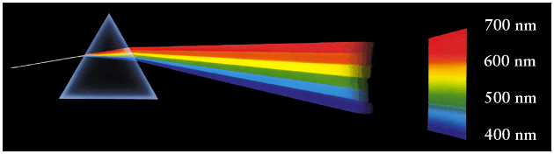
The human eye is sensitive to EM radiation with wavelength range:
  400 nm < λ < 700 nm where 1 nm =10⁻⁹ m.
  = 4,000 Å < λ < 7,000 Å where 1 Å is 10⁻¹⁰ m.
  [nm = nanometer, Å = Ångström]
This goes from violet to red.
This also demonstrates refraction: light bends when density of
medium changes. Bending angle depends on wavelength. Also
introduces a way to make a spectrum.
Notes:
ROY G BIV = 50nm difference.

Slide 8
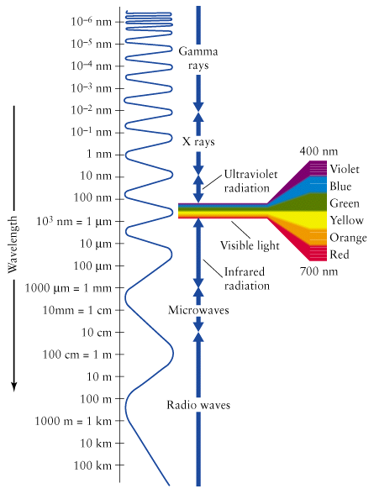
The electromagnetic spectrum
There’s much more beyond the visible!
In order of increasing wavelength:
Gamma rays, X rays, Ultraviolet (UV), Visible, Infrared (IR), Microwaves, Radio.
frequency
Note use of nm, μm, mm, cm, m, km
Notes:
Presumed to be limited by the size of the universe, and the smallest scale (a planck length) we know. 10^{-35} (10-20 of a proton). The planck length is the scale when classical ideas of gravity and space-time no longer are valid, and quantum effects take over.

Slide 9
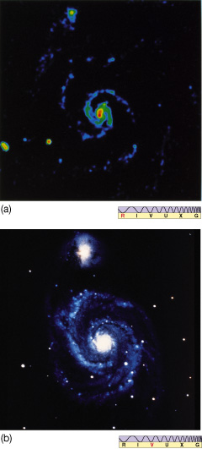
Different objects in the Universe give off EM radiation in different ways, depending on their composition and physical condition.
Notes:
N180B in the Large Magellanic cloud, it is a prominent HII region - gas that has been ionized around a young star. It gives off light just like the galaxies, but cause and properties are much different.

Slide 10
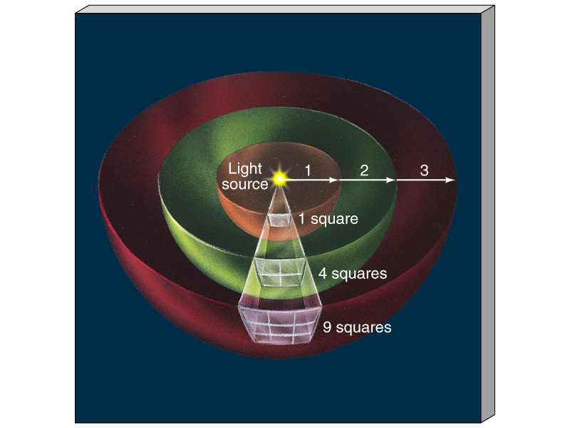
The "Inverse-Square" Law for Radiation
Each square gets 1/4 of the light
Each square gets 1/9 of the light
1
d²
d is the distance between source and observer.
Apparent Brightness α

Slide 11
How do radiation and matter interact?
Emission - light bulb, star
Absorption - your skin can absorb light, in turn the absorbed energy heats your skin. Dust grains in space behave similarly. Atoms also absorb radiation.
Transmission - glass and air lets light pass through (with refraction and diffraction possible)
Reflection and scattering - light can bounce off matter leading to reflection (in one direction) or scattering (in many directions). Dust grains also scatter light.

Slide 12
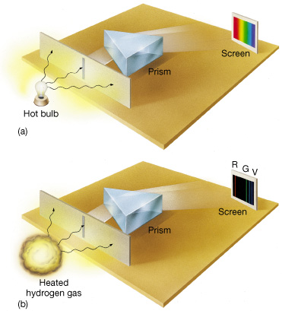
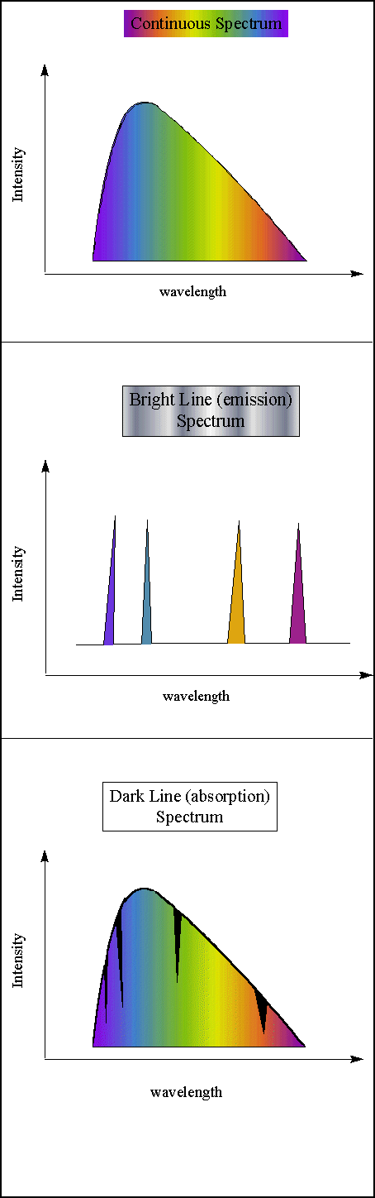
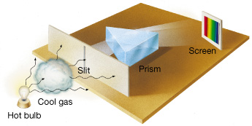
Three types of spectra and Kirchhoff's laws
Kirchhoff's laws of spectroscopy (1859):
  A hot, opaque body, or a hot, dense gas produces a continuous spectrum.
  A hot, transparent gas produces an emission line spectrum.
  A cool, transparent gas in front of a source of a continuous spectrum produces an absorption line spectrum.

Slide 13
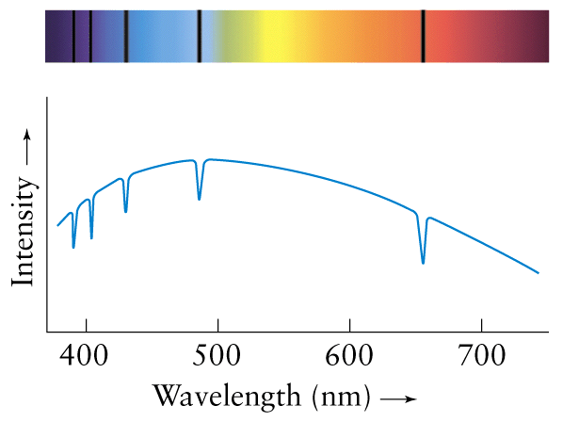
Note: two ways to show a spectrum:
as an image
(more usefully) as a plot of intensity vs wavelength
(or frequency)

Slide 14
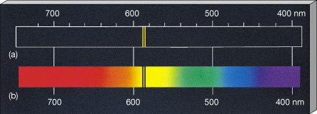
Each element has unique spectral lines. For a gas of a given element, absorption and emission lines occur at same wavelengths.
Understood after development of quantum mechanics in early 1900’s.
Sodium

Slide 15
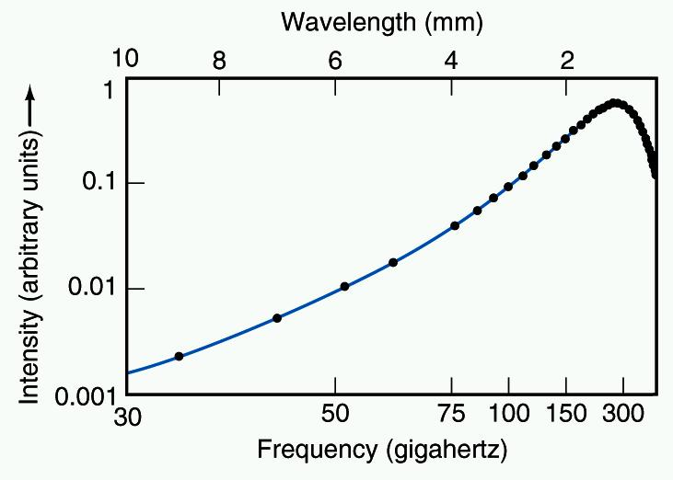
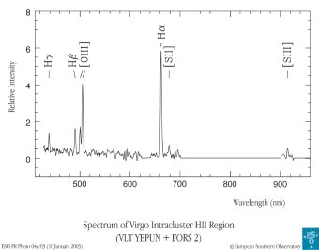
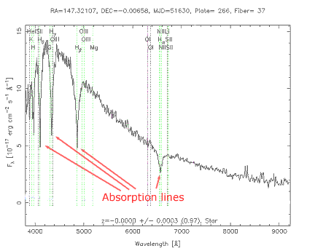
Astronomical and other examples:
Continuous: incandescent lights, “the universe”
Emission line: neon lights, hot interstellar gas -- “HII regions”, “supernova remnants”.
Absorption line: stars (relatively cool atmospheres overlying hot interiors).
Two important concepts for understanding spectra: temperature and “blackbody radiation”…

Slide 16
Temperature
A measurement of the internal energy content of an object.
Solids: higher temperature means higher average vibrational energy per atom or molecule.
Gases: higher temperature means more average kinetic energy (faster speeds) per atom or molecule.
If it gets cold enough, all motion will stop. How cold is that?
Corresponds to a temperature of -273° C (-459° F) - absolute zero.

Slide 17
Kelvin temperature scale
An absolute temperature scale in which the temperature is directly proportional to the internal energy of the object.
  Related to Celsius scale, but a different zero point
  T(K) = T(°C) + 273 °C
  0 K: absolute zero – all motion stops
  273 K: freezing point of water
  373 K: boiling point of water
  See box 5.1
How do temperature and energy relate?
Notes:
Developed by Lord Kelvin in the 19th century. The nice thing with the Kelvin temperature scale is that if you double the temperature, you double the internal energy.

Slide 18
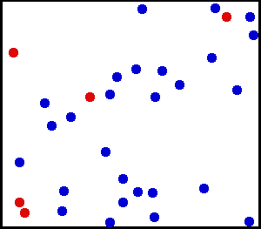
Consider an atom or a molecule in a gas:
For gas at temperature T (in K),
average KE is:
k is Boltzmann’s constant,
and has value 1.38 x 10⁻²³ kg m² s⁻² K⁻¹,
(or Joules K⁻¹). For particles of mass m,
equate:
At a given T, there is an average KE for all the atoms or molecules in a gas, but their average speed will depend on their mass. Even for each mass, this V is only an average. Particles have a spread of speeds around the average.
Average (strictly “root-mean-square”) speed of particles of mass m in a gas of temperature T
Notes:
Particles colliding all the time. Some gain energy, some lose, so speeds change.

Slide 19
Blackbody (thermal) radiation
A blackbody is an ideal object that absorbs all radiation at all wavelengths: perfect absorber. Charcoal is a decent example.
  No reflected light, no transparency
But it re-emits radiation with a continuous spectrum of characteristic shape
The more radiation an object absorbs and re-emits, the higher the temperature.
The spectrum of its radiation has no contribution from reflected light. It’s all re-emitted radiation, and spectrum depends on its temperature only (not on , e.g., composition).
Hot, dense objects, like light bulb filaments or stars, shine with a spectrum that is approximately that of a blackbody, despite their temperature being due to internally generated energy.

Slide 20
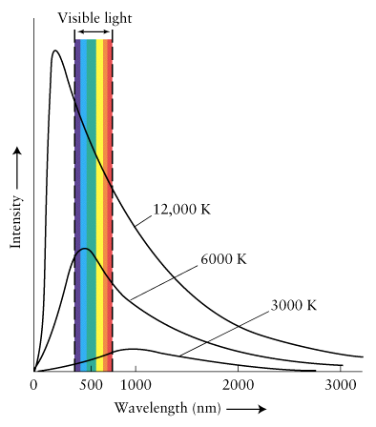
Intensity, or brightness, as a function of frequency (or wavelength) is
given by the “Planck formula”:
  where h is Planck’s constant
  (h=6.6 x 10⁻³⁴ J s), k is
  Boltzmann’s constant, and c is
  the speed of light.
  Units of I_{ν}: J s⁻¹ m⁻² ster ⁻¹ Hz⁻¹
This is explanation of Kirchhoff’s first law
Example: 3 blackbody (Planck curves) for 3 different temperatures typical of star atmospheres.
Notes:
The book calls E=hv Planck's law - wrong! He used these as assumptions to derive the law, so they are part of his law, but the expression here IS Planck's law.

Slide 21
Wien's law for a blackbody
λ_{max} = 0.0029 (m K) / T
where λ_{max} is the wavelength of maximum emission of the object in m and T is the temperature in K. The constant has units of m K.
=> The hotter the blackbody, the shorter the wavelength of maximum emission
Hotter objects are bluer, cooler objects are redder.

Slide 22
Wavelengths of peaks of the curve illustrate Wien’s Law.

Slide 23
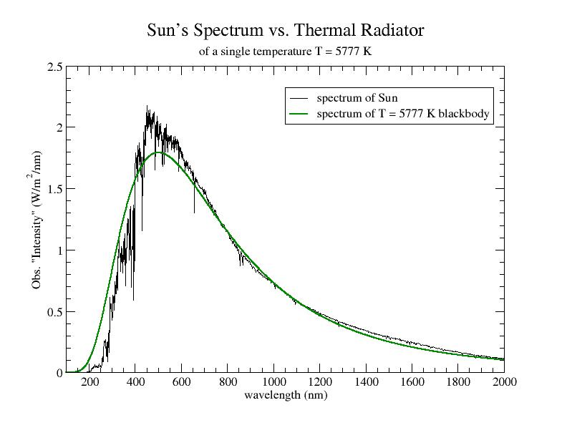
The spectrum of the Sun is almost a blackbody curve.

Slide 24
Example 1: How hot is the Sun at the “surface”?
Measure λ_{max} to be about 500 nm, so
T_{sun} = (0.0029 m K) /λ_{max} =
(0.0029 m K) / 5.0x10⁻⁷ m = 5800 K
Example 2: At what wavelength would the spectrum peak for a star which is 5800 K / 2 = 2900 K?
Or a star with T= 5800 K x 2 = 11,600 K?
What colors would these stars be?
Notes:
Lamda inversely proportional to T, so half T means double wavelength (1000nm). 2nd: 250nm.
Long wavelength: reddish, short wavelength bluish.

Slide 25
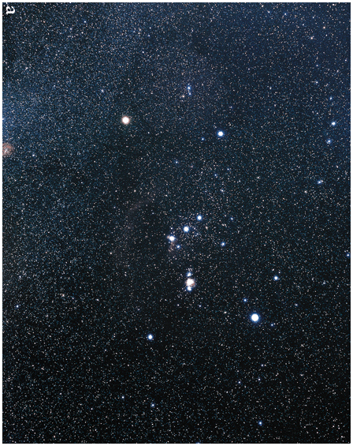
Which stars are hotter, and which are cooler?

Slide 26
Stefan-Boltzmann law for a blackbody
F_{e} = σT⁴
F_{e} is the emitted or emergent energy flux, in joules per second per square meter of surface (J s⁻¹ m⁻², or W m⁻²) over all wavelengths
σ is a constant = 5.67 x 10⁻⁸ W m⁻² K⁻⁴
T is the object’s temperature (in K).
The hotter the blackbody, the more
radiation it gives off per unit area per second
at all wavelengths.
1 m²

Slide 27
At any wavelength, a hotter body radiates more intensely.
Notes:
Energy is all that Is under the surface of this graph.

Slide 28
Example: If the temperature of the Sun were ten times what it is now, how much more energy would emerge from a unit area on the Sun every second?
See box 5-2 for more examples.

Slide 29
Luminosity and Blackbody Radiation
Luminosity is radiation energy emitted
per second from entire surface:
L = F_{e} x (surface area)
Units of L are J s⁻¹ or W
For sphere (stars),
L = 4 π R² x F_{e}
For spherical blackbody (stars, approximately):
L = 4 π R² σT⁴

Slide 30
Luminosity and Incident Flux
Each square gets 1/4 of the light
Each square gets 1/9 of the light
For a source of luminosity L at a distance d from you, the incident flux
you measure is:
F_{i} = (in W m⁻²)
L
4πd²
(True for any kind of radiation, not just blackbody).

Slide 31
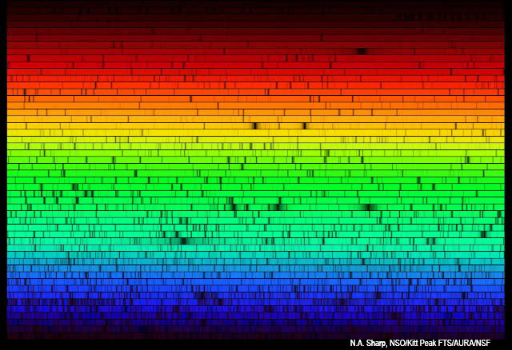
Optical spectrum of the Sun – absorption line spectrum. Broadly a blackbody, but with many absorption lines.
Notes:
Absorption line spectrum.

Slide 32
Absorption line spectrum – stars

Slide 33
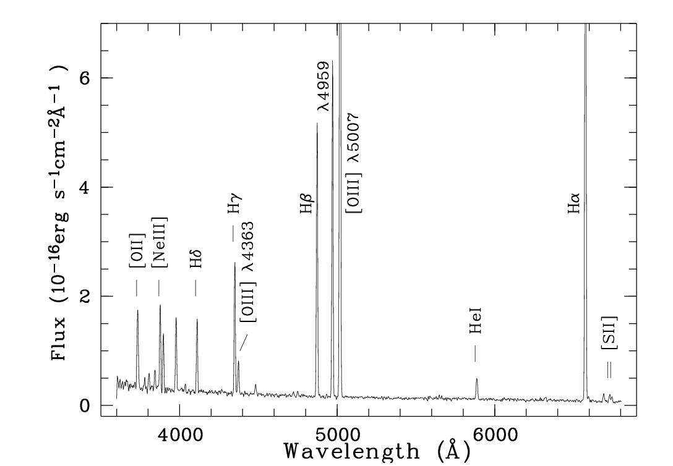
Emission line spectrum – an “HII region”
Relative intensity

Slide 34
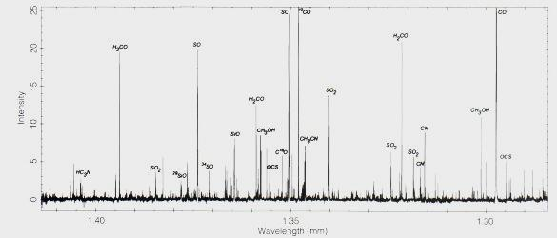
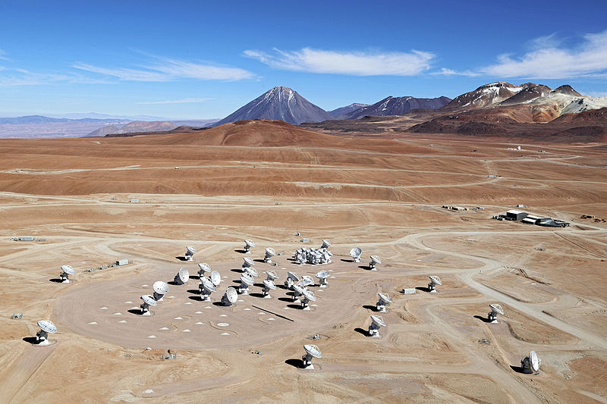
Emission line spectrum – a molecular cloud
How can we understand absorption and emission lines?

Slide 35
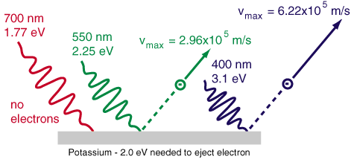
Photoelectric effect
Light hitting a metal will knock out single electrons, but only if the frequency is high enough, not the intensity.
Energy of ejected electrons also depends only on incoming light frequency, not on intensity.

Slide 36
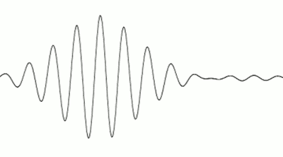
The dual nature of radiation
  Explanation (Einstein 1905, Nobel Prize):
  on scale of atoms, can consider
  light as a stream of massless particles
  (photons), with energy dependent on
  frequency. Only photons with sufficient
  energy can liberate electrons from atoms.
  Excess energy goes into KE of electrons.
  Photons still have well defined λ, ν.
  E = hν or equivalently E = hc/λ
  h = 6.6 x 10⁻³⁴ J s (Planck's constant again)
  h = 4.1 x 10⁻¹⁵ eV s
  Question: which has more energy, a photon of blue light, or of red light? UV or Radio?
Photon energies
  (1 eV = 1.6 x 10⁻¹⁹ J – energy an electron gains by accelerating through an electric potential of 1 V)
Notes:
Note: book calls this “Planck’s Law”. Planck’s Law is the blackbody spectral shape.

Slide 37
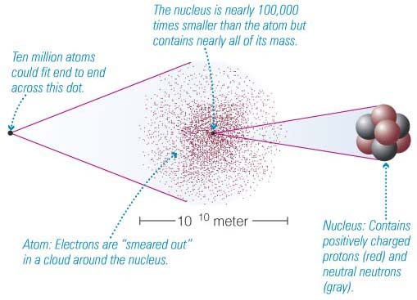
Atomic structure
Nucleus contains subatomic particles with most of atom’s mass:
Protons (positively charged)
Neutrons (uncharged)
Electrons in a cloud orbiting the nucleus (negatively charged)
Atoms have charge balance
-

Slide 38
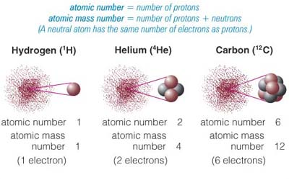
Chemical elements
Atoms are distinguished into elements by the total number of protons in the nucleus.
This is called the atomic number:
  1 proton: Hydrogen
  2 protons: Helium
  3 protons: Lithium etc.

Slide 39
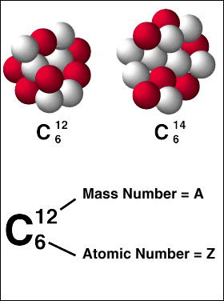
Each element can have isotopes
Same number of protons, but different number of neutrons.
¹²C has 6 protons and 6 neutrons
¹³C has 6 protons and 7 neutrons
¹⁴C has 6 protons and 8 neutrons
Typically one isotope dominates (e.g. ¹²C)

Slide 40
How is energy stored in atoms?
Atoms can contain energy in three ways:
Mass energy E=mc² (because of their mass, more when we discuss Sun)
Kinetic energy (because of their motion)
Electric potential energy (because of arrangement of electrons), important here because it is altered by EM radiation
To understand how the atom reacts to EM radiation (and to interpret the results!) we need to know how atoms gain and release electric potential energy.

Slide 41
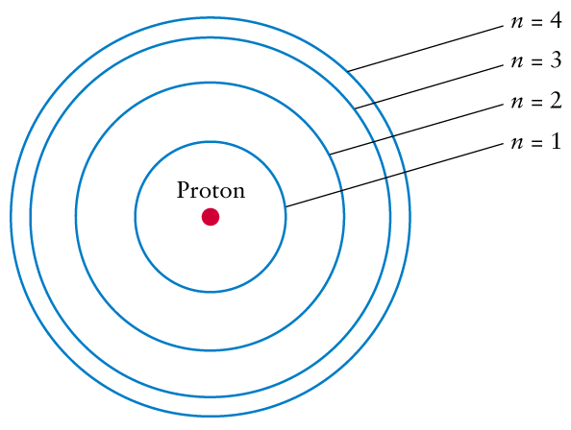
Inside the atom
Our understanding comes from the field of Quantum Mechanics:
For practical purposes we can ignore fuzziness of electrons and consider them as discrete particles. Consider the “Bohr model” (1913) for H.
Proton and orbiting electron attracted. Takes energy to increase separation.
But, only certain discrete orbitals, or
energies, allowed
Electron in “excited” state quickly
decays to lower levels.

Slide 42
The simple Bohr model for the hydrogen atom.
Allowed electron orbits (energies) shown.
First orbital = ground state (n=1). Lowest energy orbital the electron can reside in. Higher orbitals: excited states (n=2,3,4…)
First four orbitals (not to scale, the n=2,3,4 orbits should be 4, 9 and 16 times larger than the n=1 orbit).

Slide 43
Emission and Absorption
Electrons can get into excited states by either
  Colliding (with other atoms or free electrons)
  Absorbing photons
Absorption: only photons with exact energy (or frequency) to cause an excitation are absorbed, ALL others pass through unaffected (exception: ionization, see later).
Electrons get out of excited states by emitting photons in random directions.

Slide 44
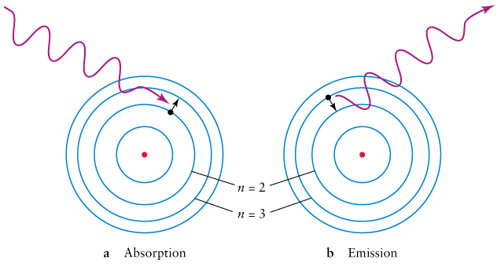
An atom can absorb a photon, causing electron to jump up to a higher energy level, if photon has energy equal to difference of energy levels.
An atom can emit a photon, as an electron falls down to a lower energy level. Photon’s energy equals difference of energy levels. Emitted photon has no memory of direction of absorbed photon.
May jump more than one level, and fall back down by various paths, emitting multiple photons.

Slide 45
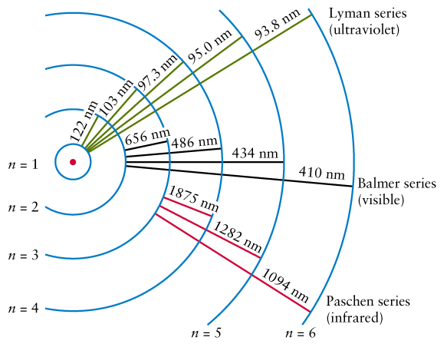
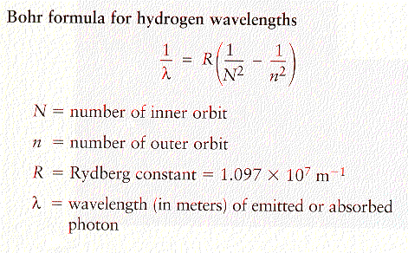
Remember: E = hν = hc/λ,
so equation gives E’s too.

Slide 46
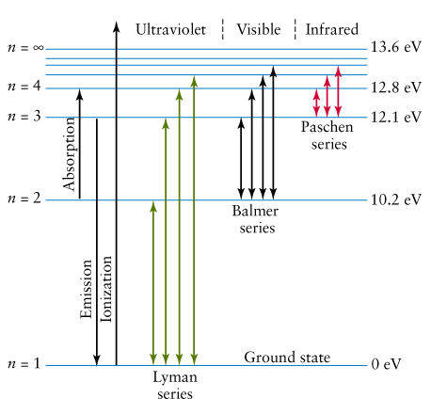
Energy level diagram for hydrogen:
Each element has its own energy levels! This is because attraction
of electrons to nucleus changes when the number of particles changes.
Energies of typical lines range from fractions of an eV to 1000’s of eV.

Slide 47
Ionization
If an atom or a molecule absorbs enough energy from a photon or a collision, an electron can escape the nuclear attraction => positive ion. For H in ground state, takes at least a 13.6 eV photon. Any extra photon energy goes into KE of electron.
By adding electrons, you can get a negative ion
Each ion has its own energy levels
N II: N with one electron removed, O III: O with two electrons removed, etc. Takes higher energy photons to remove more electrons (e.g. O II: 13.6 eV, O III: 35 eV).

Slide 48
Emission and absorption line spectra
Hot, low density gas, where collisions between atoms have sufficient energy to cause electrons to move to higher levels, gives emission lines.
Light from continuous spectrum through cooler gas gives absorption lines, as absorbed photons cause electrons to move to higher levels. Re-emitted photons are in random direction, so incident light in original direction much reduced.
Relative intensity

Slide 49

So why do stars have absorption line spectra?
Simple case: let’s say these atoms can only absorb green photons. Get dark absorption line at green part of spectrum.
.
.
.
.
.
.
.
.
.
.
.
“atmosphere” (thousands
of K) has atoms and ions
with bound electrons
hot (millions of K), dense interior
has blackbody spectrum,
gas fully ionized

Slide 50

Key points
Different elements have different sets of energy levels => electron transitions produce or absorb photons of different and unique energies.
Different energies = different wavelengths. The wavelengths of light tell you what elements you’re dealing with. Spectral lines are a fingerprint of the element.
Example: This is part of the Sun’s spectrum, along with emission lines of vaporized iron.

Slide 51
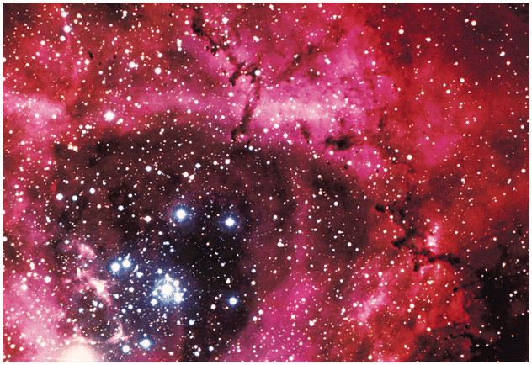
Excited, low-density hydrogen gas. Red due to “H-alpha” emission line, n = 3 to n = 2.
Relative intensity
H is mostly ionized. Hence “HII region”. Then
why does neutral-H line give it its color? Later lecture.

Slide 52
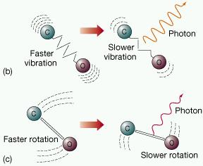
Molecules
Compounds of two or more atoms of same or different elements
Share some electrons in common orbitals
Have vibrational and rotational energy levels as well (IR, microwave, radio)
=> Very complex spectra!

Slide 53

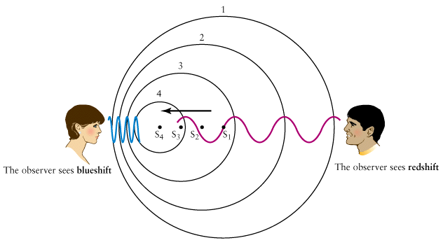
The Doppler shift
Frequency or wavelength of a wave depends on relative motion of
emitter and receiver (along the direction of wave motion).

Slide 54
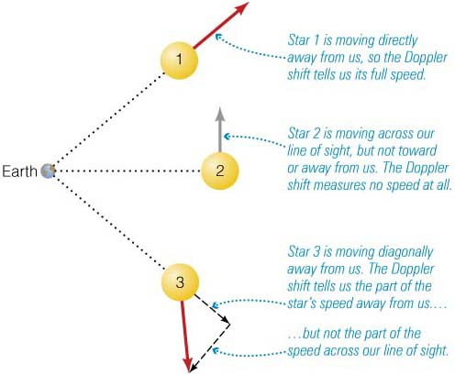
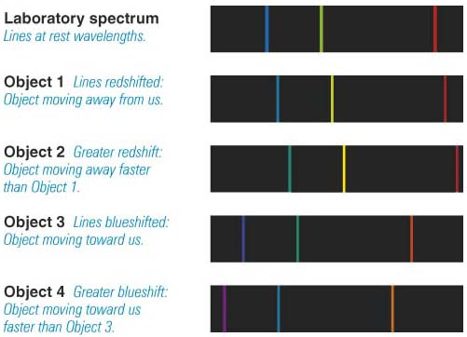
where V is the relative velocity along the line of sight, c is the speed of light (both speeds in same units). Note that motion away gives positive shift and velocity, motion towards gives negative.
If V is at some angle, only component
along line of sight enters formula
Spectral lines are used to measure Doppler shift => gives us information about the motion of an object.
V cos θ
θ
V

Slide 55
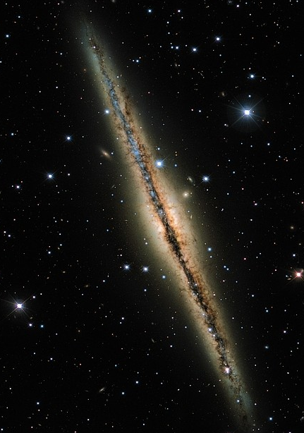
Example
The spectrum of an object shows the Hα spectral line (rest wavelength 656.28 nm) shifted to 657.43 nm due to relative motion of the source. What is the velocity of the relative motion? Is it approaching or receding?

Slide 56
Spectroscopy is an important tool!
The spectrum of an objects tells us:
Which atoms and molecules are present, and in which proportions
Which atoms are ionized, and in which proportions
How excited the atoms are, which tells us about the physical state (cold, hot, dense)
How the object is moving
Particles emit and absorb radiation in other ways too. We’ll examine them as they arise.

Slide 58
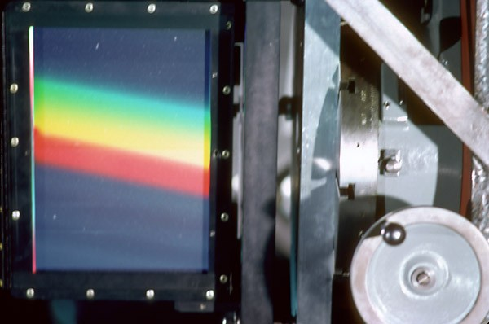
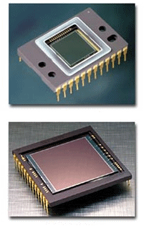
How we make spectra in optical astronomy
Light from the telescope is sent through a slit and a diffraction grating
The spectrum is recorded on a CCD, allowing a plot
of intensity vs. wavelength to be made

