Slide 1
Stellar Evolution:
Evolution off the Main Sequence
Main Sequence Lifetimes
Most massive (O and B stars): millions of years
Stars like the Sun (G stars): billions of years
Low mass stars (K and M stars): a trillion years!
While on Main Sequence, stellar core has H -> He fusion, by p-p chain in stars like Sun or less massive. In more massive stars, “CNO cycle” becomes more important.

Slide 2
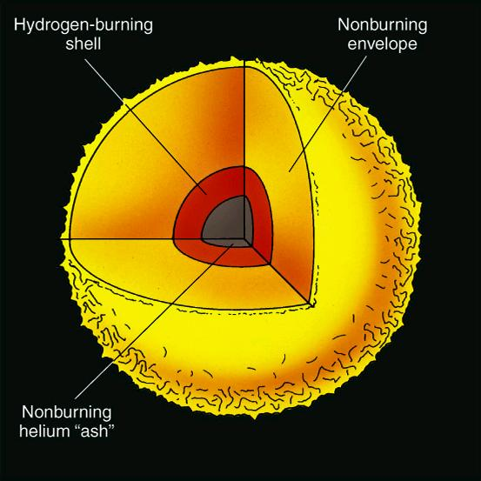
Evolution of a Low-Mass Star
(< 8 M_{sun})
- All H converted to He in core.
- Core too cool for He burning. Contracts. Heats up.
- H burns in hot, dense shell around core: "H-shell burning phase".
- Tremendous energy produced. Star must expand.
- Star now a "Red Giant". Diameter ~ 1 AU!
- Phase lasts ~ 10⁹ years for 1 M_{Sun} star.
- Example: Arcturus
Red Giant

Slide 3
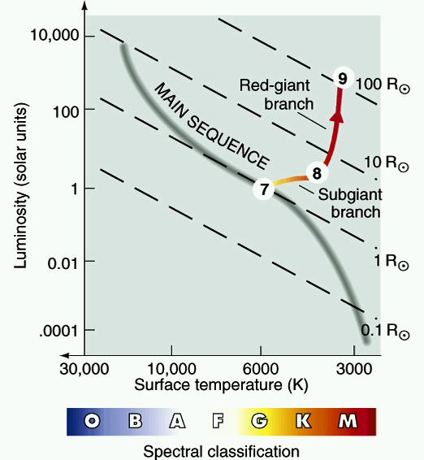
Red Giant Star on H-R Diagram

Slide 4
Eventually: Core Helium Fusion
- Core shrinks and heats up to 10⁸ K, helium can now burn into carbon.
"Triple-alpha process"
⁴He + ⁴He -> ⁸Be + energy
⁸Be + ⁴He -> ¹²C + energy
- Core very dense.
For M < 2 M_{Sun}, fusion first occurs in a runaway process: "the helium flash". Energy from fusion goes into re-expanding and cooling the core. Takes only a few seconds! This slows fusion, so star gets dimmer again.
- Then stable He -> C fusion. Still have H -> He shell fusion.
- Now star on "Horizontal Branch" of H-R diagram. Lasts ~10⁸ years for 1 M_{Sun} star.

Slide 5
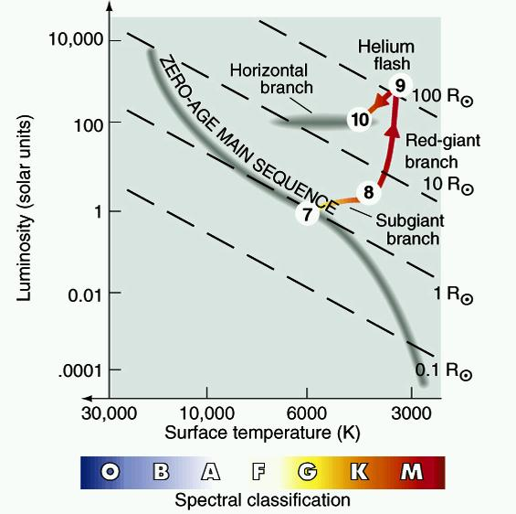
More massive less massive
Horizontal branch star structure
Core fusion
He -> C
Shell fusion
H -> He

Slide 6
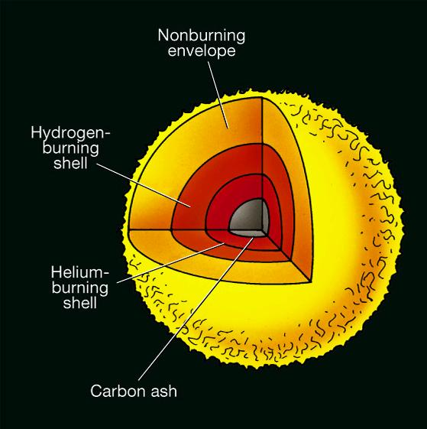
Helium Runs out in Core
- All He -> C. Not hot enough
for C fusion.
- Core shrinks and heats up, as
does H-burning shell.
- Get new helium burning shell (inside H burning shell).
- High rate of burning, star expands, luminosity way up.
Strong winds.
- Called ''Red Supergiant'' (or Asymptotic Giant Branch) phase.
- Only ~10⁶ years for 1 M_{Sun} star.
Red Supergiant

Slide 7
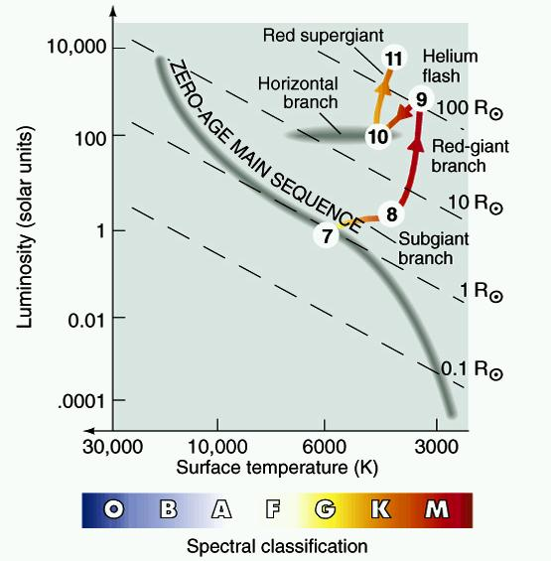

Slide 8
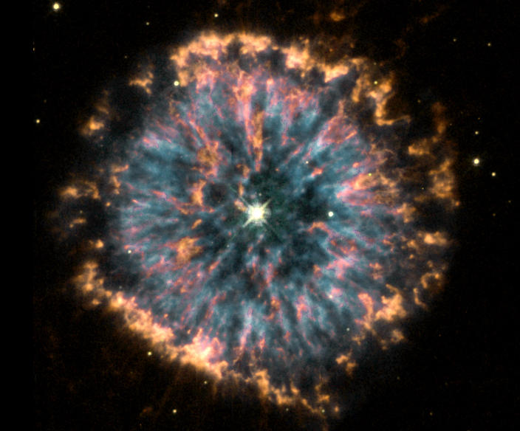
"Planetary Nebulae"
- Core continues to contract. Never hot enough for C fusion.
- He shell dense, fusion becomes unstable => “He shell flashes”.
- Whole star pulsates more and more violently.
- Eventually, shells thrown off star altogether! 0.1 - 0.2 M_{Sun} ejected.
- Shells appear as a nebula around star, called “Planetary Nebula” (awful, historical name, nothing to do with planets).

Slide 9
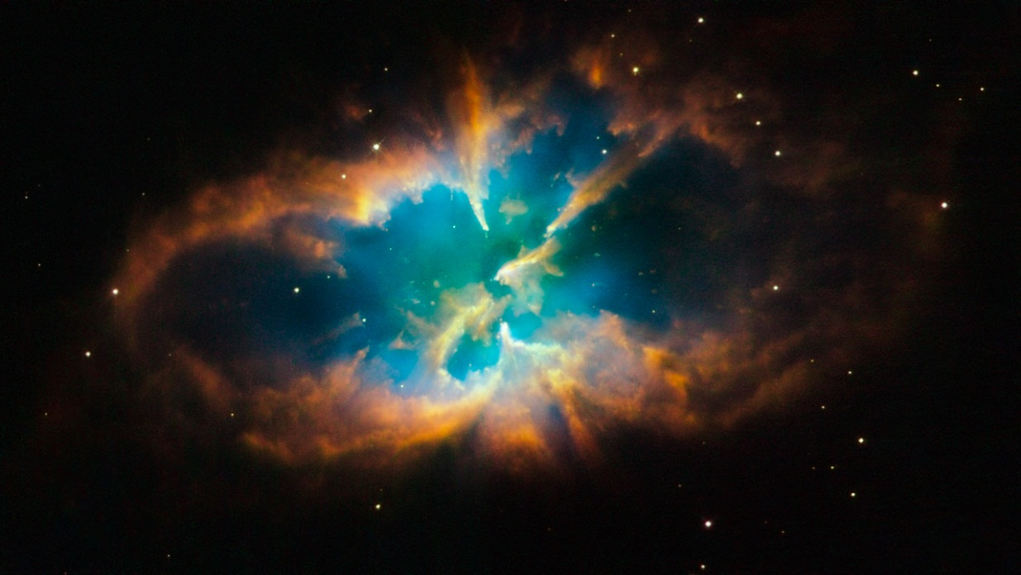
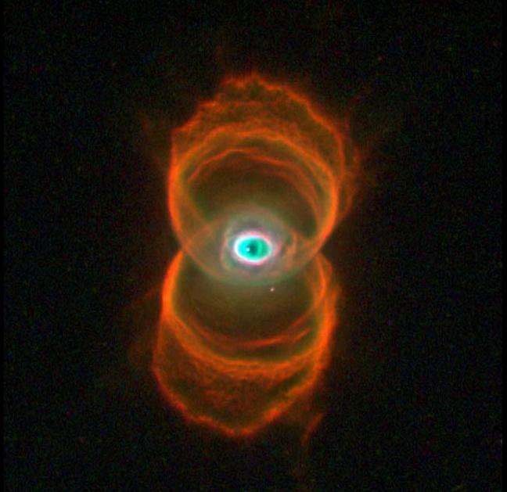
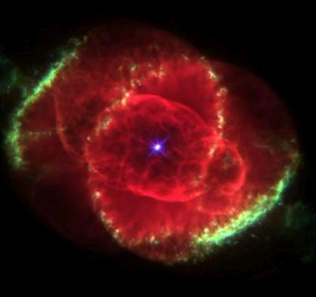
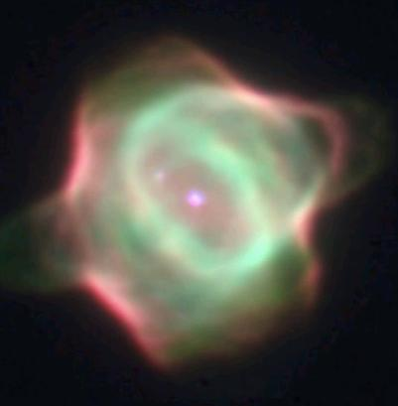

Slide 10
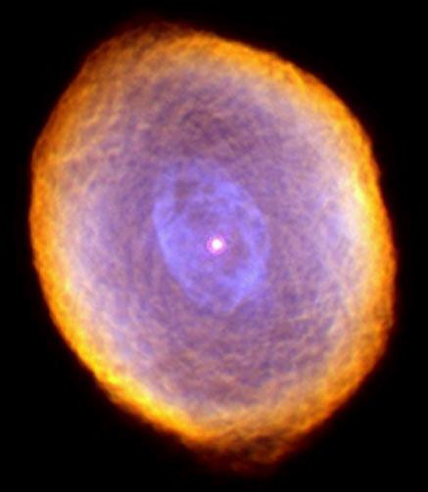
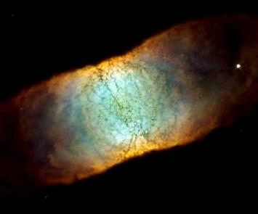
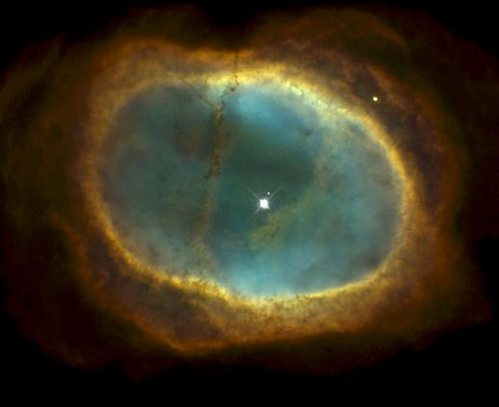
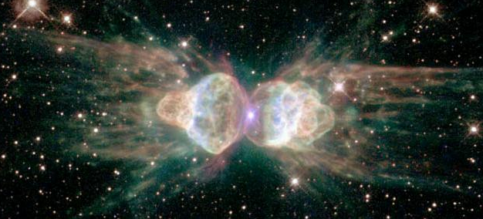

Slide 11
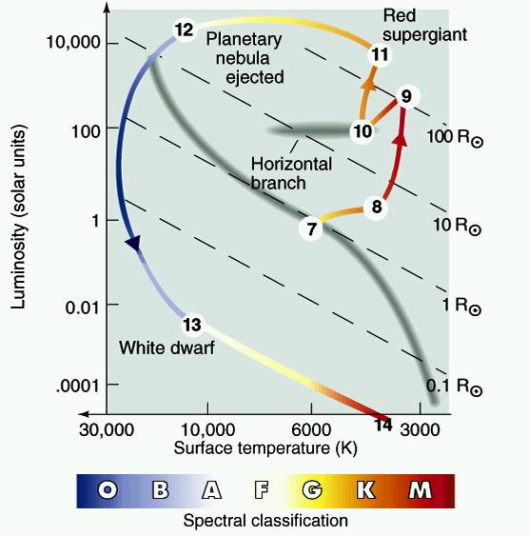
White Dwarfs
- Dead core of low-mass star after Planetary Nebula thrown off.
- Mass: few tenths of a M_{Sun}
- Radius: about R_{Earth}
- Density: 10⁶ g/cm³! (a cubic cm of it would weigh a ton on Earth).
- Composition: C, O.
- White dwarfs slowly cool to oblivion. No fusion.

Slide 12
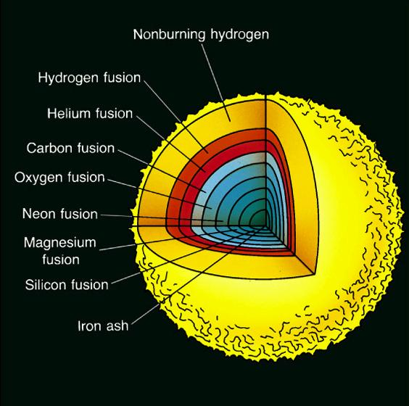
Evolution of Stars > 12 M_{Sun}
Low mass stars never got
past this structure:
Eventual state of > 12 M_{Sun} star
Not to scale!
Higher mass stars fuse heavier elements.
Result is "onion" structure with many shells of fusion-produced elements. Heaviest element made is iron. Strong winds.
Not to scale!
They evolve more rapidly. Example: 20 M_{Sun} star lives "only" ~10⁷ years.

Slide 13
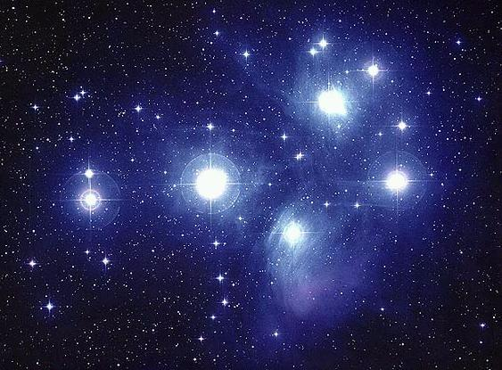
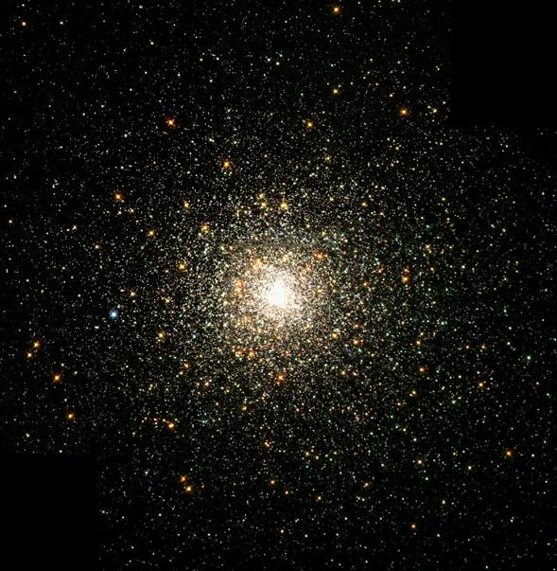
Star Clusters
Open Cluster
Globular Cluster
Comparing with theory, can easily determine cluster age from H-R diagram.

Slide 14
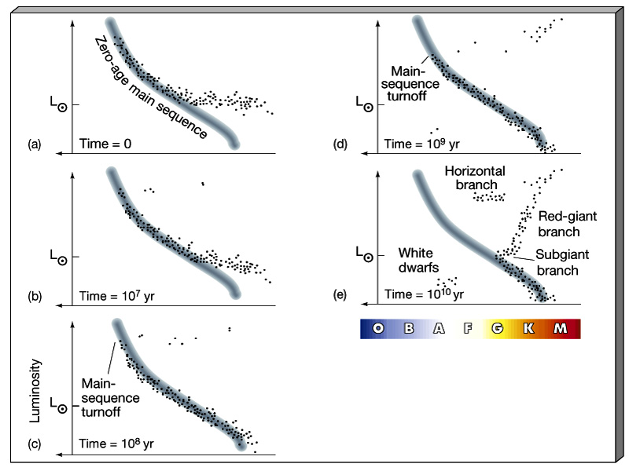
Following the evolution of a cluster on the H-R diagram
Luminosity
L_{Sun}
L_{Sun}
Temperature
100 L_{Sun}
L_{Sun}
L_{Sun}
L_{Sun}

Slide 15
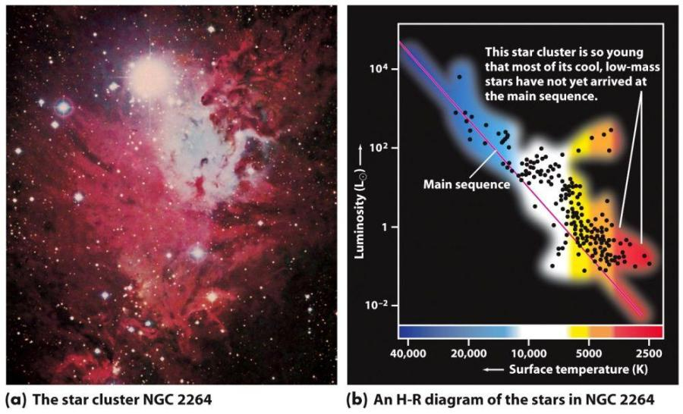
H-R diagram for a young open clusters show pre-Main Sequence stars

Slide 16
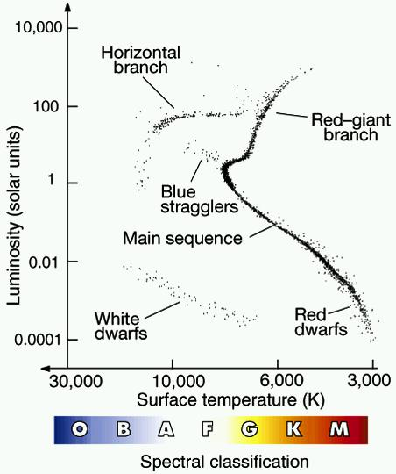
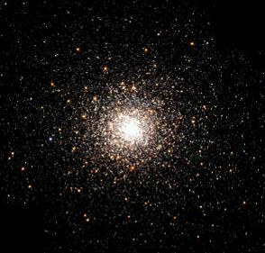
Globular Cluster M80 and composite H-R diagram for similar-age clusters.
Globular clusters formed 11-13 billion years ago. Useful info for studying the history of the Milky Way Galaxy.

Slide 17
Schematic Picture of Cluster Evolution
Massive, hot, bright, blue, short-lived stars
Time 0. Cluster looks blue
Low-mass, cool, red, dim, long-lived stars
Time: few million years.
Cluster redder
Time: 10 billion years.
Cluster looks red

Slide 19
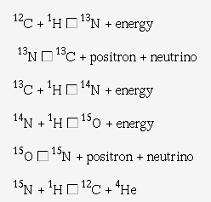
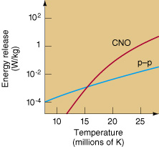
Fusion Reactions and Stellar Mass
In stars like the Sun or less massive, H -> He
most efficient through proton-proton chain.
In higher mass stars, "CNO cycle" more efficient. Same net result:
4 protons -> He nucleus
Carbon just a catalyst.
Need T_{center} > 16 million K for CNO cycle to be more efficient.
Sun
(mass) ->

