Slide 1
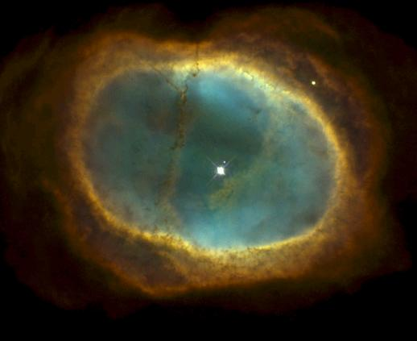
Post Main Sequence Evolution of “Low-Mass” Stars Chapter 19.1-19.3, then 20.1-20.4, then 19.4-19.6

Slide 2
Key points
Late stages of evolution: Red Giants, Horizontal Branch Stars, Asymptotic Giant Branch Stars, White Dwarfs.
At each stage, what element is fusing and where?
How does that change the structure of the star?
The evolutionary path of the star on the H-R diagram. How do L, T, R change at each stage?
Although evolution is complex, it’s driven by a few basic physical concepts.
Star clusters and their H-R diagrams
Variable stars and distance indicators

Slide 3
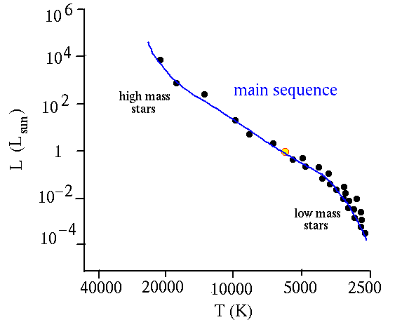
"Stellar Midlife" - Main Sequence
High-mass stars are hotter and brighter, have larger radius and short lifetime.
Low-mass stars are cooler, fainter, have smaller radius and long lifetime.
MS stars fuse H to He in cores. There is some evolution of L and T on MS (so may sometimes see ZAMS or Zero-Age Main Sequence referred to – indicates stars’ positions at beginning of MS life).

Slide 4
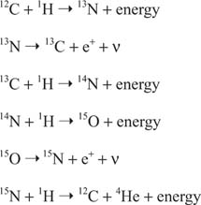
In stars more massive than about 1M (T_{core} > 1.6 x 10⁷ K), H => He fusion more efficient through “CNO cycle”: chain of six reactions where C, N and O are catalysts, but end result same as p-p chain.
Nuclear reactions are highly sensitive to core T:
p-p chain: ∝ T⁴
CNO cycle: ∝ T²⁰

Slide 5
Post main sequence evolution: “evolved” stars. Focus on 0.4 M < M < 7(?) M case
(This is a condensed version of what’s in the textbook, and is what you need
to know).
Core hydrogen exhaustion
During the MS, H => He in core
⇒ core runs out of fuel at some point.
Can it immediately “burn” He?
No, the Coulomb (electrical charge) barrier is too high.
=> core energy production drops.
=> internal pressure drops.
Hydrostatic equilibrium is being lost.

Slide 6
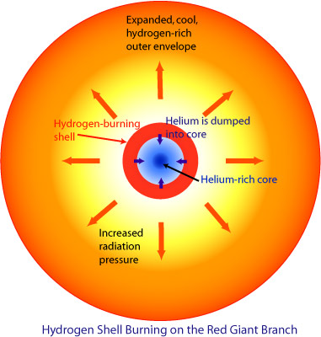
Core contracts (eventually by factor of about 3 in radius)
=> heats up
=> inner part of “envelope” (everything outside core) contracts too, heats up
=> now a zone around He core is hot enough for H burning – “H-burning shell”
T, density higher in shell than in core during MS
=> faster fusion!
4. Faster fusion results in both higher pressure, which pushes out envelope above it, and more radiation
(not to scale!)

Slide 7
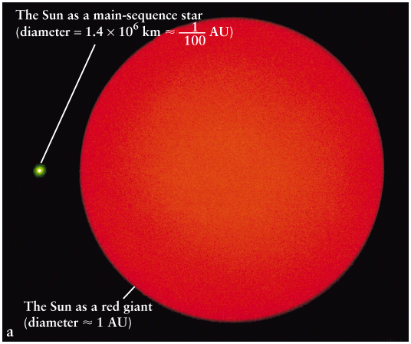
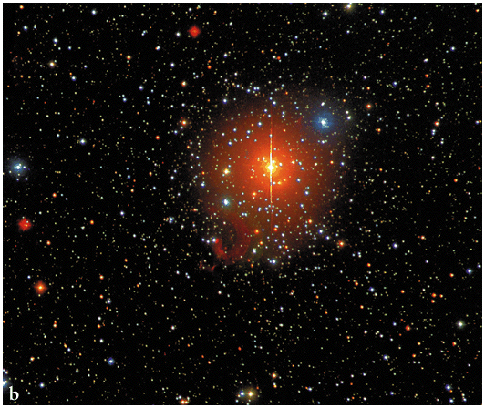
Outer envelope expands and therefore cools => redder. Luminosity rises due to vigorous shell fusion.
Result is a Red Giant (ignore subgiant/Red Giant distinction in text for this class)
Radius increases roughly 100 times.
Lasts about 1 Gyr for 1 M stars (c.f. t_{ms}~10 Gyr).
Strong winds
Red giant stars in Auriga
Notes:
Core contraction of the order of 10s m/year.

Slide 8
Evolving along the red giant branch (1 M case)

Slide 9
(Aside: evolution of stars < 0.4 M, down
to brown dwarf limit)
These are fully convective: convection zone extends from center to
surface => all gas cycles into core where fusion occurs and out again.
Eventually, all H in star converted to He. This takes 100’s of billions of years.
Never hot enough for He fusion.
Result will be dead He star.
Notes:
40 times longer on MS than in the RGB phase.

Slide 10
Helium burning (Sec 19.3, 20.1)
Back to Red Giant. Eventually, core hot enough (T almost 10⁸ K) to ignite helium:
1) He burning starts via:
The “triple alpha” process:
⁴He + ⁴He ⇒ ⁸Be + γ
⁸Be + ⁴He ⇒ ¹²C + γ
Carbon-based life!
Some C goes on to make O by fusing with another helium nucleus:
¹²C + ⁴He ⇒ ¹⁶O + γ
Notes:
Helium nuclei are called alpha particles.

Slide 11
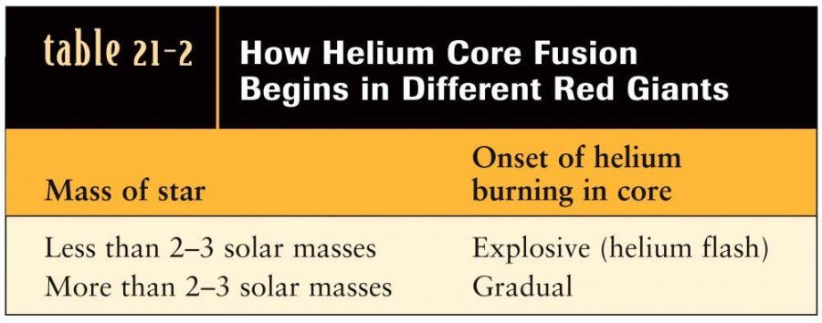
Why is the onset of helium burning explosive in lower mass stars?
To understand that, we need the concept of degeneracy, and degenerate matter.

Slide 12
Low-mass (<2-3 M) stars: Electron degeneracy and the Helium Flash (not required to learn)
In cores of low-mass red giants conditions are extreme: very high temperature and density, gas is completely ionized.
With core contracting, density rises to about 10⁷ kg m⁻³.
Electrons and nuclei of the ionized gas are tightly squeezed.
Electrons reach a limit set by quantum mechanics where they greatly resist further compression. This is a “degenerate” gas, different from an ideal gas. Its pressure depends on density only, not on temperature, and it dominates the normal, ideal gas pressure.
Notes:
Same reason why you can’t go through a solid. Solids are degenerate enough so that electrons resist being pushed together more, which is why you feel a pressure when you push against a solid, despite being mostly empty space.

Slide 13
Whether you have an ideal gas or a degenerate gas depends on both density and temperature.
log T (K)
ideal gas
8
X
(core at start of He fusion)
degenerate gas
7
5 6 7 8
log ρ (kg m⁻³)

Slide 14
So when fusion starts it adds thermal energy and raises temperature, making fusion go even faster. But pressure is hardly changing, so core is not re-expanding and cooling, so fusion accelerates. Runaway fusion. This all takes a few seconds!
Eventually, temperature so high that ideal gas pressure becomes dominant again, and gas acts like a normal, ideal gas.
Now the rapidly rising temperature causes pressure to rapidly rise, and core to violently re-expand. Re-expansion of core takes a few hours.
Note: no flash at surface of star!

Slide 15
2. Expansion of core causes it to
cool, and pushes out H-burning shell, which also cools
3. Fusion rate drops. Envelope
contracts and luminosity drops
4. Moves onto Horizontal Branch
of H-R diagram. Stable core
He burning (and shell H burning)
HB lasts about 10⁸ years for 1 M star.
All HB stars < 3 M have luminosity
of almost 100 L.
Helium flash

Slide 16
Horizontal-branch star structure (not to scale)
Core fusion
He -> C
Shell fusion
H -> He

Slide 17
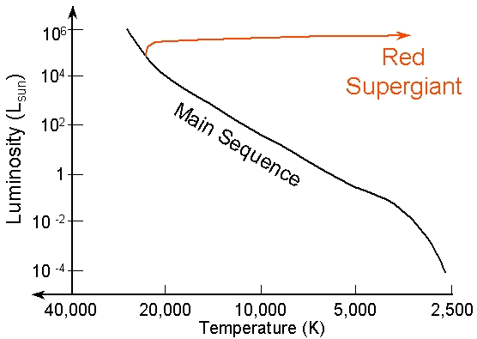
Higher-mass stars: helium burning onset
In higher mass stars, cores hotter and less dense. He fusion can start before core contracts to such a high density, so never gets degenerate.
=> H burning shell, then steady onset of He burning
(~15 M track)
Moves more horizontally across the H-R diagram, especially for stars > 5 M or so.
But structure is same, with He -> C,O fusion in core, and H-> He in shell.
Notes:
t_shell ~1 Myr

Slide 18
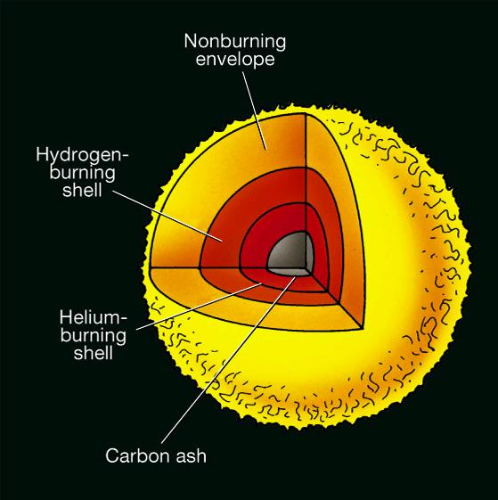
Helium Runs out in Core (Sec 20.1)
All He -> C, O in core. Not hot enough for C, O fusion.
Core shrinks (to ~1R_{Earth}), heats up, becomes degenerate again. Shell also contracts and heats up.
Get new, intense He-burning shell (inside H-burning shell).
High rate of burning, star expands, luminosity way up!
H shell also pushed out by He
shell fusion, eventually turns off
Called Asymptotic Giant Branch (AGB) phase.
Only ~10⁶ years for 1 M star.
Not to scale! Core and shells very small.
AGB star

Slide 20
Helium Shell Flashes
As He in shell used up, shell contracts, so H shell must contract too and heat up
H shell reignites, creating
new supply of He. He shell
gains mass, shrinks, heats up,
becomes “degenerate”.
Eventually He shell reignites, but in a flash
H shell re-expands, fusion stops
Cycle repeats
L and R vary on ~10³ - 10⁵ year timescales, depending on mass.
Strong winds

Slide 21
Planetary Nebulae
Pulsations become more violent. Eventually envelope ejected,
at speeds of a few 100 km s⁻¹, taking up to 40% of mass
Envelope eventually visible as a nebula with emission lines
Remaining C-O core is a White Dwarf

Slide 22
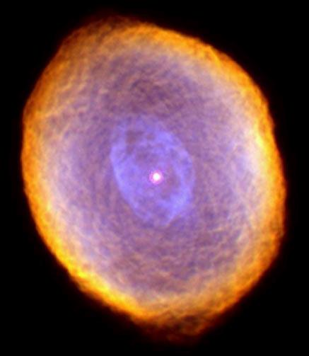
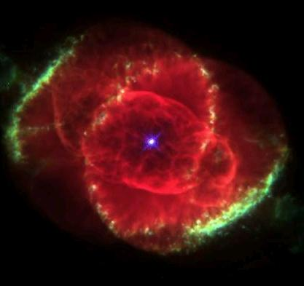
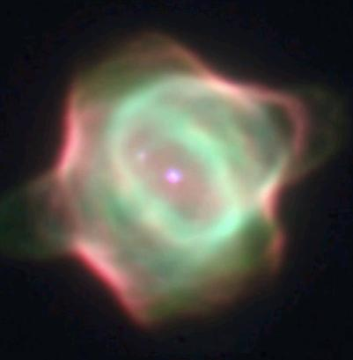

Slide 23
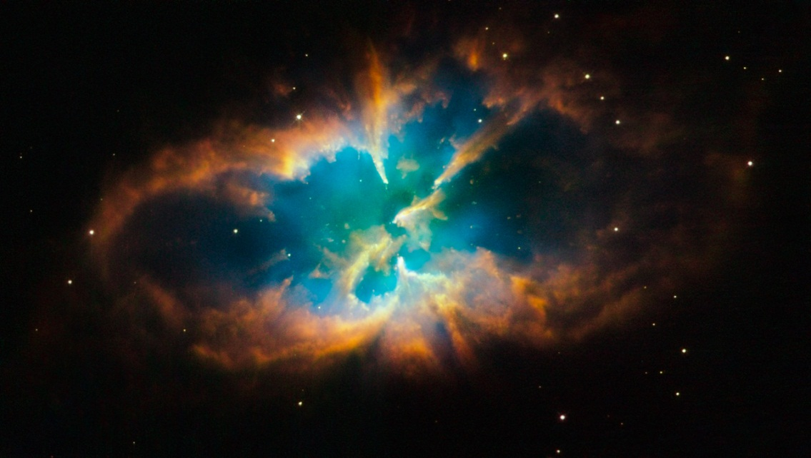
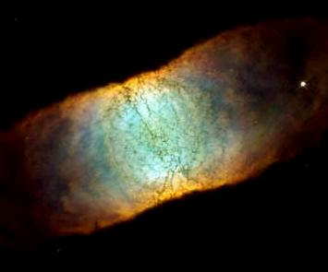
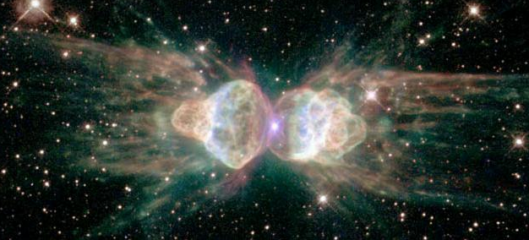
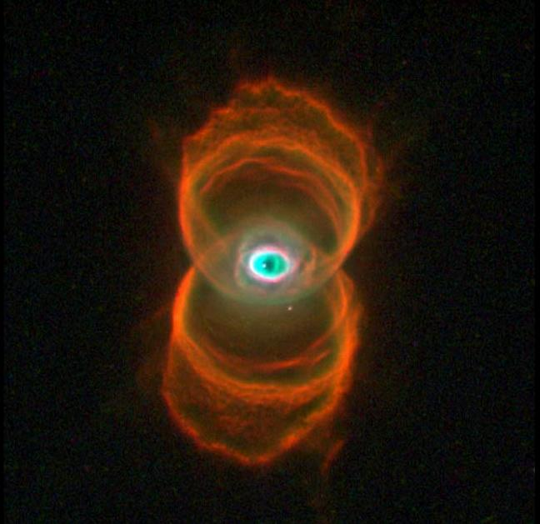

Slide 24
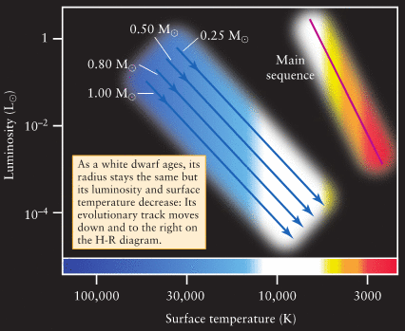
Remnant Core – a White Dwarf
Mass 0.25 M – 1.4 M , depending on mass of progenitor star
Supported by electron degeneracy pressure
With no further fusion, they cool to oblivion over billions of years
Radius about 1 R⊕
Hence enormous
densities, ∼ 10⁹ kg m⁻³
Composition C, O.
Residual H, He atmosphere seen in spectra of most WDs

Slide 25
How did this understanding come about? Had to connect expectations from physics of stellar interiors with observations, refine thinking, etc.
Powerful test of theory: compare theoretical “evolutionary tracks” on the H-R diagram with real stars – specifically star clusters.

Slide 26
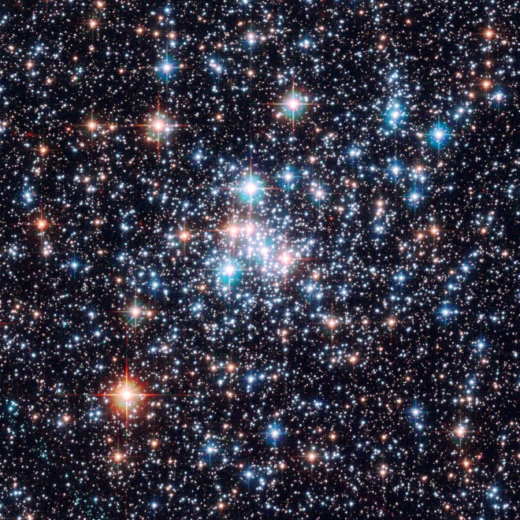
Star clusters (back to Sec 19.4)
Groups of 100’s to ~a million of stars formed together
Stars in a cluster
Are all at same distance (easy to compare e.g. luminosities)
All have the same age
All have the same chemical composition (not so important for us)
Have a wide range of stellar masses
A cluster provides a snapshot of what stars of different masses look like, at the same age and distance

Slide 27
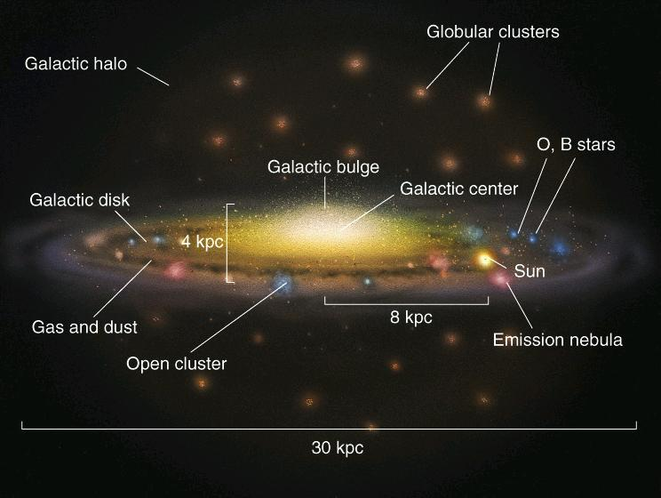
“Open” and “Globular” Clusters in the Milky Way

Slide 28
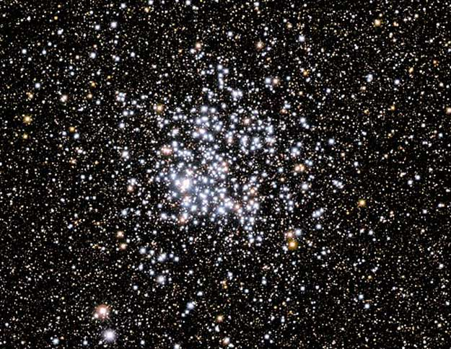
Open clusters
Open clusters (galactic clusters) contain 100’s-1000’s of stars, not very centrally concentrated.
The clusters are confined to disk of the Galaxy.
Stars are young. Open clusters generally disperse with time.
M11 the “Wild Duck” open cluster.

Slide 29
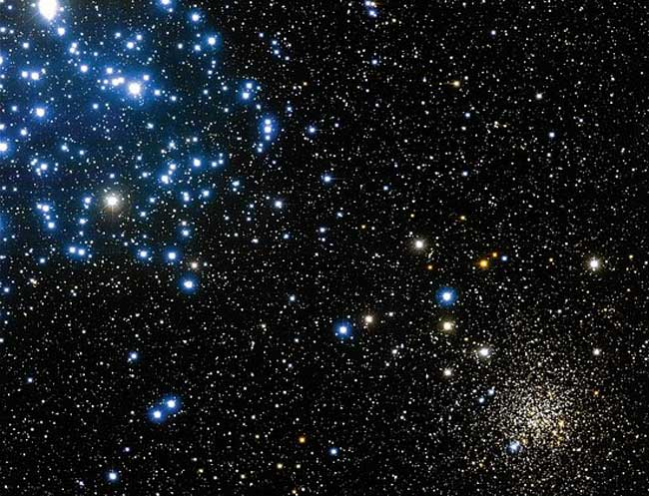
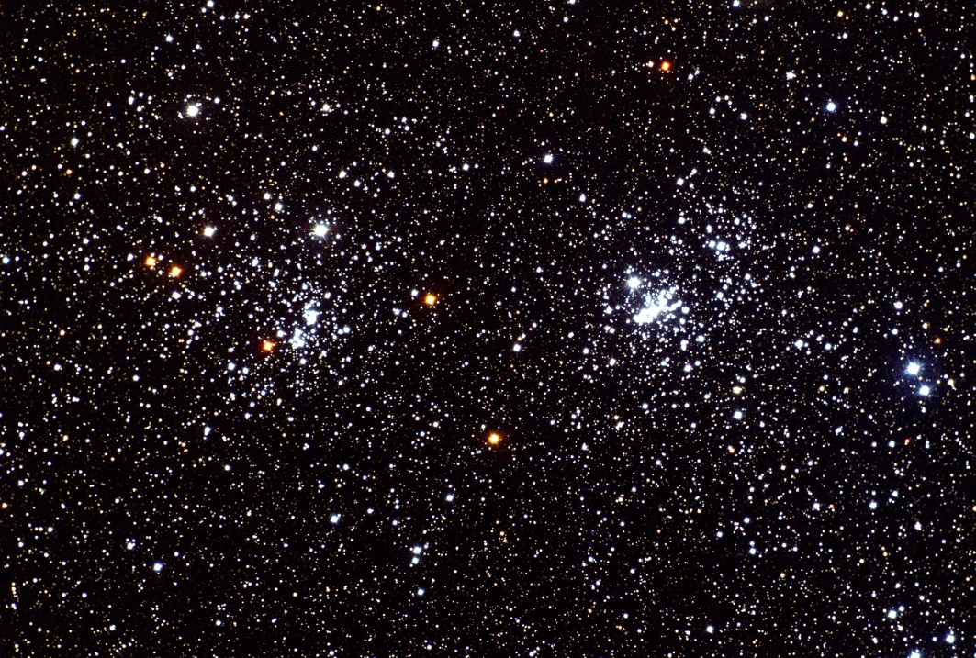
H and Chi Persei
M35 and NGC 2158 in Gemini

Slide 30
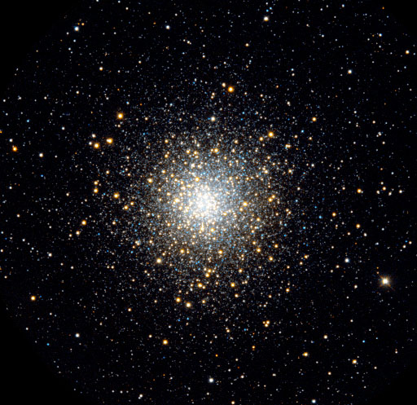
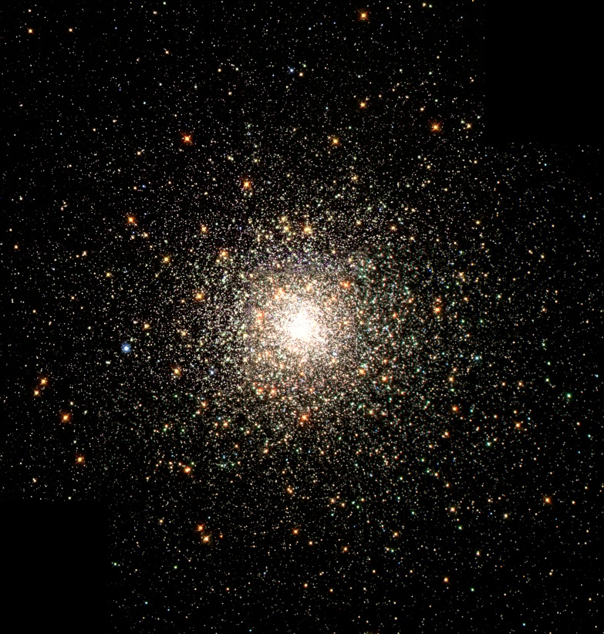
Globular clusters
Globular clusters contain 10⁵ to 10⁶ stars, centrally concentrated.
Found in the halo of the galaxy.
The stars are old.
Provide an important, lower limit to the age of the Universe.
M10
M80

Slide 31
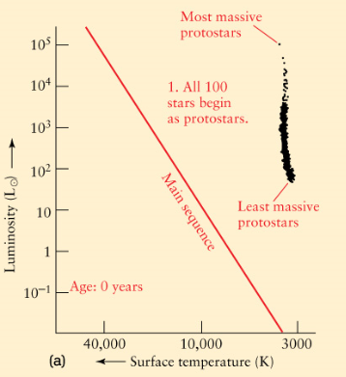
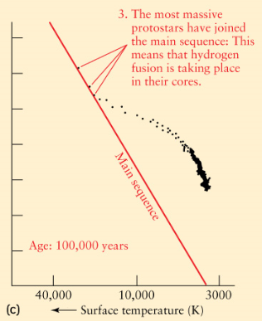
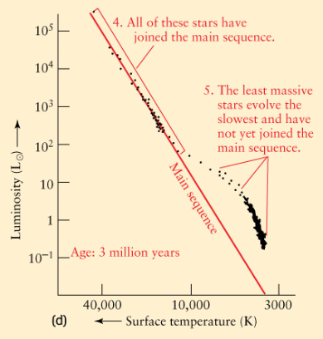
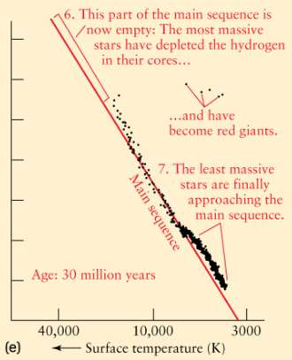
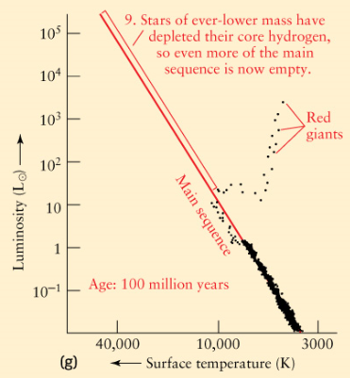
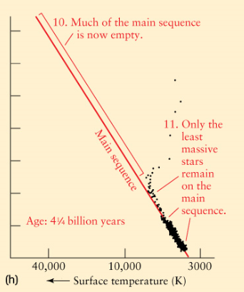
Theoretical tracks (up to Red Giant phase):

Slide 32
If distance not known,
and incident flux plotted,
will shapes change?
(Theoretical tracks not stacked on top of each other):

Slide 33
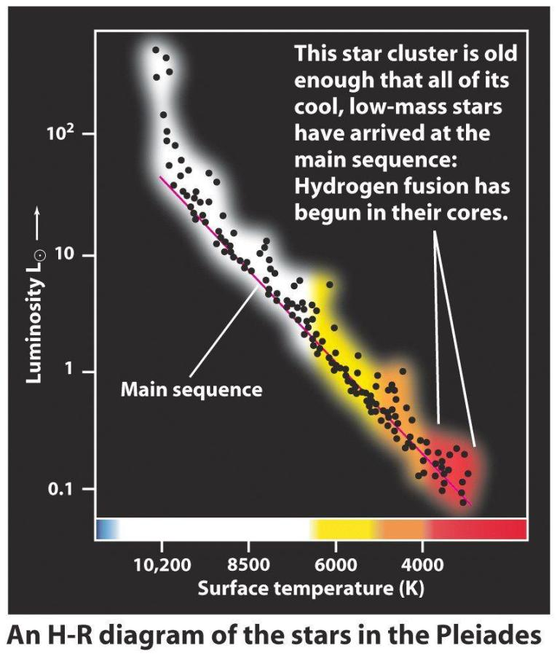
Comparison of theory and observations
Get age from color of stars
just leaving Main Sequence
(MS Turn-off point).
Get distance by measuring stars’
incident fluxes, plotting incident
flux vs. T, recognizing
MS. Know what their luminosities
should be from theoretical MS.
Main Sequence
Turn-off

Slide 34
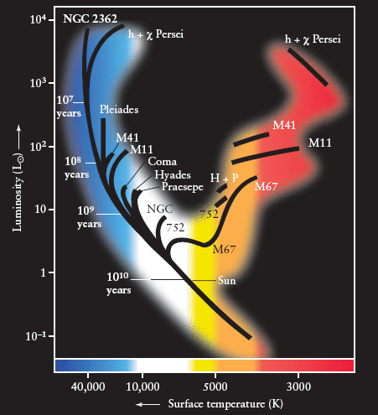
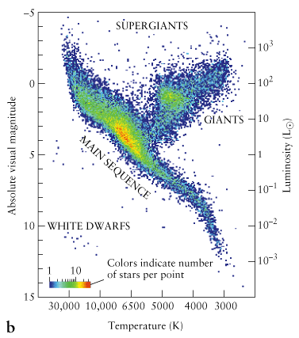
The H-R diagrams of open clusters show range of MS turnoff points – range of ages.
H-R diagram for 21,000 of the brightest nearby stars from Hipparcos. Are these stars all the same age, like in a cluster?

Slide 35
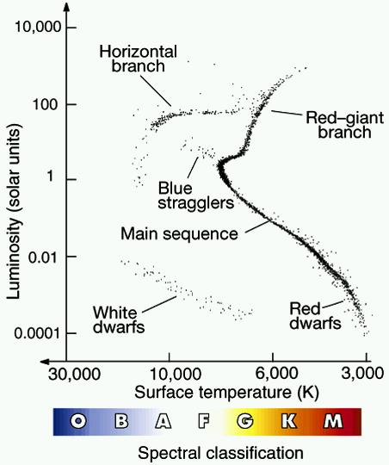
Typical globular cluster H-R diagram. Note low turnoff point, many red giants and white dwarfs. Young or old?
AGB stars
Also get distance from apparent brightness of Main Sequence or of Horizontal Branch.

Slide 36
Stellar populations
Two basic types of stars – a young class and an old class.
Population I – young, in disk of galaxy, “metal-rich”, including open clusters.
Population II – old , in halo, “metal-poor”, many in globular clusters.
Earlier stars formed out of “cleaner” gas (Pop II).
Later generations formed out of gas which the first stars “polluted” with heavier elements (“metals”) they created (Pop I). But they have a large range of metal content in spectra and thus ages.
A has low metallicity, B has high metallicity. Temperature same.

Slide 37
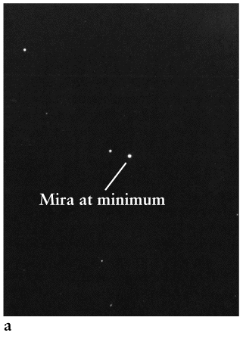
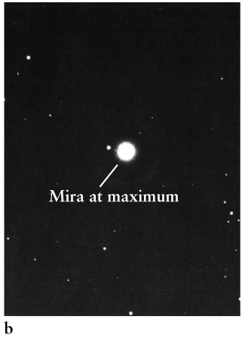
Variable stars as Distance Indicators
Some evolved stars vary in brightness. Mira variables are Long Period Variables: AGB stars varying in brightness by a factor of ~100 over a timescale of 100-700 days.

Slide 38
Short Period Variables – Cepheids and RR Lyraes
They pulsate in radius. T also varies. Timescale days – weeks.
This happens to some stars late in their evolution when their internal structure makes them unstable to pulsations – but we’ll skip the physics.
Cepheids are relatively massive, evolved, variable stars.
RR Lyrae variable stars are Horizontal Branch stars.

Slide 39
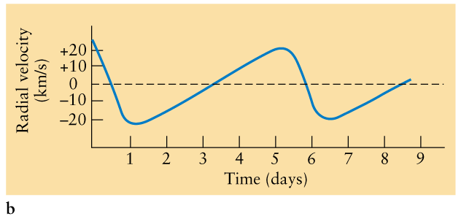
How to study variable stars
We use light curves, which show the brightness (typically in some filter) versus time for the star.
We can also look at the periodic change of other properties, such as the radial velocity, surface temperature, and size.

Slide 40
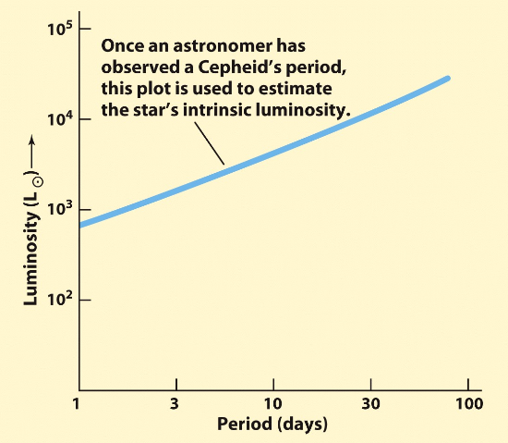
Distance indicators
Variable stars like Cepheids, and RR Lyrae stars can be used as distance indicators. How?
Cepheids exhibit a relation between their period and their (average) luminosity. Discovery goes back to Henrietta Leavitt (1912).
The mean period-luminosity (P/L) relationship for Cepheids.
=> Measure period, read off luminosity. Then with measured apparent brightness (incident flux) use inverse-square law to get distance. Usually done with a filter.
The P/L relationship for RR Lyrae stars is trivial: all have L almost 100 L

Slide 41
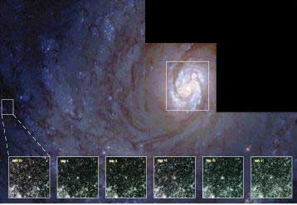
Cepheids and RR Lyrae stars are giant and thus very luminous. We can see them as individual stars in other, nearby, galaxies.

Slide 42
Concepts in understanding stellar evolution
Temperature increases with depth in a star.
A nucleus with higher atomic number requires a higher temperature for fusion.
Fusion provides pressure which supports core and star (shining is a “by-product”).
When fusing of an element is complete, core not hot enough for fusion of next element: core contracts.
As core contracts, heats up, as gravitational potential energy converted to heat.
Core contracts until T high enough to fuse next element.
When core inert and shrinking, layers above it contract, creating hot dense shell(s) where intense fusion happens, causing envelope to expand and star to become more luminous – even as core contracts.
Expanding envelopes cool.

Slide 44
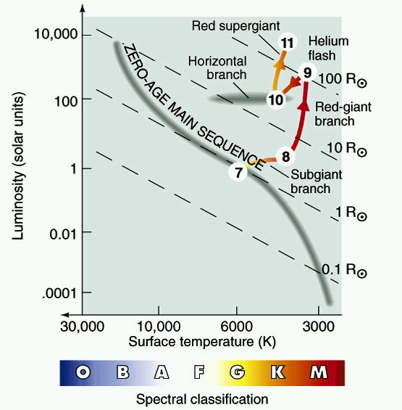
C
B
A

Slide 45
Compare to open cluster H-R diagram
Globular cluster
Open cluster

