Slide 1
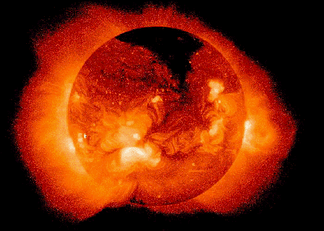
The Sun
Chapter 16
Most important concepts:
Energy production
Stability

Slide 2
Basic data
Diameter 1.4 x 10⁶ km = 109 D_{earth}
Mass 2.0 x 10³⁰ kg = 333,000 M_{earth}
Density 1400 kg/m³ (160,000 kg/m³ in center)
Temperature 5800 K (“surface”) to 1.55 x 10⁷ K (ctr)
Luminosity 3.86 x 10²⁶ W
Rotation rate 25 days (equator), 35 days (poles)
Composition (atmos, by mass) 74% H, 25% He, 1% other elements
Orbital period (MW) 220 x 10⁶ years
The Sun is a star: a shining ball of gas powered by fusion

Slide 3
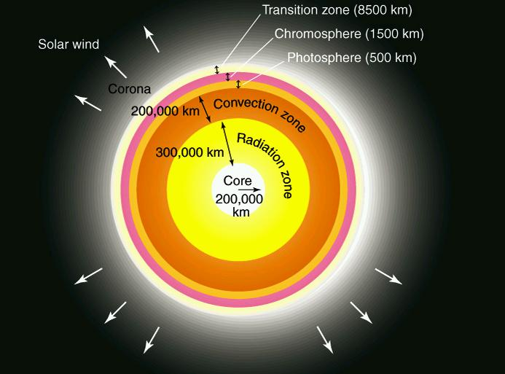
Solar structure

Slide 4
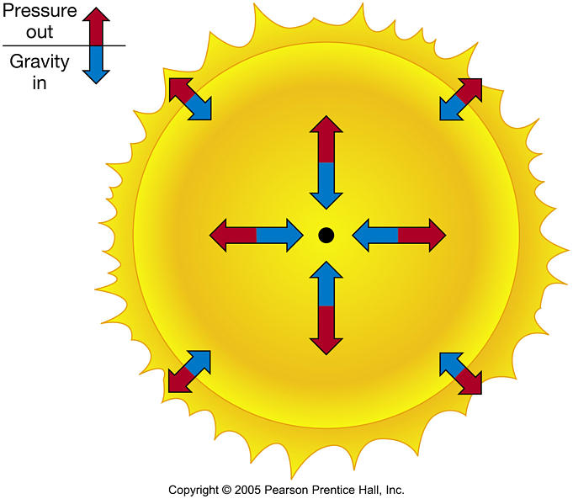
Hydrostatic equilibrium
Why is the Sun stable (not contracting or expanding)? Gravity
makes objects want to collapse. Pressure causes objects to expand.
In a star like the Sun, these are in balance at every depth: hydrostatic equilibrium
At early or late times in a star’s life, this balance is not achieved, e.g.
contraction during formation, expansion during late stages of evolution.
What is pressure and how do we calculate it? And what provides it???

Slide 5
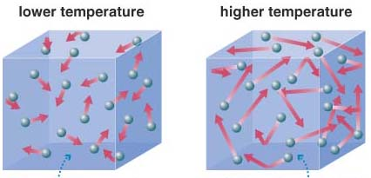
The Ideal Gas Law
Consider pressure that gas particles in a box exert on the walls (P=F/A).
Particles in hot gas move faster, and collide with more force than those in a cooler gas => hot gas exerts higher pressure
However, gas pressure also depends on the number of particles that are colliding with the surface area per sec. So depends on number density n [m⁻³] as well as temperature.

Slide 6
This is expressed in the ideal gas law:
P = nkT
where P is the gas pressure [N/m² or Pascals], n the number density [m⁻³], and k is Boltzmann's constant.
Law works well for most stellar applications (exceptions later).
Pressure very high at center of Sun, so n and T both very high. What provides this pressure? Thermonuclear fusion in the hot core: H is being fused into He. Only possible because T is so high (high n helps too), as we’ll see.
Notes:
F=N=J/m (1J=1Nm)

Slide 7
Reminder: elements and isotopes
Elements: depends on # of protons
Isotopes: depends on # of neutrons
Atoms: nuclei with electrons, with charge balance
Ions: charge imbalance
Example nuclei: ¹H = one proton
²H = one proton with one neutron (a.k.a. deuterium)
³He = 2p + 1n (light isotope of He)
⁴He = 2p + 2n (common isotope of He)

Slide 8
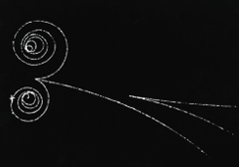
Antimatter, annihilation and neutrinos
Antimatter: for every charged particle there is an antiparticle with the opposite charge.
  Example: positron (e⁺) is like the electron except positive charge
Annihilation: if a particle and its antiparticle collide they completely disappear (explosively) as mass and liberate energy in the form of photons. Mass-energy conversion is governed by Einstein’s famous equation:
E=mc²
Neutrinos (ν):
  Exotic particles with no charge and little mass.
  Tiny probability of interacting with
  other particles.
opposite of annihilation:
pair production

Slide 9
Fundamental forces of nature
Interactions in nature are governed by four fundamental forces:
Gravitational force
Electromagnetic force
Weak nuclear force
Strong nuclear force
Gravity dominates on largest scales: binds massive objects together, and mediates orbital motions
Electromagnetism dominates on atomic scale: binds electrons to protons, atoms to atoms
Strong and weak forces dominate on nuclear scales (~10⁻¹⁵ m): strong force binds protons to neutrons, important for fusion. Very strong on this scale but quickly falls off for larger separations. Weak force important for radioactive decay

Slide 10
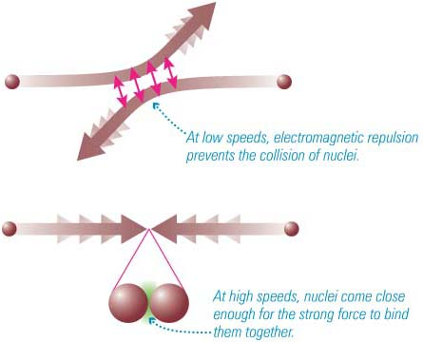
Hydrogen fusion
Box 16-1 and Cosmic Connections
Fusion is any event where nuclear particles collide and join together.
Fusion reactions obey several conservation laws.
Sun and stars fuse H into He for most of their lives. This creates energy.
How to fuse 4 ¹H (p) into a ⁴He (2p+2n)?
  Unlikely 4 protons are colliding at once – need different reaction chain
  Must turn 2 protons into 2 neutrons
  Must be > 10⁷ K to get protons close enough for fusion
Key: bring nuclei sufficiently close (~10⁻¹⁵ m) for the strong force to dominate over the electromagnetic force.
Fusion provides energy to support stars against gravity. Making new elements and shining are “by-products”

Slide 11
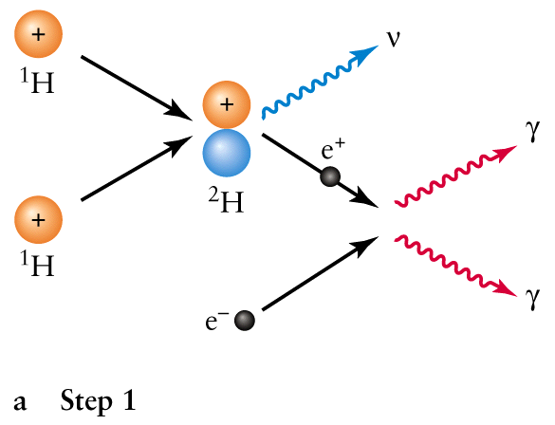
The proton-proton chain - in pictures
Starting point: at 1.5x10⁷ K, hydrogen in the core of the Sun is completely ionized, thus a mixture of free electrons and protons. Ignore other elements.
Step 1:

Slide 12
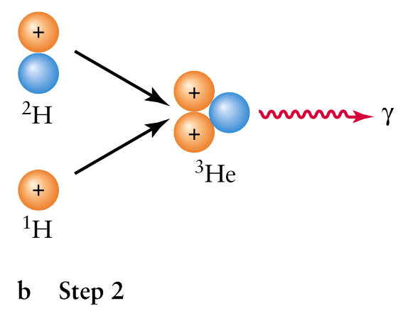
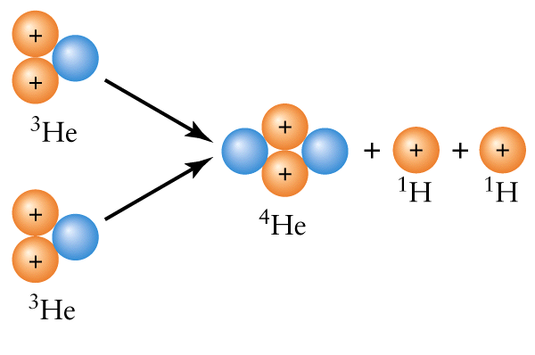
Step 2:
Step 3:

Slide 13
Proton-proton chain
p + p → ²H + e⁺ + ν + γ (twice)
(e⁺ + e⁻ → γ + γ)
p + ²H → ³He + γ (twice)
³He + ³He → ⁴He + p + p + γ

Slide 14
Energy Generation
The 4 protons have 4.8 x 10⁻²⁹ kg more mass than the He nucleus (0.7% of the total mass has been converted to energy).
E=mc² => 4.3 x 10⁻¹² J is released by the formation of a single He nucleus.
L/E = (3.9 x 10²⁶ J/s) / (4.3x10⁻¹² J) = 9.1x10³⁷ conversions per second. Each conversion involves four protons, so (9.1x10³⁷/sec) x (4m_{p}) = 6x10¹¹ kg/sec of H is converted to He. About 4x10⁹ kg (0.7% of this mass) converted to energy per second (also just L /c²).

Slide 15
Sun began with about 1.5 x 10³⁰ kg of H. But only the inner 10% of the Sun [i.e. 10% of its mass] is hot enough for fusion to take place
=> fusion lifetime about 10 Gyrs
Composition must now be different at core than at the surface!
How do we know fusion occurs? We detect neutrinos from the Sun.

Slide 16
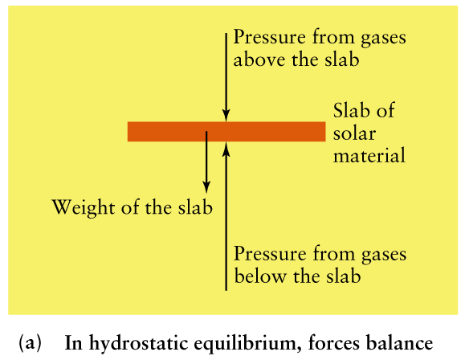
Models of the Sun's interior
The Sun's interior is an ionized gas
Hydrostatic equilibrium keeps it stable
Upward pressure is caused by the nuclear reactions and upward flow of energy
Using ideas of hydrostatic equilibrium, thermal equilibrium (all energy generated by fusion in core must be eventually radiated into space), fusion rates, energy transport, and the ideal gas law, we can create models of the Sun’s interior. Info also from “solar oscillations”.

Slide 17
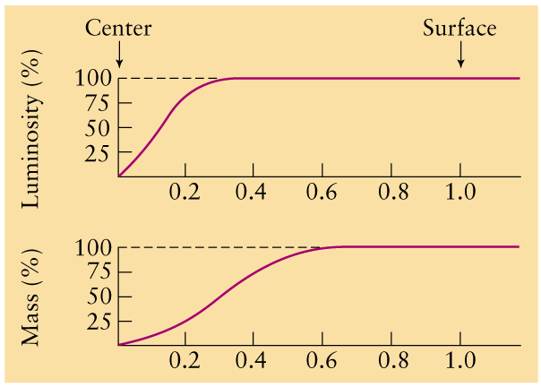
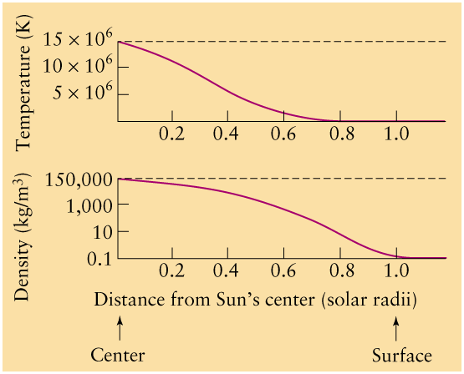
i.e. energy generated per sec, all in core

Slide 18
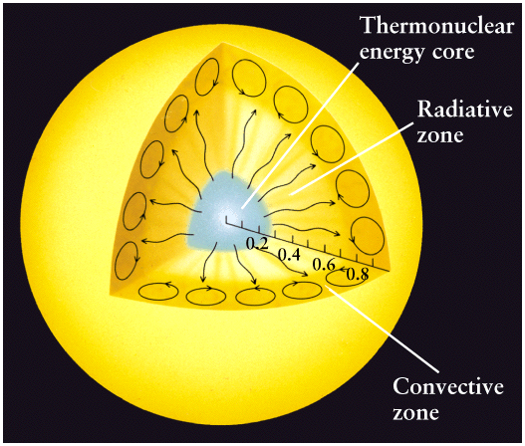

How does energy get to the surface?
Radiation, or "radiative diffusion"
  Photons created in core diffuse outward toward surface. Radiative zone is essentially fully ionized. Individual photons are frequently scattered by electrons (every cm!). Nevertheless, the radiation can effectively diffuse away from core.

Slide 19
Convection
  Atoms and ions with bound electrons form in outer layer. Much harder for radiation to get through as photons too frequently absorbed and re-emitted (in random directions). Hot gas starts to rise, releases energy near surface, falls back down.
Takes about 170,000 years for energy created in the core to get out, but only about 8 minutes for light to travel from the photosphere to us.

Slide 20
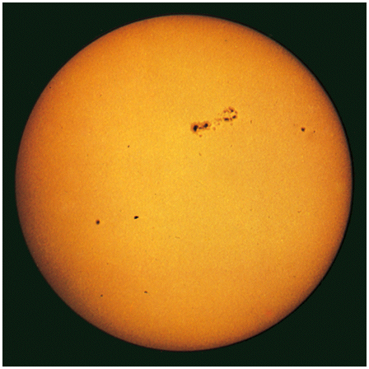
The Sun's Atmosphere
Layers are photosphere, “transition zone”, chromosphere, and corona
The Photosphere
What we see as “surface” (below which atmosphere becomes opaque). Defines diameter
Peak emission 500 nm (greenish) => T=5800 K in photosphere

Slide 21
Solar photosphere as a function of depth
Depth (km) % Direct Light Temp (K)
0 99.5 4465
100 97 4780
200 89 5180
250 80 5455
300 64 5840
350 37 6420
375 18 6910
400 4 7610
Why does surface look sharp? 400 km is a tiny fraction (0.06%) of radius (696,000 km).
Notes:
Source: Fraknoi, Morrison, and Wolf, Voyages through the Universe

Slide 22
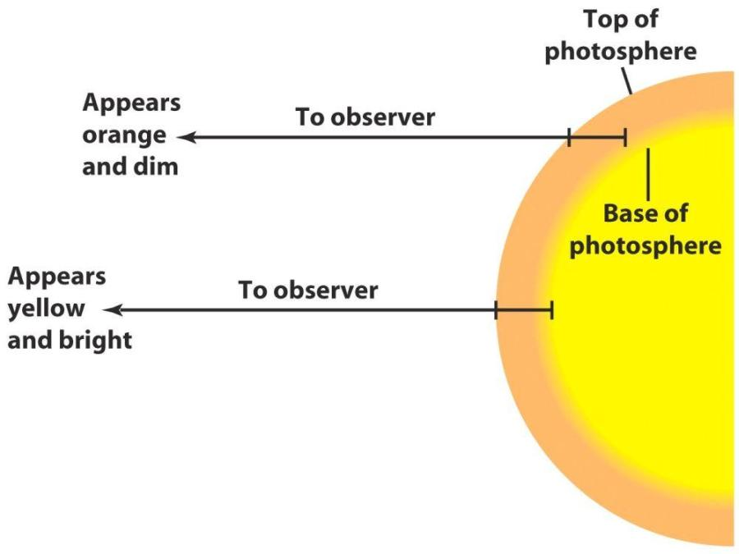
Limb darkening
Edge of Sun looks dimmer
Reason: we look to nearly the same physical
depth at center and edge
Dimmer light comes from higher, relatively
cool layer within the photosphere
Bright light comes from
low-lying, hot layer
within the photosphere

Slide 23
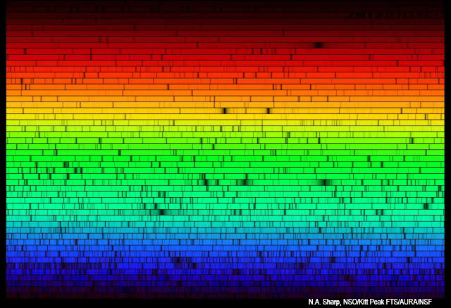
The Solar (absorption line) spectrum is from gas in photosphere only
10,000's of lines from 67 elements, in various excited or ionized states.
Elements weren’t made in Sun, but in previous stellar generations.

Slide 24
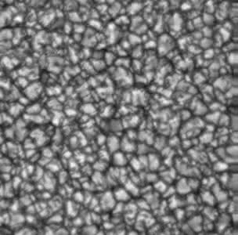
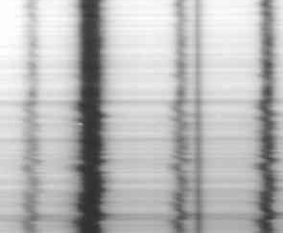
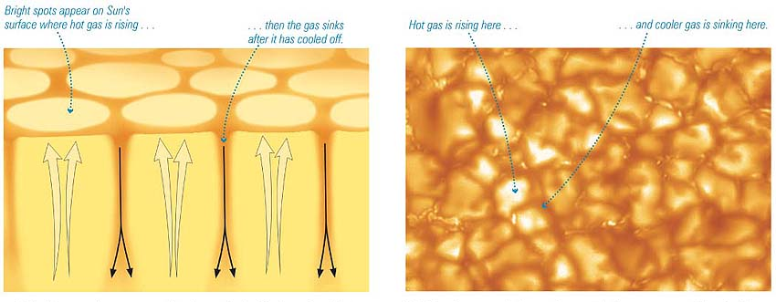
Granulation
Due to convection. Each cell lasts a few minutes
Doppler shifts reveal
vertical motions
~1000 km or 1”
position
Link if video
doesn’t work
wavelength
Cooler regions darker
(Stefan's Law: flux α T⁴)

Slide 25
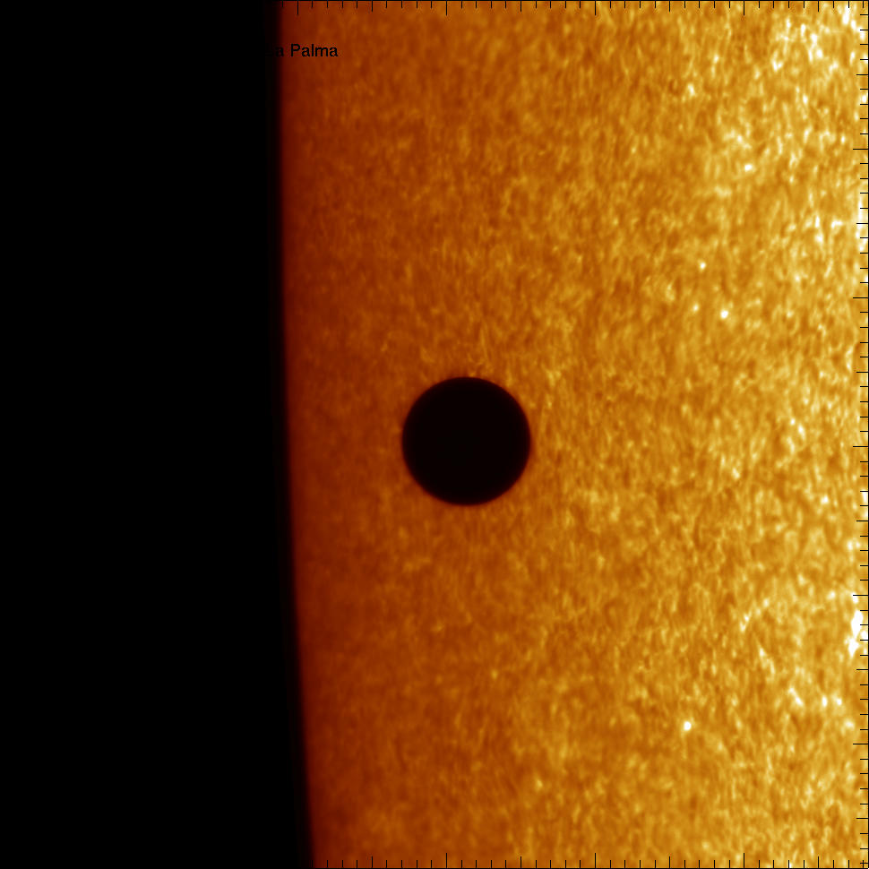

Slide 26
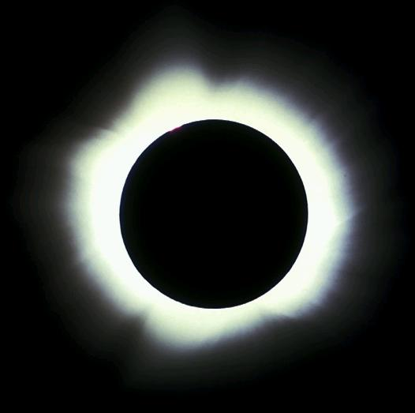
Above photosphere is chromosphere. Please read.
The Corona
Best viewed during eclipses.
T = 10⁶ K
Density = 10⁻¹² kg/m³
Highly ionized, e.g. Fe XI – XIV

Slide 27
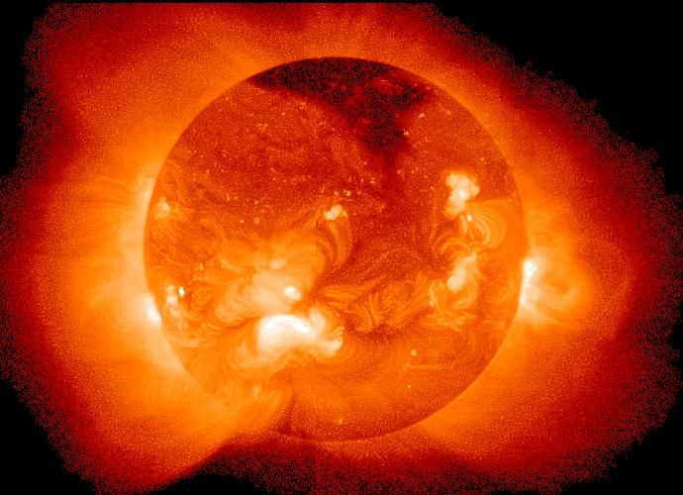
We expect X-rays from gas at this temperature.
Yohkoh X-ray satellite

Slide 28
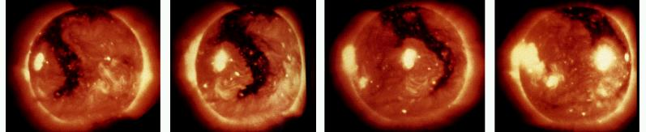
The Solar Wind
At top of corona, typical gas speeds are close to escape speed => Sun losing gas in a solar wind.
Fast (700 km/s) wind observed to escape through "coronal holes", seen in X-ray images. Steadier (350 km/s) wind is more widespread. Holes last about 6 months.
Particles take a few days to reach Earth.
10⁶ tons/s lost. But Sun has lost only 0.1% of its mass from solar wind.

Slide 29
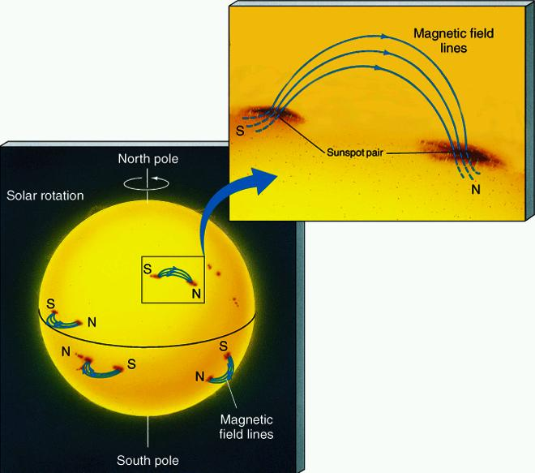
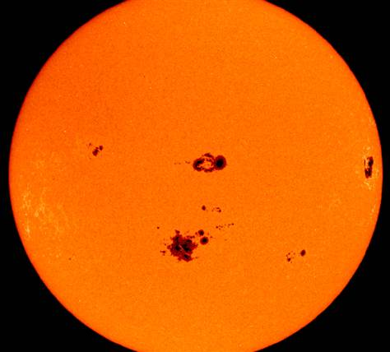
Sunspots, Solar Cycle – Please Read
About Earth-sized.
Darker because cooler (4300 K vs. 5800 K).
Related to loops of the Sun's magnetic field. Numbers vary on 11-year Solar Cycle of activity.

Slide 31

Sunspots
About Earth-sized.
Darker because cooler (4300 K vs. 5800 K).
Related to loops of the Sun's magnetic field.
radiation from hot gas flowing along magnetic field loop at limb of Sun.

Slide 32
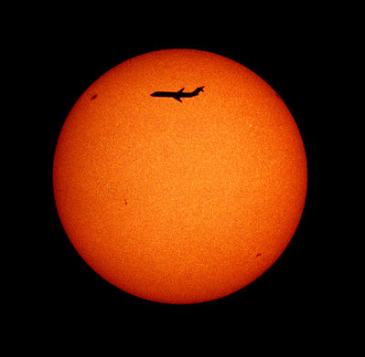

Slide 33
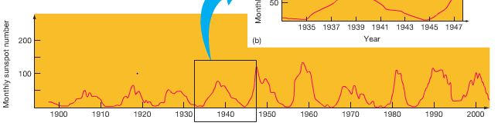
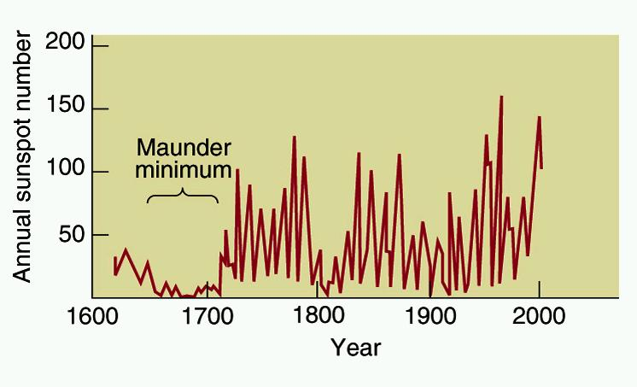
Sunspot numbers vary on a 11 year cycle.

Slide 34
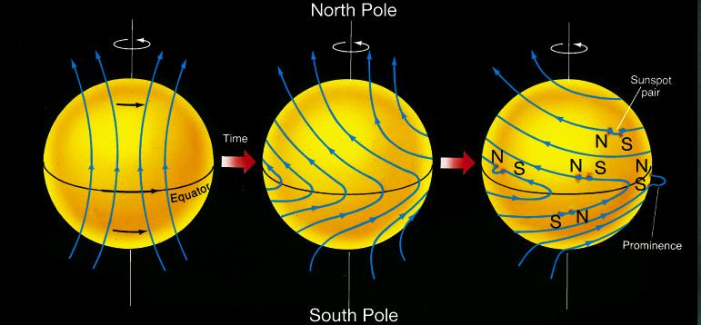
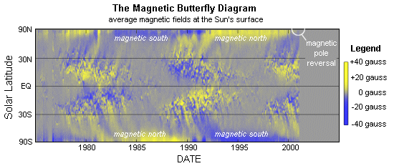
Magnetic field stretched by Sun’s “differential” rotation. Field strengthens. Some regions protrude from surface (=> sunspots). Eventually, oppositely directed regions cancel each other out. Field relaxes into bipolar shape again, with reversed direction. Takes 11 years, or 22 years to return to initial direction.

Slide 35

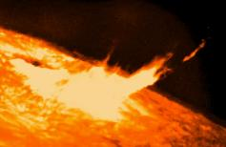
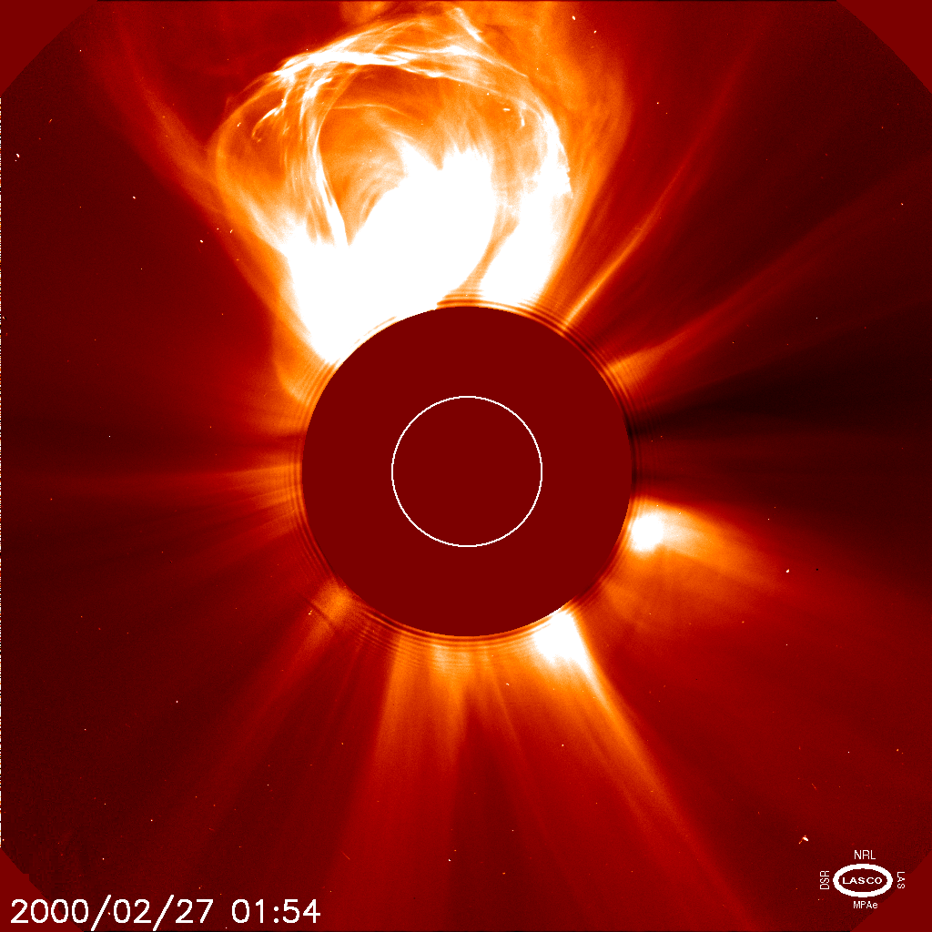
Active Regions
Prominence
Flare
Coronal Mass Ejection
All occur most often at solar maximum.

Slide 36
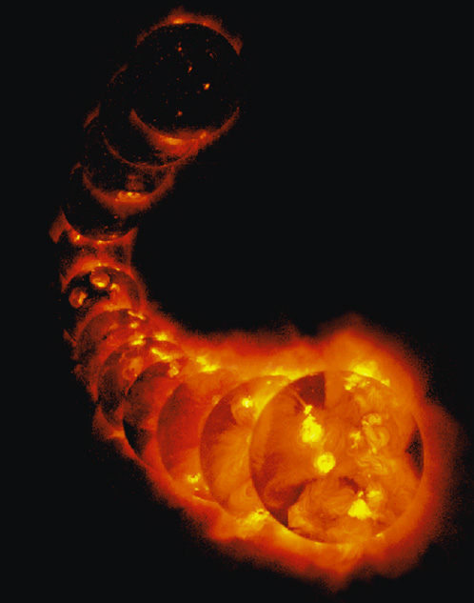
We expect X-rays from gas at this temperature.
Yohkoh X-ray satellite
X-ray brightness varies over 11-year Solar Cycle: coronal activity and sunspot activity go together.

Slide 37
Energy Generation
The 4 protons have 4.8 x 10⁻²⁹ kg more mass than the He nucleus (0.7% of the total mass has been converted to energy).
E=mc² => 4.3 x 10⁻¹² J is released by the formation of a single He nucleus.
L = 3.9 x 10²⁶ J/s => 6 x 10¹¹ kg of H is converted to He every second. About 4x10⁹ kg (0.7% of this mass) converted to energy per second (also just L /c²).
L/E = (3.9 x 10²⁶ J/s) / (4.3x10⁻¹² J) = 9.1x10³⁷ conversions per second. Each conversion involves four protons, so (9.1x10³⁷/sec) x (4m_{p}) = 6x10¹¹ kg/sec of H is converted to He. About 4x10⁹ kg (0.7% of this mass) converted to energy per second (also just L /c²).

