Slide 1
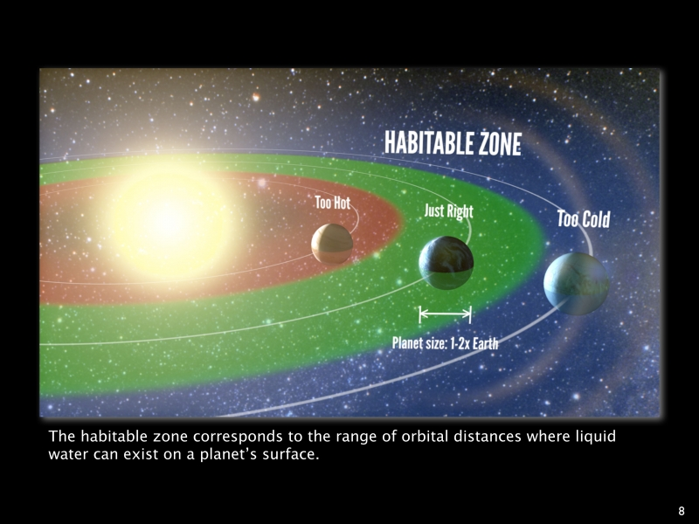
Habitable zones – where the incident flux from the star has a certain range of values, allowing liquid water to exist on a planet.
If the flux we get from the Sun puts us at the center of the habitable zone in the Solar System, at 1 AU from the Sun, where is it in AU for a 0.25 solar mass Main Sequence star, assuming L α M^{3.5} ?
What would be the length of a planet’s year at this radius (for a circular orbit) in terms of Earth years? Assume the planet is much less massive than the star.

Slide 2
Spectra of two Main Sequence stars
Star 1
Star 2
Which star:
is bluer?
is cooler?
is more luminous?
has larger radius?
is more massive?
has a longer lifetime?

Slide 3
Two photons of equal energy collide and annihilate to produce an electron-positron pair. Is there a minimum or maximum wavelength the photons can have to do this? What is that value? Ignore the kinetic energy of the electron and positron.
What would this wavelength be for producing a proton-antiproton pair?

